Slide 1
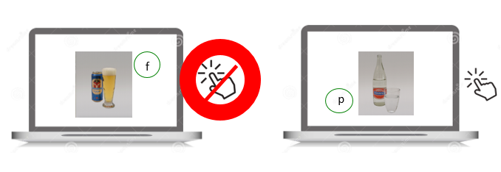
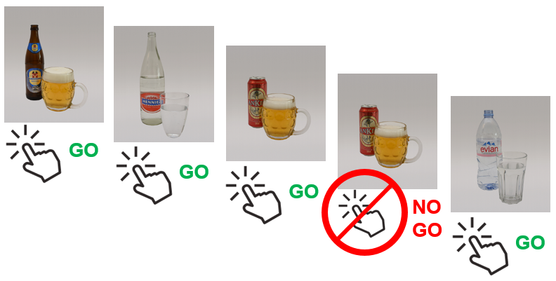
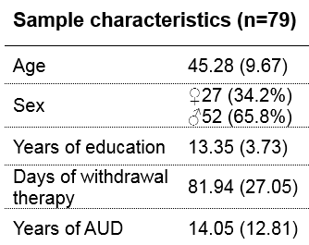
Computerized Inhibition Training in Patients with Alcohol Use Disorder: Preliminary Results
Hallie Batschelet¹, Raphaela Tschümperlin^{1,2}, Franz Moggi¹, Leila Soravia^{1,2}, Susanne Rösner³, Anne Keller³, Alexander Wopfner² & Maria Stein^{1,4}
1 University Hospital of Psychiatry, Translational Research Center, Bern, Switzerland 2 Klinik Südhang, Kirchlindach, Switzerland 3 Forel Klinik, Ellikon a.d. Thur, Switzerland 4 University of Bern, Institute of Psychology, Bern, Switzerland
Objectives
Introduction
The main goal of the study is to investigate whether inhibition training leads to increased inhibitory control and better therapy outcome in alcohol dependent patients. The present analyses will concentrate on variables linked to inhibitory control before the inhibition training.
Patients with Alcohol Use Disorder (AUD) show an imbalance between enhanced cue reactivity towards alcohol-associated stimuli and decreased inhibitory control regarding alcohol use behavior. Computerized interventions may be able to modify some of these maladaptive processes, possibly improving relapse prevention [1]. To date, the effect of a certain computerized inhibition training has only been examined in non-clinical populations [2,3]. Furthermore, it is yet to be unraveled which variables play a role in terms of inhibitory control alteration.
Methods
Inhibition training
In this randomized controlled, and double-blind study, AUD inpatients either complete six sessions of a computerized alcohol-specific inhibition training aiming to increase inhibitory control, or a control condition. At baseline assessment, a number of questionnaires are completed, and at pre- and post-training, inhibitory control is measured by assessing errors of commission within a Go-NoGo task.
Figure 2. Alcoholic beverages are consistently paired with no reaction in the experimental condition
6 inhibition trainings
50/50
Go-NoGo task
Experimental
group 1
6 inhibition trainings
75/25
Figure 3. Participants are required to press a button at display of every picture (Go), unless a picture is repeated (NoGo)
Inclusion
Randomization
Experimental
group 2
3-month follow-up
Post-training: Go-NoGo task
Treatment entry
Pre-training: Go-NoGo task
Discharge assessment
6-month follow-up
Baseline assessment
12-month follow-up
6 control trainings
Control
group
Figure 1. Study procedure
Preliminary results
The number of errors of commission (i.e. less inhibitory control) at pre-training correlates negatively with years of education (r = -0.305, p < 0.01) and motivation to drink less (r = -0.341, p < 0.01). → A regression analysis indicates that they predict 17.4% of the variance (R² = 0.174, F = 8.001, df = 76, p < 0.01).
No significant correlation between inhibitory control at pre-training and neither age nor different measures of AUD severity (i.e. number of DSM 5 criteria fulfilled, total amount of alcohol consumed within past 3 months).
Meanwhile, different measures of AUD severity correlate among each other.
Discussion
Participants with fewer years of education and less motivation to change their drinking behavior show less inhibitory control at pre-training
Adding motivational interventions to inhibition training may be of advantage.
Contrary to assumptions based on existing literature, AUD severity is not linked to inhibitory control at pre-training
However, it may function as a covariate when determining training effects.
Outlook
Within our study, we expect inhibition training to have an effect on inhibitory control, reflected by fewer errors of commission. Further, we assume a more significant effect for alcohol-specific stimuli. More studies are required to investigate inhibition training in clinical populations, and need to take into account variables linked to inhibitory control.
Contact:
Hallie Batschelet, cand. PhD
University Hospital of Psychiatry Bern Translational Research Center
Bolligenstrasse 111
3000 Bern 60, Switzerland E-Mail:hallie.batschelet@upd.unibe.ch
Study financially supported by
References: [1] Wiers, R. W., Gladwin, T. E., Hofmann, W., Salemink, E., & Ridderinkhof, K. R. (2013). Cognitive bias modification and cognitive control training in addiction and related psychopathology: Mechanisms, clinical perspectives, and ways forward. Clinical Psychological Science, 1(2), 192-212. [2] Houben, K., Nederkoorn, C., Wiers, R. W., & Jansen, A. (2011). Resisting temptation: decreasing alcohol-related affect and drinking behavior by training response inhibition. Drug and alcohol dependence, 116(1), 132-136. [3] Houben, K., Havermans, R. C., Nederkoorn, C., & Jansen, A. (2012). Beer à No‐Go: Learning to stop responding to alcohol cues reduces alcohol intake via reduced affective associations rather than increased response inhibition. Addiction, 107(7), 1280-1287.

