Slide 1
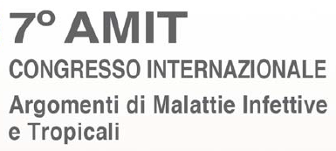
Milano – 15 Marzo, 2019
(11:45 - 12:15)
Sessione 7:
Le Infezioni nei Pazienti Fragili
Carbapenem-Resistant Enterobacteriaceae
in the community
La circolazione di microrganismi CRE in comunità
Prof. Andrea Endimiani, MD, PhD, FAMH
Institute for Infectious Diseases - University of Bern, Switzerland

Slide 2
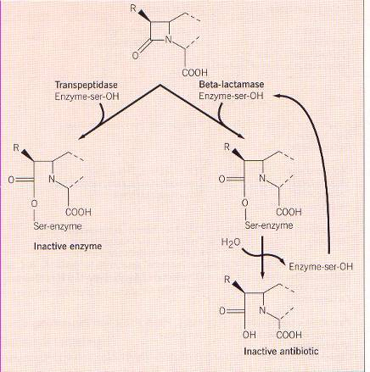
Klebsiella pneumoniae
Antibiotics tested | Wildtype (WT) | MDR Multidrug-resistant | XDR Extensively drug-resistant | PDR Pandrug-resistant
Ampicillin | R | R | R | R
Amoxicillin-clav. | S | S/R | R | R
Piperacillin-tazob. | S | S/R | R | R
Cephalotin | S | R | R | R
Cefoxitin | S | R | R | R
Cefpodoxime | S | R | R | R
Ceftriaxone | S | R | R | R
Cefotaxime | S | R | R | R
Ceftazidime | S | R | R | R
Cefepime | S | S/R | R | R
Aztreonam | S | R | R | R
Imipenem | S | S | R | R
Meropenem | S | S | R | R
Gentamicin | S | S/R | R | R
Tobramycin | S | S/R | R | R
Amikacin | S | S | R | R
Ciprofloxacin | S | R | R | R
Doxycycline | S | R | R | R
Trimethoprim/sulfa. | S | R | R | R
Fosfomycin | S | S | S/R | R
Tigecycline | S | S | S/R | R
Colistin | S | S | S/R | R
Beta-Lactams
Penicillins
Penicillins “protected”
Narrow-, broad- spectrum enzymes
Cephalosporins
Ig
IIg
ESBLs
AmpCs
IIIg
Carbapenemases
IVg
Monobactams
Carbapenems
Aminoglycosides
Quinolones
Tetracyclines
Antifolates
Miscellaneous
But remember:
Porins
efflux pumps
PBPs
“LAST OPTIONS”

Slide 3
Cefamycins (cefoxitin)
Hydrolyzed
1-2GCs (cephalotin, cefpodoxime)
Monobactams (aztreonam)
4GCs (cefepime)
Carbapenems (imipenem, meropenem)
Penicillins (ampicillin)
3GCs (ceftriaxone, ceftazidime)
Not hydrolyzed
A
Narrow/Broad-spectrum
(TEM-1, TEM-2, SHV-1)
ESBLs
(TEMs, SHVs, CTX-Ms)
Carbapenemases
(KPCs)
B
Carbapenemases, MBLs
(NDMs, VIMs, IMPs)
C
AmpCs
(both chromosomal and plasmidic)
D
Broad/Narrow-spectrum OXAs
(OXA-1)
Extended-spectrum OXAs
(OXA-11, OXA-15)
OXA Carbapenemases
(OXA-48-like, OXA-23, OXA-24)

Slide 4
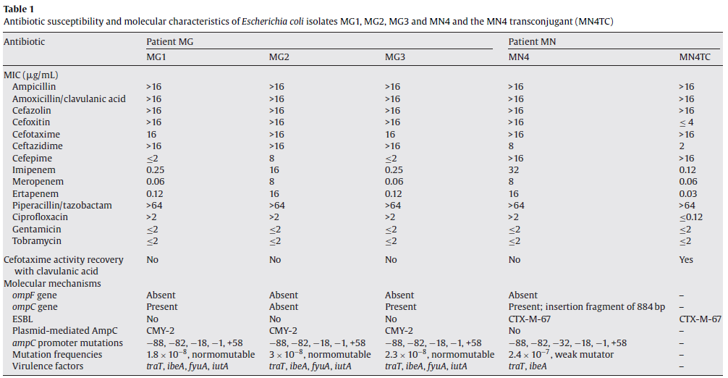
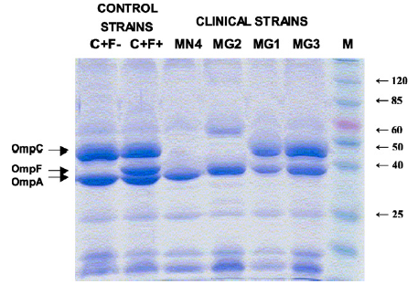
Ertapenem treatment
S
R
Main reasons for loss of porin:
stop codon (TAA, TAG, TGA) due to mutation(s)
insertion of IS elements (gene truncated)

Slide 5
IJAA 52: 898, 2018
334 CRE:
87% CPE - 13% non-carbapenemase producers
OmpK36
OmpK35
OmpA

Slide 6
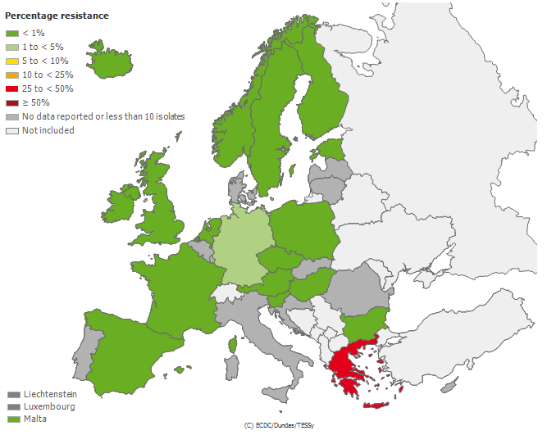
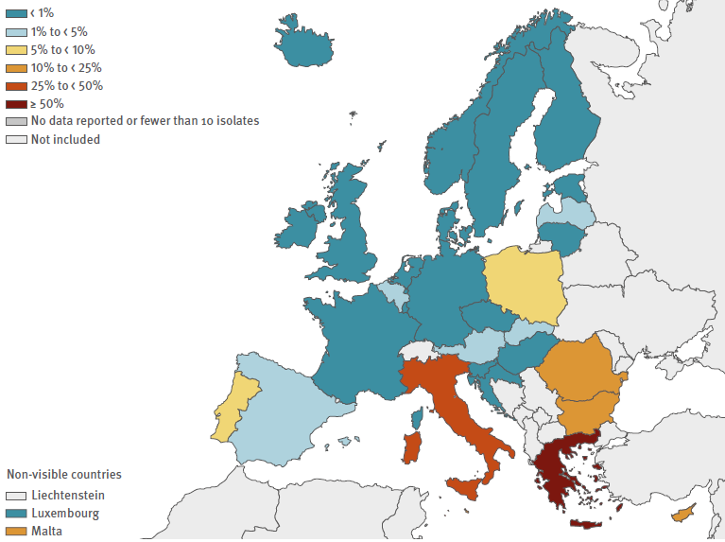
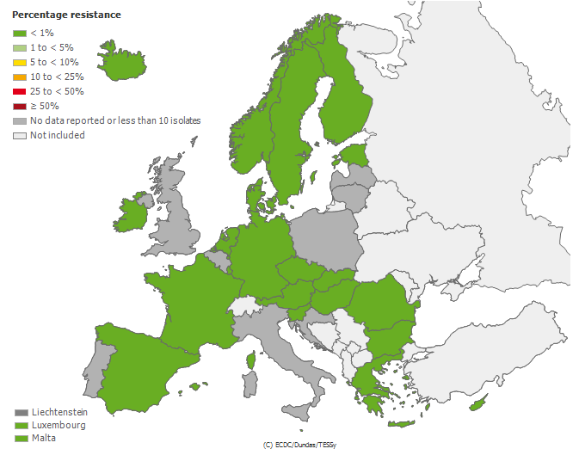
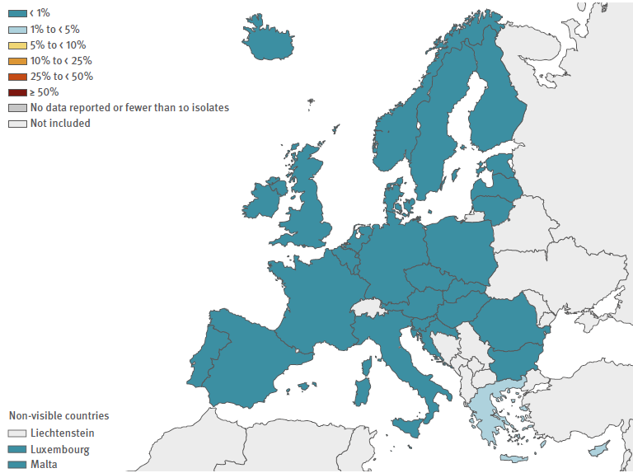
ECDC: 2005 versus 2017: invasive strains
Carbapenem-I/R
K. pneumoniae
(incl. carbapenemases)
EU: 2014: 7.3% - 2017: 7.2%
Carbapenem I/R
E. coli
(incl. carbapenemases)
EU: 2014: 0.1% - 2017: 0.1%

Slide 7
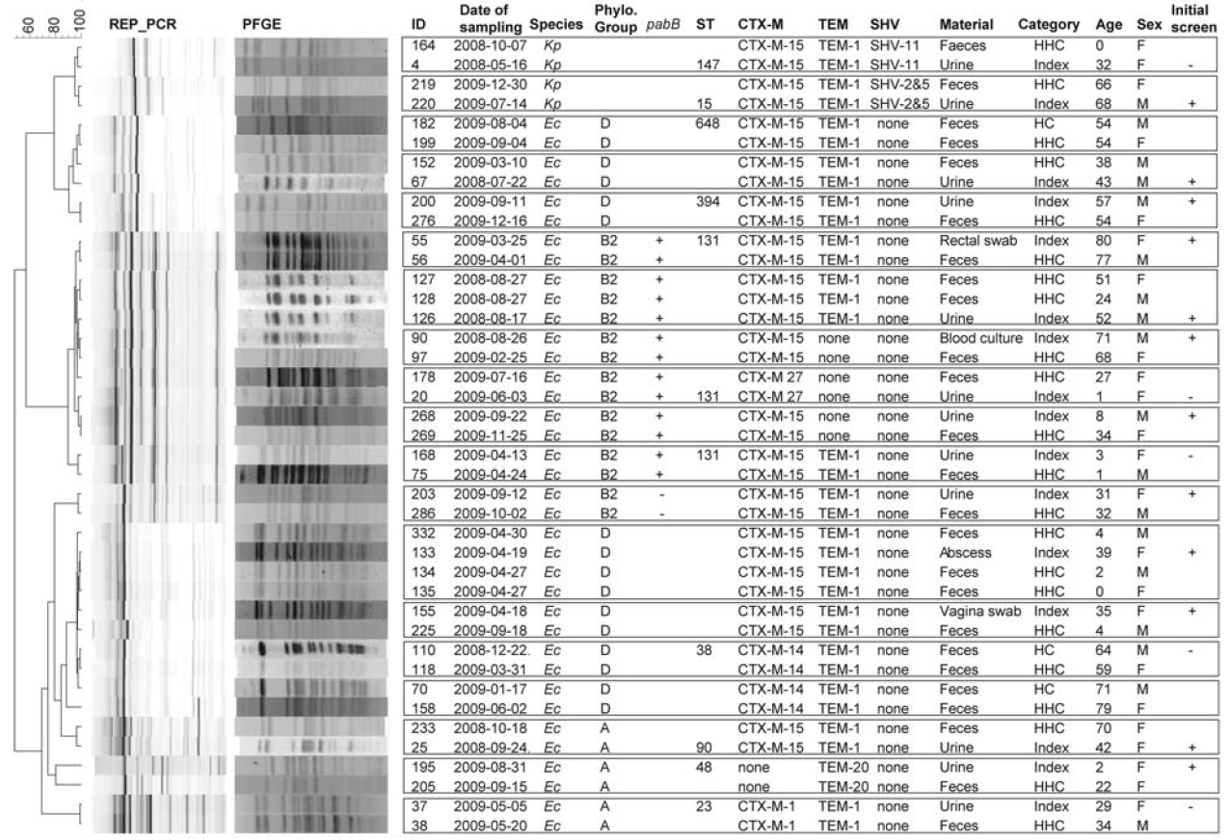
82 index patients (72 Ec; 10 Kp)
112 hospital contacts
96 household contacts
Transmission rates in hospital
4.5% ESBL-E. coli
(5.6/1000 exposure days)
8.3% ESBL-K. pneumoniae
(13.9/1000 exposure days)
28%
ST131
Transmission rates at home
23% ESBL-E. coli
25% ESBL-K. pneumoniae

Slide 8
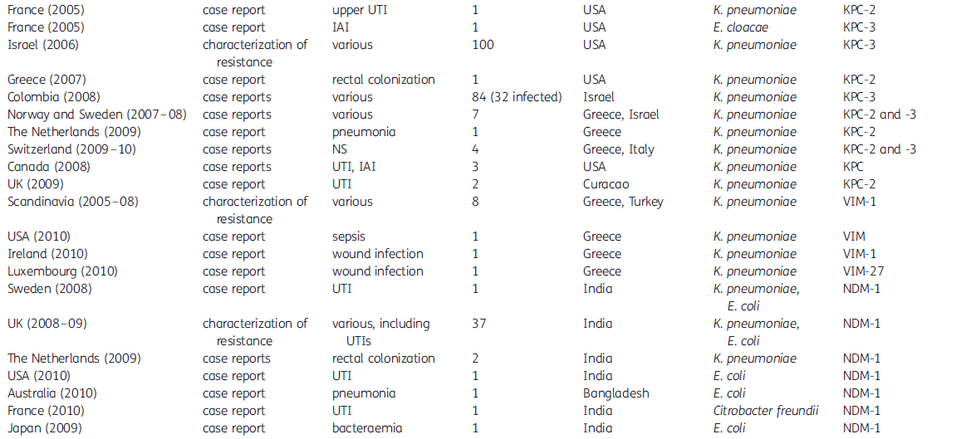
Receiving healthcare in
endemic areas (transfer from)

Slide 9
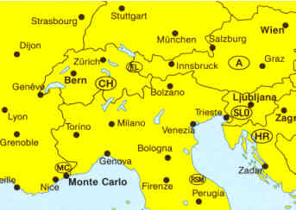
From ICU in Serbia
(Polytrauma)
From hospital in Libya
(Polytrauma)
ST101
ST198
ST101
From hospital in Egypt
(2 patients)
ST15
ST11

Slide 10
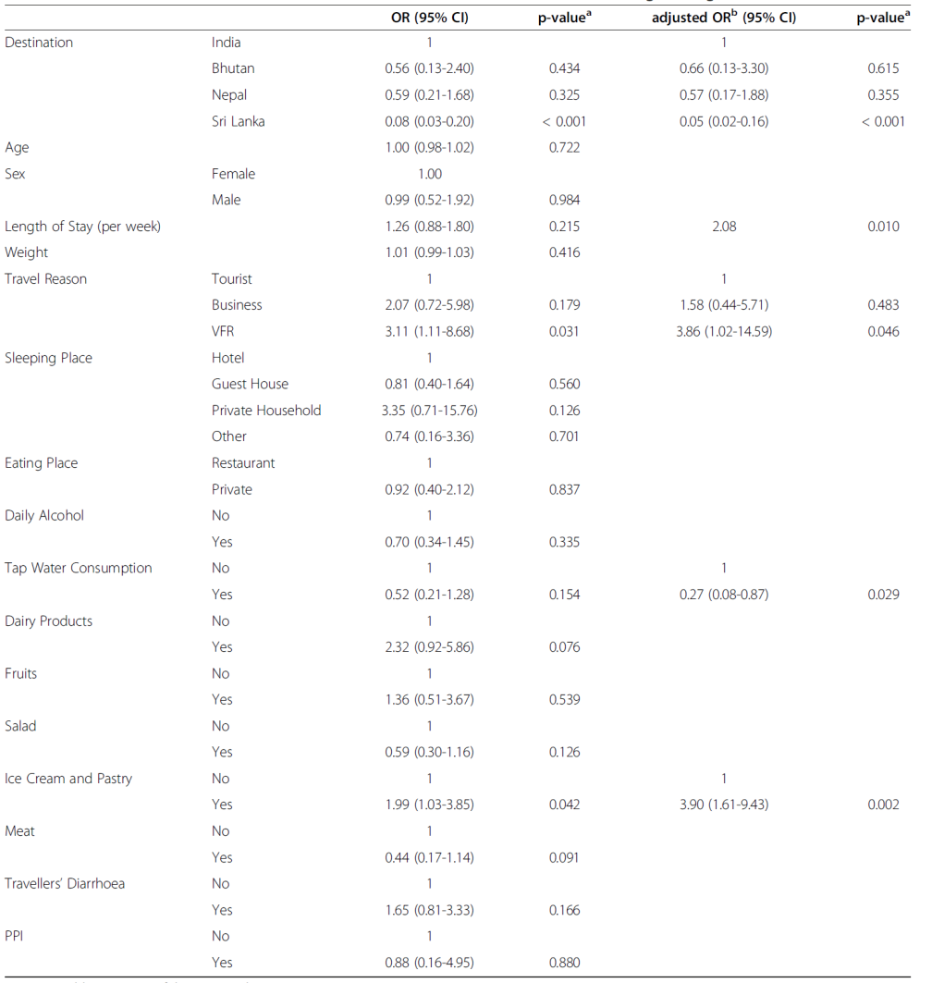
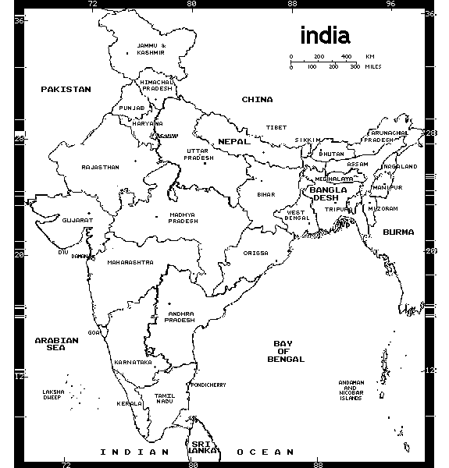
December 2012 - October 2013
170 healthy travelers negative at departure
Kuenzli E et al., BMC Infect Dis, 2014
Univariate
Multivariate
87% [3GC-R]
0%
India: N=68
One CPE
NDM-1-producing E. coli
Overall
0.6%
CPE
India
1.5%
CPE

Slide 11
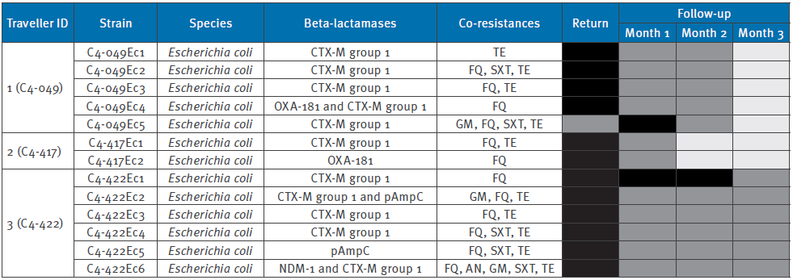
VOYAG-R: Feb 2012 – March 2013
574 French travelers of which
57 who visited India (all negative)
Ruppé E et al., Eurosurv., 2014
OXA-181 !
0.5%
CPE
5.3%
India
Detected
Not detected
Not provided
1:
~50-y healthy female
Traveled alone
17 days – April 2012
Backpacker tourist
No exposure to HCS or ABs
2:
~30-y healthy female
Traveled with another person
10 days – Nov 2012
No exposure to HCS or ABs
3:
~30-y healthy female
Traveled alone
30 days – Jan 2013
Backpacker + visited relatives
No exposure to HCS or ABs
Digestive disorders
Transmission in the household?

Slide 12
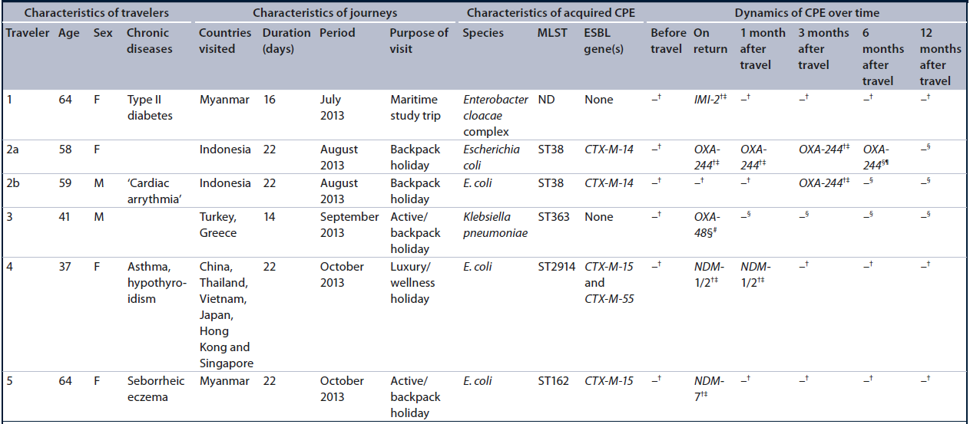
COMBAT study
Nov 2012 – Nov 2013
2001 travelers and 215 non-traveling HH
Van Hattem JM et al., Future Microbiol, 2016
All without
HC exposure
0.25%
CPE * (n=500)
Possible
Household
Transmission
Diarrhea
Diarrhea
Antibiotic intake
Ligation-mediated PCR

Slide 13
CPE cases in the community
(infection or colonization)
Most of the CPE found in community are healthcare-associated
Healthy travelers seem not significantly contributing to CPE importation
Impact of non-human settings (e.g., animals) ???
Is this overall phenomenon underestimated ???
Will “community CPE” increase ???

Slide 14
Better epidemiological data about CPE (define CAI, COI, HAI)
Not only laboratory-based studies
Adequate methods to screen for CPE gut carriage
We need studies focusing on:
Follow-up studies on discarded CPE carriers
CPE transmission in the household
Gut colonization with CPE in the community (healthy people, travelers)
Surveys
Animals
Environment
Food chain
Better characterization of the CPE found in the community/travelers (gut)
Whole-genome sequencing
Importance of plasmid characterization and “plasmid transmission”

Slide 15
GRAZIE!
University of Bern: Institute for Infectious Diseases (IFIK)
Odette J. Bernasconi (PostDoc)
Mathieu Clément (PhD student)
Thomas Büdel (Lab Tech)
Andreas Candinas (Master student)
Max Scheidegger (Master student)
Centre of Competence for Military and Disaster Medicine, Swiss Armed Forces
Grant No. 170063
Grant No. 177378

