Slide 1
OS099 - Polymyxin resistance around the globe
April 14th, 2019: 13:30 - 15:30
High prevalence of gut colonization with
extended-spectrum cephalosporin- and colistin-resistant Enterobacteriaceae in healthy people
in Zanzibar, Tanzania
T. Büdel,¹ E. Kuenzli,^{2,3} M. Clément,^{1,4} O.J. Bernasconi,¹ J. Fehr,² A. H. Mohammed,⁵
N. K. Hassan,⁵ J. Zinsstag,³ C. Hatz,^{2,3} and A. Endimiani ¹
¹Institute for Infectious Diseases, University of Bern, Switzerland;
²Epidemiology, Biostatistics and Prevention Institute, University of Zurich, Zurich, Switzerland;
³Swiss Tropical and Public Health Institute, Basel, Switzerland;
⁴Graduate School of Cellular and Biomedical Sciences, University of Bern, Bern, Switzerland;
⁵Zanzibar Food and Drug Agency, Zanzibar, Tanzania

Slide 2
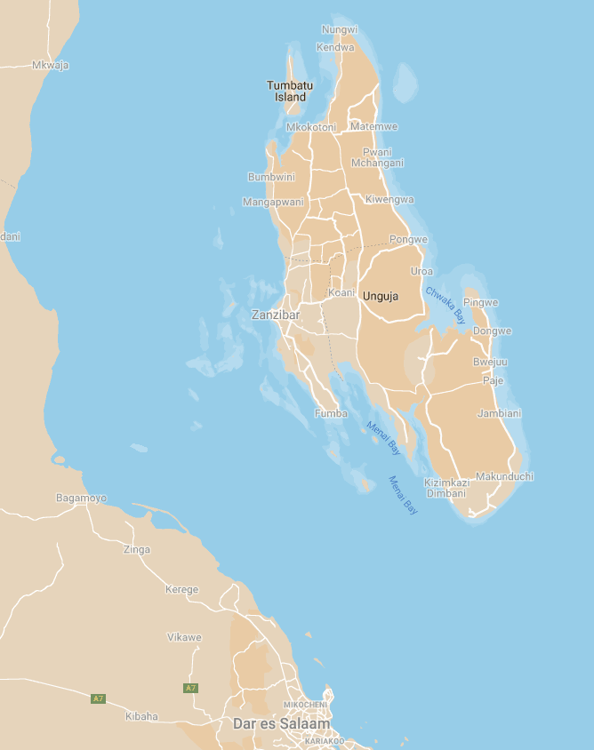
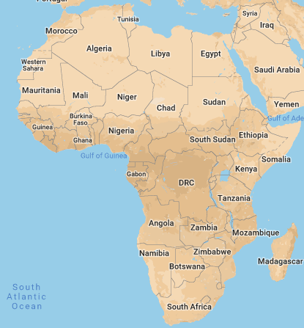
Scarcity of data for gut colonization
with MDR-Ent in the community
(especially for COL-R-Ent)
For low-income countries studies are needed
Zanzibar Island (Unguja)
2015: 1.1 million visitors
(39% from Europe and 14% from North America)
Hotel #6
Hotel #9
Hotel #11
Hotel #12
Hotel #3
Hotel #8
Hotel #10
Hotel #2
Hotel #5
Hotel #7
Hotel #1
Hotel #4
Population:
1.3 million
Population:
57 million
June-July 2018
5 employees from each hotel
Rectal swabs
Epidemiological questionnaires

Slide 3
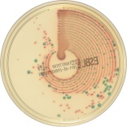
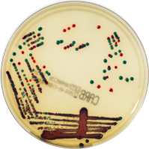
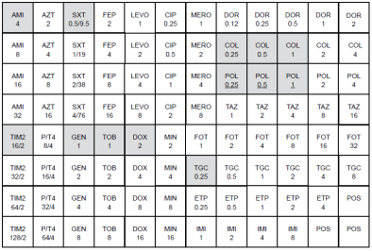
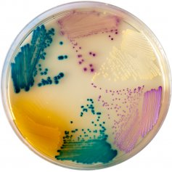
ChromID ESBL
ChromID Carba
Species ID
MALDI-TOF MS
CXM
[3 mg/L]
5 colonies
(each plate)
LB broth
(overnight)
ChromAgar Orientation
COL
4 mg/L
MICs
(microdilution)
COL
[2 mg/L]
VAN
8 mg/L
Only E. coli and K. pneumoniae
CTX > 1 mg/L
CAZ > 1 mg/L
Carba_{s} > 0.25 mg/L
CT103XL microarray:
bla_{ESBLs}, bla_{pAmpCs,} bla_{Carbas,} mcr-1, mcr-2
PCR-based:
mcr-1 to mcr-8
COL > 0.25 mg/L
Rep-PCR (for 60%):
Clonality
WGS using NovaSeq 6000 and Nanopore (for 25%):
ST, ARGs, VFs, plasmids
(BioProject: PRJNA523709)

Slide 4
Thank you!
University of Bern: Institute for Infectious Diseases (IFIK)
Thomas Büdel (Lab Tech)
Mathieu Clément (PhD student)
Dr. Odette J. Bernasconi (PostDoc)
University of Basel and University of Zurich
Prof. Christoph Hatz
Dr. Esther Kuenzli
Grant No. 170063
Zanzibar Food and Drug Agency, Zanzibar
Dr. Ali Haji Mohammed
Dr. Nadir Khatib Hassan
Grant No. 177378

