Slide 1
Coping as a Travelling Concept in Conflict Research
IFK Annual Conference 2019
Interfaculty Research Cooperation “Religious Conflicts and Coping Strategies”
6 May 2019 University of Bern

Slide 2
Introduction
Martino Mona, IFK Deputy Director
7
Burqa
8
Emotions
10
Switzerland
1
Episteme
4
Monotheism
6
Rituals
9
Councils
11
Mongolia
12
Israel
2 Psychology
3
Law
5
Gender

Slide 3
Welcoming Address
Silvia Schroer
Vice Rector Uni Bern

Slide 4
Coping as a Travelling Concept in Conflict Research
Katharina Heyden
7
Burqa
8
Emotions
10
Switzerland
1
Episteme
4
Monotheism
6
Rituals
9
Councils
11
Mongolia
12
Israel
2 Psychology
3
Law
5
Gender

Slide 5
Travel Bug
Searching Useful Tools for Interdisciplinary Research
7
Burqa
8
Emotions
10
Switzerland
1
Episteme
4
Monotheism
6
Rituals
9
Councils
11
Mongolia
12
Israel
2 Psychology
3
Law
5
Gender

Slide 6
Preparation
Potentials and Risks of Travelling Concepts

Slide 7
Preparation
Potentials and Risks of Travelling Concepts
Edward Saïd, Travelling Theory.
In: The World, the Text and the Critic, Cambridge 1983, 227-246.
Mieke Bal, Travelling Concepts in the Humanities.
A Rough Guide. Toronto 2002.
“offer miniature theories” p.22
“articulate an understanding, convey an interpretation, enable a discussion, on the basis of common terms and in the awareness of absences and exclusions” p.23

Slide 8
Preparation
Potentials and Risks of Travelling Concepts
Foster innovative interdisciplinary research
Transferable to various disciplines
Cross borders
Epistemologically: between academic disciplines
Culturally: between academic and national cultures
Diachronically: between historical and empirical research
Synchronically: between academia and society
Baumbach, S. et al. (eds. 2012). Travelling Concepts, Metaphors and Narratives:
Literary and Cultural Studies in an Age of Interdisciplinary Research, Trier, p.6.

Slide 9
Preparation
Potentials and Risks of Travelling Concepts
Conquest, provincialization of academic disciplines by a ruling theory
.
Dissolution of concepts into mere metaphors
Cf. Chakrabarty, D. (2008). Provincializing Europe: Postcolonial Thought and Historical Difference, Princeton.

Slide 10
Preparation
Challenges with Travelling Concepts
Maintain the balance between
Theory and metaphor, Precision and flexibility
Prescriptive and normative use

Slide 11
Departure
The Reason to Travel
Conflict resolution
Conflict transformation
Coping with Conflicts
Lederach, J.P. (2003a). The Little Book of Conflict Transformation, Intercourse.
Lederach, J.P. (2003b). Conflict Transformation. Beyond Intractability, in: Conflict Information Consortium Bolder.
Cf. Schliesser, C. (in press). Conflict Resolution and Peacebuilding. In: Jeffrey Haynes (ed.), Routledge Handbook of Religion and Political Parties.

Slide 12
Departure
The home base
Within individual psychology, coping
Means cognitive and behavioral responses people use to manage stressful situations
Aims at a re-evaluation of a conflict situation that causes stress
Is distinguished into:
Emotion-based coping
Problem-oriented coping
Meaning-focused coping
Lazarus, R. S. (1966). Psychological stress and the coping process. New York: McGraw Hill.
Lazarus, R. S. and Folkman, S. (1984). Stress, Appraisal, and Coping. New York: Springer.

Slide 13
Departure
Equipment
Within conflict research, coping should
Serve as a descriptive, analytical category
Focus on dynamics and socializing processes of conflicts
Enable a differentiated and well structured analysis of various dimensions of conflicts
Have the potential to promote the development of appropriate coping strategies

Slide 14
Travel Map
Draft Analytical Model
emotion-based
problem-oriented
meaning-focused
Coping Strategies
Addressing
Contingency
Forming Identity
Interpreting the World
Dimensions of Religion
Roots
Breaking Lines
Discourse
Levels of Conflict
Notes:
Katharina
Our NCCR project answers this need by providing an analytical model that helps identify religious and non-religious aspects in conflicts, thus laying the ground for the development of appropriate coping strategies.
Here you can see the draft model which we created during the last year within the framework of an Interfaculty Research Cooperation at the University of Bern. This draft will be jointly evaluated and further developed in the first phase of the NCCR.
The model combines findings from the various disciplines involved: in the field of conflict analysis, we work with findings of social and political sciences, in the distinction between various dimensions of religion, we include knowledge from cultural and religious studies as well as theology, and in the field of Coping we include findings from psychology and law.
Our research will focus on better understanding the complex connections and interactions between these aspects.

Slide 15
Travel Map
Draft Analytical Model: Conflict
Roots
Shortage of
Raw materials
(Territory, Food, Water)
Immaterial goods
(Power, Education, Recognition, Participation)
Breaking Lines
Gender
Generation
Religion
Nation
Social Class
Discourse
Interpretation
Representation
Rhetoric
Images
Levels
of Conflict
Notes:
Katharina (only for the discussion)

Slide 16
Travel Map
Draft Analytical Model: Conflict
Addressing Contingency
Rituals
Lifestyle
Spirituality
Forming Identity
Individual
Family
Group
Society
Interpreting
the World
Symbols
Myths
Narratives
Teaching
Dimensions of Religion
Roots
Shortage of
Raw materials
(Territory, Food, Water)
Immaterial goods
(Power, Education, Recognition, Participation)
Breaking Lines
Gender
Generation
Religion
Nation
Social Class
Discourse
Interpretation
Representation
Rhetoric
Images
Levels
of Conflict
Notes:
Katharina (only for the discussion)

Slide 17
Travel Map
Draft Analytical Model
emotion-based
problem-oriented
meaning-focused
Coping Strategies
Addressing
Contingency
Forming Identity
Interpreting the World
Dimensions of Religion
Roots
Breaking Lines
Discourse
Levels of Conflict
Notes:
Katharina
Our NCCR project answers this need by providing an analytical model that helps identify religious and non-religious aspects in conflicts, thus laying the ground for the development of appropriate coping strategies.
Here you can see the draft model which we created during the last year within the framework of an Interfaculty Research Cooperation at the University of Bern. This draft will be jointly evaluated and further developed in the first phase of the NCCR.
The model combines findings from the various disciplines involved: in the field of conflict analysis, we work with findings of social and political sciences, in the distinction between various dimensions of religion, we include knowledge from cultural and religious studies as well as theology, and in the field of Coping we include findings from psychology and law.
Our research will focus on better understanding the complex connections and interactions between these aspects.

Slide 18
En Route
Coping travelling through IFK individual projects
7
Burqa
8
Emotions
10
Switzerland
1
Episteme
4
Monotheism
6
Rituals
9
Councils
11
Mongolia
12
Israel
2 Psychology
3
Law
5
Gender

Slide 19
Coping en Route
Precise enough?
7
Burqa
8
Emotions
10
Switzerland
1
Episteme
4
Monotheism
6
Rituals
9
Councils
11
Mongolia
12
Israel
2 Psychology
3
Law
5
Gender

Slide 20
Coping en Route
Precise enough?
Emotion-based Coping
Rituals
7
Burqa
8
Emotions
10
Switzerland
1
Episteme
4
Monotheism
6
Rituals
9
Councils
11
Mongolia
12
Israel
2 Psychology
3
Law
5
Gender

Slide 21
Coping en Route
Precise enough?
Emotion-based Coping
Rituals
7
Burqa
8
Emotions
10
Switzerland
1
Episteme
4
Monotheism
6
Rituals
9
Councils
11
Mongolia
12
Israel
2 Psychology
3
Law
5
Gender

Slide 22
Coping en Route
Precise enough?
Emotion-based Coping
Rituals
7
Burqa
8
Emotions
10
Switzerland
1
Episteme
4
Monotheism
6
Rituals
9
Councils
11
Mongolia
12
Israel
2 Psychology
3
Law
5
Gender

Slide 23
Coping en Route
Precise enough?
Connections between emotion-based and meaning-focused coping
7
Burqa
8
Emotions
10
Switzerland
1
Episteme
4
Monotheism
6
Rituals
9
Councils
11
Mongolia
12
Israel
2 Psychology
3
Law
5
Gender

Slide 24
Coping en Route
Precise enough?
Emotion-based Coping
Rituals
Problem-oriented Coping
Legal regulations
7
Burqa
8
Emotions
10
Switzerland
1
Episteme
4
Monotheism
6
Rituals
9
Councils
11
Mongolia
12
Israel
2 Psychology
3
Law
5
Gender

Slide 25
Coping en Route
Precise enough?
Emotion-based Coping
Rituals
Problem-oriented Coping
Legal regulations
Armed violence
7
Burqa
8
Emotions
10
Switzerland
1
Episteme
4
Monotheism
6
Rituals
9
Councils
11
Mongolia
12
Israel
2 Psychology
3
Law
5
Gender

Slide 26
Coping en Route
Precise enough?
Emotion-based Coping
Rituals
Problem-oriented Coping
Legal regulations
Armed violence
Create “substitute” identities
7
Burqa
8
Emotions
10
Switzerland
1
Episteme
4
Monotheism
6
Rituals
9
Councils
11
Mongolia
12
Israel
2 Psychology
3
Law
5
Gender

Slide 27
Coping en Route
Precise enough?
Emotion-based Coping
Rituals
Problem-oriented Coping
Legal regulations
Armed violence
Create “substitute” identities
Spatial coping (?)
7
Burqa
8
Emotions
10
Switzerland
1
Episteme
4
Monotheism
6
Rituals
9
Councils
11
Mongolia
12
Israel
2 Psychology
3
Law
5
Gender

Slide 28
Coping en Route
Precise enough?
Emotion-based Coping
Rituals
Problem-oriented Coping
Legal regulations
Armed violence
Create “substitute” identities
Spatial coping (?)
Preserve the status quo (?)
7
Burqa
8
Emotions
10
Switzerland
1
Episteme
4
Monotheism
6
Rituals
9
Councils
11
Mongolia
12
Israel
2 Psychology
3
Law
5
Gender

Slide 29
Coping en Route
Precise enough?
Emotion-based Coping
Rituals
Problem-oriented Coping
Legal regulations
Armed violence
Create “substitute” identities
Meaning-focused Coping
‘Othering’
7
Burqa
8
Emotions
10
Switzerland
1
Episteme
4
Monotheism
6
Rituals
9
Councils
11
Mongolia
12
Israel
2 Psychology
3
Law
5
Gender

Slide 30
Coping en Route
Precise enough?
Emotion-based Coping
Rituals
Problem-oriented Coping
Legal regulations
Armed violence
Create “substitute” identities
Meaning-focused Coping
‘Othering’
Invent counter narratives
7
Burqa
8
Emotions
10
Switzerland
1
Episteme
4
Monotheism
6
Rituals
9
Councils
11
Mongolia
12
Israel
2 Psychology
3
Law
5
Gender

Slide 31
Coping en Route
Precise enough?
Emotion-based Coping
Rituals
Problem-oriented Coping
Legal regulations
Armed violence
Create “substitute” identitie
Meaning-focused Coping
‘Othering’
Invent counter narratives
Highlight common heritage
7
Burqa
8
Emotions
10
Switzerland
1
Episteme
4
Monotheism
6
Rituals
9
Councils
11
Mongolia
12
Israel
2 Psychology
3
Law
5
Gender

Slide 32
Coping en Route
Precise enough?
Meaning-focused coping strategies
Interactions and interdependencies
7
Burqa
8
Emotions
10
Switzerland
1
Episteme
4
Monotheism
6
Rituals
9
Councils
11
Mongolia
12
Israel
2 Psychology
3
Law
5
Gender

Slide 33
Coping en Route
Flexible enough?
7
Burqa
8
Emotions
10
Switzerland
1
Episteme
4
Monotheism
6
Rituals
9
Councils
11
Mongolia
12
Israel
2 Psychology
3
Law
5
Gender

Slide 34
Coping en Route
Flexible enough?
Individual and collective emotions
7
Burqa
8
Emotions
10
Switzerland
1
Episteme
4
Monotheism
6
Rituals
9
Councils
11
Mongolia
12
Israel
2 Psychology
3
Law
5
Gender

Slide 35
Coping en Route
Flexible enough?
Individual and collective emotions
Success and failure of coping strategies
7
Burqa
8
Emotions
10
Switzerland
1
Episteme
4
Monotheism
6
Rituals
9
Councils
11
Mongolia
12
Israel
2 Psychology
3
Law
5
Gender

Slide 36
Coping en Route
Flexible enough?
Individual and collective emotions
Success and failure of coping strategies
Power issues
7
Burqa
8
Emotions
10
Switzerland
1
Episteme
4
Monotheism
6
Rituals
9
Councils
11
Mongolia
12
Israel
2 Psychology
3
Law
5
Gender

Slide 37
Coping en Route
Flexible enough?
Individual and collective emotions
Success and failure of coping strategies
Power issues
7
Burqa
8
Emotions
10
Switzerland
1
Episteme
4
Monotheism
6
Rituals
9
Councils
11
Mongolia
12
Israel
2 Psychology
3
Law
5
Gender

Slide 38
Coping en Route
Flexible enough?
Individual and collective emotions
Success and failure of coping strategies
Power issues
Influence of researchers
7
Burqa
8
Emotions
10
Switzerland
1
Episteme
4
Monotheism
6
Rituals
9
Councils
11
Mongolia
12
Israel
2 Psychology
3
Law
5
Gender

Slide 39
Arrival
Short Trip, Research Stay, or Migration?
7
Burqa
8
Emotions
10
Switzerland
1
Episteme
4
Monotheism
6
Rituals
9
Councils
11
Mongolia
12
Israel
2 Psychology
3
Law
5
Gender

Slide 40
Responses
Members of the Scientific Advisory Board
Anna Sapir Abulafia
Professor of the Study of the Abrahamic Religions
University of Oxford (UK)

Slide 41
Responses
Members of the Scientific Advisory Board
Michael Bongardt
Professor für Anthropologie, Kultur- und Sozialphilosophie, Interreligiöse Theologie
Universität Siegen (D)

Slide 42
Responses
Members of the Scientific Advisory Board
Andreas Feldtkeller
Professor für Religionswissenschaft und Interkulturelle Theologie
Humboldt-Universität Berlin (D)

Slide 43
Responses
Members of the Scientific Advisory Board
Nicola Lacey
Professor of Law, Gender and Social Policy
The London School of Economics and Political Science (UK)

Slide 44
Responses
Members of the Scientific Advisory Board
Joram Tarusarira
Assistant Professor of Religion, Conflict and Peacebuilding Centre for Religion, Conflict and Globalization, University of Groningen (NL)

Slide 45
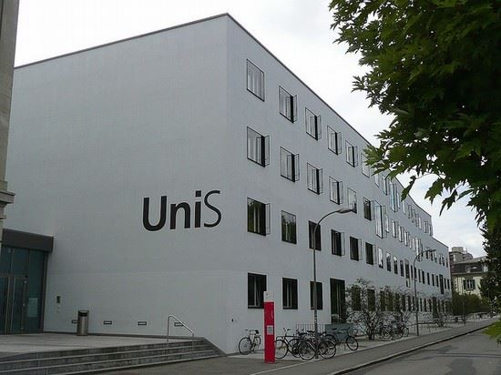
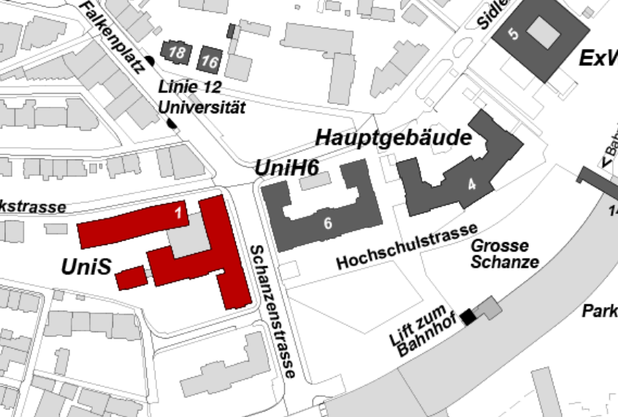
Lunch break
Entrance Hall UniS
Please enter the building UniS.
The lunch buffet will be served in the entrance hall.
After lunch, 2:00pm, please go back to the main
building and go directly to the workshop rooms.

Slide 46
IFK Annual Conference
Coping as a travelling concept in Conflicts Research
Final Discussion
7
Burqa
8
Emotions
10
Switzerland
1
Episteme
4
Monotheism
6
Rituals
9
Councils
11
Mongolia
12
Israel
2 Psychology
3
Law
5
Gender

