Slide 1
NRP72 Meeting
KKL Lucerne – May 21st, 2019
15.40-16.00
Carbapenemase-producing Enterobacteriaceae in humans
Whole Genome and Plasmid Sequencing for MDR Enterobacteriaceae Simultaneously Isolated from Multiple Human and Non-Human Settings: Deciphering Impact, Risks, and Dynamics for Resistance Transmission and Spread
Module 1: SNF No. 177378 – Started on 01.03.208 (350.000 CHF)
Prof. Andrea Endimiani, MD, PhD, FAMH
Institute for Infectious Diseases - University of Bern, Switzerland

Slide 2
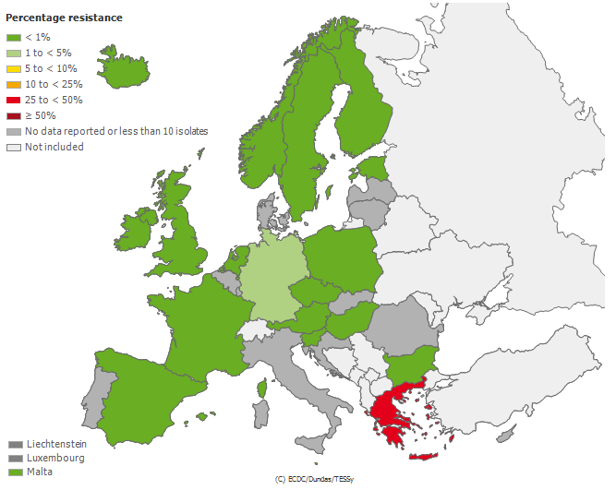
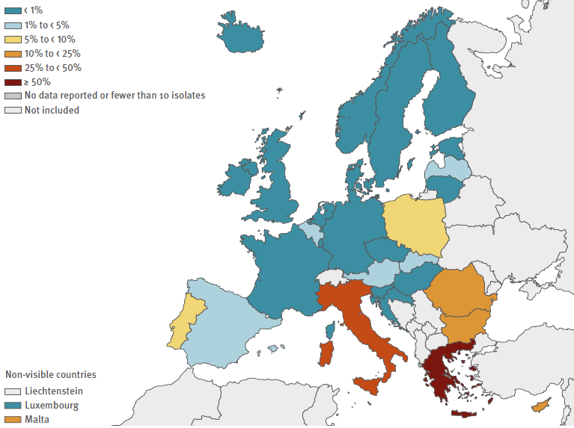
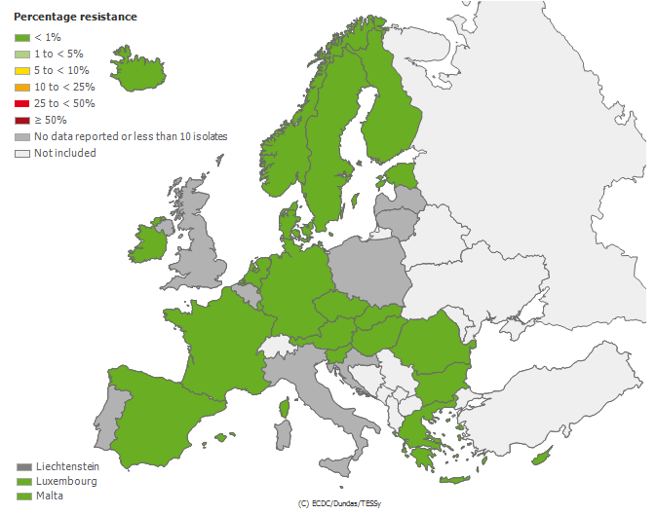
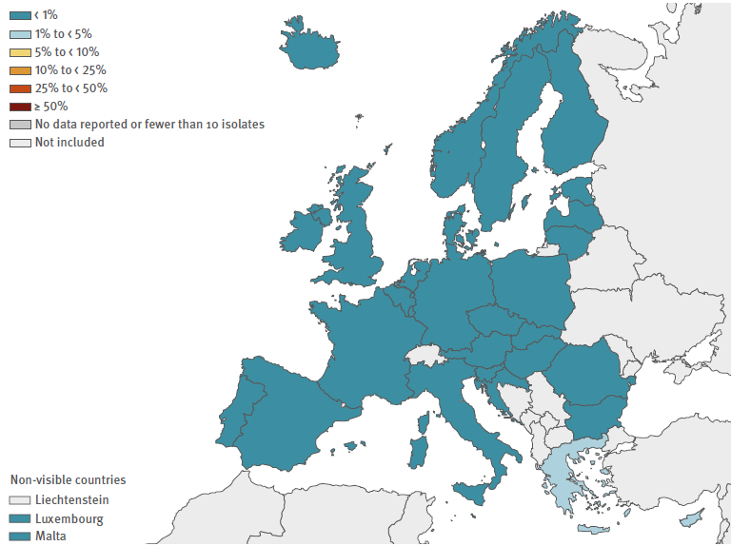
ECDC: 2005 versus 2017: invasive strains
Carbapenem-I/R
K. pneumoniae
(incl. carbapenemases)
EU: 2014: 7.3% - 2017: 7.2%
Carbapenem I/R
E. coli
(incl. carbapenemases)
EU: 2014: 0.1% - 2017: 0.1%

Slide 3
Nov 2013 – Apr 2014
455 hospitals
36 countries
Grundmann et al., LID, Feb 2017
70.6%
39.7%
18.2%
26.0%
55.8%
OVERALL RANKING
KPC: 42.4%
OXA-48-like: 38.1%
NDM: 12.2%
VIM: 7.3%
44.6%
10.9%
36.5%
0.08%

Slide 4
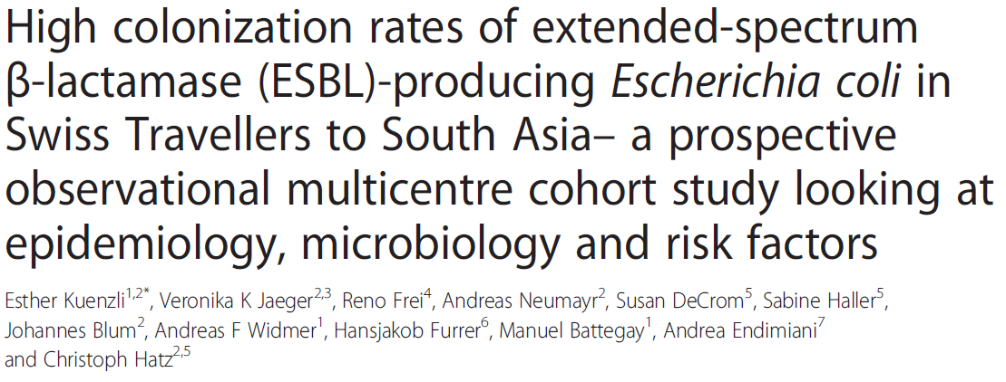
Healthy people in the community
Zurfluh K et al., Ant Res & Infect Control, 2015
Nüesch-Inderbinen M et al., Ant Res & Infect Control, 2013
September 2014
1,086 subjects:
healthy staffs of a meat company:
One OXA-48 E. coli ST38
Apr 2012 - July 2012
605 subjects:
314 healthy staffs of a meat company: 0%
291 primary care patients: 0%
Travelers
Pires J et al., J Glob Antimicrob Res, 2018
July 2013 – November 2016
337 subjects:
164 healthy staffs of VetSuisse: =0%
101 HIV+ subjects: 0%
32 healthy staffs of Med Faculty: 0%
40 healthy people not traveling: 0%
NDM-1-producing E. coli
(1.5% from India)

Slide 5
Genomes
Plasmids
MLST, ARGs, VFs
Size / Inc group / Conjugation
cgMLST
pMLST *
SNPs
Mapping/Comparing
Schürch AC et al., CMI, Apr 2018

Slide 6
THANK YOU!
Grant No. 177378
Grant No. 170063 PI: Prof. C. Hatz
PIs: Prof. S. Schuller/Dr. B. Willi
No. 174273 - PI: Prof. Perreten

