Slide 1
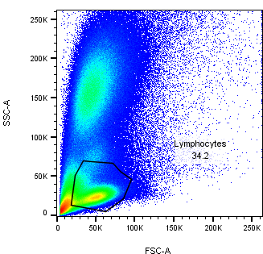
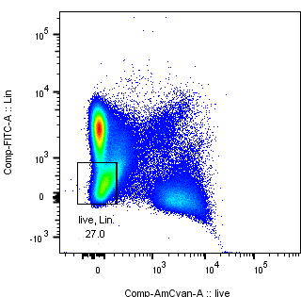
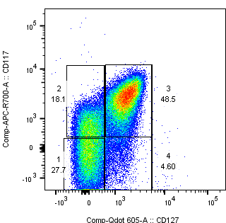
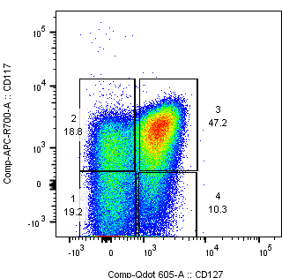
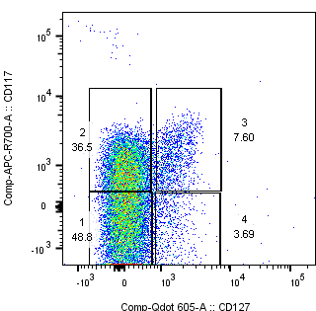
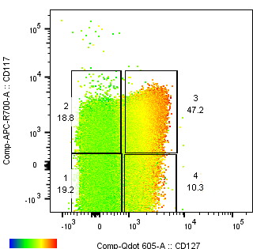
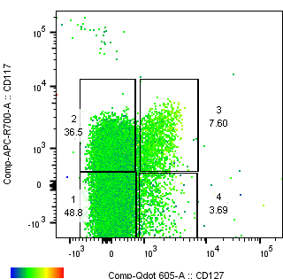
Human hepatic Lin-CD117+CD127+CRTH2+ cells and IL-22 secretion decrease in patients with morbid obesity
A.
Gating strategy
B.
Lin-CD117+CD127+CRTH2+ decrease in patients with higher BMI
SSC-A
Lineage
CD117
BMI=38.1
BMI=51.7
FSC-A
Live
CD127
C.
IL-22 secretion decrease in patients with higher BMI
 | Phenotype
1 | Lin-CD117-CD127-CRTH2-T-bet+Eomes+GATA-3-RORyt-NKP46+CD56+CD161+/-
2 | Lin-CD117-CD127-CRTH2-T-bet+Eomes+GATA-3-RORyt-NKP46-CD56+
3 | Lin-CD117+CD127+CRTH2+T-bet-Eomes-GATA3++RORyt+/-CD56+CD161++
4 | Lin-CD117-CD127+CRTH2-T-bet+/-Eomes-GATA3+RORyt-NKP46+CD56+CD161-
IL-22
IL-22
BMI=38.1
BMI=51.7
Conclusions
ILCs are present in the human liver where Lin-CD117+CD127+CRTH2+ ILCs are the frequent populations between all ILCs subpopulations.
- Patients with morbid obesity showed a significantly decrease in Lin-CD117+CD127+CRTH2+ ILCs
IL-22 expression decreased in patients with high BMI simultaneously with the decrease of Lin-CD117+CD127+CRTH2+ ILCs.

