Slide 1
Antimicrobial Use in Animals and Links to Resistance in Humans
Moscone Center 201/202 South
June 23rd, 2019 / 8:00 - 10:30
Extended-Spectrum Cephalosporin- and/or Colistin-Resistant
E. coli in Tanzania: High Prevalence of Gut Colonization
in Healthy People and Chicken Meat Contamination
T. Büdel,¹ E. Kuenzli,^{2,3} M. Clément,¹ O.J. Bernasconi,¹ J. Fehr,² A. H. Mohammed,⁴
N. K. Hassan,⁴ J. Zinsstag,³ C. Hatz,^{2,3} and A. Endimiani ¹
¹Institute for Infectious Diseases, University of Bern, Switzerland;
²Epidemiology, Biostatistics and Prevention Institute, University of Zurich, Zurich, Switzerland;
³Swiss Tropical and Public Health Institute, Basel, Switzerland;
⁴Zanzibar Food and Drug Agency, Zanzibar, Tanzania

Slide 2
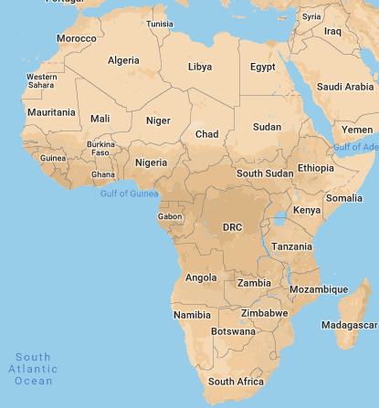
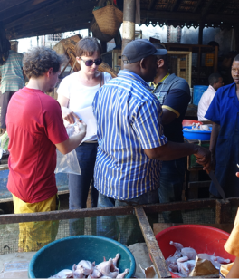
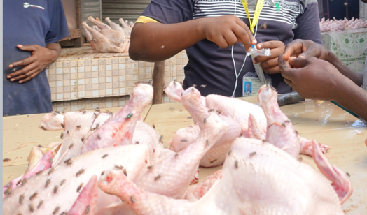
Zanzibar Island (Unguja)
2015: 1.1 million visitors
(53% from Europe + North America)
Hotel #6
Hotel #9
Hotel #11
Hotel #12
Population:
57 million
Hotel #3
Hotel #8
Hotel #10
Population:
1.3 million
Hotel #2
Hotel #5
Hotel #7
Hotel #1
Hotel #4
June-July 2018
Rectal swabs from hotel employees
Max 5 people from each hotel
Epidemiological questionnaires
June-July 2018
Chicken meat from markets

Slide 3
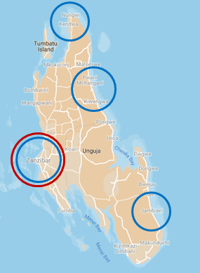
STs of E. coli previously reported in continental Tanzania
ST46-mcr-1
ST361-bla_{CTX-M-15}
ST3580-bla_{CTX-M-15}
ST10
ST34
ST38
ST44
ST48
ST131
ST156
ST167
ST205
ST398
ST405
ST410
ST448
ST617
ST648
ST1177
ST1421
ST1585
ST2852
ST4450
ST5173
ST46-mcr-1
ST361-bla_{CTX-M-15}
ST131-bla_{CTX-M-15}
ST58
ST131
ST224
ST405
ST410
ST617
ST636
ST648
ST46-mcr-1
ST361-bla_{CTX-M-15}
ST48-PmrB
ST226-bla_{CTX-M-15}
ST8881-bla_{CTX-M-15}
ST46-mcr-1
ST361-bla_{CTX-M-15}
ST224-mcr-1
ST3489-bla_{CTX-M-15}
ST131-bla_{CTX-M-15}
ST636-bla_{CTX-M-15}
ST1303-bla_{CTX-M-15}
ST1585-bla_{CTX-M-15}
Moremi N et al., JHI, 2018; Marando R et al., IJMM, 2018
Moremi N et al., Plos One, 2017; Mshana SE et al., BMC Infect Microbiol, 2016
Strains from humans in community - Strains from chicken meat – Strains from humans in hospital

Slide 4
Conclusions
Employees: high prevalence of ESC-R E. coli, 78% (prev. studies: 12-32%)
- Clone ST361-bla_{CTX-M-15} in 22.5%
Employees: high prevalence of COL-R E. coli, 34% (first study for Africa)
Clone ST46-mcr-1 in 25%
Both ST46 and ST361 not previously reported in continental Tanzania
Chicken meat: 21% with ST361 and 25% had ST46
is it the source of clones?
most likely, acquired at local abattoirs
Further analyses (ongoing):
Food animals (e.g., poultry)
Environment
Travelers (e.g., from Switzerland)

Slide 5
Thank you!
University of Bern: Institute for Infectious Diseases (IFIK)
Thomas Büdel (Lab Tech)
Mathieu Clément (PhD student)
Dr. Odette J. Bernasconi (PostDoc)
University of Basel and University of Zurich
Prof. Christoph Hatz
Dr. Esther Kuenzli
Grant No. 170063
Zanzibar Food and Drug Agency, Zanzibar
Dr. Ali Haji Mohammed
Dr. Nadir Khatib Hassan
Grant No. 177378

