Slide 1
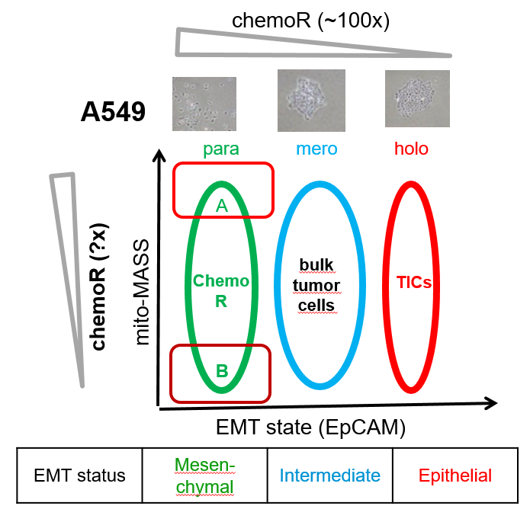
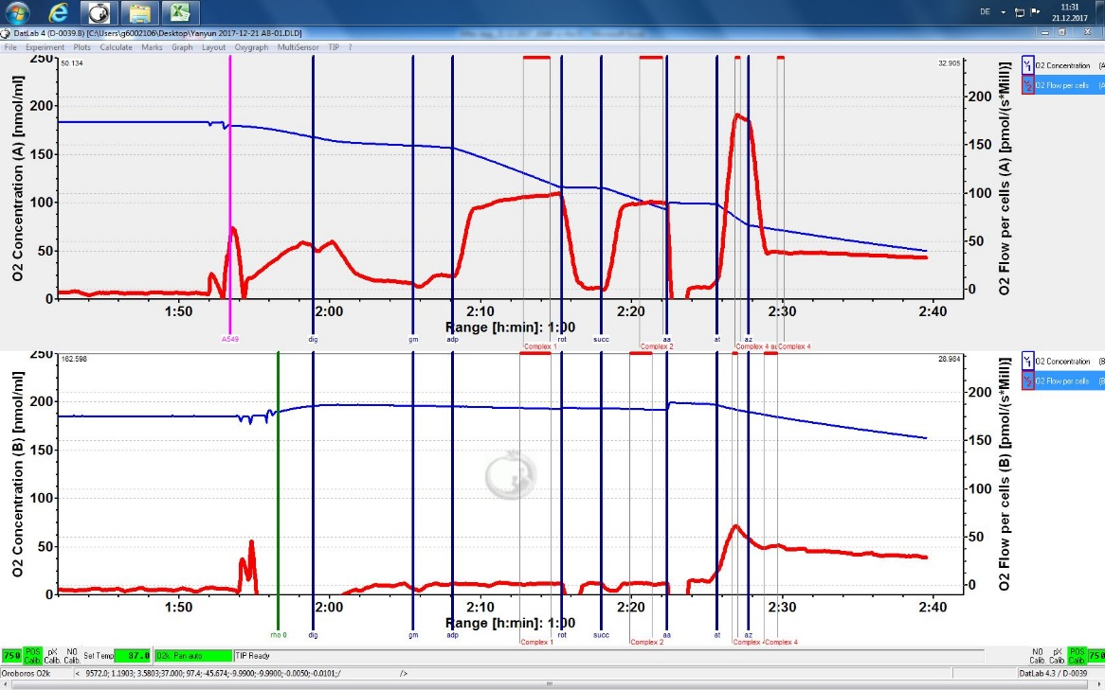
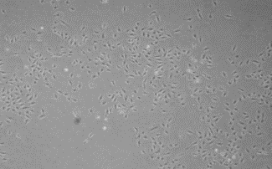
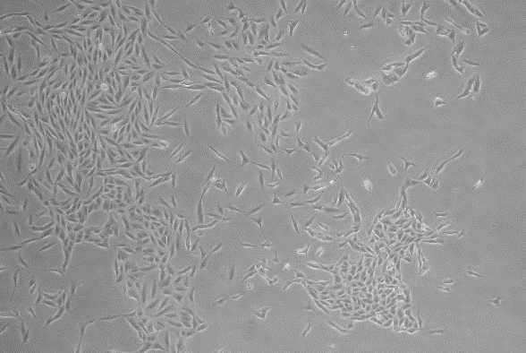
Figure S1
a
c
A549
O₂ Concentration
O₂ Flow per cell
A549 Rho 0
 | A549 |  |  | Rho 0
Complex* | I | II | IV | I | II | IV
O₂ Flow per cell pmol /(s* Mill) | 96 | 89 | 136 | 1.3 | 1.9 | 20
b
A549 Rho 0
A549
EtBr treatment
(~3 months)
*Complex I, III,IV, V related to mitochondrial DNA
bp
20000
10000
7000
5000
4000
3000
2000
1500
1000
700
500
400
300
200
75
d
A549
A549 Rho 0
mtDNA HVR gene 901bp
nDNA hNuc gene 467bp
DuplexPCR
40×
40×
Notes:
Fig 4. Generation of A549 Rho 0 cells. Representative gels of PCR diagnostics of the ρ0 phenotype induced by transient transfection.
A and B, 3T3#52 cells were transiently transfected with a plasmid encoding both EGFP and mUNG1, and
total DNA from the resulting large (A) and small (B) clones was subjected to diagnostic PCR. C, Human
osteosarcoma 143B cells were transiently transfected with the same plasmid and analyzed by PCR.
by lipofectamine 2000, A549, plasmid(pMA3790 and pMA4008)

