Slide 1
Outcome and prognostic factors of SARS CoV-2 infection in cancer patients: A cross-sectional study (SAKK 80/20 CaSA)
M Joerger, Y Metaxas, AM Schmitt, D Koeberle, K Zaman, D Betticher, N Mach, C Renner, M Mark, U Petrausch, C Caspar, C Britschgi, C Taverna, F Zenger, W Mingrone, J Schulz, C Kopp, S Hayoz, A Stathis, R von Moos, for the Swiss Group for Clinical Cancer research (SAKK)
Markus Joerger
Medical Oncologist
Chair Clinical Trials Unit
Dep. Oncology & Hematology
Cantonal Hospital
9007 St. Gallen (Switzerland)

Slide 2
DISCLOSURE INFORMATION
Our Institute receives Consultant/Advisory Fees from Novartis, Astra Zeneca, Basilea Pharmaceutica, Bayer, BMS, Debiopharm, MSD, Roche, Sanofi
Principal/Sub-Investigator of Clinical Trials for AstraZeneca, Basilea Pharmaceutica, Bayer, BMS, Daiichi Sankyo, Immunophotonics, Innomedica, Janssen, Lilly, MSD, Novartis, Intensity Therapeutics, Pfizer, Pharmamar, Roche, Sanofi, Takeda
Travel grants from Roche, BMS, MSD

Slide 3
Background
Controversy regarding the outcome of COVID-19 in cancer pts
Some studies found a poorer outcome of COVID-19 in cancer versus non-cancer pts¹⁻³
Collateral damage of the pandemic, incl. less cancer screening⁴, diagnosis⁵ and treatment⁶
COVID-19 mortality estimates in cancer pts between 14.6%⁷ and 36.6% (lung cancer)⁸
We assessed COVID-19 outcome in cancer pts in a country severely affected by the pandemic
¹ Liang et al., Lancet Oncol, Vol 21 March 2020
² Mehta et al., Cancer Discovery 2020, Vol 10, Iss 7
³ Zhang et al., Ann Onc 2020, Vol 31, Iss 7, 894-901
⁴ https://www.statnews.com/2020/05/04/cancer-screenings-drop-coronavirus-pandemic-epic/
⁵ Dinmohamed et al., Lancet Oncol, April 30, 2020
⁶ Wise, BMJ 2020;369
⁷ Barlesi et al., AACR virtual symposium, April 2020
⁸ Garassino et al., THERAVOLT initiative, ASCO 2020

Slide 4
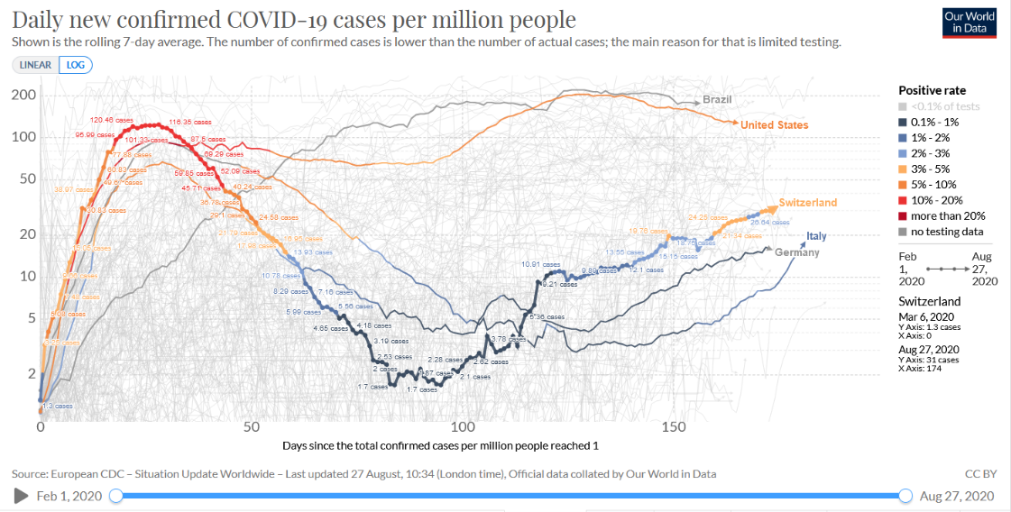

Slide 5
Methodology
Cohort study collecting data from symptomatic SARS-CoV-2 infected, adult cancer pts between March 1, 2020 and March 1, 2021
Pts had lab-confirmed SARS-CoV-2 infection, or COVID-19 infection diagnosed by clinical and radiological findings
23 Swiss sites participated, covering the majority of the Swiss population
We included pts with solid and hematological malignancies
Primary objective: Assess the outcome of COVID-19 infection in Swiss cancer pts
Main secondary objective: Define prognostic factors of COVID-19 outcome

Slide 6
Results: n=357 cancer pts with symptomatic COVID-19 as of July 16, 2020
Patient characteristics | N | %
Gender (m/f) | 212 / 145 | 59.4 / 40.6
Age 65+ | 214 | 60
Solid tumor / hematological malignancy Breast / lung / prostate cancer / myeloma | 266 / 91 63 / 40 / 24 / 16 | 74.5 / 25.5 17.6 / 11.2 / 6.7 / 4.5
Palliative v. curative tumor disease | 104 / 168 | 38.2 / 61.8
Systemic anticancer treatment within 3 months: Chemotherapy Targeted agents Steroids Endocrine treatment Checkpoint inhibitors No anticancer treatment | 65 54 39 35 22 155 | 18.2 15.1 10.9 9.8 6.2 43.4
Comorbidity (Y/N) Cardiovascular disease Diabetes Lung disease Adipositas Cachexia / malnutrition | 352 / 0 178 44 42 38 26 | 100 / 0 50.6 12.5 11.9 10.8 7.4

Slide 7
Results: COVID-19 infection outcome
Term | N | %
Hospitalization for COVID-19 (Y/N) | 230 (42 already in hospital) | 64.4
Oxygen requirement (Y/N) | 167 / 190 | 46.8 / 53.2
ICU admission (Y/N) | 43 / 314 | 12.0 / 88.0
Invasive ventilation (Y/N) | 33 / 324 | 9.2 / 90.8
COVID-19 mortality In all studied cancer pts In hospitalized cancer pts In cancer pts requiring oxygen In cancer pts admitted to ICU | 63 / 357 XX / 230 XX / 167 XX / 43 | 17.6 XX XX XX
Specific treatment during COVID-19 (Y/N) Antibiotics Chloroquine Antivirals Steroids Fungistatics | 261 / 22 154 81 48 39 11 | 92.2 / 7.8 54.4 28.6 17.0 13.8 3.9

Slide 8
Multiple logistic regression model
Outcome = Death (yes/no), N = 269 complete observations
Term | Odds ratio (95%CI) | P value
Intercept | 0.02 (0.01 - 0.08) | 0.000
Gender (M v. F) | 1.02 (0.49 - 2.10) | 0.961
Age (65+ v. 18-64) | 5.49 (2.13 - 14.13) | <0.001
Palliative v. curative disease setting | 2.42 (1.12 - 5.22) | 0.025
Chemotherapy (Y v. N) | 1.54 (0.69 - 3.46) | 0.293
Tumor type (Hematologic v. Solid) | 1.08 (0.45 - 2.57) | 0.862
ICU admission (Y v. N) | 5.81 (2.29 - 14.72) | <0.001
Significant univariable covariates: Age 65+, palliative v. curative disease setting, ICU admission, oxygen therapy

Slide 9
Univariable logistic regression (outcome = death)
Important covariates not significantly associated with COVID-19 outcome
Term | Odds ratio (95%CI) | P value
Gender (M v. F) | 1.59 (0.89 - 2.84) | 0.116
Geographic region French v. German region Italian v. German region | 0.85 (0.45-1.58) 1.70 (0.80-3.62) | 0.599 0.168
Systemic anticancer treatment within 3 months Chemotherapy Immunotherapy | 1.31 (0.66-2.58) 2.25 (0.87-5.80) | 0.439 0.094
Comorbidity Cardiovascular disease Lung disease | 1.14 (0.66-1.97) 0.93 (0.39-2.20) | 0.645 0.864

Slide 10
Conclusions
COVID-19 mortality in Swiss cancer pts was higher than the general population (17.6 v. 5%)
Substantial rate of hospitalization (64.4%) and ICU admission (12.0%)
Higher age and palliative disease setting were strong negative prognostic factors
Current or recent (< 3months) chemo or immunotherapy did not adversely affect COVID-19 outcome
Neither did major categories of comorbidities
So far, the decentralized, high-quality Swiss health care system coped comparably well with the COVID-19 pandemic

Slide 11
Acknowledgments
Patients and their families
Investigators
Dr. N. Cantoni (Aarau), Dr. C. Caspar (Baden), Prof. D. Köberle (Basel), Dr. A. Schmitt (Basel), PD Dr. Stathis (Bellinzona), Dr. F. Zenger (Bern), Prof. M. Zweifel (Biel), Dr. M. Mark (Chur), Prof. D. Betticher (Fribourg), Prof. N. Mach (Geneva), PD Dr. K. Zaman (Lausanne), Dr. S. Stettler (Luzern), Dr. W. Mingrone (Olten), Dr. R. Malval (Sion), Dr. P. von Burg (Solothurn), Prof. U. Güller (Thun), PD Dr. C. Taverna (Münsterlingen), Prof. M. Pless (Winterthur), Prof. C. Renner (Zurich), PD Dr. U. Petrausch (Zurich), Prof. M. Schmid (Zurich), PD Dr. C. Britschgi (Zurich), Dr. I. Metaxas (Chur), Prof. I. Guessous (Geneva), Prof. R. von Moos (Chur)
Swiss Group for Clinical Cancer Research (SAKK) – Coordinating Center
Dr. Stefanie Hayoz, Dr. Christoph Kopp, Dr. Stefanie Seiler, Isabelle Zürcher, Jessica Schulz, Jens Schulenburg

