Slide 1
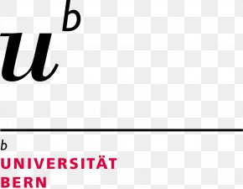
Evidentiality in Deedmongol
A preliminary account
Benjamin Brosig

Slide 2
Middle Mongol past tense forms
 | neutral | feminin | plural
factual past | -bA | -bi | -bA-i
direct past | -lUA | -lii | -lUA-i
indirect past | -jUU | -jiAi > -jii | -jUU-i
perfect | -san

Slide 3
Middle Mongol evidentiality: direct past -lUGA vs. indirect past -JUGU vs. factual past -bA
(1) Moŋqol-un ceri-üd Saari Keer-i büte-tele bawu-lua.
'[Naiman scouts reporting to Naiman-Khan:]' The Mongol troops have set up camp so as to cover the {whole} Sa’ari Steppe.' (SH §193, de Rachewiltz 2004: 116)
(2) Moŋqol maši gücü-tey-e ire-jü bidan-u (...) ceri-üd-i daru-ju bürel-tele kidu-juu-i. Itegel-tü Cabciyal-i ber buli-ju ab-cuu-i.
'[Report of the Jin chancellor to Jin emperor:] {Apparently} the Mongols came in great strength and killed and utterly destroyed our (…) troops. {it seem} they have even taken Chabchiyal Pass that we were relying on.' (SH §248, Street 2009: 142)
(3) Höelün eke öter gü bos-bi. Temüjin-tE-n köü-d öterle-n gü bos-uad mori-d-iyan bari-ju Temüjin niken mori unu-ba. Höelün eke niken mori unu-ba.
'[Author of SH to his readers:] Mother Höelün rose in haste. After the sons including Temüjin had also got up, {they} grabbed their horses and Temüjin mounted one horse. Höelün mounted one horse.' (SH §99, adapted from Street 2008: 407)
Notes:
speaker has seen vs. speaker has heard or infers vs. event is unproblematic, so that access path to information does not matter

Slide 4
Contemporary Mongolic languages
Southern Mongolic
Shirongolic
Baoanic
Dongxiang (Santa)
Kangjia
Baoan (Bonan)
Monguor
Mongghul
Mangghuer
Moghol
Dagur
Central Mongolic
Oirat (west)
Kalmyk Oirat (...)
Ysyk-Köl Oirat (extinct?)
Xinjiang Oirat (...)
Altai Oirat (...)
Alasha (...)
Deedmongol (...)
Khalkha-Chakhar (center)
Khorchin-Kharchin (east)
Buryat (north)
(...)
Eastern Shira Yugur
Notes:
Dagur

Slide 5
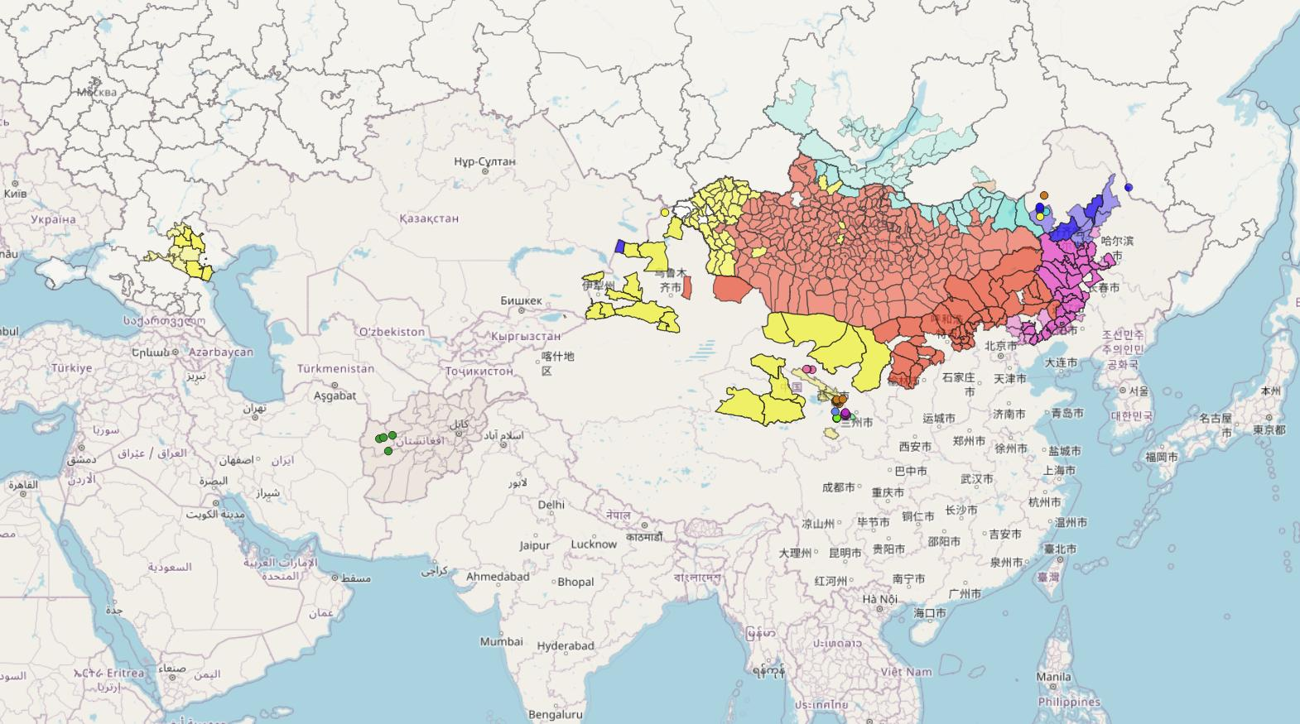
GROSSE KARTE

Slide 6
Presupposed internal structure of Oirat (cf. Rakos 2015)
Kalmyk Oirat Kalmykia, Russia three dialects, isolated from other
Mongolic varieties
Ysyk-Köl Oirat Kyrgyzstan a few villagers / extinct
Xinjiang Oirat Xinjiang, China several dialects
Altai Oirat Western Mongolia several dialects
Deedmongol Qinghai/Gansu, China dialectology unknown
Alasha Inner Mongolia, China two dialects
Imin Ööld Hulunbuir, IM, China New Bargu Buryat with a few remnant Oirat
features (Zigmundova et al. 2019: 27)
most research available
limited research available
Notes:
occasionally classified vis-a-vis each other, including in a quite notable way by Cenggeltei, but never classified in terms of their subdialects

Slide 7
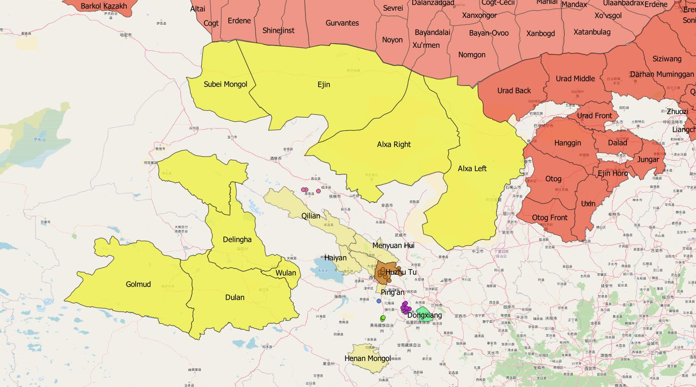
Khökhnuur

Slide 8
Materials for Deedmongol
Media: influence of barimjiya abiya
Oral literature:
mostly just in standardized Mongolian script
Secenmöngke’s corpus of yabuġan üliger (recordings & mongġul bicig)?
Linguistic materials
Oyunnasun 2009 Haixi only transcripts
Rakos 2015 Henan only recordings
Bagatur 2016 > Brosig&Zoljargal unp. BBZ Haixi 3.5 hours rec. & transc.
Brosig et al. unpublished Haixi 51 hours rec., 3 transc., 6 hours selected for transc.
Historical materials
Cing ulus-un dotuġadu narin bicig-ün yamun-u Mongġul dangsa ebkemel-ün emkidkel (Cimeddorji et al. 2003, Gantulga unpublished)
Dayicing gürün-ü dotuġadu yamun-u mongġul bicig-ün ger-ün dangsa (Buyandelger, & Oyunbilig, Canžid et al. 2010, Čojmaa et al. 2017)

Slide 9
Henan Deedmongol

Slide 10
Henan Oirat (Balogh 2017): past tense forms
(1) kiilik-εεn ʊγaa-jiγlaa. (speaker’s own action)
‘I washed my shirt’
(2) woroo or-jiku. (directly witnessed) ‘It rained / It was raining.’
(3) woroo or-jiγċəə. (not witnessed)
‘It has rained / It has been raining’

Slide 11
Amdo Tibetan (Sun 1993: 956-7): previous perception
(4) ŋæ xabda sʰoŋ=nə. [own action]
I(abs) deer-hunt(dat) go-PART
'I went deer-hunting.'
(5) dordʑe xabda sʰoŋ=tʰæ. [direct: visual evidence]
'Rdo-rje went deer-hunting.'
(6) dordʑe xabda sʰoŋ=zɔg. [indirect: inference, hearsay]
'Rdo-rje went deer-hunting.'

Slide 12
Henan Oirat (Balogh 2017): past tense forms
(1) kiilik-εεn ʊγaa-jiγlaa. (speaker’s own action)
‘I washed my shirt’
(2) woroo or-jiku. (directly witnessed) ‘It rained / It was raining.’
(3) woroo or-jiγċəə. (not witnessed)
‘It has rained / It has been raining’
Бороо ор-чих-жээ.

Slide 13
Henan Oirat (Balogh 2017): past tense forms
(1) kiilik-εεn ʊγaa-jiγ-laa. (speaker’s own action)
‘I washed my shirt’
(2) woroo or-jiku. (directly witnessed) ‘It rained / It was raining.’
(3) woroo or-jiγ-ċəə. (not witnessed)
‘It has rained / It has been raining’
Бороо ор-чих-жээ.

Slide 14
Henan Oirat (Balogh 2017): past tense forms
(1) kiilik-εεn ʊγaa-jiγ-laa. (speaker’s own action)
‘I washed my shirt’
(2) woroo or-ji[γ]-[w]u. <? or-ciqa-wa (directly witnessed) ‘It rained / It was raining.’
(3) woroo or-jiγ-ċəə. (not witnessed)
‘It has rained / It has been raining’
Бороо ор-чих-жээ.

Slide 15
Henan Oirat (Balogh 2017): present tense forms
(7) wə kiilik-εεn ʊγaa-jii. (speaker’s own action)
‘I am washing my shirt’
(8) ter kiilik-εεn ʊγaa-jεεn. (non-speaker actor)
‘He is washing his shirt.’
(9) nar ɧɩγaa-jip. (uncontrolled action)
‘The sun is setting.’

Slide 16
Amdo Tibetan (Sun 1993: 973&977, 976, 950): imperfective situations; non-control situations would be marked by =ʰkə
(10) tæ ŋə tɕæ ntʰoŋ=ʰkə jod.
now I(erg) tea drink=prog aux
'I am drinking tea now.'
(11) tæ kʰu tɕæ ntʰoŋ=ʰkə jod=ʰkə.
'He is drinking tea now (I just found out).'
(12) tʂaɕʰi=kə ʰtæ ŋu=nə re.
Bkra-shis=erg horse buy(com[plete])=part cop
['Bkra-shis buys a horse (as if a generic statement).']

Slide 17
Amdo Tibetan (Sun 1993: 973&977, 976, 978): immediate vs. previous perception (also inference possible)
(11) tæ kʰu tɕæ ntʰoŋ=ʰkə jod=ʰkə.
now he(erg) tea drink=prog aux
'He is drinking tea now (I just found out).'
(13) tʂaɕʰi=kə tæ mumu li=ʰkod=tʰæ.
Bkra-shis=erg now momo make=prog.aux=dir.ev
'Bkra-shis is now making momos (I saw him do so just now).'

Slide 18
Henan Oirat (Balogh 2017): present tense forms
(7) wə kiilik-εεn ʊγaa-jii. (speaker’s own action)
‘I am washing my shirt’
Би хийлэгээн угааж бий.
(8) ter kiilik-εεn ʊγaa-jεεn. (non-speaker actor)
‘He is washing his shirt.’
Би хийлэгээн угааж байна.
(9) nar ɧɩγaa-jip. (uncontrolled action)
‘The sun is setting.’
?

Slide 19
Haixi Deedmongol

Slide 20
Oyunceceg. 2009. Degedü mongġul aman ayalġun-u sudulul [A study of the Deedmongol dialect], cited as OY
conventional Inner Mongolian-style dialect grammar
morphological structuring, e.g. treating finite verbal forms and finitely used participles in different sections
→ describes morphological, but not functional systems
no contrastive analysis of individual suffixes from paradigms
no precise frequency data (though occasionally general assessments)
no input from modern linguistic theory, including relevant Chinese sources
→ highly imprecise and incomplete semantic descriptions
written by a native speaker
semantic values ascribed to sentences should be rather reliable (though
potentially trouble with distinguishing morphemic and contextual meaning)

Slide 21
Past tense system: -lɑ as an example
-lɑ,-læ,-lɑː,-læː ᠳᠠᠭᠠᠪᠤᠷᠢ᠄ ᠲᠤᠰ ᠳᠠᠭᠠᠪᠤᠷᠢ ᠳᠡᠭᠡᠳᠦ ᠮᠤᠩᠭᠤᠯ ᠠᠮᠠᠨ ᠠᠶᠠᠯᠤᠨ ᠳᠤ ᠮᠠᠰᠢ ᠢᠳᠡᠪᠬᠢᠲᠡᠢ ᠶᠠᠷᠢᠭᠳᠠᠳᠠᠭ᠃ ᠲᠡᠭᠡᠬᠦ ᠳᠡᠭᠡᠨ ᠪᠢᠴᠢᠭ ᠦᠨ ᠬᠡᠯᠡᠨ ᠦ 《᠊ᠯ᠎ᠠ》 ᠲᠠᠢ ᠲᠤᠬᠢᠷᠠᠯᠴᠠᠵᠤ᠂ -lɑ,-lɑː ᠨᠢ ᠴᠢᠩᠭ᠎ᠠ ᠦᠭᠡᠨ ᠳᠦ᠂ -læ,-læː ᠨᠢ ᠬᠦᠨᠳᠡᠢ ᠦᠭᠡ ᠢᠢᠨ ᠠᠷᠤ ᠳᠤ ᠤᠷᠤᠵᠤ᠂ ᠦᠢᠯᠡ ᠢᠢᠨ ᠨᠢᠭᠡᠨᠲᠡ ᠥᠩᠭᠡᠷᠡᠭᠰᠡᠨ ᠪᠤᠶᠤ ᠬᠤᠵᠢᠮ ᠡᠬᠦᠰᠬᠦ ᠢᠷᠡᠭᠡᠳᠦᠢ ᠴᠠᠭ ᠤᠨ ᠤᠳᠬ᠎ᠠ ᠢᠢ ᠢᠯᠡᠳᠭᠡᠵᠦ᠂ ᠥᠭᠦᠯᠡᠪᠦᠷᠢ ᠳᠦ ᠲᠡᠭᠦᠰ ᠥᠭᠦᠯᠡᠬᠦᠨ ᠪᠤᠯᠳᠠᠭ᠃ (Oyunceceg 2009: 155)
The suffix -lɑ,-læ,-lɑː,-læː: This suffix is used a lot in the Deedmongol dialect. It correlates with the suffix –l-a of the written language. -lɑ,-lɑː is used in back-vocalic words, -læ,-læː in front-vocalic words. It expresses the meaning that the event is already past or is about to arise in the future. In the sentence, it forms finite predicates.
info partially redundant
accompanied by examples, but none associated with individual claims
not distinguished as a past form from other past tense forms

Slide 22
Past tense system: -lɑ as an example
What could we EXPECT for a suffix like –la in Central Mongolic or Oirat?
direct sensory, usually visual perception of the event, including events committed by the speaker herself (Goto 2009 on Kalmyk, cf. Street 2009 on Middle Mongol, Binnick 1979 and many subsequent publications on Khalkha)
restriction to immediate perception and very specific and restricted use in questions (Brosig 2018 on Khalkha), similar to Amdo Tibetan =ʰkə
future-referring uses (in Khalkha [e.g. Brosig 2018], and exclusively in Kharchin [Cáodàobātèěr 2007, cf. Ashimura 2002], but not in Middle Mongol [Street 2009] and apparently not in Kalmyk [Bläsing 1984: 94-95])
control probably doesn’t play a role

Slide 23
Past tense system: -lɑ as an example
(10) mɑl tɔː tʰøll-æː pɑr-lɑː.
cattle now give_birth-prf.cvb finish-dir.pst
‘The cattle have now finished given birth.’
(11) en tʃil mɑn-ɑ̌ ɑŋg telikæː-t tsʰʊglɑ̌-lɑ.
this year 1pl-gen class place-dat assemble-dir.pst
‘This year our class met up in Delkhii.’
(12) tʃʰiː tsʰyɤylter χɑː jɔwʊ-lɑ?
2sg yesterday where go-dir.pst
‘Where did you go yesterday?’

Slide 24
Past tense system: -lɑ as an example
(10) mɑl tɔː tʰøll-æː pɑr-lɑː.
cattle now give_birth-prf.cvb finish-dir.pst
‘The cattle have now finished given birth.’
(11) en tʃil mɑn-ɑ̌ ɑŋg telikæː-t tsʰʊglɑ̌-lɑ.
this year 1pl-gen class place-dat assemble-dir.pst
‘This year our class met up in Delkhii.’
(12) tʃʰiː tsʰyɤylter χɑː jɔwʊ-lɑ?
2sg yesterday where go-dir.pst
‘Where did you go yesterday?’
In many example sentences: speaker likely witness (10) or participant (11).
Often used for questions about the addressee (12), no restrictions similar to Khalkha here.
No transparently future-referring examples, though e.g (10) might conceivably fulfill such a function in a suitable context.

Slide 25
Further past tense markers: -tʃeː etc.
(13) mɔrin jɔwʊ-tʃeː, tɔː ɔl-tɑ-χ=ʊː gɔː? [OY: past]
horse go-indir.pst now find-pass-fut.ptcp=plr.q ex.neg [BB: inference]
‘The horse has left, now will it be found or not?’
(14) sɔnʊm mɑl-ɑːn ʊsʊl-χ-ɑːr jɔwʊ-ttʃ. [OY: speaker just finds out]
name cattle-rposs water-fut.ptcp-ins go-indir.pst [BB: inference]
‘Sonum went to water his cattle.’
(15) χʊj! χɑltʰɑ̌r nɔχɑː alt-ʊːl-tʃitʃʰ, ʊj-ij! [OY: action is fully completed]
interj dark.brown dog lose-caus-indir.pst bind-vol [BB: inference; loss of control]
‘Hey! Subject allowed the brown dog to get loose, I shall tie it!’

Slide 26
Further past tense markers: -w, -san
“used in constituent clauses” > used in lining up sentences
(16) ɢɑgtsʰ kʰyːkʰen æːl-iːn peri-t jɔp-p,
only girl family-gen daughter_in_law-dat go-pst
tɔː mɑn-ɑ̌ χʊj-ʊl-χɑn ylty-wæː.
now 1pl-gen two-coll-dim remain-pst
‘Our only girl went away as the daughter-in-law of a family, now
only the two of us remain.’
(17) tʃʰintʃʰin nɑt-ɑːs tʰyryːn jɔwω-s=iːm.
name 1sg-abl ahead go-pst.ptcp=ass
‘Chinchin (has) left ahead of me.’
neutral past?
somebody (Ø) is pleased (sedkil qanumjitai)
exclamative?
Overall few examples in OY that contain -w
past
all example sentences contain SFP

Slide 27
Past system of Haixi Oirat based on OY and what is plausible based on other dialects
Direct past -lɑ vs. indirect past -ttʃ.
Unclear whether -ttʃ is only for inference or also for hearsay
-ttʃ < *[elided suffix + od-jai]_{indir.pst} has replaced the more common direct past -tʃeː < -jai < Middle Mongol -jiAi
Neutral past -w possibly marginalized for exclamatives (cf. a similar situation in Khalkha)
Former apparent Middle Mongol perfect -san (cf. Brosig 2014) only usable in some perhaps modal or interactional contexts with Sentence-Final Particles.
→ two-partite past evidential system without neutral element?

Slide 28
Present tense system
Present forms: -na, -tak, -tʃæːn, -tʃiː.
-na “ongoing present ᠦᠷᠭᠦᠯᠴᠢᠯᠡᠨ ᠪᠠᠢᠭ᠎ᠠ ᠤᠳᠤ ᠴᠠᠭ” & “certain future ᠵᠠᠪᠠᠯ ᠪᠤᠯᠬᠤ ᠢᠢ ᠪᠠᠲᠤᠯᠠᠭᠰᠠᠨ ᠠᠶᠠᠰ ᠲᠠᠢ ᠢᠷᠡᠭᠡᠳᠦᠢ ᠴᠠᠭ”
-tʃiː “ongoing present ᠦᠷᠭᠦᠯᠴᠢᠯᠡᠵᠦ ᠪᠠᠢᠭ᠎ᠠ ᠤᠳᠤ ᠴᠠᠭ” & “certain future ᠵᠠᠪᠠᠯ ᠪᠤᠯᠬᠤ ᠢᠢ ᠪᠠᠲᠤᠯᠠᠭᠰᠠᠨ ᠠᠶᠠᠰ ᠲᠠᠢ ᠢᠷᠡᠭᠡᠳᠦᠢ ᠴᠠᠭ”
-tʃæːn “present ᠤᠳᠤ ᠴᠠᠭ”
-tak (in another section) “habitual ᠪᠠᠢᠩᠭᠤ ᠦᠢᠯᠡᠳᠬᠦ ᠤᠳᠬ᠎ᠠ”
-na for potential developments (Khalkha, Brosig 2015) or general future-potential-habitual (Khorchin, cf. Brosig 2014b). Labeling it “ongoing present” (as in Late Middle Mongol) is unexpected. But OY illustrates this with ᠶᠠᠪᠤᠨ᠎ᠠ (which in Khalkha next to ᠪᠠᠢᠨ᠎ᠠ does express ongoing present with -na) or the archaic ᠠᠢᠰᠤᠨ᠎ᠠ. If these are the only verbs with ongoing-present uses, then Deedmongol -na is mostly not a present form at all.
-tʃæːn as simple present highly unlikely, an outsider might thus translate “imperfect”, vs. “progressive” -na.
Examples with -tʃæːn and -tʃiː both progressive (with regular verbs), thus compare!

Slide 29
Present tense system: progressives
(18) mal-t jɔwω-sen kʰyːkʰe-s-yːs ʃɔgʃ-aː ir-tʃiː.
cattle-dat go-prf.ptcp child-pl-pl joke-prf.cvb come-prs.prog
‘The children who went to the cattle are coming (returning) jokingly.’
(19) piː ent ykʰyr sɑː-tʃæːn.
1sg here cow milk-prog.pres
‘I am milking the cows here.’
speaker probably witness
speaker as participant
If pragmatically unspectacular and representative uses, this might be the very opposite of Henan Deedmongol (where participatory -tʃiː vs. rest -tʃæːn).

Slide 30
Past and progressive forms in Bagatur 2016 as revised by Brosig & Zoljargal unpublished
 |  | plain regular stem | quotative verb | completive | quot.v. & compl.
 |  |  | kɘ- | -tʃʰikʰ- | kɘ-tʃʰikʰ-
direct past | -lɑː | 119 | 15 | 12
indirect past | -tʃ ~ -tʃeː | 241 | 235 | 51 | 13
past | -sɑn + pcl | 41 | 6 | 4
 | -sɑn | 184 | 16 | 51
 | -w | 25 |  | 2
 | -tʃæː | 105 | 15 | 1
 | -tʃiː | 11 | 5
 | -tʃæː ~ -tʃiː | 5 | 1
present progressive | -tʃæː-n | 163 | 34 | 3

Slide 31
Different shapes of the indirect past
(20) ʊs=ɑn tsɔgs-ɔː=tsʰ tʰeg-eːt nʊːr tʰɔgtʰ-ɔː
water=3poss form-cvb=ad.foc do_so- cvb lake form-cvb
xɵxnʊːr ik-eː tʰɔgtʰ-tʃæː. (Bagatur et al. 2016)
Blue_Lake do_so-cvb form-indir.pst
‘The water stood still, then a lake formed and the Blue Lake came into being in this way.’
(21) en pɔltʃʊm ɔtɔː pɑsə + ɢɑr-t=ɑː nek kʰesek nɔɢɔː pær-tʃi wɑː?
this top now also hand-dat=rposs one part vegetable grab-indir.pst? mp
nɔɢɔː, nɔɢɔː ... + tʰiːm=iːn pær-tʃʰik-sen. (Brosig et al. unpublished)
vegetable vegetable such=thing grab-compl-prf?
‘Now, has he also + grabbed / is he also + grabbing a piece of vegetable in his hand?
Vegetable, vegetable + he has grabbed something like this.’

Slide 32
Conclusions
Henan Deedmongol (Balogh 2017): Amdo Tibetan-style system
participant vs. other, in past subdivided into direct vs. indirect, but details unclear
Etymologically & functionally unclear: -jip (“uncontrolled, naturally occuring action”)
Haixi Deedmongol: Mongolic-style system with regional features
OY: -ttʃʰ < V[-cvb] odu-jai ‘went there V-ing’ would resemble Amdo Tibetan -tʰæ ‘went past [V-ing]’ (Zemp 2017: 622), though inferential rather than visual/sensory.
OY: Apparent two-part-system (without -w/-san) would resemble Southern Mongolic. BBZ: There might be neutral -san.
OY: Evidential values of -la vs. -ttʃʰ (BBZ: -tʃʰeː) are participatory INCLUDING visual vs. inference (BBZ: including hearsay).
Although -la usually participatory (BBZ, not OY), contrasting indirect marker very rare with witnessed evens.
Present progressive distinction semantically unclear in OY, and in BBZ the potential number of possible -tʃiː-progressives is very low

