Slide 1
Mechanisms of Exclusion: a collective engagement
Pascale Altenburger
Claire Vionnet
& CHAKKARs

Slide 2
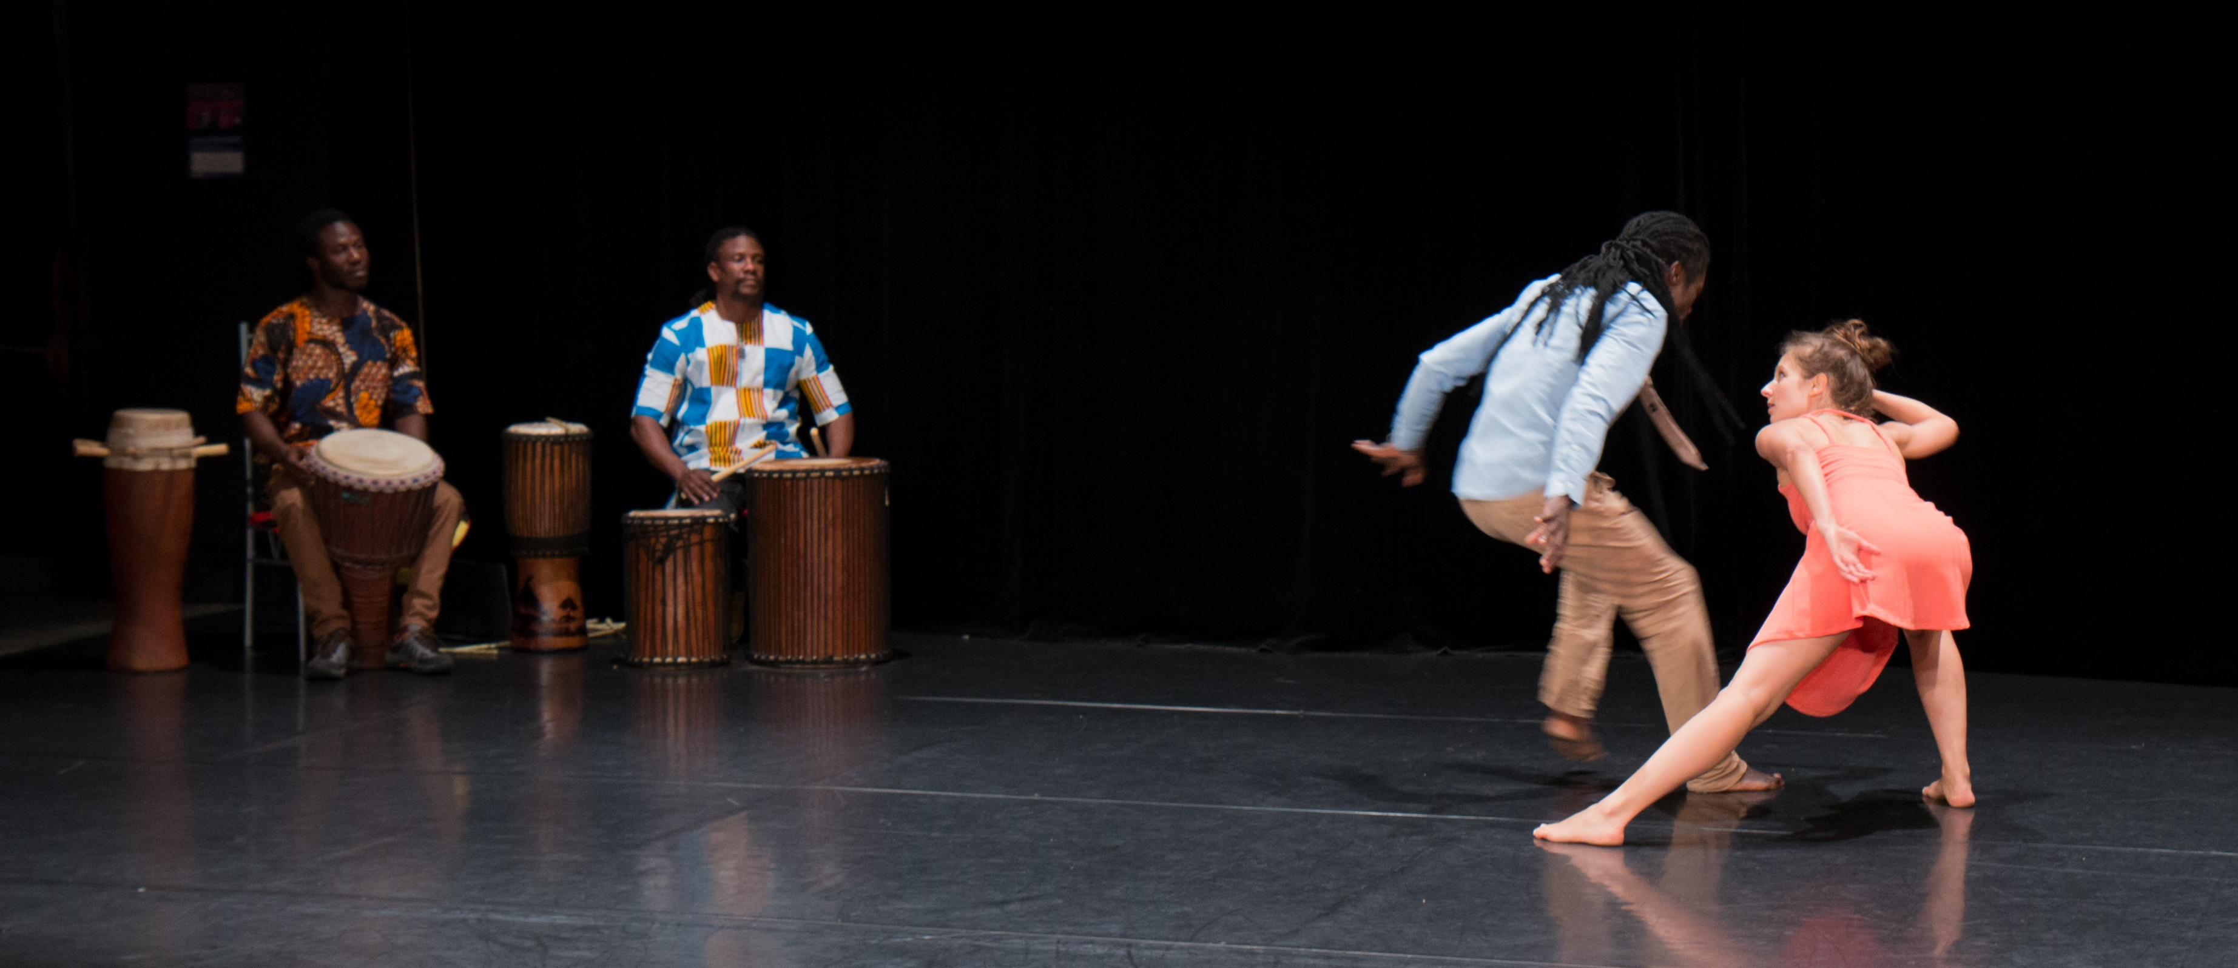
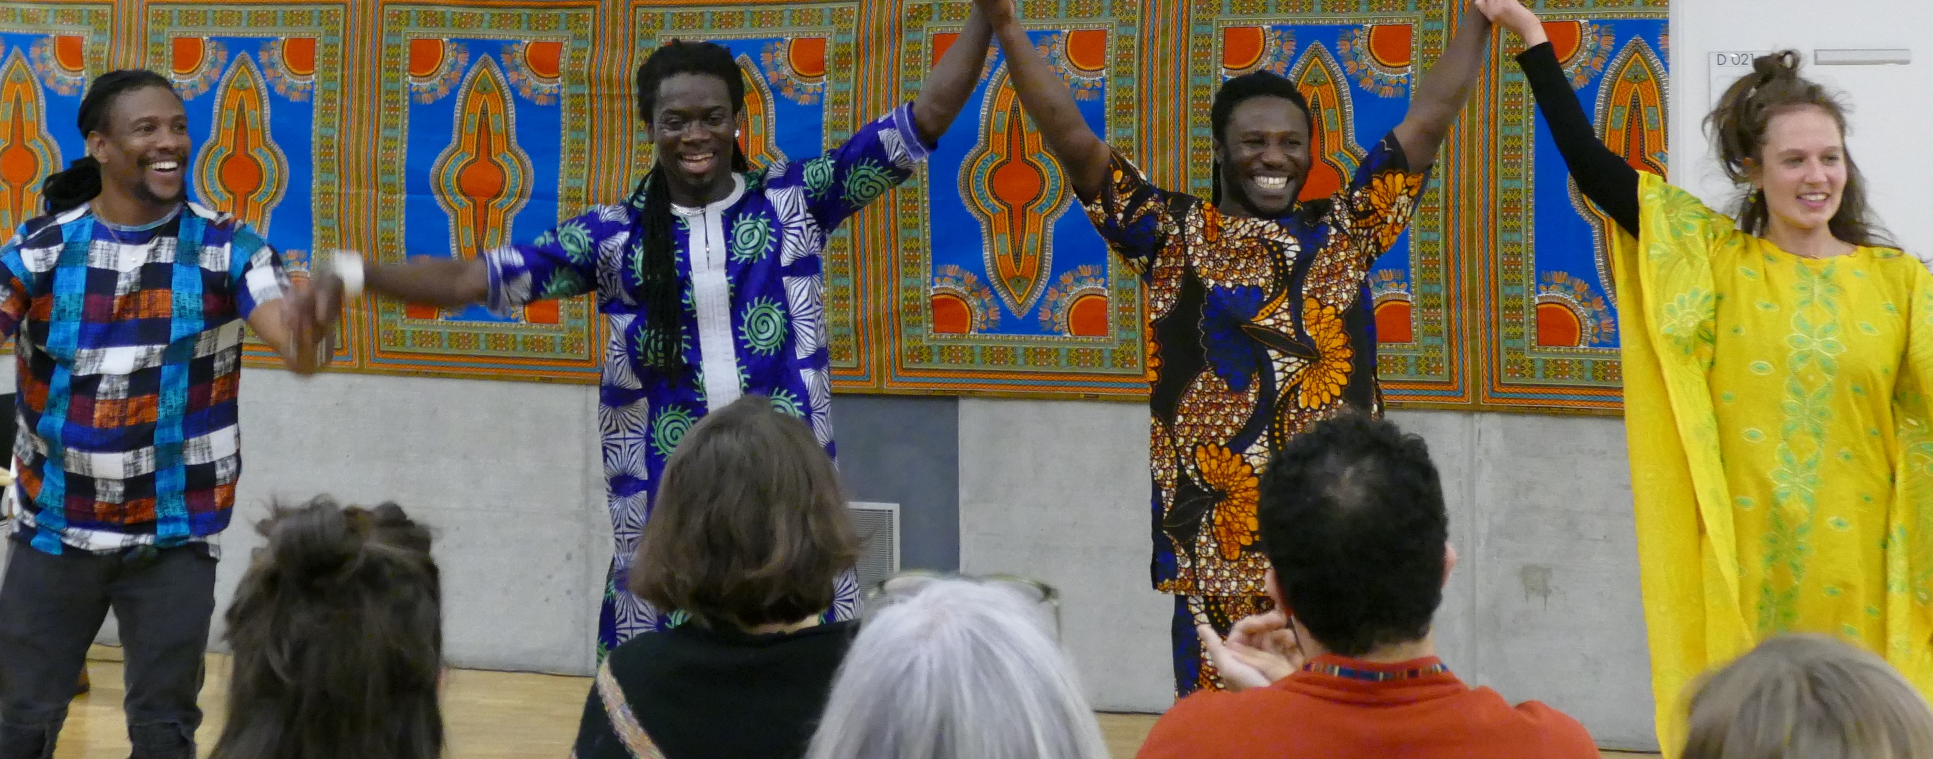
Kunda

Slide 3
Dance History

Slide 4
Katherine Dunham 1909-2006

Slide 5
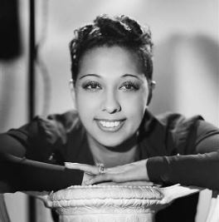
Josephine Baker 1906 – 1975

Slide 6
Féral Benga 1906 -1957

Slide 7
Ghana Ballet 1940 - 1960

Slide 8
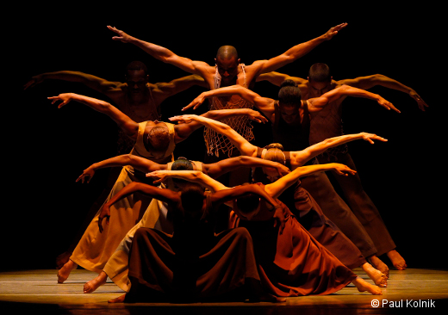
Alvin Ailey 1931-1989

Slide 9
Carlotta Ikeda 1941-2014

Slide 10
Zab Maboungou 1986

Slide 11
Merlin Nyakam 1990

Slide 12
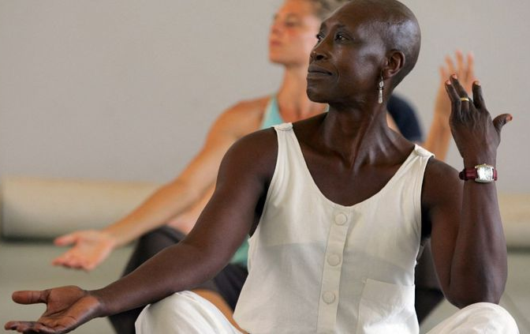
Germaine Acogny 1977

Slide 13
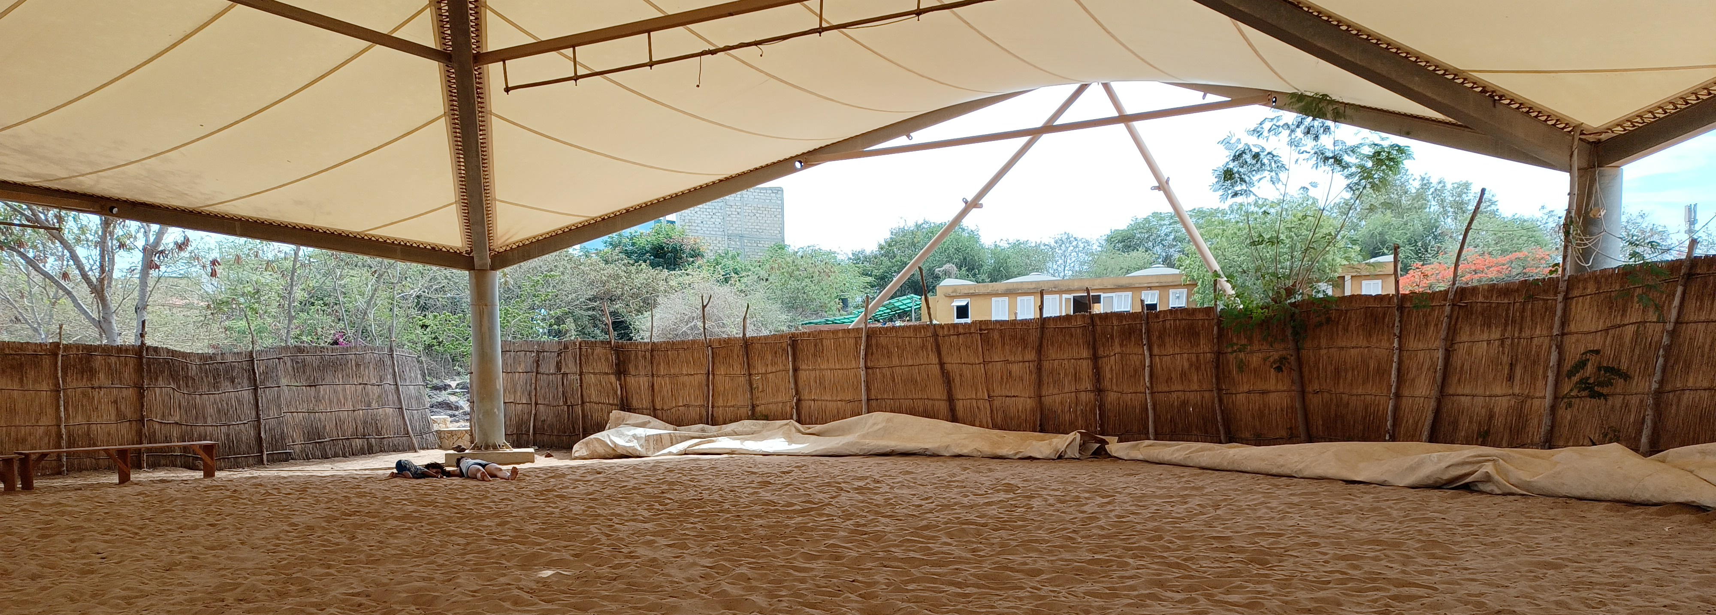
Ecole des Sables 2004
Alesandra Seutin
Wesley Ruzibiza

Slide 14
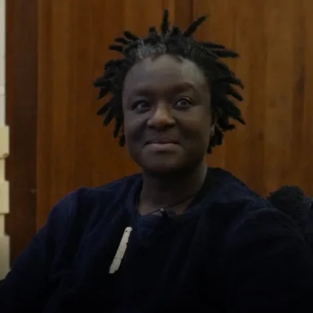
Bintou Dembélé 2002

Slide 15
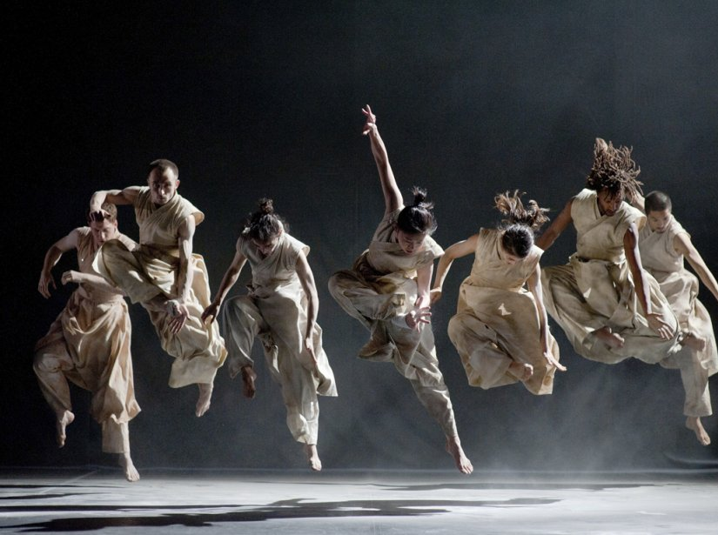
Akram Khan 2000

Slide 16
Let’s move!

Slide 17
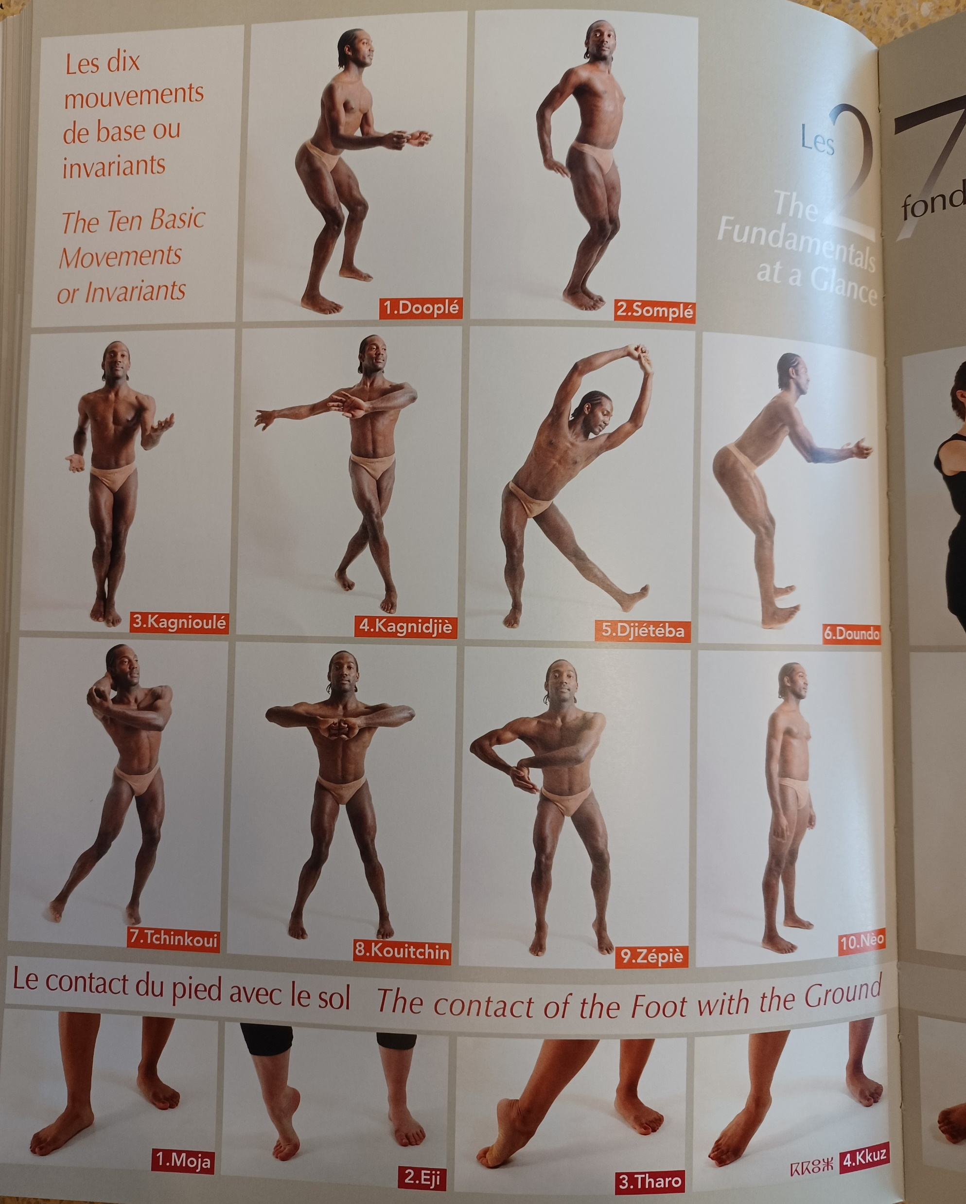
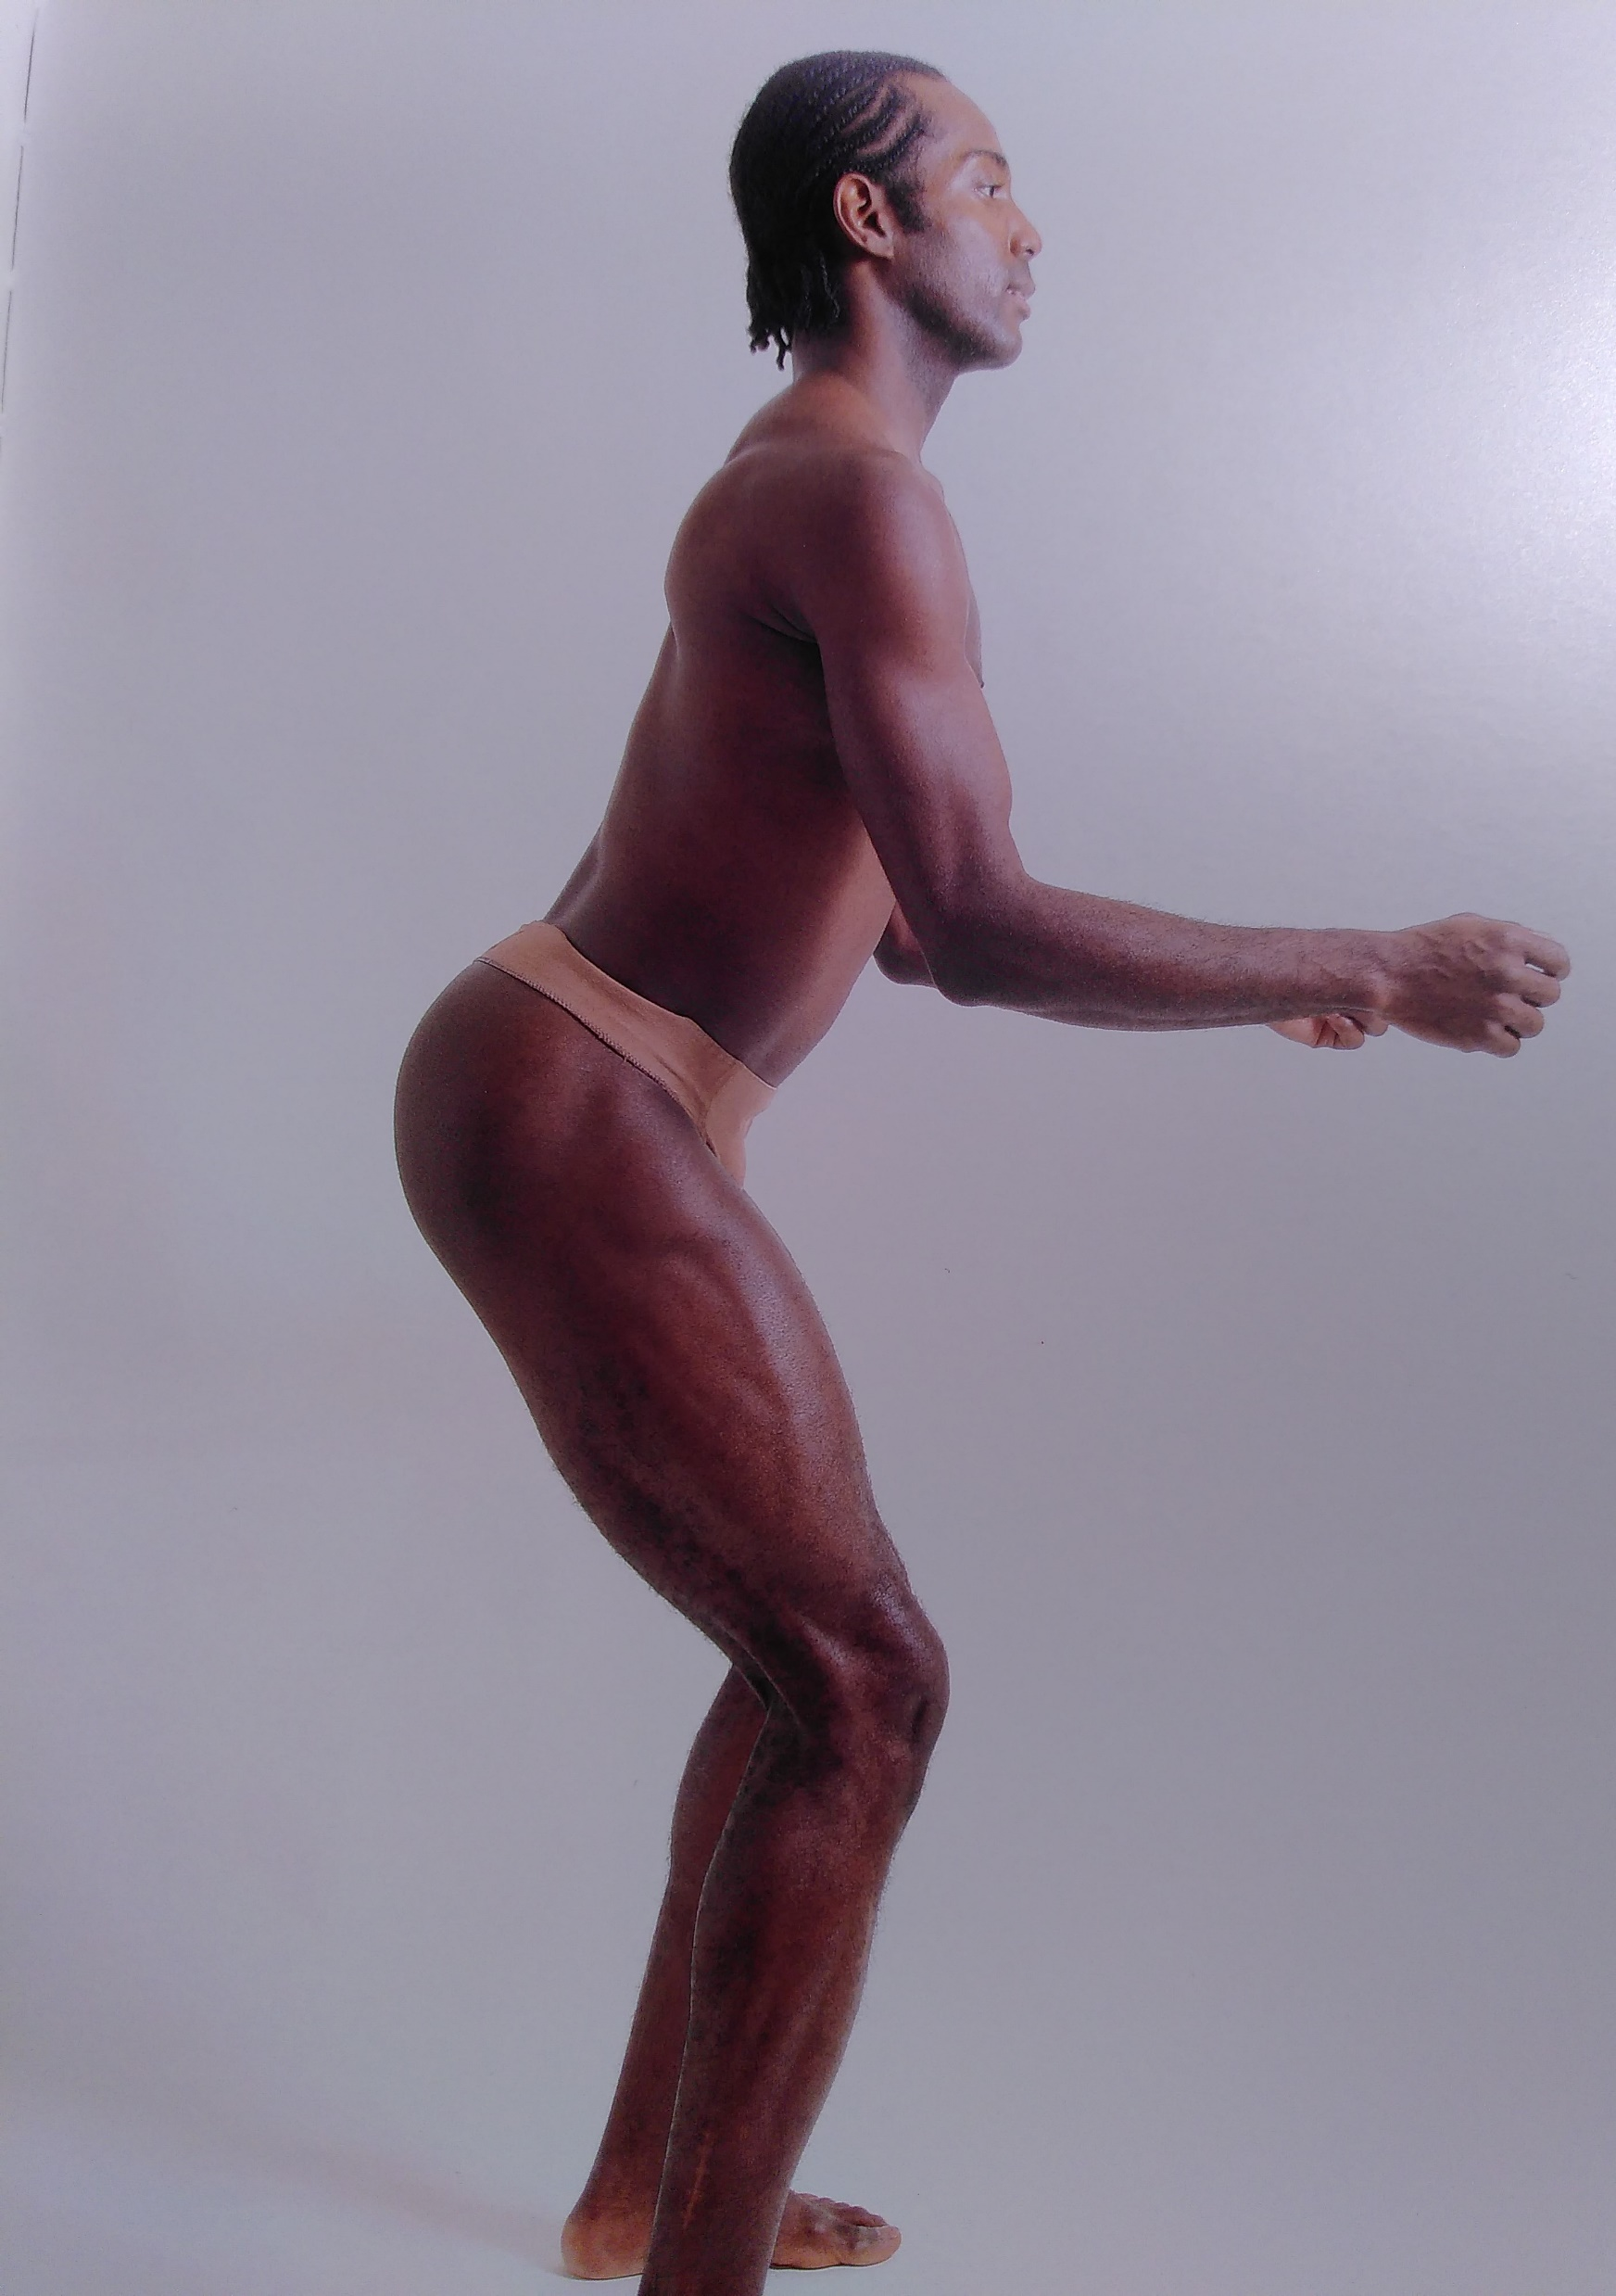
Doople The Eternal Law of African Dance
Alphonse Tiérou, 1989

Slide 18
Decentralize & Decolonize

Slide 19
Let’s talk…
Ciekunda.com

Slide 20
World Café
My White Gaze in Choreography
Changing White Institutions
My White Gaze in my daily work

Slide 22
World Café
Behavioral guidelines
possibility to leave the space at any time
no racist word/attitude
Safer spaces: a respectful area for everyone to express themselves, reminding that White people usually speak more
accessibility and inclusiveness: all invited to participate with their bodily possibility

Slide 23
Game rules
Start the discussion by introducing oneself through an acknowledgment of one’s privileges
Change the table after 15 min
No need of finding a solution
Addressing the issue from a White perspective ‘’What is my gaze/responsibility as a White person?’’ (instead of othering)
Write keywords on postits

Slide 24
Questions
I. My white gaze in Choreography:
Where are racist mechanisms in choreography/performance? How does (dance)performance (re)produce racist stereotypes on stage?
What stereotypes of otherness do I bring on stage?
How do I consider hip-hop, and “African” dance companies? And Butoh?

Slide 25
II. Changing White Institutions How racist are the structures of institutions? What are the hierarchies (institutional/noninstitutional)? What position do I have in a hierarchical structure? What power do I have in my position? What can I do within the role that I have in a working structure?

Slide 26
III. My White Gaze in my daily work
What is my responsibility as a dancer, choreographer, and programmer?
How do I run auditions?
How do I select dancers?
How do I select dance companies?

Slide 27
Talawa Technique

Slide 29
Politics of Black Representation in Dance
Which images of black bodies are produced, in articulation with white bodies? What themes? What iconic items come again and again? (objects, costumes, music, metaphors)
how the meaning of blackness is negotiated on stage, though notions of desire, erotization, eroticism, hypersexuality and exotism?
How African symbolism is represented in dramaturgy? (African rituals, mythology, superstition, religion)

Slide 30
Whiteness/Blackness in Dance
By "blackness" I mean the social and artistic meanings that adhere to dancing bodies that can be read as marked by the culture and history of Africans in the New World. By "whiteness" I mean the social and artistic privilege that adhere to dancing bodies that can be read as racially unmarked, the legitimizing norms against which bodies of color take their color."
Blackness and whiteness became perceptual constructs onstage, ways for linking physical bodies and theatrical meanings, ways for reading bodies in motion
Susan Manning, 2019
Race in motion: modern dance, negro dance, and Katherine Dunham

Slide 31
Whiteness/Blackness
Whiteness as
a structural position of social privilege and power
a powerful means of reproduction and maintenance of systems of racial inequality
Whiteness as the norm defining all others (nonwhiteness)
Blackness serves as the primary form of Otherness by which whiteness is constructed
Hartigan, American Anthropologist, Virtual Issue March 2020
Schwarz is a political self definition. It expresses a commonality of people going throw same experiences of racism
White refers to people who do not experience racism
Blas.Sh

Slide 32
Skin
Skin is the principal medium that has carried the past into the present
Skin has been and continues to be not only a document but also a performance
deep skin = a melanoma of the imagination
Skin depends into the cancer of race when supposed inner essences and stereotypical behaviors are infected by it in the collective fantasies of one people about another
First, deep skin becomes invisible; then, after the passage of time (...) it alone remains visible
Roach 2001: 102

