Slide 1
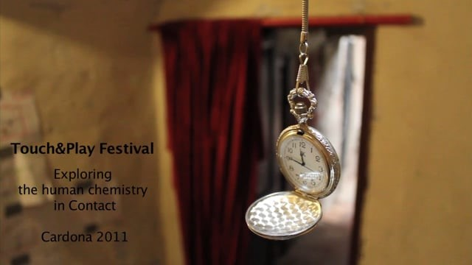
00:15-2:30
Notes:
Show Video: 00:15-2:30

Slide 2
Lee
USA
2014
I have found that CI jams often attract people who crave human touch, or are lacking it. Some jams have rules or statements, such as “this is not a place to pick up a date”. I have often experienced sexual desire, or felt it from someone else. Most of the time, it is a confused feeling. Be aware, be awake. In doing this you can define your own boundaries, finding the dance. I would not expect this skill from a beginner.

Slide 3
Michel Dorais Petit traité de l’érotisme 2010
Eroticism results from an active process: a situation (not necessarily erotic per se) is consciously perceived to trigger sexual arousal
Eroticism is generated by an act of transformation in which a sensual/sexual feature is given to a person, a context, a gesture, an attitude
Eroticism is entangled with imagination and fantasy

Slide 4
Kinga
Montreal
2017
I recognize that I am speaking from a privileged position of a person who is young, conventionally attractive, experienced dancer and has a lot of physical contact in her life outside of CI. I can imagine that for people who don’t have that, CI may seem like a good doorway to sexual intimacy that they’re lacking in life.

