Slide 1

In the Intimacy of the Dancing Body
An Anthropology in
Feeling, Moving, Touching
Dr. Claire Vionnet

Slide 2
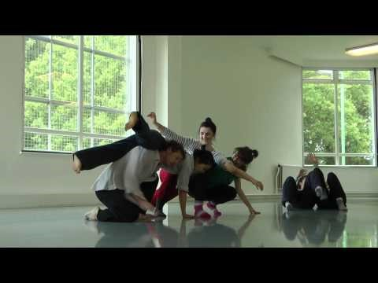

Slide 3
Doris Uhlich More than naked
2013
https://www.youtube.com/watch?v=R0UBQNNa6J8

Slide 4
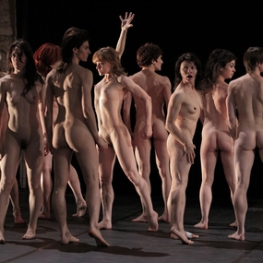

Olivier Dubois Tragédies 2013
https://www.youtube.com/watch?v=A3Jno6Y5u9w

Slide 5
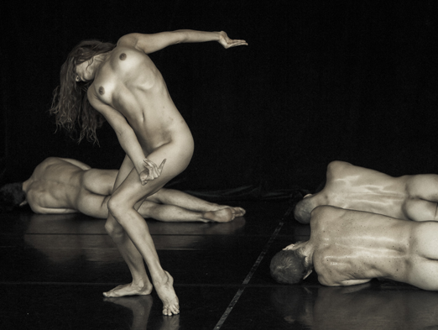
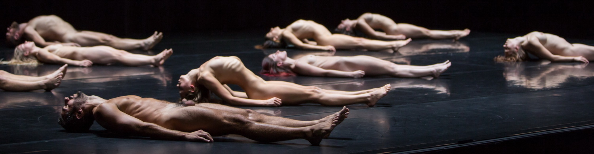
Alias
Guilherme Botelho
Antes
2014

Slide 6


Prototype Status. Jasmine Morand
Mire 2016

Slide 7
Intimacy and Contemporary Dance
♣ Intimacy & Contemporary dance
♣ Definition
♣ Hypothesis
♣ 3 axes: feeling, moving, touching
♣ Methodology
♣ Research question
♣ Professionals vs non-prof. dancers
♣ Bodily vs “Heart” Intimacy

Slide 8
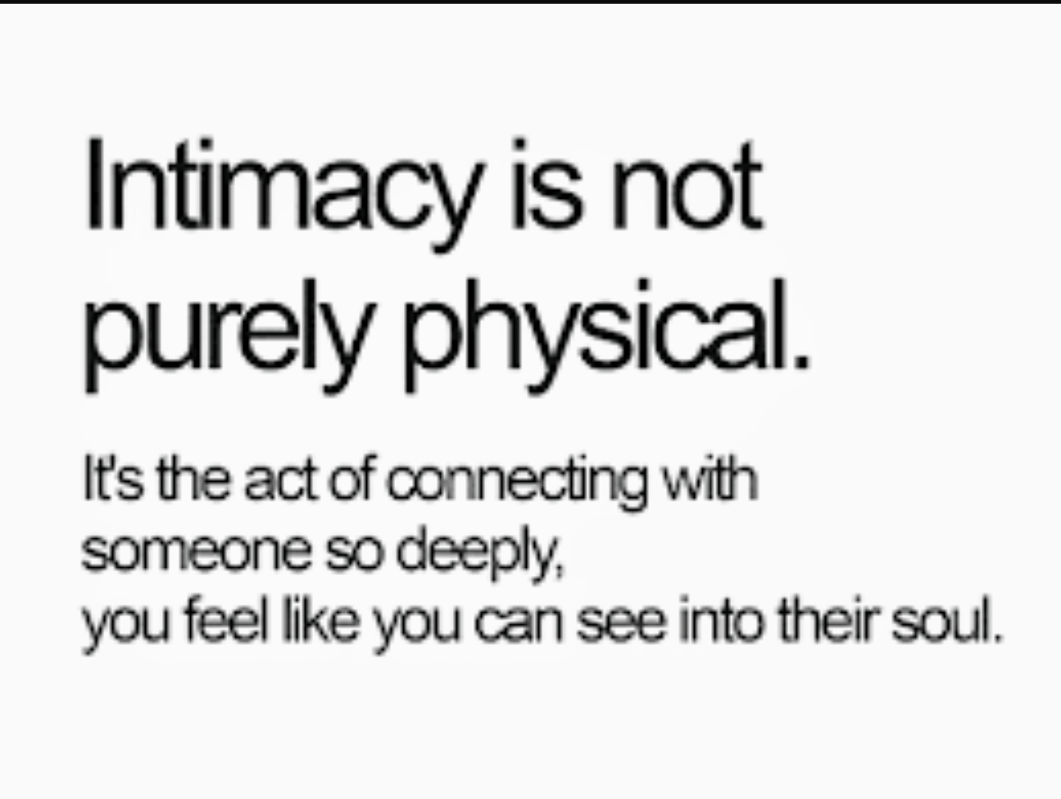
Vulnerability in improvisations

Slide 9
Definition
♣ Polysemy of significations
(Register & Henley 1992)
♣ Double signification
Interrelation with others
Relation to oneself
(Gauthier & Mercier 2017)
Notes:
What do we understand by intimacy?
Social scientists L. Register and T. Henley acknowledge that although intimacy lays at the core of a numerous academic researches and popular literature, critical reflections on the notion have been neglected. The authors list around twenty different definitions, stressing on the polysemy of its significations (Register and Henley 1992: 467-468). For example, intimacy refers to different domains like sexual activity, friendships, family relationships (Register and Henley 1992: 467), female lingerie or scenic performances (Marar 2014). Register and Henley stress on the ambiguity of the notion.
M. Gauthier and É. Mercier have noted the double signification of intimacy: the interrelation with others and the relation to oneself (Gauthier and Mercier 2017: §1). On one hand, intimacy is used to qualify the quality of a relation between two persons who have a close link. In that case, we say to have an intimate relationship with somebody. On the other hand, intimacy is used to indicate the most “private sphere” of the individual. For instance, we talk about the violation of the “private sphere”. It is to this second conception that the etymology of the term intime refers to. Intimus is the superlative of intus and inter, which means ”inside” (Marar 2014: 20). Here, intimacy indicates the most hidden part of human being, which is in a sense “inaccessible” to others, pointing out the limit between one and one another.

Slide 10
Hypothesis
♣ Not a solipsist concept
♣ Intimacy starts at the edge of community
Michael Jackson
“interplay between being a part of and being apart from the world"
Notes:
This assessment leads to the hypothesis that rather than a solipsist concept, intimacy starts at the edge of the community, when one faces somebody else. Philosopher J-L. Nancy considers proximate as the correlate of intimate, and argues that the two aspects hold together (Nancy 1996: 103-105). Intimacy is what delimits the border between (two) persons and at the time, bring two people together. It starts in the presence of others or/and in confrontation to them. Nancy writes that the proximity shared between two people is at the same time marked by distance (even if it is tiny).
Anthropologist M. Jackson calls intersubjectivity the bond between people, writing that each one is simultaneously linked to others and at the same time separated from others. The “interplay between being a part of and being apart from the world" lays in human experience (Jackson 2012: 2).
3 axes: feeling (expression of the self), moving (between self and community), touching (expression of community)

Slide 11
1. Feeling
♣ Linguistic imbroglio around the somatic felt body (Blackman 2008)
♣ Feelings, sensations, senses, affects, emotions???
♣ Dialog between Anthropology, Dance studies and Philosophy

Slide 12
But I do want to make a very clear distinction between affect and emotion. I use the word affect rather than emotion because emotion is always understood to be something internal, which is then expressed in somebody’s activities. The beauty of the word affect, whether used as a noun or as a verb, is that it avoids this internalist assumption that you get with the notion of emotion. Affect is simply the way I respond to things or am affected by them in the world. So it’s pretty close to feeling, and I like feeling too because it is something you do with things rather than something inside you that you express.
Tim Ingold
Notes:
Vionnet & Ingold, 2018
When psychologists talk about emotions, they usually mean some kind of interior mental – or maybe bodily – state, which is then expressed in behaviour. And I definitely don’t like that idea. I don’t want the idea that what we do is an expression of what we feel inside. I want to say that what we do is what we are. So if I am angry, and you can see that I am angry – because of the way I am throwing my arms around and shouting – then it’s not that I’ve got something inside and using a loud voice or waving arms to express it. Rather, my anger is the loud voice. It exists in the action itself. And therefore, you can perceive it quite directly. You don’t infer from my behaviour that I might be feeling angry inside. You actually perceive my anger in my loud voice and gestures, which means that other people are often better witnesses of our affective condition than we are ourselves.
For example, I can’t see my facial expressions. You look at my face and you say: «he’s angry». But I can’t see that. Psychologists often think I have some privileged access to my own mental states because they’re inside me and not inside you. It’s actually the opposite: you have better access to the way I feel than I do because you can see it. That’s why feelings are inherently relational and not individual. I think this affect theory thing is part of a general move to a relational way of thinking in the social sciences, to realizing that one’s condition is revealed to others in a relational engagement of some kind.

Slide 13
2. Moving
♣ Movement: intersection self/others
♣ Which relation between movement and sensation?
♣ Expressivist thesis: movement = incorporation of feelings
♣ Sheet-Johnstone’s thesis (1998): feelings incorporate movement
→ H: Feelings emerge in/with movement
Notes:
Movement = outside shape that gives access to the “inner” feelings (to find the accurate language to talk about this without reproducing the dichotomy inside/outside).
Drawing on the work of dance phenomenologist M. Sheet-Johnstone, this research will explore the interrelatedness between movement and feeling. Contrarily to the expressivist thesis that conceives movement as incorporation of feelings, Sheet-Johnstone argues that feeling incorporates movement (sheets-Johnstone 1998), or said differently, is generated by movement. This approach, points out the relationality between sensation and the world, contesting experimental psychology which defines emotion as inner sensation (Despret 1999). Rather than considering emotion as an “inside feeling” preceding movement, I argue that feeling emerge with movement. In this research, I will critically build on the work of Sheet-Johnstone by exploring her hypothesis in the dance studio.

Slide 14
3. Touching
♣ Where lays the frontier between oneself and others?
♣ Is the skin the border of one’s intimacy?
♣ “To touch”, “toucher” and “berühren” simultaneously refer to physical touch and intimate feelings
Notes:
Touch is an interesting way to investigate intimacy, since it brings two bodies into relation. This research will explore how feelings differ when touch comes into consideration. Where lays the frontier of oneself when the body enters the space of another? Is the skin the border of one’s intimacy?
Anthropologist D. Adis Tahhan uses the notion of “skinship” that she understands as intimacy through skin (Adis Tahhan 2010)? But does bodily intimacy necessary lead to intimate relationships?
Bodily vs heart intimacy
In the case of contemporary dancers, accustomed to enter into relationship with others by touching, the notion of intimacy seems to be understood differently to Western ordinary life (where bodies maintain very little bodily contact). The research will give insights into the interrelation between intimacy and touching, asking whether there are several versions of intimacy. Recent researches by dance scholars G. Brandstetter, G. Egert, and S. Zubarik (Brandstetter, Egert and Zubarik 2013) and philosopher E. Manning (Manning 2006) will be a point of departure to define theoretical aspects concerning touch. An interesting aspect is that in French and German, “toucher” and “berühren” refer at the same time to the physical touch of an object, and to intimate feelings.
Tim Ingold: Feeling comes from the verb to feel, which is not specific to touch. You can feel something visually, you can feel it in an auditory way, you can feel it through touch. But feeling is not the same as touch. You can’t touch the wind for example, but you can certainly feel it. Feeling and affect are for me pretty much the same thing

Slide 15
Methodology
♣ Research-Creation (Manning - Senselab)
Thought in the act
♣ Collaborative anthropology (Lassiter 2005)
♣ Autoethnography (Lancaster 2011)
♣ Phenomenology (Sheet-Johnstone)

Slide 16
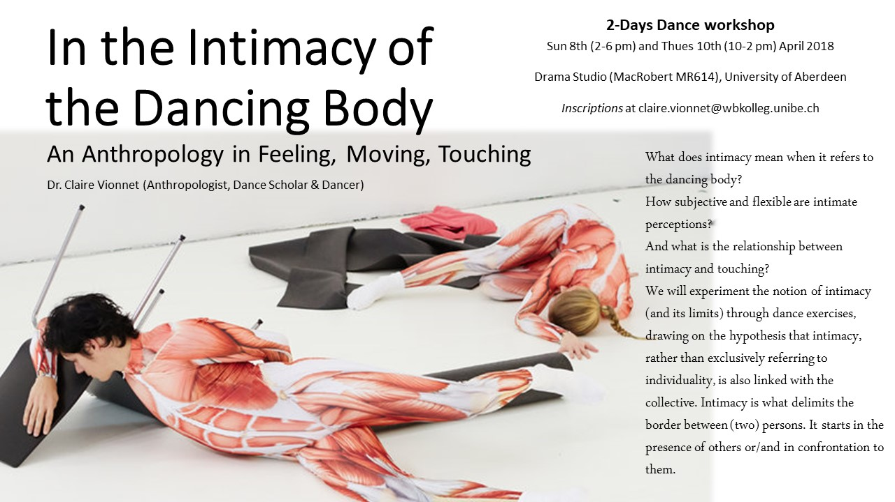

Slide 17
From experience to writing
Lying on the back, eyes closed, I breathe out. Palms toward the sky, arms are resting along the body. Muscles are released. I breathe in - retain my breath a few seconds - and breathe out. My body sinks into the floor. It is fresh. It cools my body still hot after this warm summer day. I feel points of connection with the floor: sit-bones, lumbar vertebra, neck, right heel. I open the mouth, chew, suck my gums, rub my cheeks making small circles with my fingers. I release the muscles of my face. I remember the discussion with Diane this morning. Her constant bodily pains. I breathe in.
Notes:
(Clarke & Vionnet, 2017)
Every morning, it is a fight to wake up her body. Circling my arms in an arc across my pubis, I stretch out my right arm to the left side. After fifty years of dancing, she has to relax what she sometimes calls a “carcass”. I breathe out. She tells me that it is better to dance, movement helps her forgetting the pain. I feel a twist in my chest. I move my right leg in the opposite direction. I stretch out my fingers and toes until the opposite ends. I breathe in - hold- release. My breath has slown down.
My methodology will focus on “research-creation”, a methodology developed by Manning in her Senselab, a laboratory for thought in motion at Concordia University in Montreal, Canada. Manning describes Senselab as “an international network of artists and academics, writers and makers, from a wide diversity of fields, working together at the crossroads of philosophy, art, and activism. Their aim is to experiment with creative techniques for thought in the act”. “Research-creation” is used to rethink theory and practice beyond dualism, with the idea that philosophy is a creative practice “thinking by doing, always with the understanding that concepts are made in and through the event”. H http://senselab.ca/wp2/
Idem.

Slide 18
Research question
♣ Central hypothesis: Intimacy lays at the frontier between individual and collective
♣ General objective: to understand the different versions of intimacy through/in contemporary dance
Notes:
Main interest: phenomenon of intimacy. Experience of the limit of the intimate sphere. How is it flexible? How does it evoluate in time? Relying on my own experience: what changed in 8 years?
Notion of Boundary % choreographer Dupuy, p. 18: «Transiter, errer, vagabonder aux confins, croiser aux frontières? On objectera que l’on peut considérer une frontière comme une barrière, comme une fermeture. Mais, à l’opposé, on peut envisager comme ligne de contact entre deux zones mitoyennes, parsemées de postes frontières, où les barrières peuvent se lever pour peu que l’on y montre patte blanche»
18: La peau comme « propotype de la frontière » « Pour les uns, une enveloppe (pour certains, même, une carapace, une cuirasse) à l’intérieur de laquelle tout se joue (…) Pour d’autres, bien au contraire, un lieu d’échanges, un agent de liaison ; en tant qu’émonctoire, d’abord, mais aussi comme un organe d’absorbsion » la peau comme « frontière aérienne » car le corps est fait d’air)

Slide 19
Objectives
♣ To establish the current state of research on intimacy
♣ To clarify the notions used to describe the intimate body
♣ To develop a methodology permitting to reach the core of the intimate dancing body
♣ To shed light on the concept of intimacy
Notes:
1. intimacy. To study a relevant corpus of texts on intimacy
2. Body. and their articulation
3. Intimacy and body. in anthropology, dance studies and contemporary philosophy

Slide 20
Tracing the Intimate
This session addresses methodological questions on studying intimacies. We define the intimate as a set of sensory experiences unfolding invisibly in the individual that is intrinsically social (…)
In this session, we are interested to discuss different experiences of the intimate – from interpersonal relationships, to intimacy through touch, or situations that seem to violate the intimate, when ‘the other’ (things, people, experiences) gets too close, too proximate. We are also keen to explore methodological questions: how do we access intimate experience of others? Are words capable to give account of expression of feelings, pain or hope? Or does tracing intimacy call for other approaches? What kind of tools/methods can we develop to reach the core of intimate issues experienced by the people we encounter? And then, how do we translate these experiences into written texts?
We are looking for innovative/creative contributions responding to these questions.
Notes:
Abstract VANDA with Dr. Julia Rehman
Following Jean-Luc Nancy (1996), who considers intimate closely linked to proximate, we want to explore the interdependency and synergy of the individual intimate body with others. Proximate refers to closeness, to a limited distance – physical, emotional, spatial, and temporal – between bodies and experiences. We understand the intimate to only emerge in the presence of others and/or in confrontation with them, and argue that rather than a solipsist concept, intimacy starts at the edge of community, when individuals face each other. Thus, intimacy has to be conceptualized and analysed in its social and cultural embeddedness, in its relatedness to others. Moreover, shaped by social habits and encounters, intimate experiences have the potential to be transformative phenomena, extending or shrinking the flexible ‘limits’ of what we consider to demarcate as ‘the intimate’.

Slide 21
Questions
Ethic commission?
Notes:
Ethic questions

