Slide 1
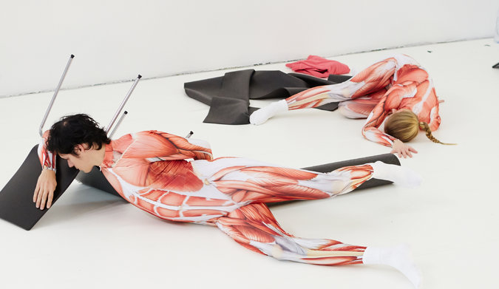
In the Intimacy of the Dancing Body
2-Days Dance workshop
Sun 8th (2-6 pm) and Thues 10th (10-2 pm) April 2018
Drama Studio (MacRobert MR614), University of Aberdeen
Inscriptions at claire.vionnet@wbkolleg.unibe.ch
An Anthropology in Feeling, Moving, Touching
Dr. Claire Vionnet (Anthropologist, Dance Scholar & Dancer)
What does intimacy mean when it refers to the dancing body?
How subjective and flexible are intimate perceptions?
And what is the relationship between intimacy and touching?
We will experiment the notion of intimacy (and its limits) through dance exercises, drawing on the hypothesis that intimacy, rather than exclusively referring to individuality, is also linked with the collective. Intimacy is what delimits the border between (two) persons. It starts in the presence of others or/and in confrontation to them.
Notes:
Research on intimacy of the dancing body drawing on a fieldwotk on contemporary dance as practice.
The theoretical framework is interdisciplinar, articulating anthropology, dance studies and contemporary philosophy
SNF early postdoc mobility project that should open to a biger Habilitation’s research.
______________________
Contemporary dance as practice (plutôt que technique. Cf Lampert & Diehl). Hybride bodies (formé de plusieurs skills)
Foster dit que dans les années 1990, les corps des d sont devenus hybrides pr s’adapter au marché de l’emploi. Ils ne correspondent pas à un seul style de chorégraphe mais savent s’adapter à ce qui leur est demandé, multipliant les méthodes. Foster critique ceci en disant que les corps perdent spécificité.
Julia Wehren écrit que dans les années 2000, ceci n’est plus perçu comme un manque, défaut mais comme une force. Ce sont des corps qui ont gagné qqch. % Foster, corps hybrides est nég alors que chez Julia, hybridité est positive car perçue comme compétence.

