Slide 1
Neuroanatomy of Intergenerational Sustainable Behavior
Emmanuel Guizar Rosales, M.Sc. Dept. of Social Neuroscience and Social Psychology University of Bern, Switzerland
ESCAN 2022-07-20
Notes:
Hi everyone! My name is Emmanuel Guizar, I am a PhD student in the Department of Social Neuroscience and Social Psychology of the University of Bern, and I feel honored to welcome you to my presentation. I will talk about a recent study in which my collaborators Thomas Baumgartner, Daria Knoch and I investigated the neuroanatomical underpinnings of intergenerational sustainability.
I’d like to start my presentation by revisiting the common use of the term “sustainability”.

Slide 2
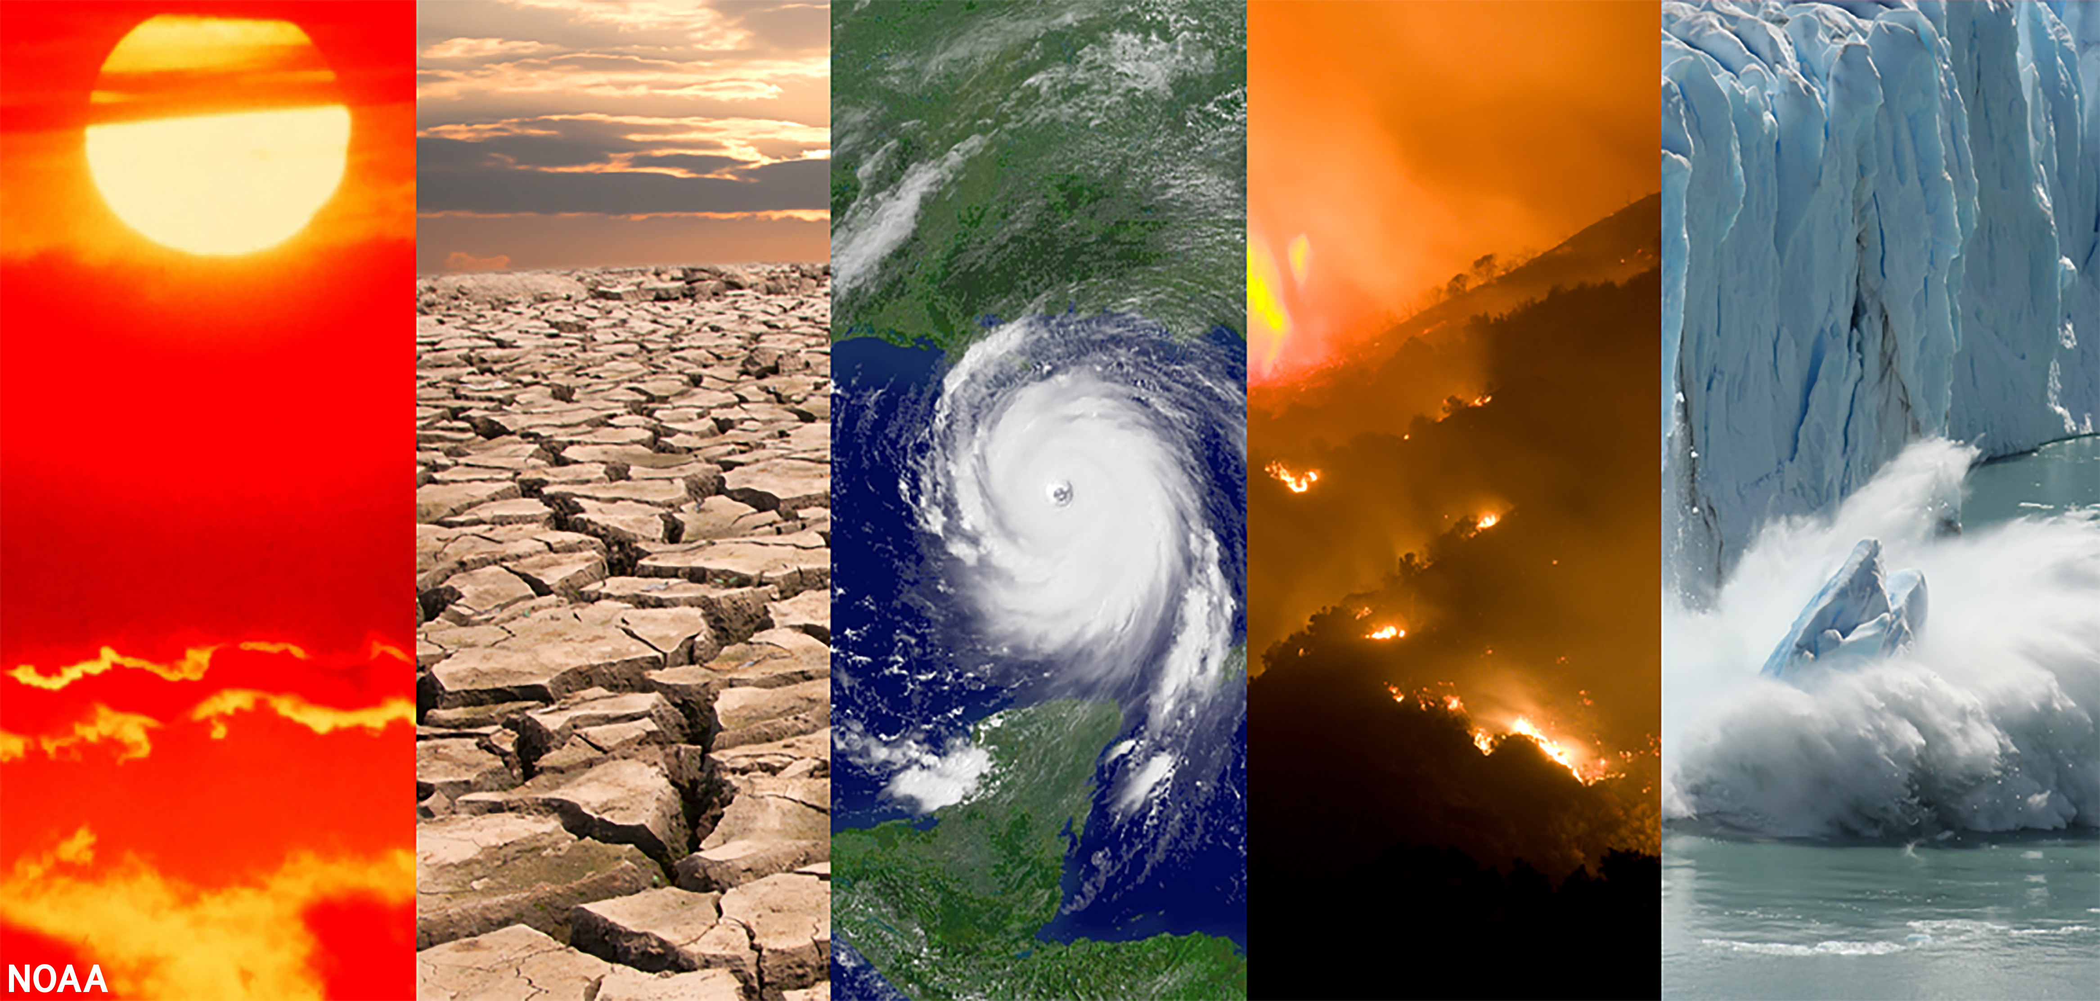
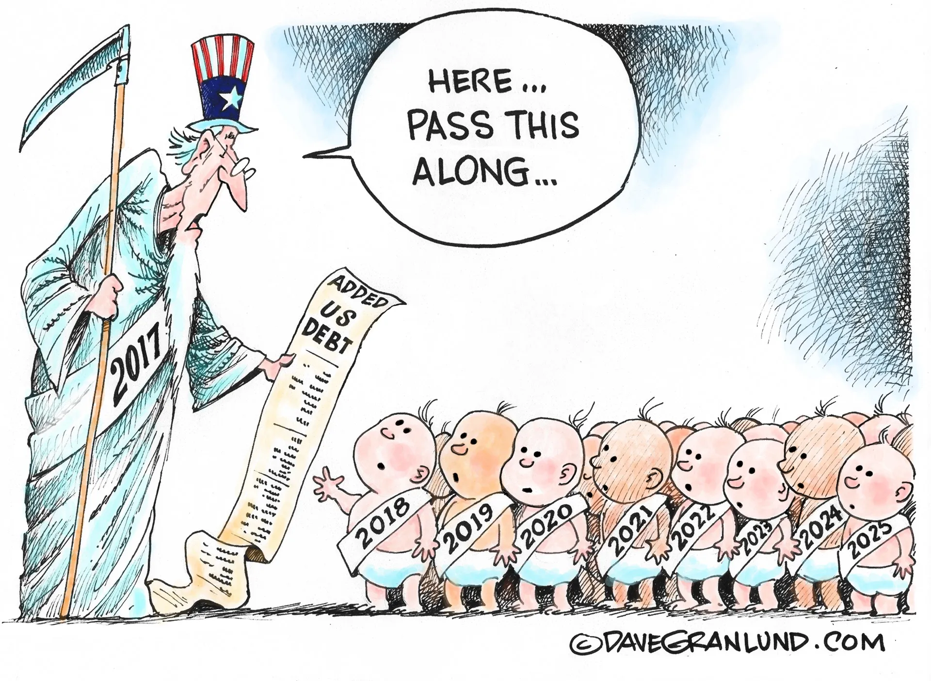
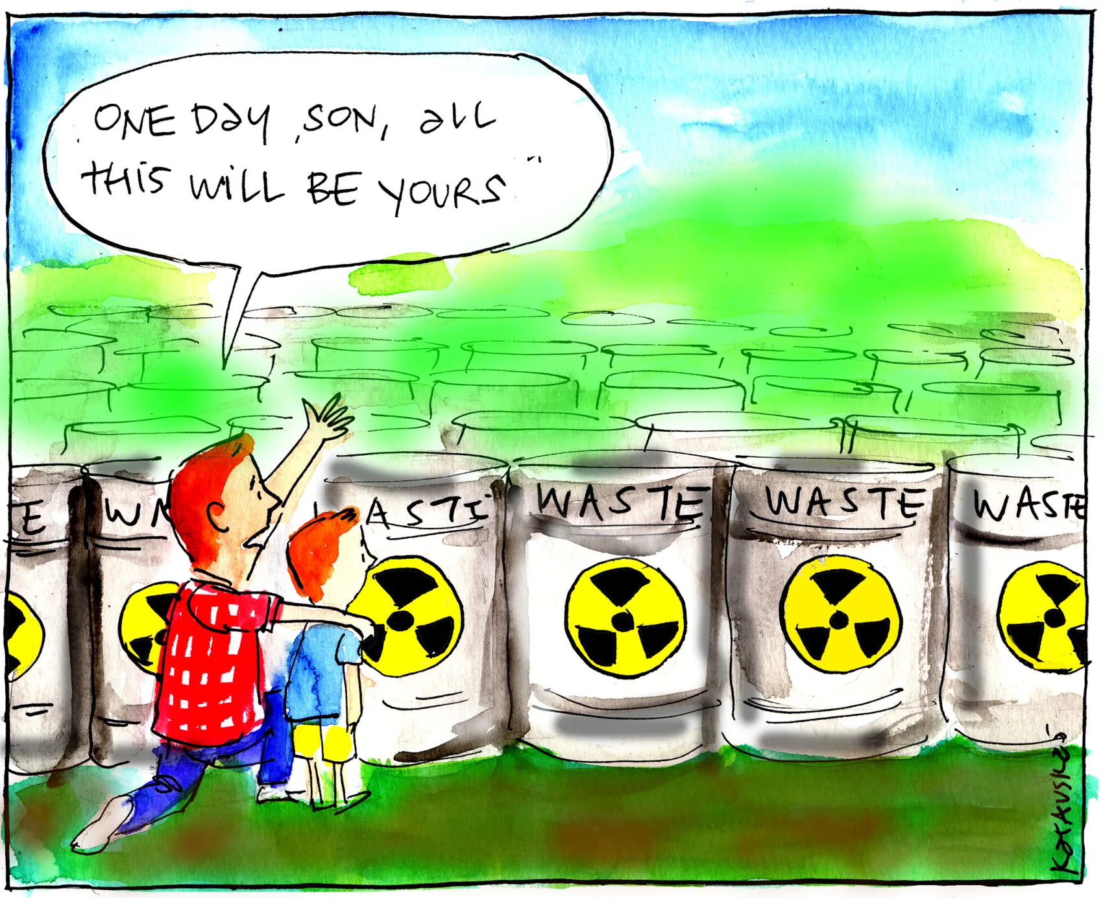
Intergenerational Sustainability
Sustainability: Meeting the needs of the present [generation] without compromising the ability of future generations to meet their own needs.
(United Nations Brundtland Report, 1987)
Climate Change
Public Debt
Nuclear Waste
1
Notes:
The most often quoted definition describes sustainability as “meeting the needs of the present [generation] without compromising the ability of future generations to meet their own needs.” To highlight and focus on this this intergenerational aspect of sustainability, I will speak about intergenerational sustainability from now on.
Climate change is certainly the most paradigmatic and dominant issue discussed in the context of intergenerational sustainability.
However, intergenerational sustainability also extends to other challenges like reducing public debt. To deal with the pandemic, countries worldwide drastically increased public debt, which will be passed on to future generations, deeply harming future generations’ ability to deal with their own crisises.
Another intergenerational sustainability challenge is the disposal of nuclear waste. We of the present generation benefit from nuclear power, which produces nuclear waste that future generations will need to deal with.

Slide 3
Intergenerational Sustainability
Intergenerational Sustainability Dilemmas
We of the present generation must make sacrifices now
that will mainly provide
others of next generations with benefits in the future.
2
Notes:
The reason why it is so difficult to deal with global challenges like climate change and public debt is that these challenges essentially represent intergenerational sustainability dilemmas.
In these situations, the present generation needs to decide between maximizing or sacrificing their own benefits, which will harm or benefit future generations.
There are mainly two dimensions of psychological distance that render these dilemmas so difficult.

Slide 4
Intergenerational Sustainability
Intergenerational Sustainability Dilemmas
We of the present generation must make sacrifices now
that will mainly provide
others of next generations with benefits in the future.
Social Distance
(we vs. others)
single-generation
intergroup situations
2
Notes:
For one thing, we have to overcome the social distance between us of the present generation and others of future generations.
Difficulties to overcome social distance are also known from single-generation intergroup situations. In these situations, people are prone to intergroup bias. They tend to favor ingroups at the expense of outgroups.

Slide 5
Intergenerational Sustainability
Intergenerational Sustainability Dilemmas
We of the present generation must make sacrifices now
that will mainly provide
others of next generations with benefits in the future.
Social Distance
(we vs. others)
Temporal Distance
(now vs. future)
single-generation
intergroup situations
single-generation intertemporal choice
2
Notes:
For another thing, we have to overcome the temporal distance between actions now and their consequences that will manifest in the future.
Difficulties to overcome temporal distance are also known from single-generation intertemporal choice. In these choices, people are prone to temporal discounting. They have a hard time being patient and choosing delayed over immediate rewards for themselves.

Slide 6
Intergenerational Sustainability
Intergenerational Sustainability Dilemmas
We of the present generation must make sacrifices now
that will mainly provide
others of next generations with benefits in the future.
Social Distance
(we vs. others)
Temporal Distance
(now vs. future)
single-generation
intergroup situations
single-generation intertemporal choice
Individual Differences
2
Notes:
In intergenerational sustainability dilemmas, these two dimensions of psychological distance uniquely combine and interact, which makes these dilemmas distinctively more complex than single-generation intergroup situations or intertemporal choice decisions.
Given this complex psychological structure, it does not surprise that there are great individual differences in intergenerational sustainability. And the sources of these differences are not well understood yet.

Slide 7
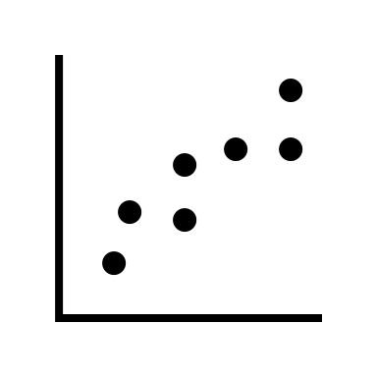
Neural Trait Approach
(Nash et al., Front. Behav. Neurosci., 2015)
Cortical thickness can serve as an objective trait-like marker (neural trait):
Relatively stable over time (Gregory et al., J. Magn. Reson. Imaging, 2020)
Individually specific (Valizadeh et al., Sci. Rep., 2018)
Relates to individual differences in behaviors (e.g. Baumgartner et al., Neuroimage, 2013; Yamagishi et al., Proc. Nati. Acad. Sci., 2016)
Neural traits are objective brain-based measures free from response biases or demand characteristics.
Neural traits allow for inferences about the mental processes underlying behavioral heterogeneity.
3
Notes:
To fill this research gap, we applied the neural trait approach.
The goal of the neural trait approach is to use neuroscientific measures of dispositional differences to illuminate the sources of variability in behavior.
The approach makes use of the fact that task-independent, brain-based characteristics like cortical thickness can serve as an objective trait-like marker, a so called neural trait, because cortical thickness fulfils the following three requirements.
First, cortical thickness is relatively stable over time in healthy individuals.
Second, it is individually specific, meaning that it is like a neural fingerprint: No two people have exactly the same pattern of cortical thickness across their brains.
And third, cortical thickness relates to individual differences in behaviors.
Importantly, neural traits are objective brain-based measures free from response biases or demand characteristics.
And neural traits allow for neuroscientifically informed inferences about the mental processes underlying behavioral heterogeneity.

Slide 8
Intergenerational Sustainability Paradigm
63 healthy participants (33 females, mean age $±$ SD = 21.8 $±$ 2.8)
Present Generation
Next Generation
Collective threshold = 40
0-20
0-20
7 days
80
0-20
0-20
4
Notes:
We assessed intergenerational sustainable behavior in a well-controlled laboratory setting with real monetary consequences.
After exclusions, we had a total of 63 healthy participants partake in a intergenerational sustainability dilemma game over 16 trials.
In groups of 4, they each could extract points from a common pool of 80 points.
Each participant could exract between 0 and 20 points while each point was exchanged to one Swiss Franc after the experiment.
However, exceeding a collective extraction threshold of 40 points had consequences for either participants’ present generation or the next generation, which consisted of the next 4 participants that would partake in the same game 7 days later.

Slide 9
Intergenerational Sustainability Dilemma
trials affecting the present generation
trials affecting the next generation
individual decisions
consequences for
individual decisions
consequences for
present generation
next generation
present generation
next generation
10
10
10
10
Reduction of each participant’s payoff by 80%
none
No reduction of payoff
Reduction of each participant’s payoff by 80%
20
10
20
10
10
10
10
10
No reduction of payoff
none
No reduction of payoff
No reduction of payoff
10
10
10
10
median extraction $≤$ 10: sustainable
median extraction $>$ 10: unsustainable
5
Notes:
In 8 trials affecting the present generation, exceeding the threshold reduced each participant's payoff by 80%
In 8 trials affecting the next generation, exceeding the threshold reduced each participant's payoff of the next generation by 80%, while payoffs of the present generation remained unaffected.
If the threshold was not exceeded, there were no payoff reductions neither for the present nor the next generation in both types of trials.
In trials affecting the next generation, each participant could extract 10 points on average without reducing the payoff of the next generation. We therefore categorized participants as sustainable if their median extraction in these trials was lower than or equal to 10 points and as unsustainable otherwise.

Slide 10
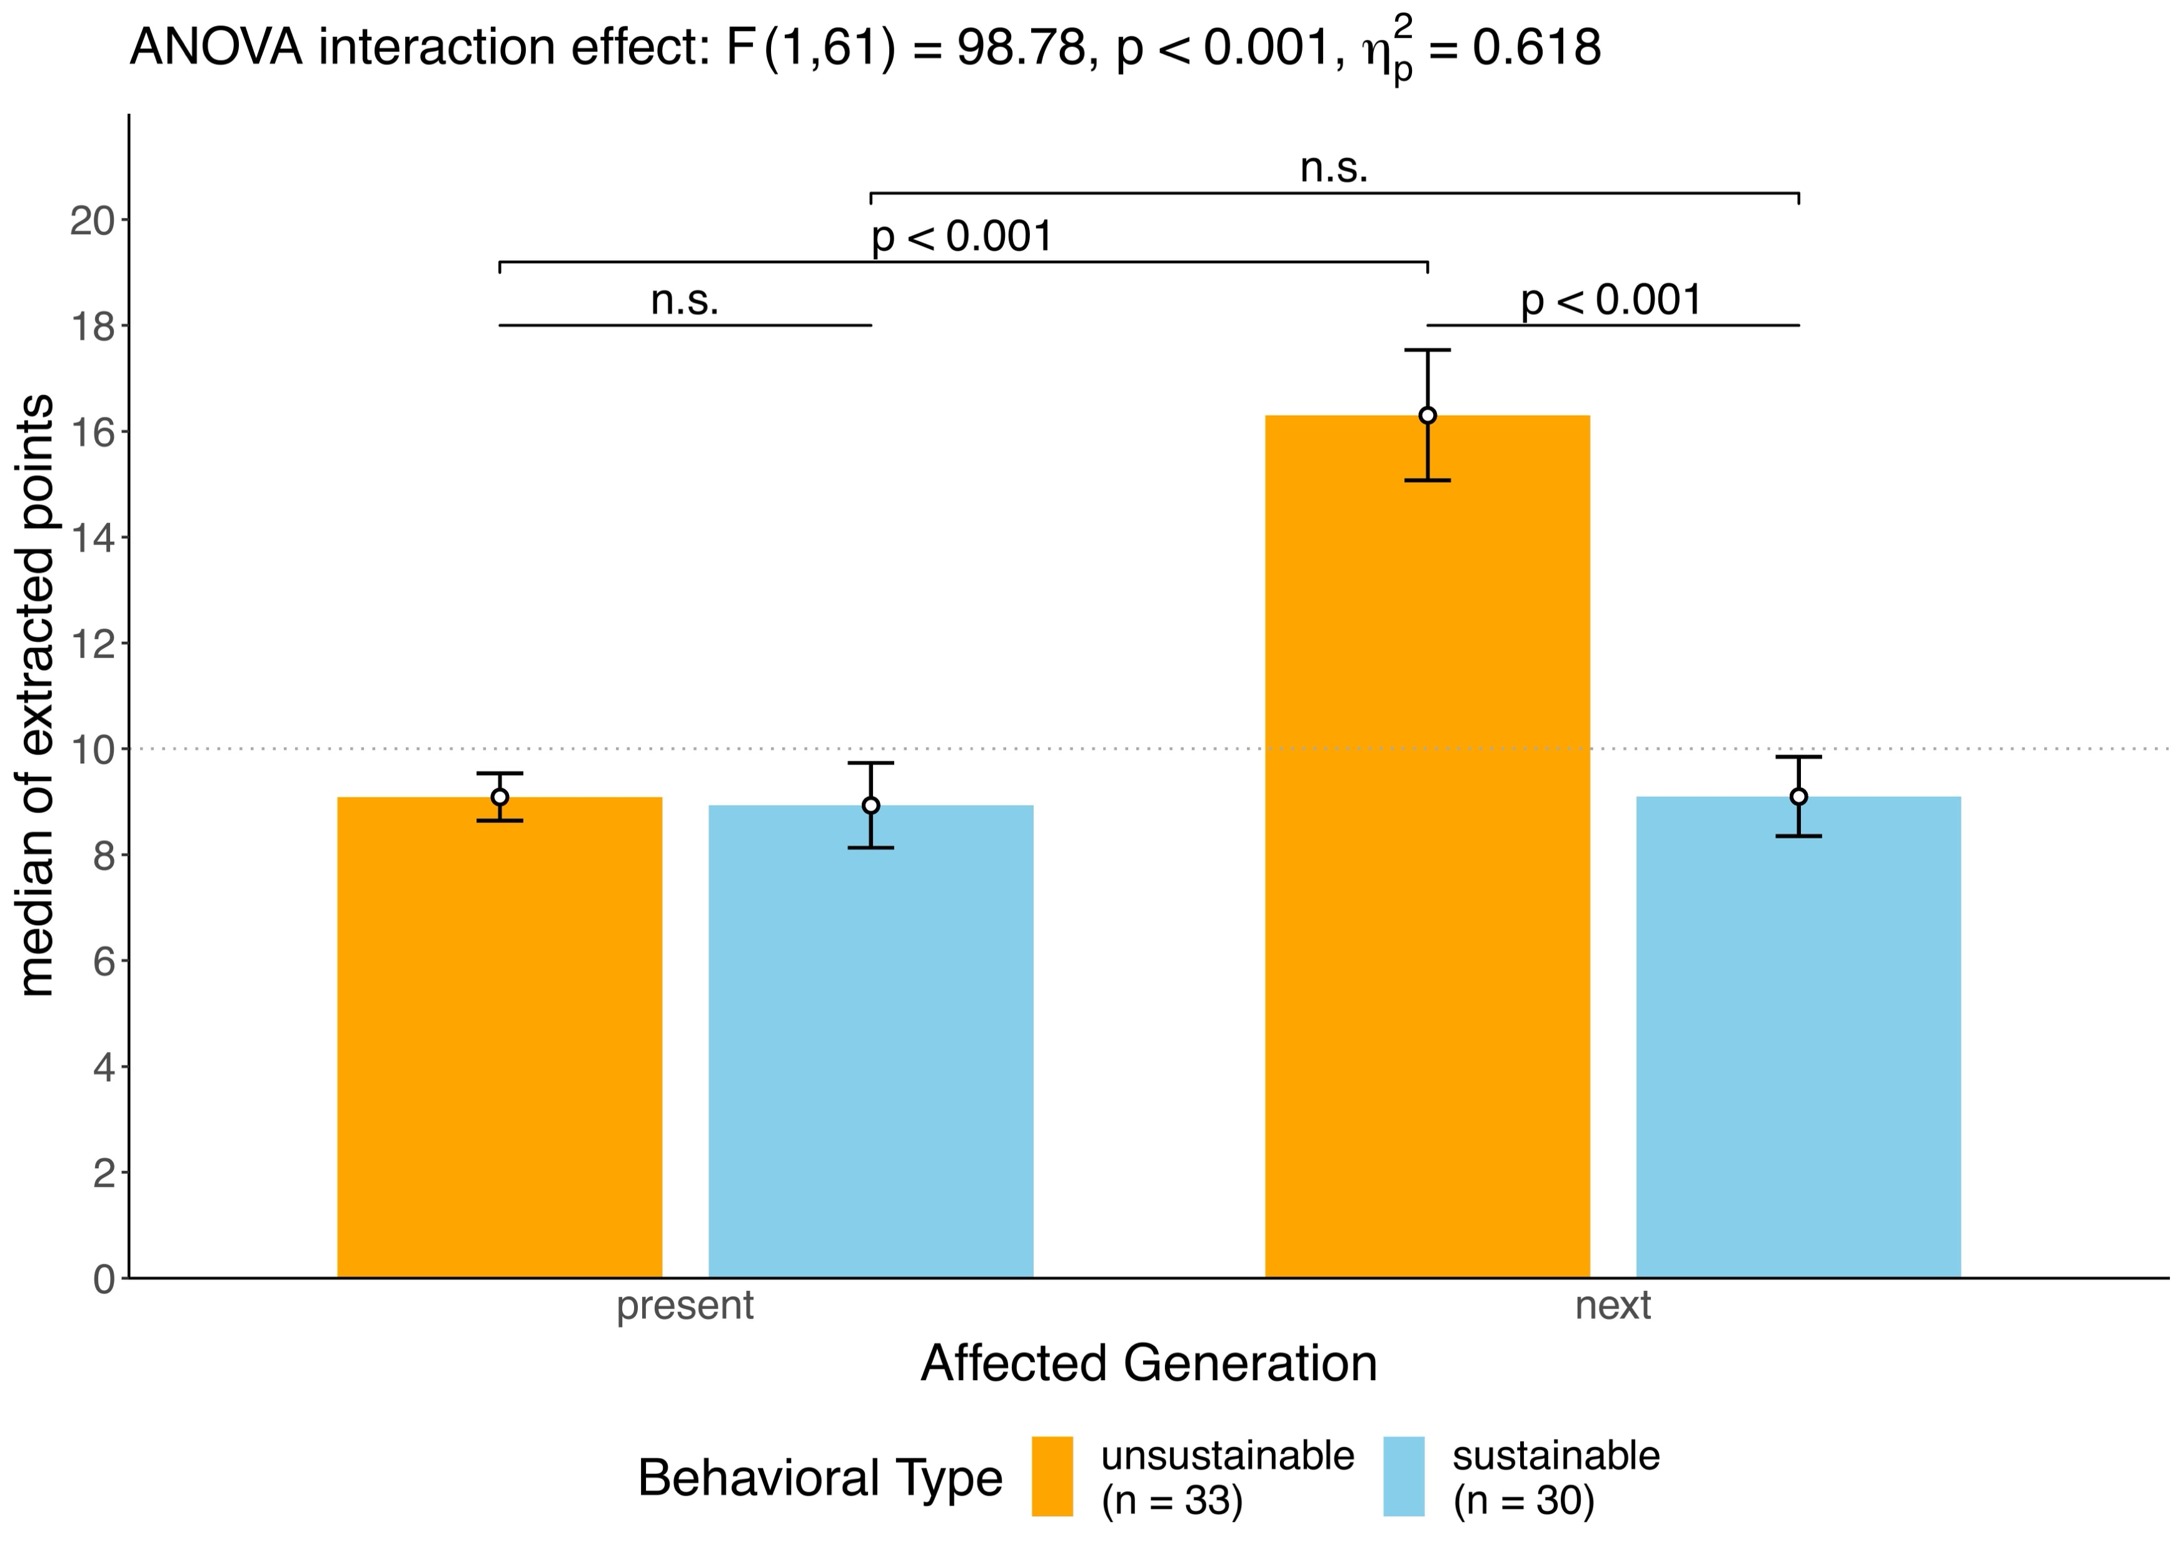
Behavioral Types
6
Notes:
Using this paradigm, we categorized 33 participants as unsustainable and 30 participants as sustainable. As required by our categorization protocol, unsustainable participants extracted considerably more points than sustainable participants in trials affecting the next generation.
However, and not necessarily implied by our categorization protocol, the types did not differ in their extraction behavior in trials affecting the present generation.
We then investigated whether these two types were marked by differences in cortical thickness.

Slide 11
Behavioral Types
6
Notes:
Using this paradigm, we categorized 33 participants as unsustainable and 30 participants as sustainable. As required by our categorization protocol, unsustainable participants extracted considerably more points than sustainable participants in trials affecting the next generation.
However, and not necessarily implied by our categorization protocol, the types did not differ in their extraction behavior in trials affecting the present generation.
We then investigated whether these two types were marked by differences in cortical thickness.

Slide 12
Behavioral Types
6
Notes:
Using this paradigm, we categorized 33 participants as unsustainable and 30 participants as sustainable. As required by our categorization protocol, unsustainable participants extracted considerably more points than sustainable participants in trials affecting the next generation.
However, and not necessarily implied by our categorization protocol, the types did not differ in their extraction behavior in trials affecting the present generation.
We then investigated whether these two types were marked by differences in cortical thickness.

Slide 13
Hypotheses
Intergenerational Sustainability Dilemmas
Perspective-Taking
DMPFC & TPJ
Van Overwalle, Hum. Brain Mapp., 2009
Healey & Grossman, Front. Neurol., 2018
Lamm, Neurosci. Lett., 2019
Self-Control
lateral PFC
Figner et al., Nat. Neurosci., 2010
Peters & Büchel, Trends Cogn. Sci., 2011
Wyss & Knoch, Curr. Opin. Psychol., 2022
Social Distance
(we vs. others)
Temporal Distance
(now vs. future)
DMPFC
lateral PFC
TPJ
7
Notes:
Regarding hypotheses for brain regions where such cortical thickness differences could be expected, we again started from the observation that behaving intergenerationally sustainably requires individuals to overcome the social and temporal distance between the present and future generations. We excpected that mainly two cognitive processes would be involved in intergenerational sustainability.
From single-generation intergroup situations we know that taking the perspective of outgroup members can reduce the social distance between ingroup and outgroup members. On the neural level, perspective-taking is mainly supported by the DMPFC and TPJ.
From single-generation social dilemmas and intertemporal choice tasks, we know that it requires self-control to resist temptations to benefit us vs. others or temptations to receive benefits now vs. in the futur. On the neural level, self-control is mainly supported by the lateral PFC.
Therefore, we hypothesized that sustainable and unsustainable participants would be marked by cortical thickness differences in these brain regions. In addtion to whole-brain analyses, we therefore used this mask for small-surface corrections in the following cortical thickness analyses.
In case someone asks about the creation of the small-surface mask:
DMPFC & TPJ: meta-analysis on on social cognition (Van Overwalle, Hum. Brain. Mapp., 2009). 20mm spheres around peaks in the left TPJ (x = ‑49, y = ‑58, z = 22), the right TPJ (x = 53, y = ‑54, z = 22), and the DMPFC (x = -3, y = 48, z = 30). We mapped these volumes to the 32k surface mesh as implemented in the surface tools in CAT.
Lateral PFC: For the lateral PFC, we used the Desikan-Killiany surface atlas as provided in CAT. We combined the rostral and caudal parcellations of the MFG, and the pars orbitalis and triangularis of the IFG.

Slide 14
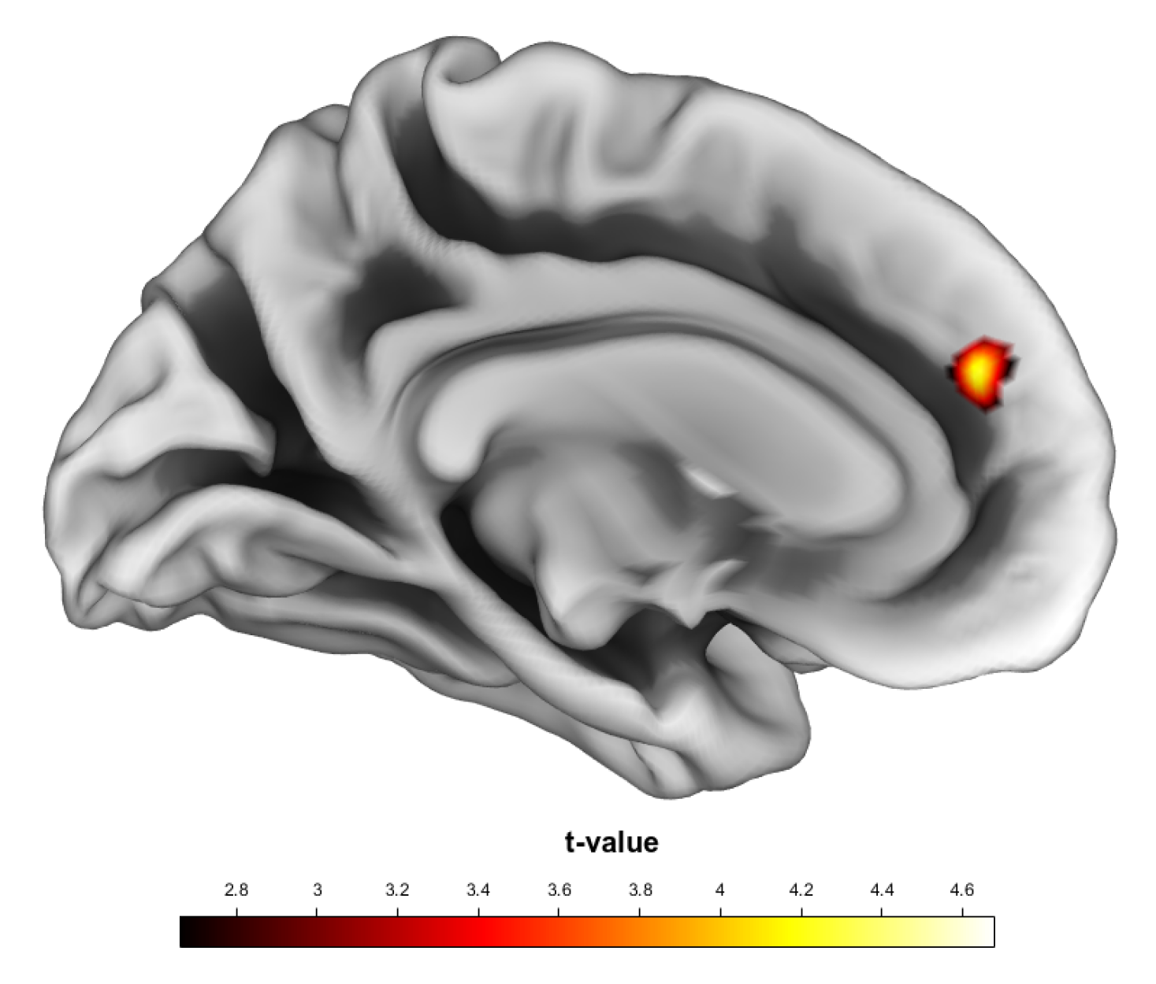
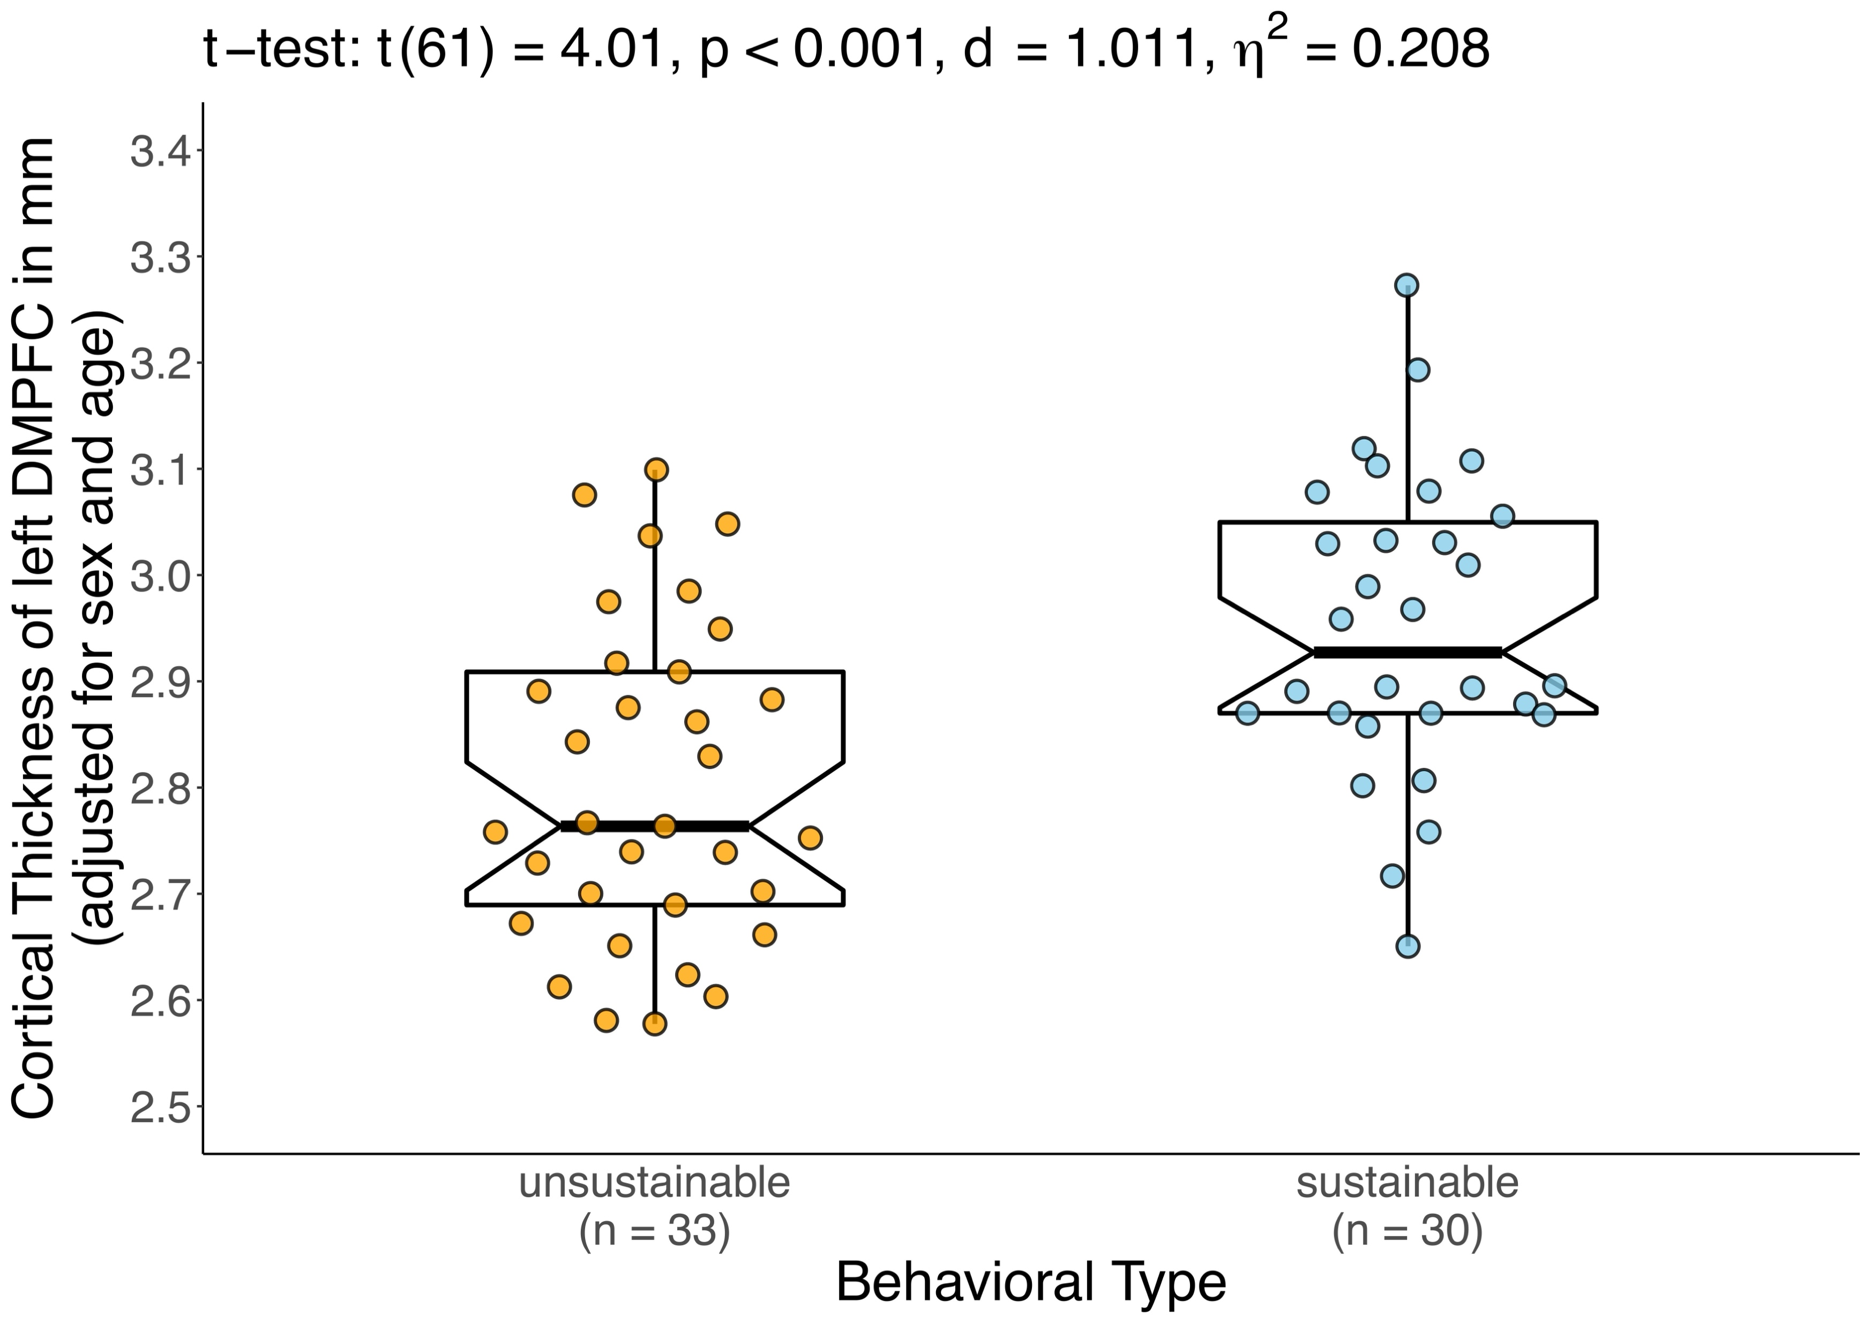
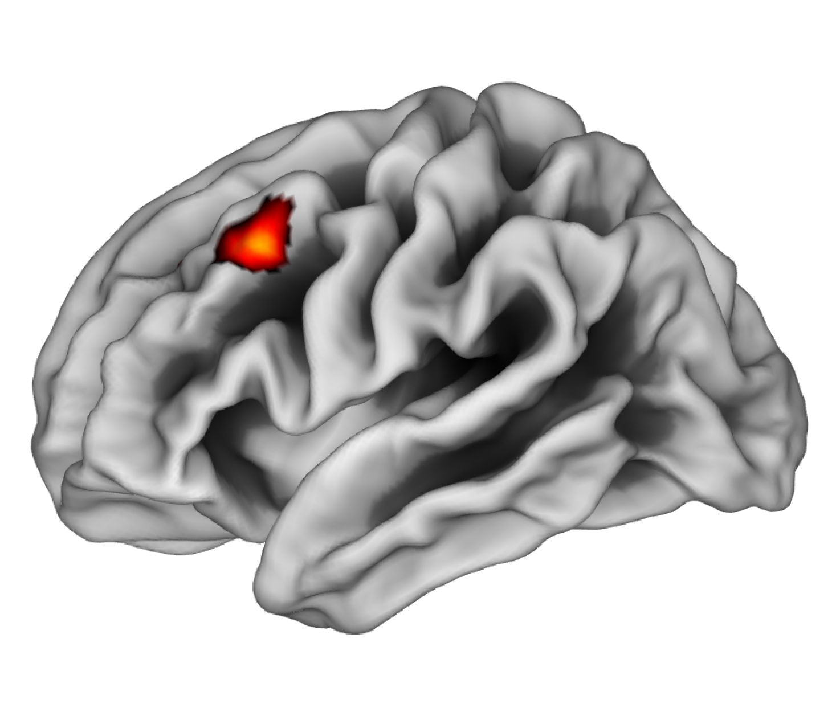
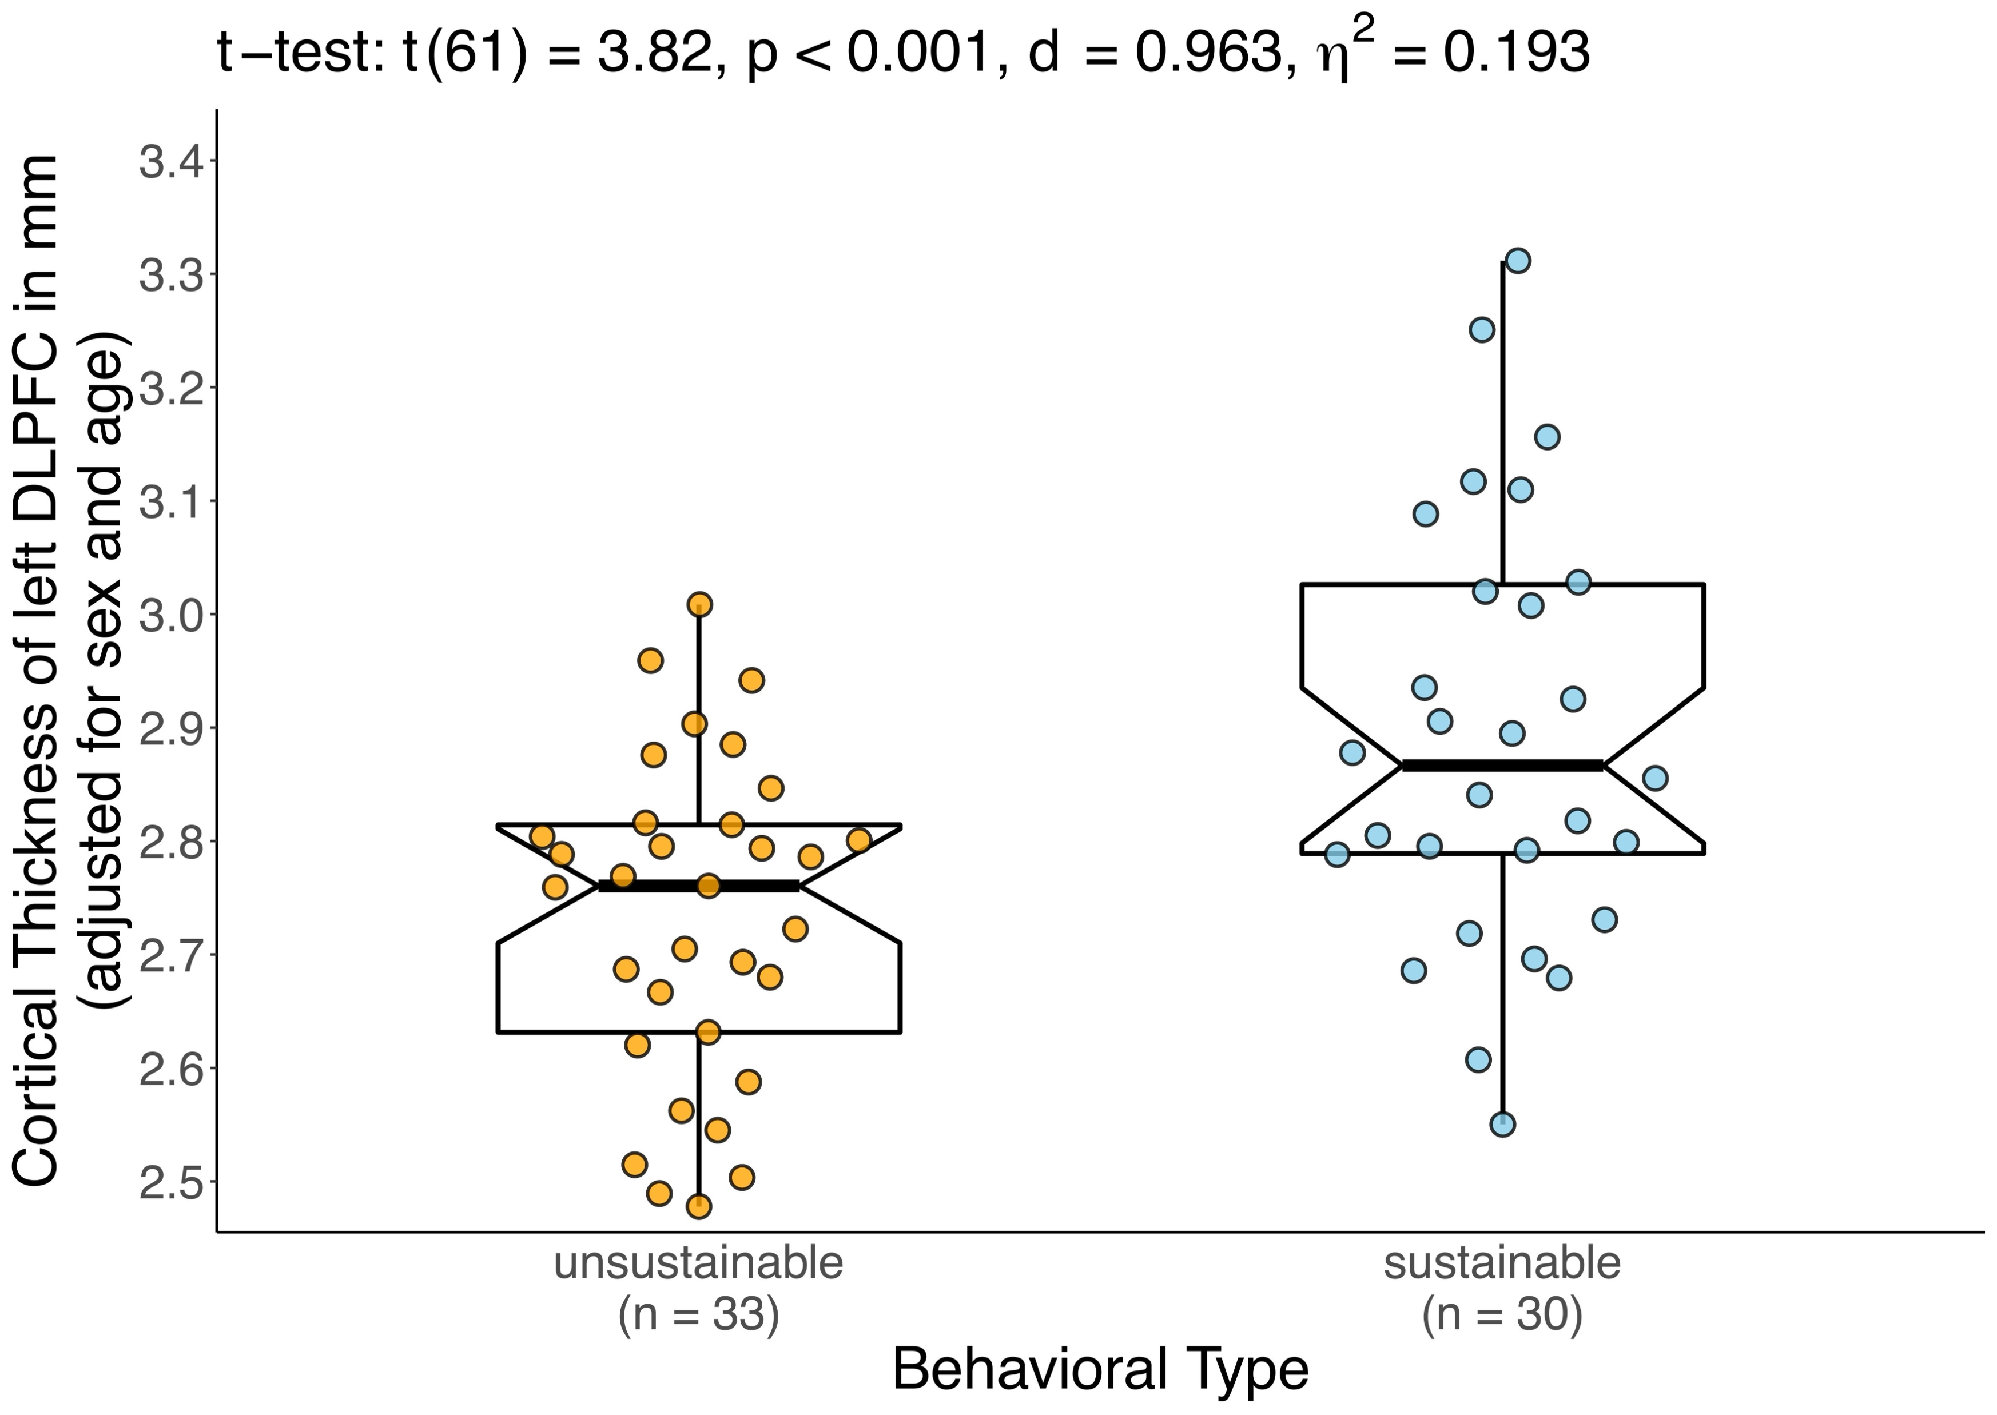
Cortical Thickness Differences
DMPFC (BA 9)
p < 0.05, small-surface FWE peak-corrected
depicted at p_{uncor.} < 0.005
DLPFC (BA 8)
p < 0.05, small-surface FWE cluster-corrected
depicted at p_{uncor.} < 0.005
8
Notes:
(We conducted surface-based morphometric analyses to test whether sustainable and unsustainable particpants were marked by differences in cortical thickness. We considered results significant if they survived whole-brain or small-surface FWE correction on peak- or cluster-level, and we used a cluster-defining threshold of p < 0.001.)
We found that the behavioral types differed in cortical thickness of two brain regions: the left DMPFC and the left DLPFC.
In both regions, sustainable participants were marked by greater cortical thickness compared to unsustainable participants.

Slide 15
Mediation via Perspective-Taking
In trials affecting the next generation, putting myself in the shoes of members of the next generation affected my decision.
Differential Engagement in Perspective-Taking (Next Generation – Present Generation)
Behavioral Type 0 = unsustainable: ● (n = 33) 1 = sustainable: ● (n = 30)
$$c=6.766 \\ p<0.001$$
9
Notes:
Based on our hypotheses, we then tested whether the effect of cortical thickness of the DMPFC on sustainability was in fact due to perspective-taking processes.
To this end, participants rated their agreement to two statements.
We then took the difference between perspective-taking with the next minus the present generation.
In this difference score, which we called differential engagement in perspective-taking, higher positive values indicated more next generation oriented perspective-taking.

Slide 16
Mediation via Perspective-Taking
In trials affecting the next generation, putting myself in the shoes of members of the present generation affected my decision.
Differential Engagement in Perspective-Taking (Next Generation – Present Generation)
Behavioral Type 0 = unsustainable: ● (n = 33) 1 = sustainable: ● (n = 30)
$$c=6.766 \\ p<0.001$$
9
Notes:
Based on our hypotheses, we then tested whether the effect of cortical thickness of the DMPFC on sustainability was in fact due to perspective-taking processes.
To this end, participants rated their agreement to two statements.
We then took the difference between perspective-taking with the next minus the present generation.
In this difference score, which we called differential engagement in perspective-taking, higher positive values indicated more next generation oriented perspective-taking.

Slide 17
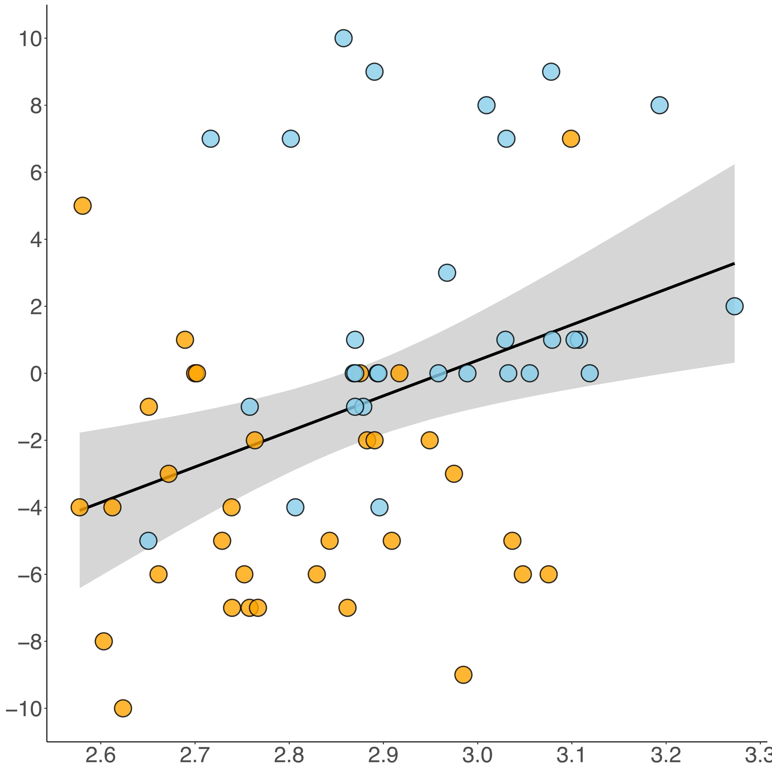
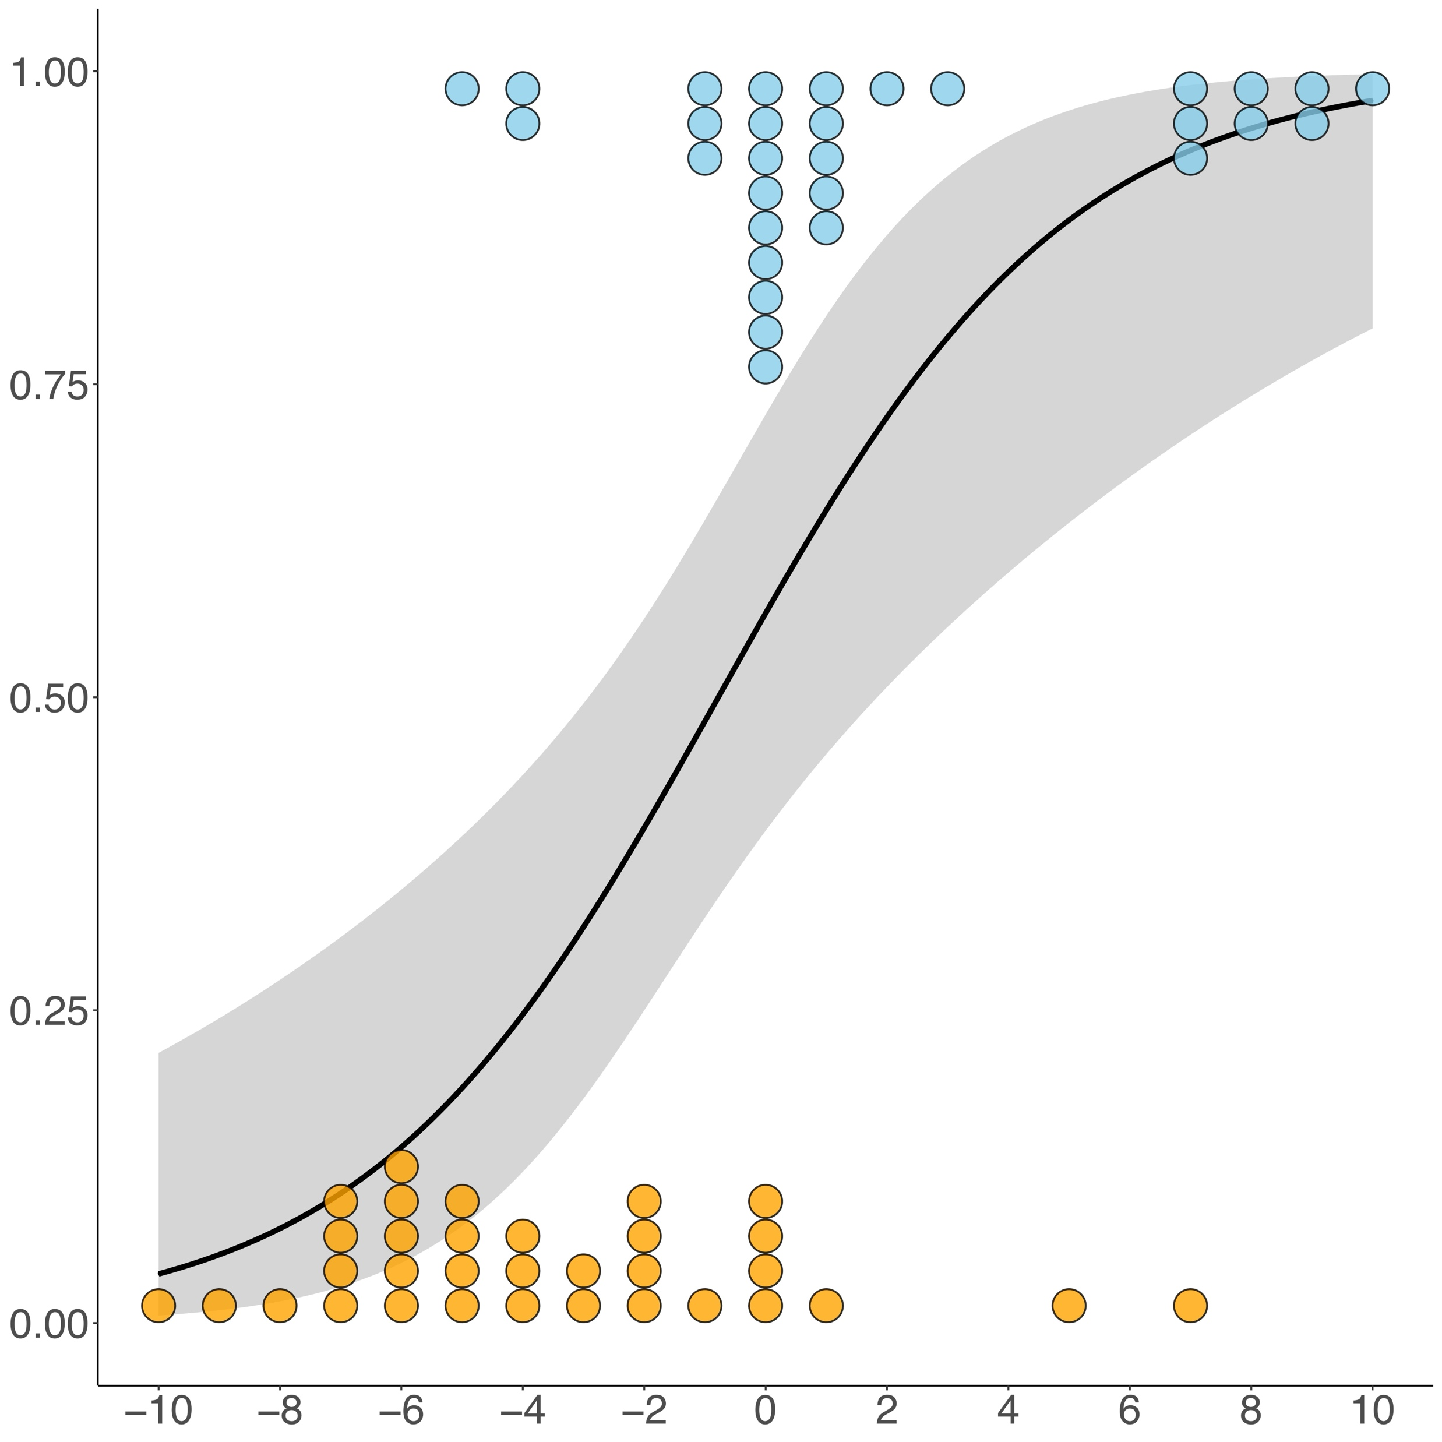
Mediation via Perspective-Taking
$$r_{Pearson}=0.361, p=0.004$$
$${∆R}_{Tjur}^{2}=0.251, p=0.001$$
$$ab=3.68 [1.229;10.273]$$
$$∆Engagement in Perspective−Taking$$
Differential Engagement in Perspective-Taking (Next Generation – Present Generation)
$$Probability of Behavioral Type=sus.$$
$$Cortical Thickness of DMPFC$$
$$∆Engagement in Perspective−Taking$$
$$a=10.607 \\ p=00.004$$
$$b=0.347 \\ p<0.001$$
$$c^{′}=5.835 \\ p′=0.018$$
Behavioral Type 0 = unsustainable: ● (n = 33) 1 = sustainable: ● (n = 30)
$$c=6.766 \\ p<0.001$$
9
Notes:
We indeed found that increased cortical thickness of the DMPFC was associated with more next generation oriented perspective-taking, …
… which in turn increased the probability of being a sustainable participant.
Importantly, the indirect effect was significant, indicating that perspective-taking processes mediated the effect of cortical thickness of DMPFC on intergenerational sustainability.
We therefore provided evidence thtat greater cortical thickness of DMPFC reflects a greater capacity to take the perspective of future generations, which in turn motivates intergenerational sustainability.

Slide 18
Mediation via Self-Control
In trials affecting the next generation, I tried to resist the temptation to extract more than 10 points.
Differential Effort to Resist Temptation (Next Generation – Present Generation)
Behavioral Type 0 = unsustainable: ● (n = 33) 1 = sustainable: ● (n = 30)
$$c=6.172 \\ p=0.002$$
10
Notes:
Based on our hypotheses, we tested whether the effect of cortical thickness of the DLPFC on sustainability was in fact due to self-control processes needed to resist temptations.
To this end, participants again rated their agreement to two statements.
We then took the difference between temptation resistance efforts in next minus present generation affecting trials.
In this difference score, higher positive values indicated more next generation oriented efforts to resist temptations and hence more next generation oriented engagement in self-control.

Slide 19
Mediation via Self-Control
In trials affecting the present generation, I tried to resist the temptation to extract more than 10 points.
Differential Effort to Resist Temptation (Next Generation – Present Generation)
Behavioral Type 0 = unsustainable: ● (n = 33) 1 = sustainable: ● (n = 30)
$$c=6.172 \\ p=0.002$$
10
Notes:
The DLPFC is known to be involved in self-control and we excpected self-control to play a role in individual differences in intergenerational sustainablity.
Based on our hypotheses, we tested whether the effect of cortical thickness of the DLPFC on sustainability was in fact due to self-control processes needed to resist temptations.
To this end, participants again rated their agreement to two statements.
We then took the difference between temptation resistance efforts in next minus present generation affecting trials.
In this difference score, higher positive values indicated more next generation oriented efforts to resist temptations and hence more next generation oriented engagement in self-control.

Slide 20
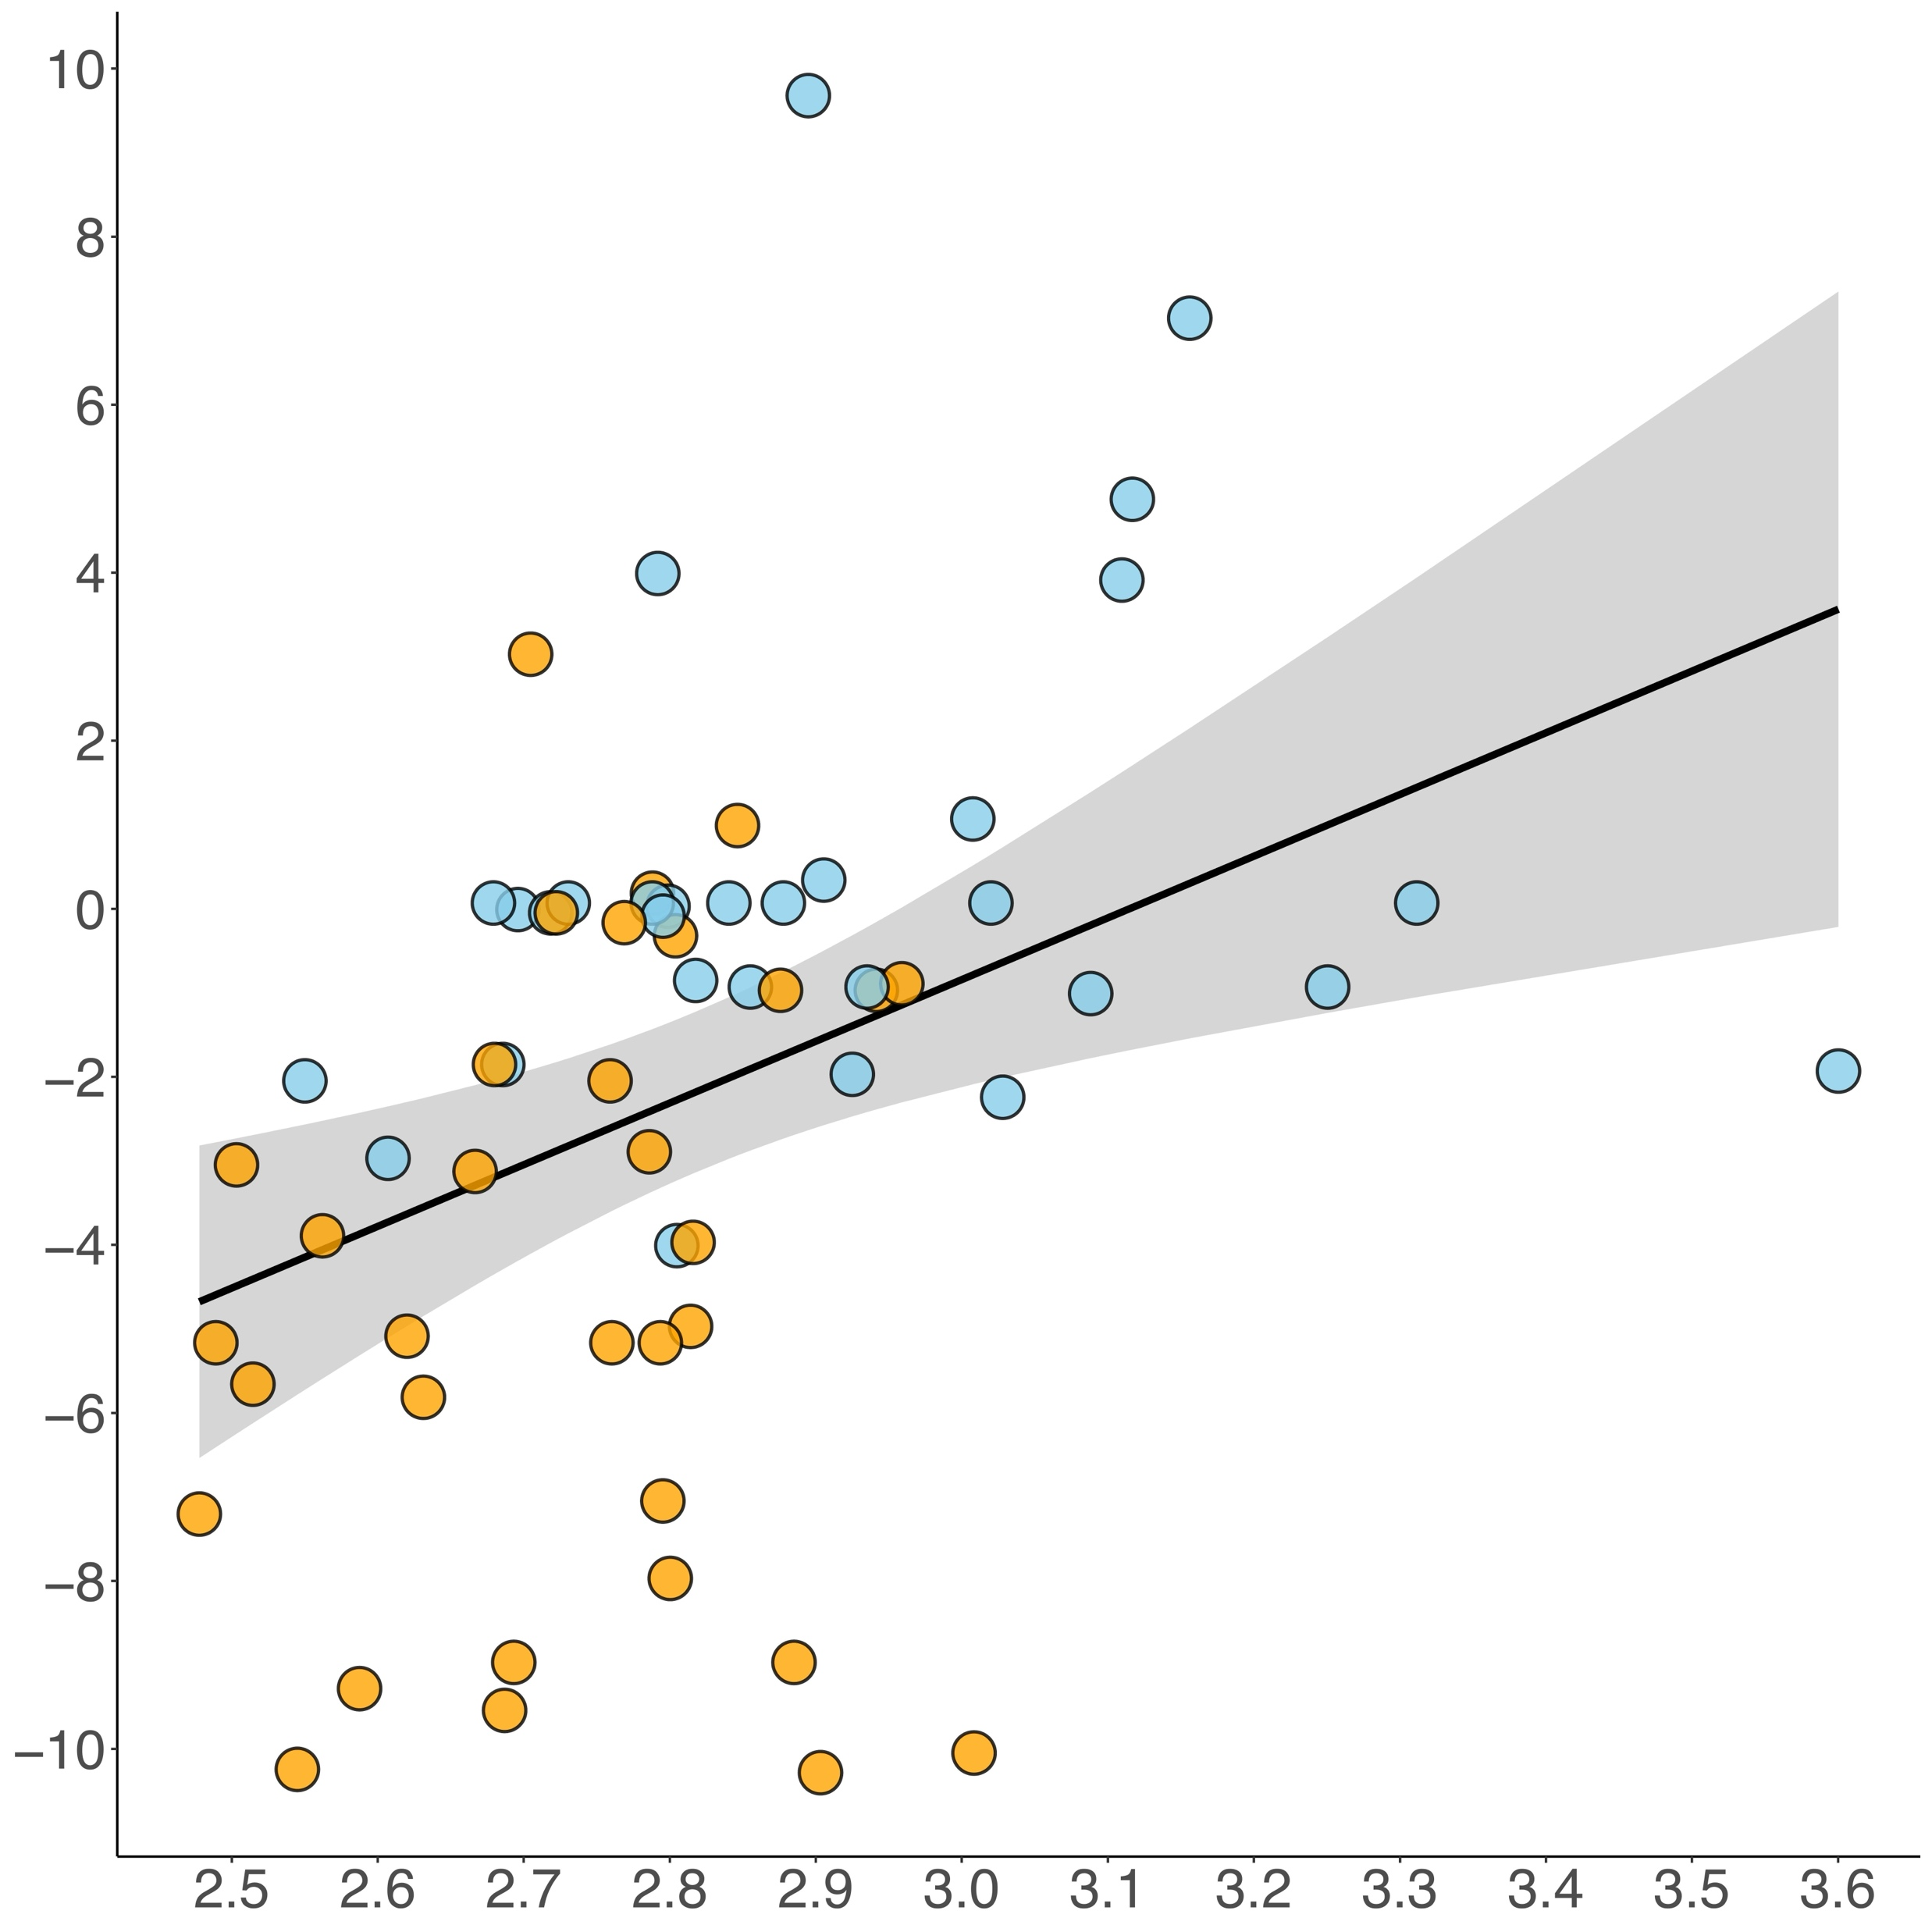
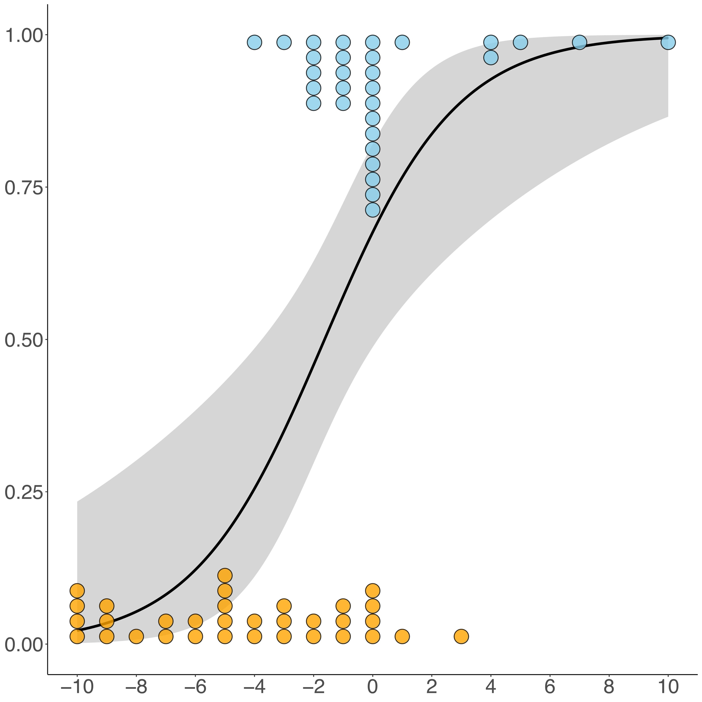
Mediation via Self-Control
$$r_{Pearson}=0.363, p=0.003$$
$${∆R}_{Tjur}^{2}=0.221, p=0.002$$
$$ab=3.32 [1.131;9.697]$$
$$∆Effort to Resist Temptation$$
Differential Effort to Resist Temptation (Next Generation – Present Generation)
$$Probability of Behavioral Type=sus.$$
$$Cortical Thickness of DLPFC$$
$$∆Effort to Resist Temptation$$
$$a=7.344 \\ p=0.003$$
$$b=0.451 \\ p=0.002$$
$$c^{′}=4.017 \\ p′=0.085$$
Behavioral Type 0 = unsustainable: ● (n = 33) 1 = sustainable: ● (n = 30)
$$c=6.172 \\ p=0.002$$
10
Notes:
We indeed found that increased cortical thickness of the left DLPFC was associated with more next generation oriented efforts to resist temptations, …
… which in turn increased the probability of being a sustainable participant.
Importantly, the indirect effect was significant, indicating that self-control processes mediated the effect of cortical thickness of DLPFC on intergenerational sustainability.
We therefore provided evidence thtat greater cortical thickness of the DLPFC reflects a greater capacity to engage in self-control, which in turn enables individuals to resist egoistic or short-sighted temptations, thereby promoting intergenerational sustainability.

Slide 21
Conclusion
Cortical thickness of DMPFC and DLPFC was associated with individual differences in intergenerational sustainability: sustainable > unsustainable
Brain structure affected intergenerational sustainability via perspective-taking and self-control processes.
HD-tDCS anodal stimulation of TPJ increases sustainable decision-making. (Langenbach et al., Cortex, 2022)
Higher rs-EEG baseline activity in the lateral PFC predicts more frequent everyday pro-environmental behavior in a single-generation context. (Baumgartner et al., Sci. Rep., 2019)
Potential prospect: Brain structure is plastic and can be modulated by experience and training! (e.g. Valk et al., Sci. Adv., 2017)
11
Notes:
We found that cortical thickness of the DMPFC and DLPFC are associated with individual differences in intergenerational sustainability. Sustainable individuals are marked by greater cortical thickness of these brain areas compared to unsustainable individuals.
Additionally, brain structure affected intergenerational sustainability by influencing perspective-taking and self-control processes.
These findings resonate well with two other recent studies of our group.
First, we found that HD-tDCS anodal stimulation of the TPJ increased sustainable decision-making in a paradigm similar to the one used here. Since the TPJ is another core node of the mentalizing network and is highly interconnected with the DMPFC structurally and functionally, this corroborates that perspective-taking plays a key role for intergenerational sustainability.
Second, in a rs-EEG neural trait approach study, we found that cortical baseline activity in the lateral PFC predicted more frequent everyday pro-environmental behavior in a single-generation context. In combination with our current study, thiss corroborate that self-control plays a key role for sustainability not only in pro-environmental but in intergenerational contexts more generally.
(Our findings might also be interpreted in the light of the prospective-thinking study presented by Damien Brevers. He showed that mentally simulating the reduction of unsustainable behaviors triggered higher activation in the DLPFC, which was negatively associated with hippocampal activation. Hence the DLPFC might also be involved in overcoming temptations to act unsustainably by down-regulating memory retrieval of rewarding unsustainable behaviors.)
Importantly, we do not take our results as suggesting that cortical thickness immutably predetermines whether an individual is compelled to behave sustainably or unsustainably. In contrast, a plethora of evidence suggests that brain structure is plastic and can be modulated by experience and training. In fact, long-lasting intervention-induced changes in behavior should be expected to be accompanied by corresponding changes in brain structure. Therefore, our present study might help inspire intervention studies promoting intergenerational sustainability with long-lasting effects.

Slide 22
Discussion DMPFC
Future generations might be seen as an outgroup. (Meleady & Crisp, J. Environ. Psychol., 2017)
Taking the perspective of outgroup members reduces intergroup bias. (Todd & Galinsky, Soc. Personal. Psychol. Compass, 2014)
The DMPFC is heavily involved in perspective-taking. (Van Overwalle, Hum. Brain Mapp., 2009)
Greater DMPFC volume and thickness was associated with increased perspective-taking with outgroup members, which in turn led to less intergroup bias. (Baumgartner et al., Neuroimage, 2013)
In line with a recent HD-tDCS study showing that anodal stimulation of the TPJ increases sustainable decision-making. (Langenbach et al., Cortex, 2022)
Greater cortical thickness of DMPFC reflects a greater capacity to take the perspective of future generations, which in turn motivates intergenerational sustainability.

Slide 23
Discussion DLPFC
Self-control enables individuals to resist temptations resulting from conflicting goals (e.g. benefits for oneself vs. others, larger-later vs. smaller-sooner rewards). (Inzlicht et al., Annu. Rev. Psychol., 2021; Kotabe & Hoffmann, Perspect. Psychol. Sci., 2015)
The DLPFC is involved in self-control in social and intertemporal decision-making. (e.g. Baumgartner et al., Nat. Neurosci., 2011; Figner et al., Nat. Neurosci., 2010)
Greater DLPFC volume and thickness is associated with more goal-directed and less impulsive behavior. (Pan et al., Hum. Brain Mapp., 2021; Schmidt et al., J. Neurosci., 2018)
In line with a recent rs-EEG study showing that cortical baseline activity in the lateral PFC predicted more frequent everyday pro-environmental behavior. (Baumgartner et al., Sci. Rep., 2019)
Greater cortical thickness of DLPFC reflects a greater capacity to engage in self-control, which in turn enables intergenerational sustainability.

Slide 24
Thank you for your attention!
Contact Authors
Social NeuroLab Bern
https://www.soz.psy.unibe.ch/index_eng.html
@SocialNeuroBern
Emmanuel Guizar Rosales, M.Sc.
emmanuel.guizarrosales@unibe.ch
Dr. Thomas Baumgartner
thomas.baumgartner@unibe.ch
Prof. Dr. Daria Knoch
daria.knoch@unibe.ch
Notes:
Thank you very much for your attention.
If you would like to get in contact with us, you are very welcome to do so either by directly emailing us or by visiting our lab website. Also, we would be thrilled to keep you updated on our twitter account.
And now I am happy to answer questions and to discuss much appreaciated ideas and further inputs.

Slide 25
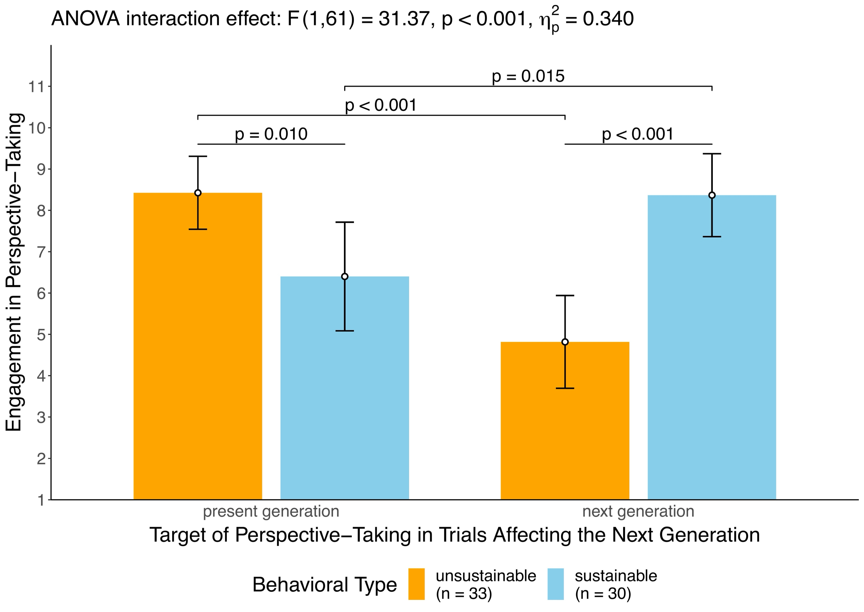
In trials affecting the next generation, putting myself in the shoes of members of the [next/present] generation affected my decision.
12

Slide 26
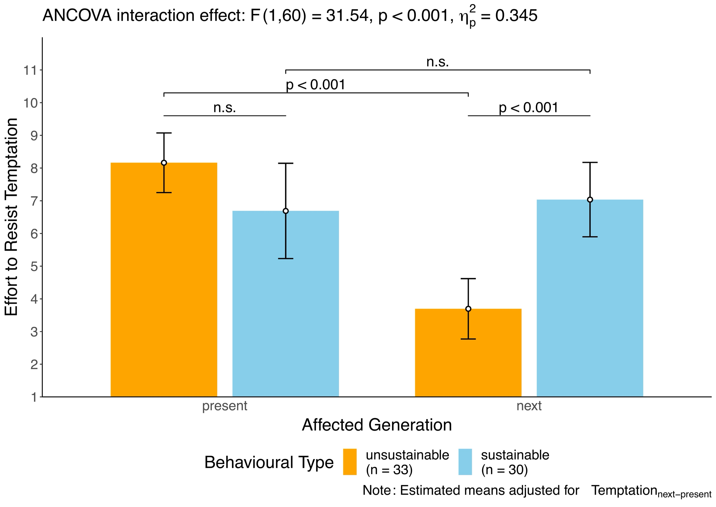
In trials affecting the [next/present] generation, I tried to resist the temptation to extract more than 10 points.
$$∆$$
13
Notes:
Behavior resulting from self-control processes (or the lack thereof) depend on both, on efforts to resist temptations as well as on the magnitude of initial temptations (desires conflicting with a higher-order goal). If you only feel little temptation to act unsustainably, it will cost you only little efforts to resist this temptation and to act sustainably. We therefore had participants additionally rate their agreement to two statements: In trials affecting the [next/present] generation, I was tempted to extract more than 10 points. We then calculated differential temptation scores by taking the difference between temptation in next minus present generation affecting trials. We included this differential temptation as a covariate of no interest in the ANCOVA you see here as well as in the mediation analyses regarding the DLPFC finding. In doing so, we adjusted all findings regarding efforts to resist temptations for potential influences of differences in initial temptations. This allowed us to interpret findings of these analyses in terms of self-control proceses.

Slide 27
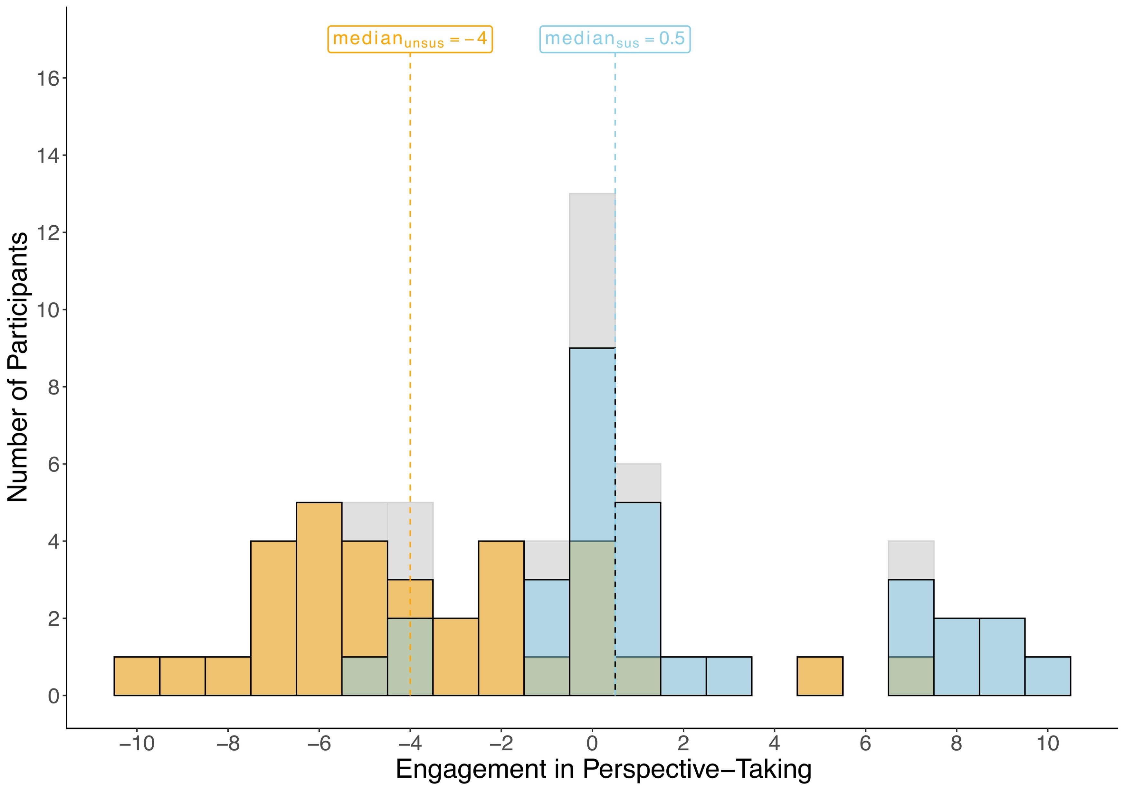
Differential Perspective-Taking
$$∆$$
14

Slide 28
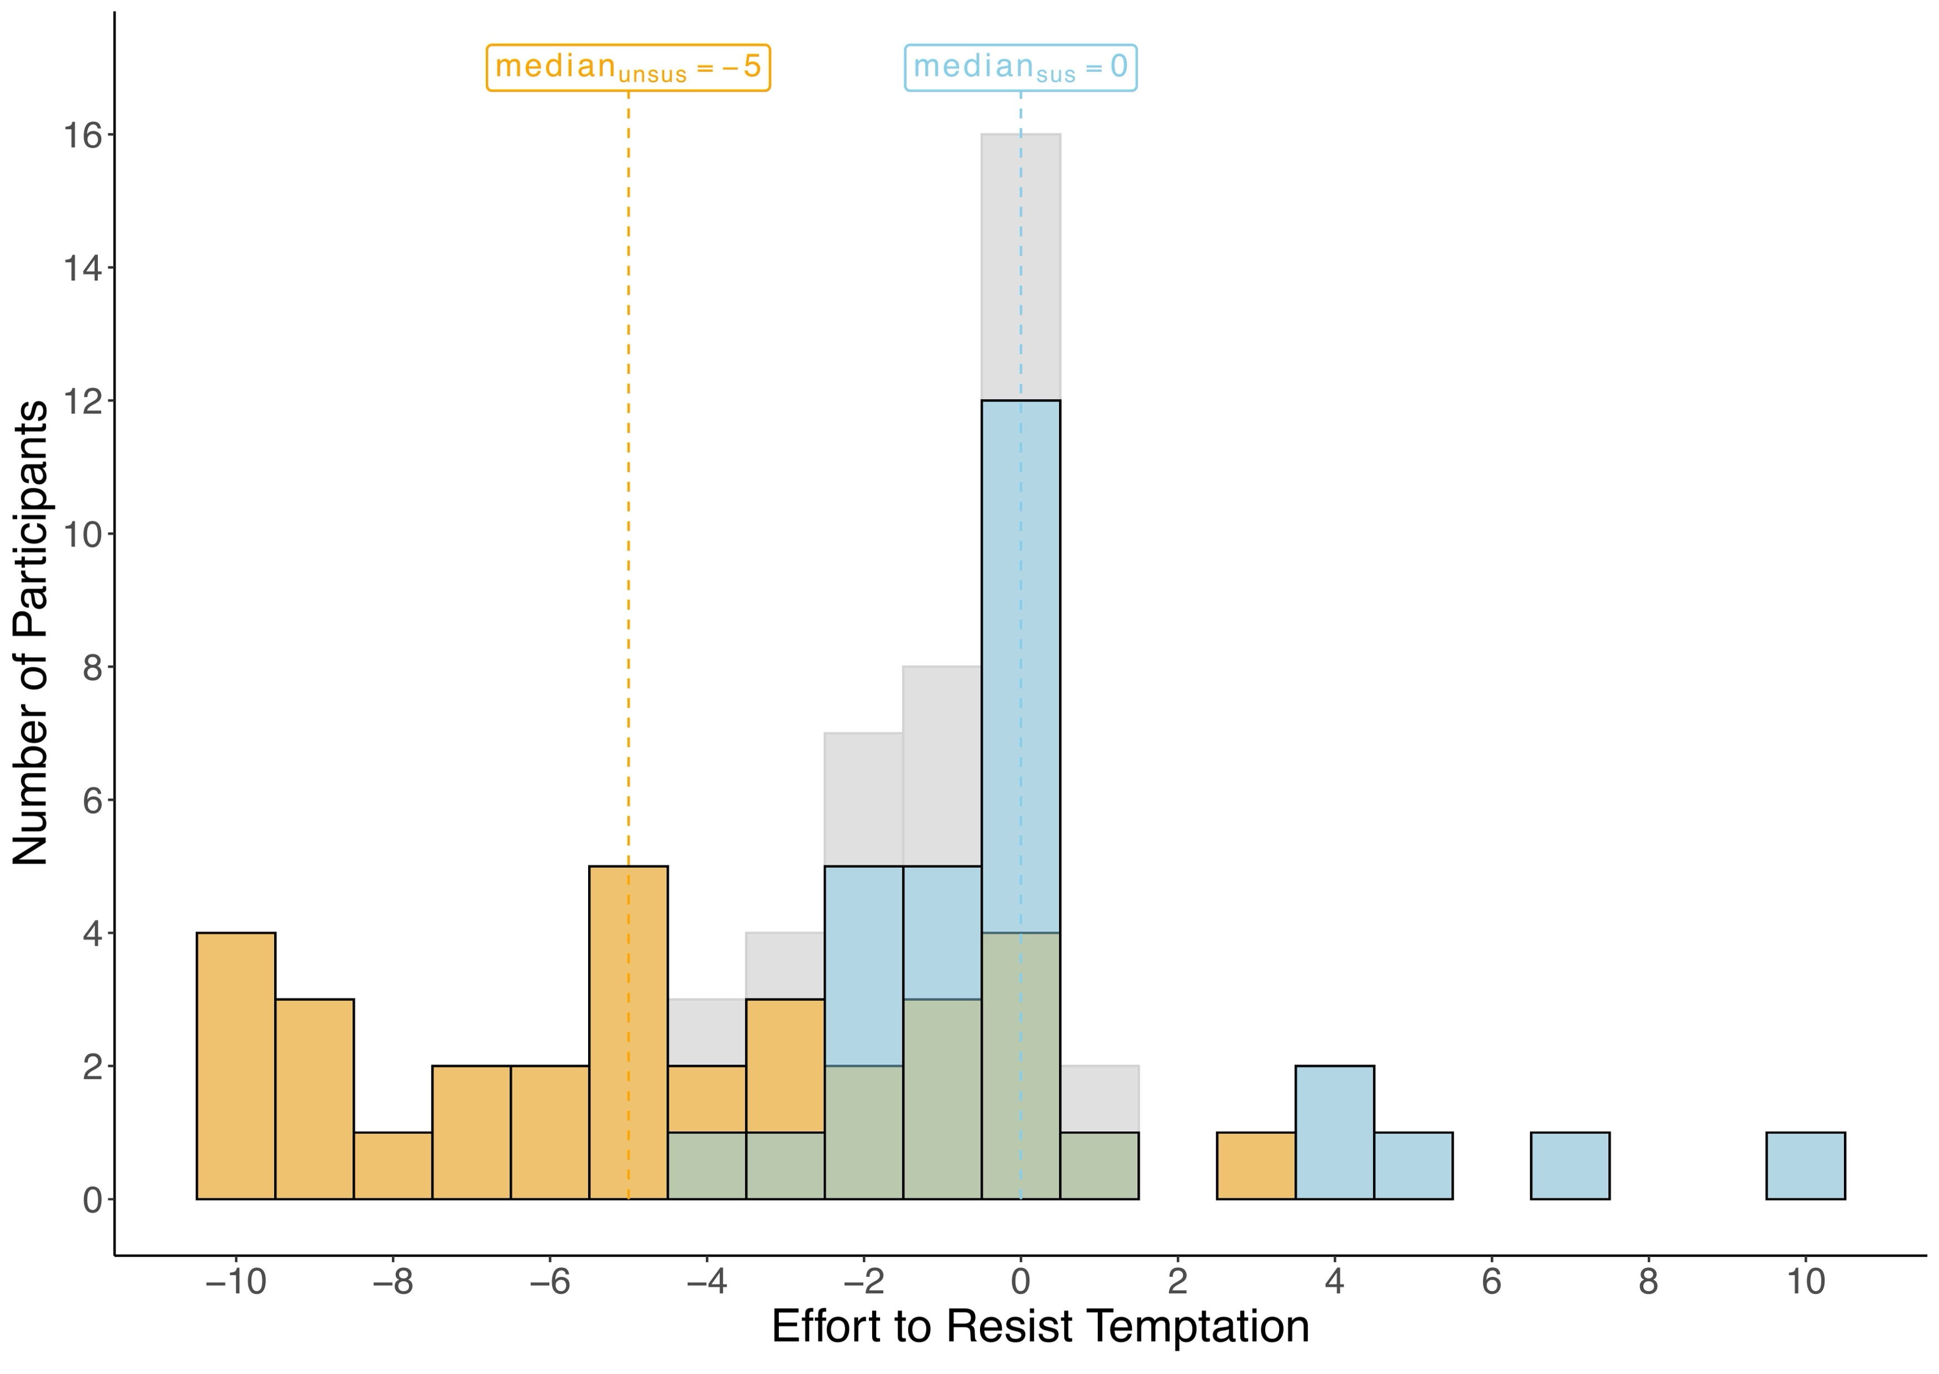
Differential Effort to Resist Temptation
$$∆$$
15

Slide 29
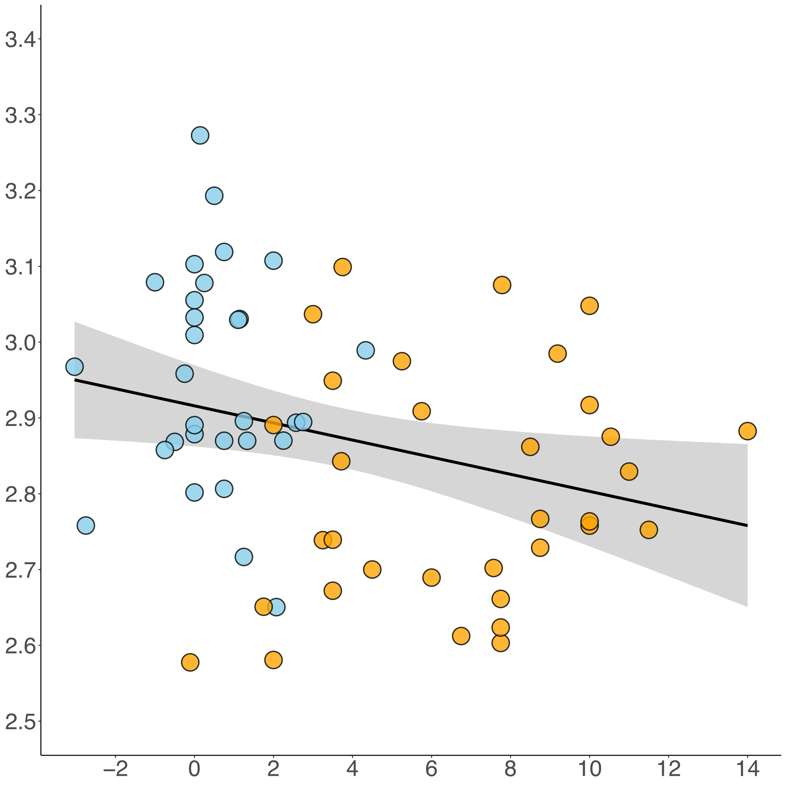
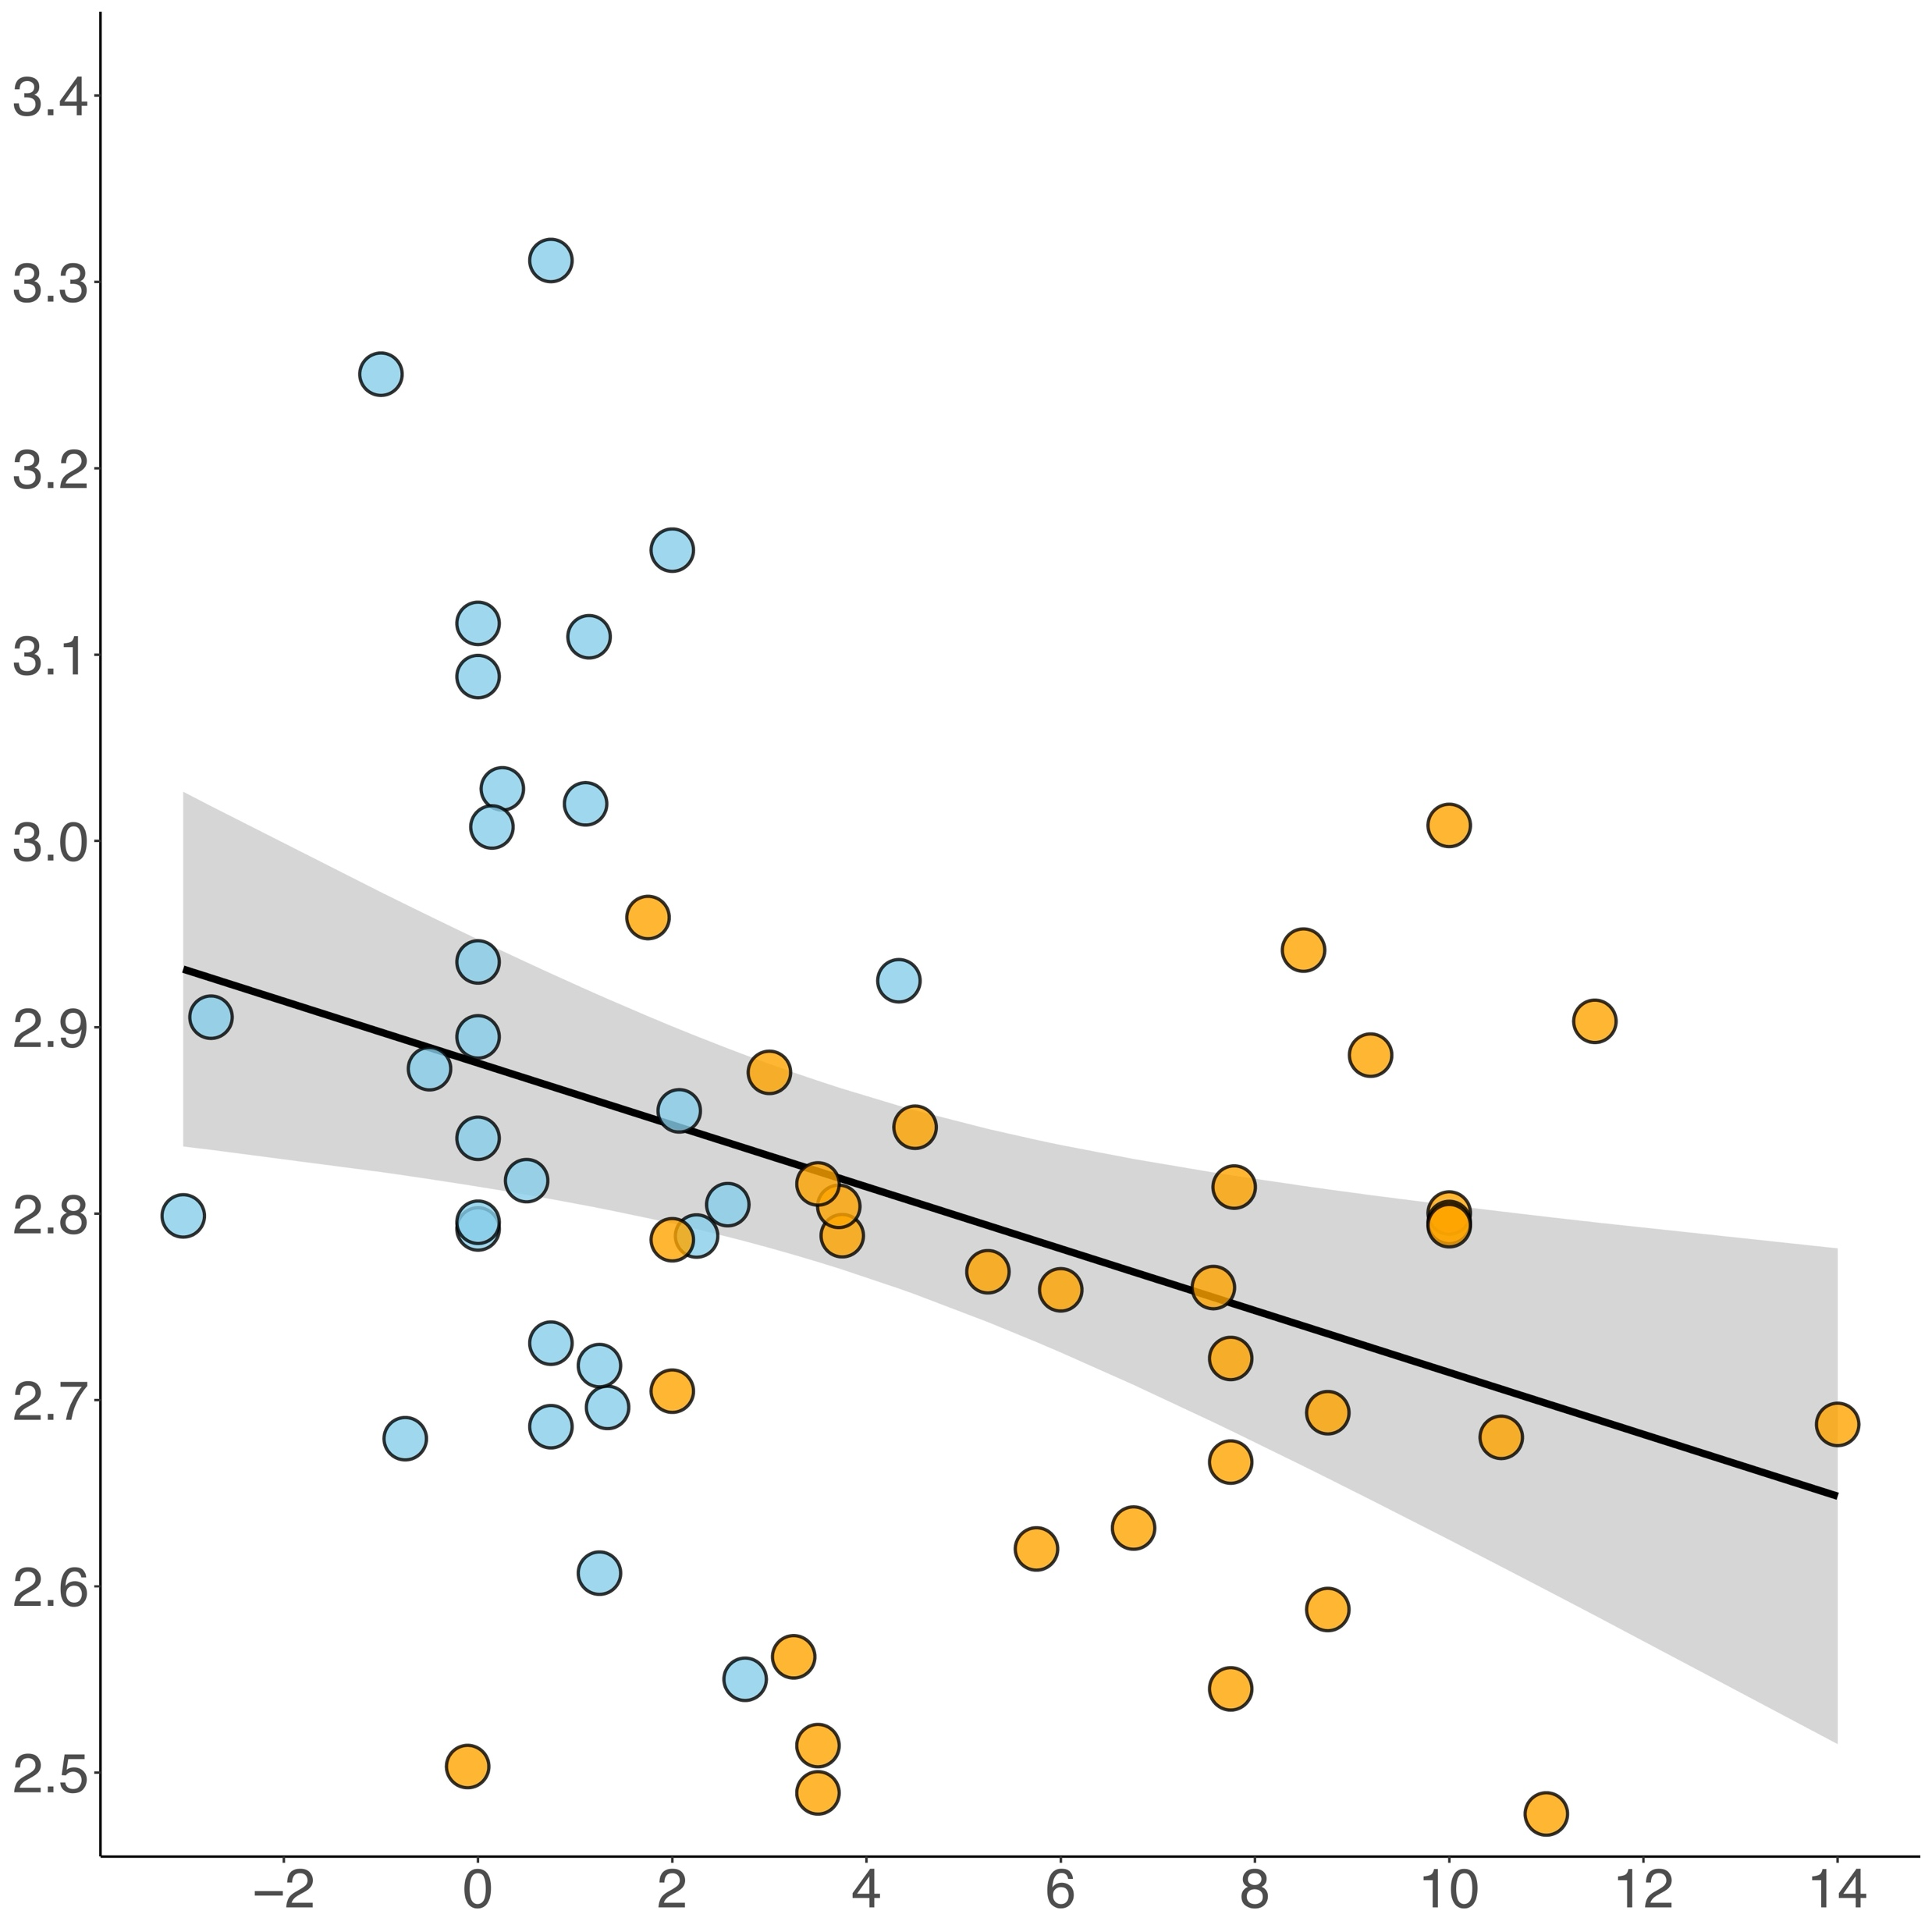
Continuous Behavior
$$r_{Pearson}=−0.279, p=0.027$$
$$r_{Pearson}=−0.326, p=0.009$$
sustainable
unsustainable
sustainable
unsustainable
$$Cortical Thickness of DMPFC \\ (adjustes for sex and age)$$
$$Cortical Thickness of DLPFC \\ (adjustes for sex and age)$$
$${∆Extraction}_{next−present}$$
$${∆Extraction}_{next−present}$$
16
Notes:
For continuous analyses, one could take participants’ difference in extraction behavior between next and present generation affecting trials.
However, this loses an important categorization: For example, if a participant changes their extraction from 12 to 20 points, this looks like a much stronger change than changing from, say, 10 to 12. Yet, in the former case, both decisions were unsustainable, while in the latter case, the participant decided to move from a sustainable decision to an unsustainable one.

Slide 30
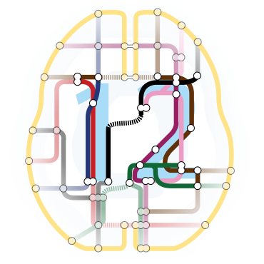
Cortical Thickness Analyses
MRI: T1-weighted MDEFT sequence (1 mm³)
Surface-based morphometric analyses of cortical thickness with correction for sex and age
Control for multiple testing
p < 0.05 FWE-correction on peak- or cluster-level
Cluster-defining threshold: p_{uncor.} < 0.001
Whole-brain and small-surface analyses
17

