Slide 1
Negotiating Resettlements: The Power of Experts in Building Dams and Displacing Alpine Communities in Switzerland and Italy, 1940–1970 Dr. Sebastian De Pretto, University of Bern Workshop: Dam scientists: exploring the role of hard sciences in framing the environmental impact of dams University of Trento April 17 – 18, 2023

Slide 2
Introduction
1
This presentation will investigate the involvement of experts in planning and negotiating the resettlements of the local populace due to reservoir construction in Switzerland and Italy.
Case studies from the canton of Grisons (Switzerland) and Trentino-Alto Adige (Italy):
What was the function of experts in publicly justifying controversial reservoir projects?
For what purposes did energy companies engage experts to facilitate resettlements?
How differently did energy companies proceed in federal Switzerland compared to central-state Italy?

Slide 3
Dam Induced Resettlements in Switzerland after 1940
2
Since 1916, energy companies did not have to ask the central government for water concessions, but different administrative authorities, depending on each canton.
Projects & resettlements
Rheinwald / canton of Grisons / 1940 – 1946 / around 430 people (project not realised)
Zervreila / canton of Grisons / 1946 – 1957 / 12 families
Marmorera / canton of Grisons / 1948 – 1954 / 100 persons
Göscheneralp / canton of Uri / 1952 – 1960 / 10 residential buildings
Schiffensee / canton of Fribourg / 1959 – 1963 / village and spa resort Bad Bonn
Vogorno / canton of Ticino / 1960 – 1965 / village of Vogorno (partially)
Emosson / canton of Valais / 1953 –1970 / 50 people

Slide 4
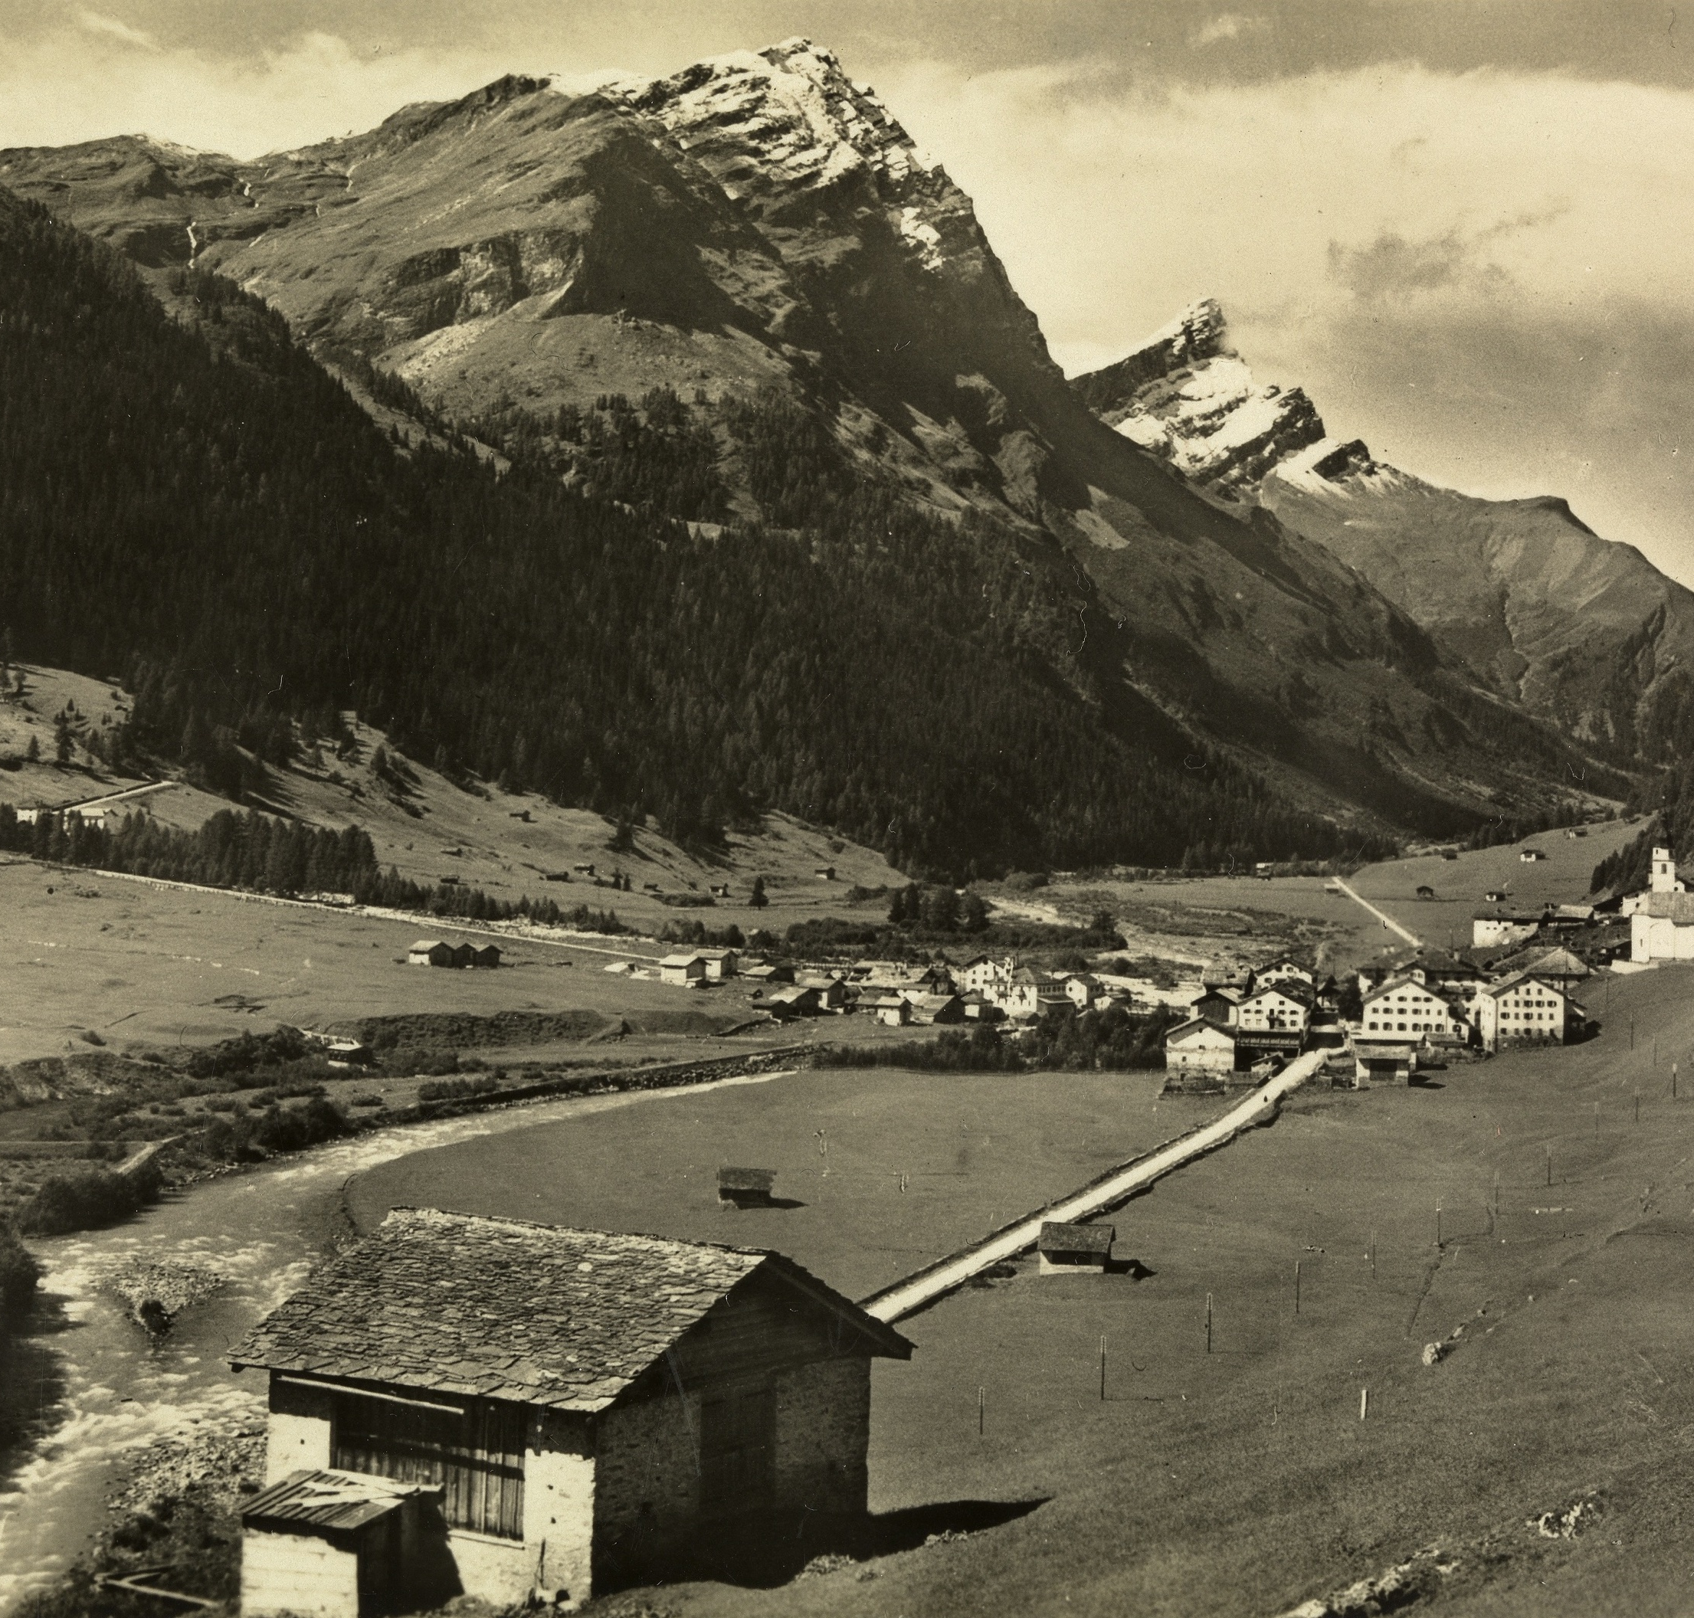
Rheinwald, 1940 – 1946
3
The Rheinwald project failed, although experts exerted pressure on the communities of Splügen, Nufenen and Medels at different administrative levels.
The energy company "Kraftwerke Hinterrhein" engaged experts from different epistemic fields (science, economy, politics, and agriculture) to propagate the hydro project publicly.
The Swiss Federal Council appointed a second expert commission without any representatives from the alpine region. They confirmed the project and recommended further hydropower schemes.
Both commissions failed to convince the three villages to resettle.
Abb. 1: Juf, Averstal, 17.07.1929.
fig. 1: Town of Splügen, around 1930 .
Notes:
jsjsjsjs
jsjsjs

Slide 5
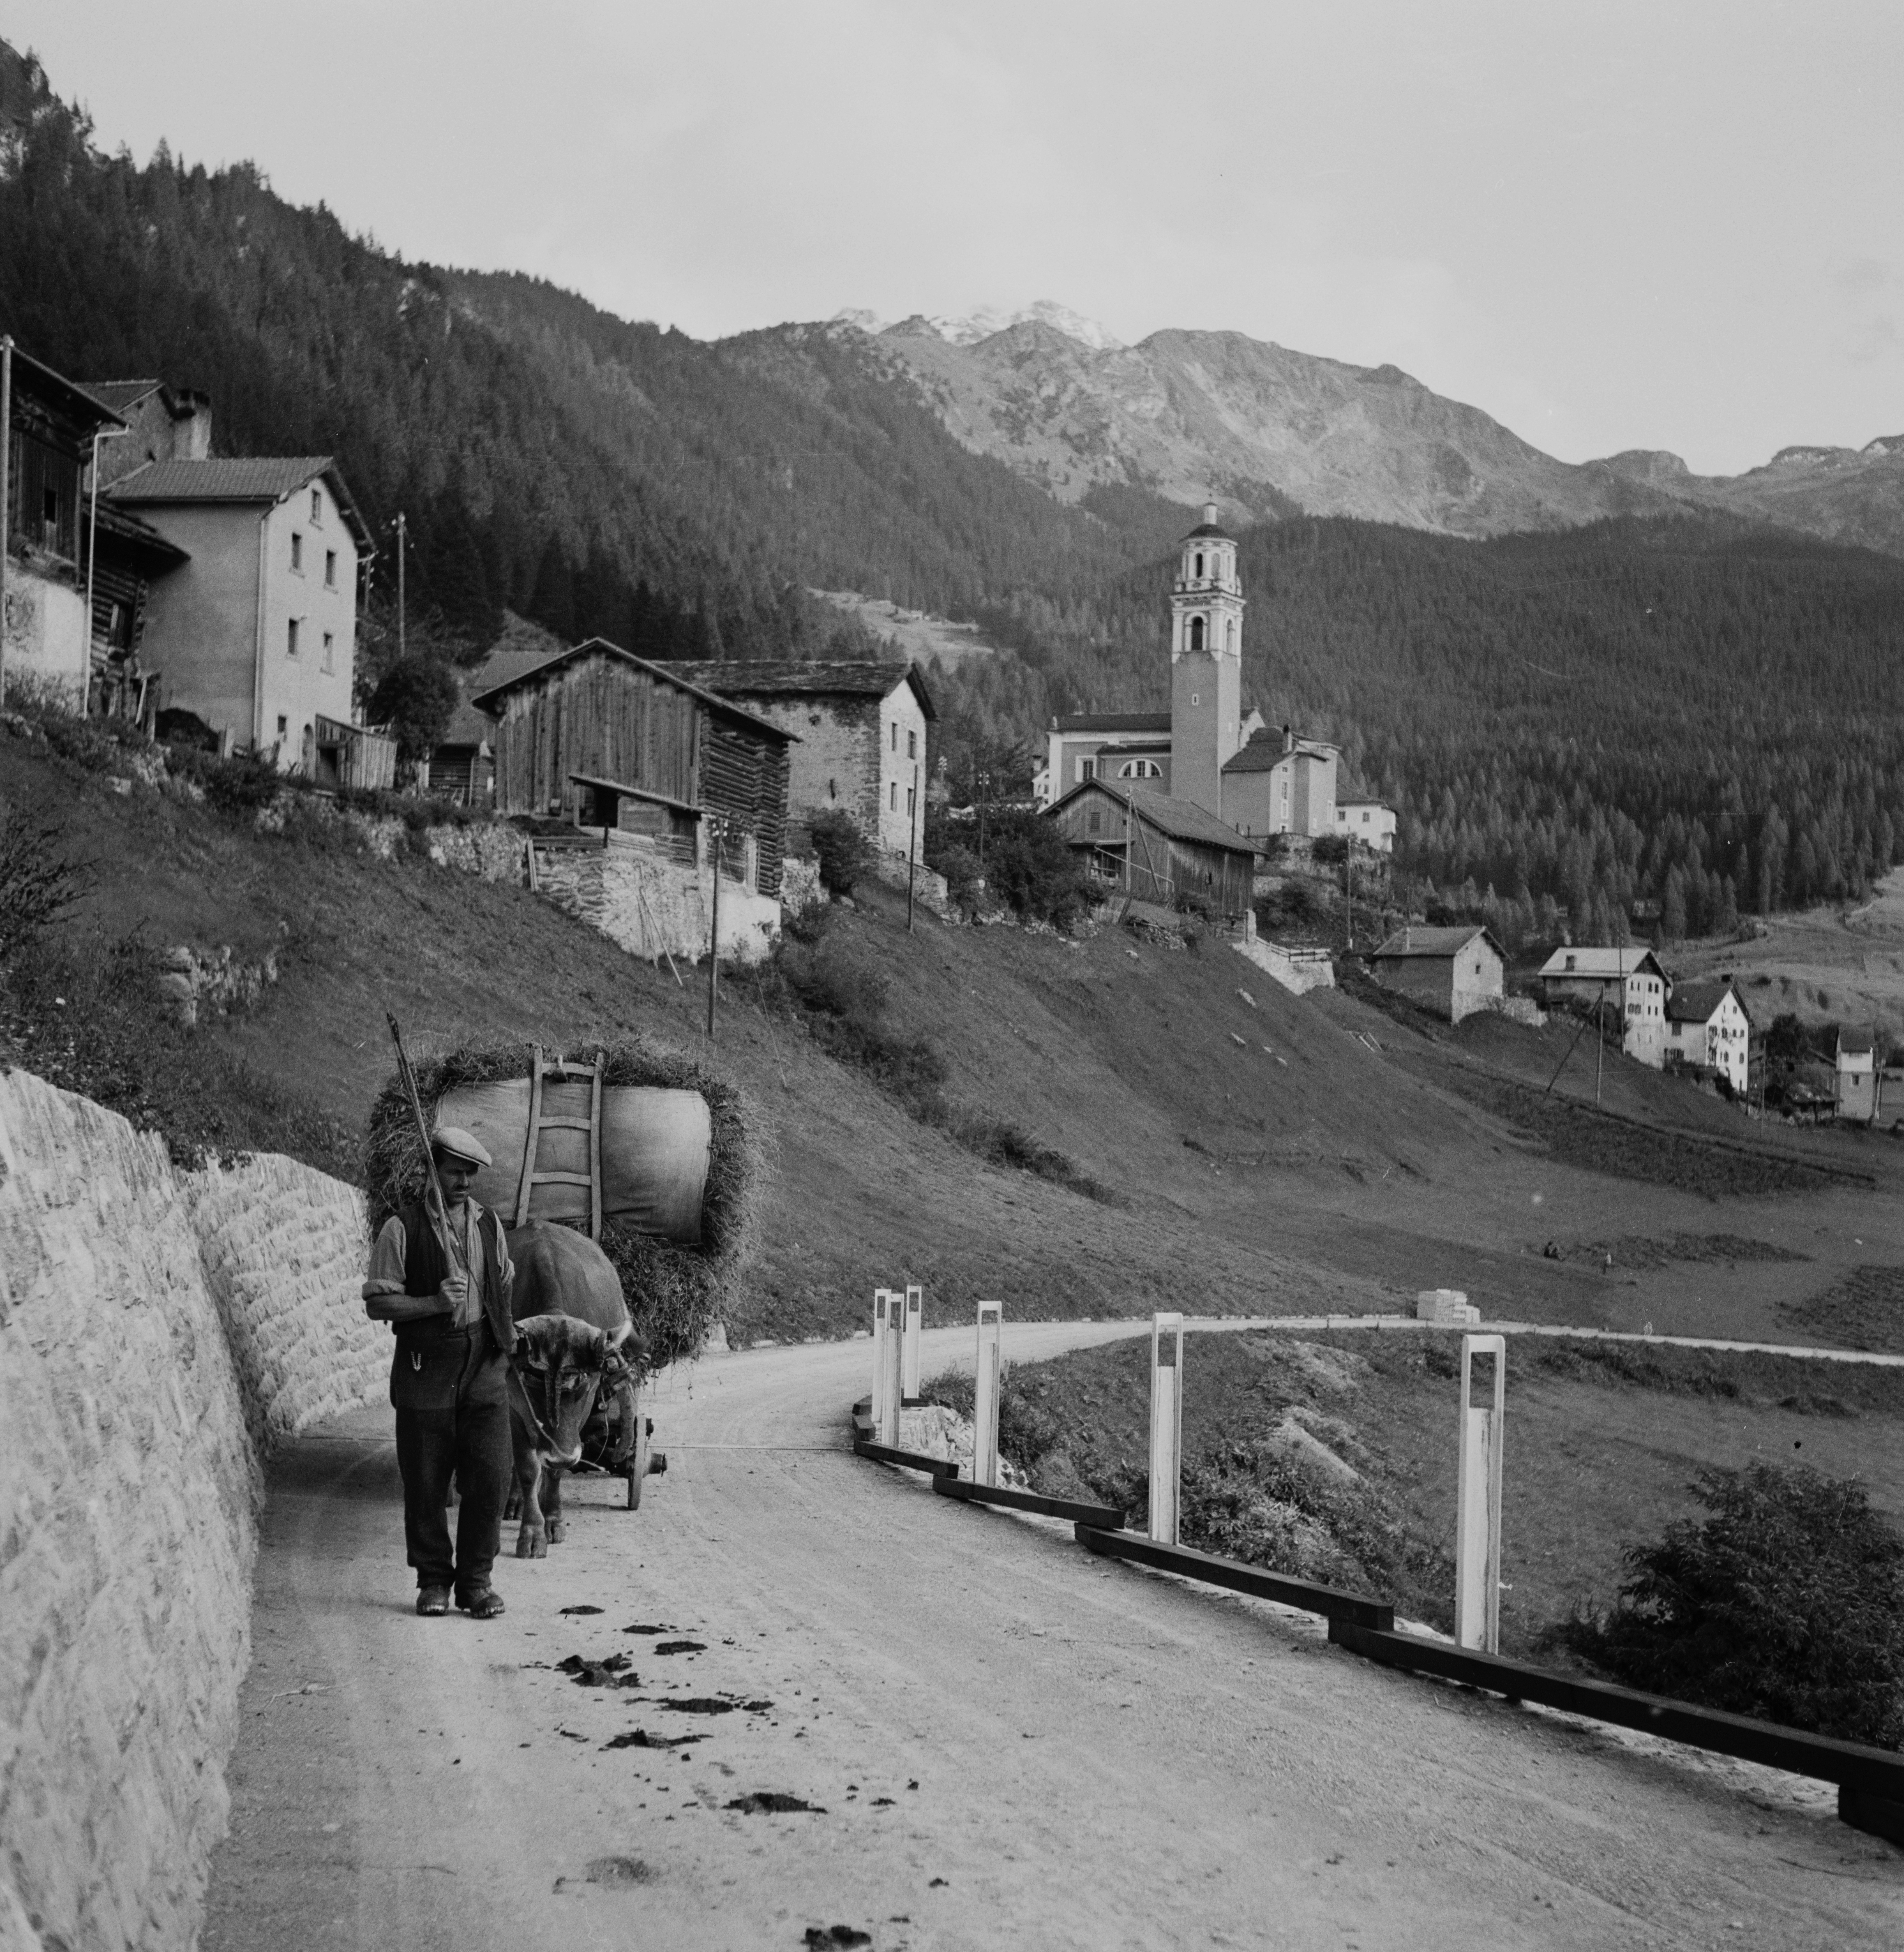
Marmorera, 1948 – 1954
4
The Zurich electricity company received the concession for the Marmorera reservoir within just one year without any resistance by the villagers. What strategy did the electrical company use?
Marmorera was impoverished, indebted and its population over-aged.
Experts from the Swiss Federal Institute of Technology conducted an economic-geographical survey, which confirmed the poor condition of the village and its poverty.
A lawyer individually purchased all the properties in the village before its assembly was able to vote on the project.
Abb. 1: Juf, Averstal, 17.07.1929.
fig. 2: Marmorera resettlement action, 1952. .

Slide 6
Dam Induced Resettlements in Trentino-Alto Adige after 1945
5
In Italy since 1916, the central government in Rome decided over concessions for hydroelectric power plants according to the "Bonomi-Decree".
Although autonomous regions received special regulations in the First Republic, Rome retained its previous hydro-authority in Trentino-Alto Adige – all concessions continued to be granted by the Ministry of Public Works.

Slide 7
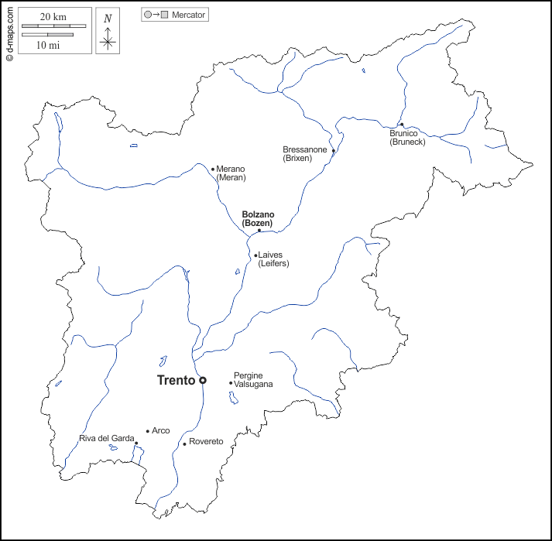
Dam Induced Resettlements in Trentino-Alto Adige after 1945
6
Reschen / province of Alto Adige / 1947 – 1950 / 290 buildings (residential houses, farms, shops, and a church)
Vernagt / province of Alto Adige / 1964 – 1964 / 12 farms and one chapel
Stramentizzo / province of Trento / 1947 – 1956 / village of Stramentizzo
Ulten valley (6 reservoirs) / province of Alto Adige / 1949 – 1969 / 40 buildings (residential houses and farms)
Reschen
Vernagt
Ulten
Stramentizzo
Abb. 1: Juf, Averstal, 17.07.1929.
fig. 3: Map of Trentino-Alto Adige after 1918.

Slide 8
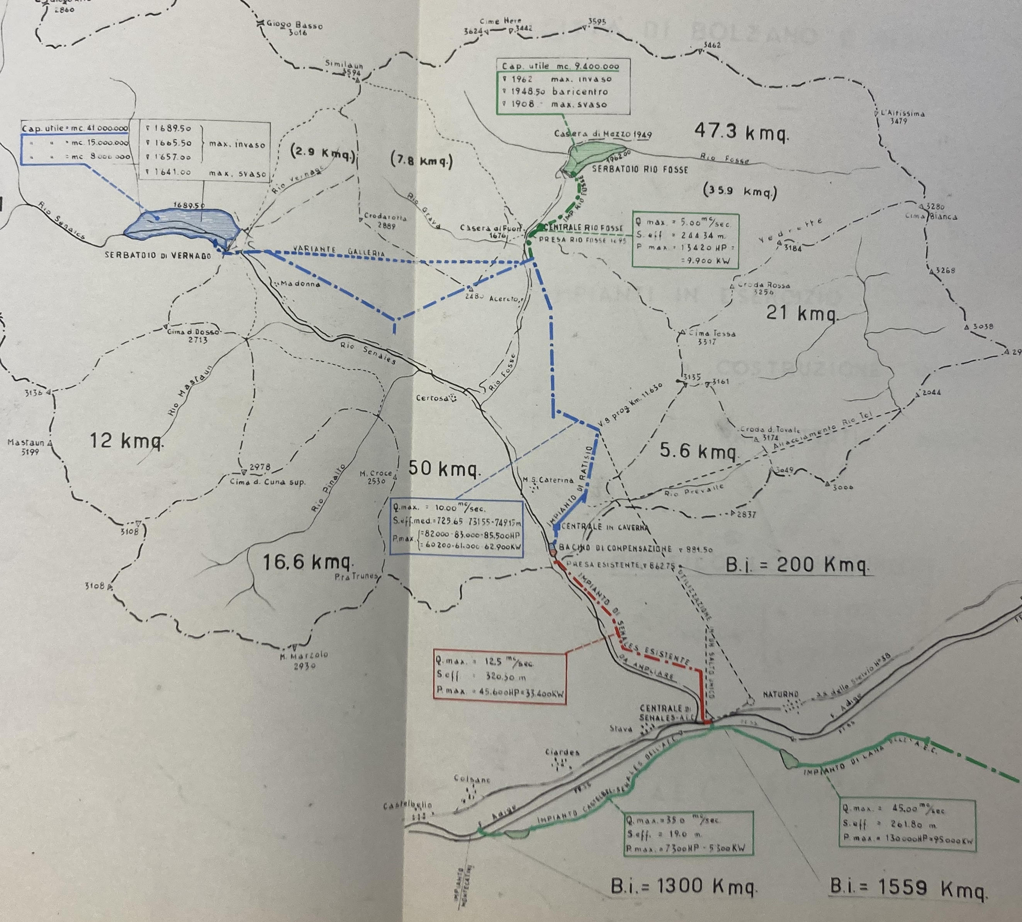
Reschen – Vernagt – Stramentizzo – Ulten
7
The conflict over the resettlement at Lake Reschen was also caused by the Montecatini experts' failure to communicate with the villagers clearly and transparently.
In Stramentizzo, Vernagt, and Ulten electricity companies had learned their lessons from Reschen. They commissioned engineers to write scientific reports and construction plans, thereby, convincing administrations to promote their projects publicly.
Experts also determined compensation for expropriated properties. Engineers and hydrologists calculated the soil productivity and the flow rate of water courses and classified them accordingly.
Abb. 1: Juf, Averstal, 17.07.1929.
fig. 4: Hydrological map of the Schnals valley, around 1954.

Slide 9
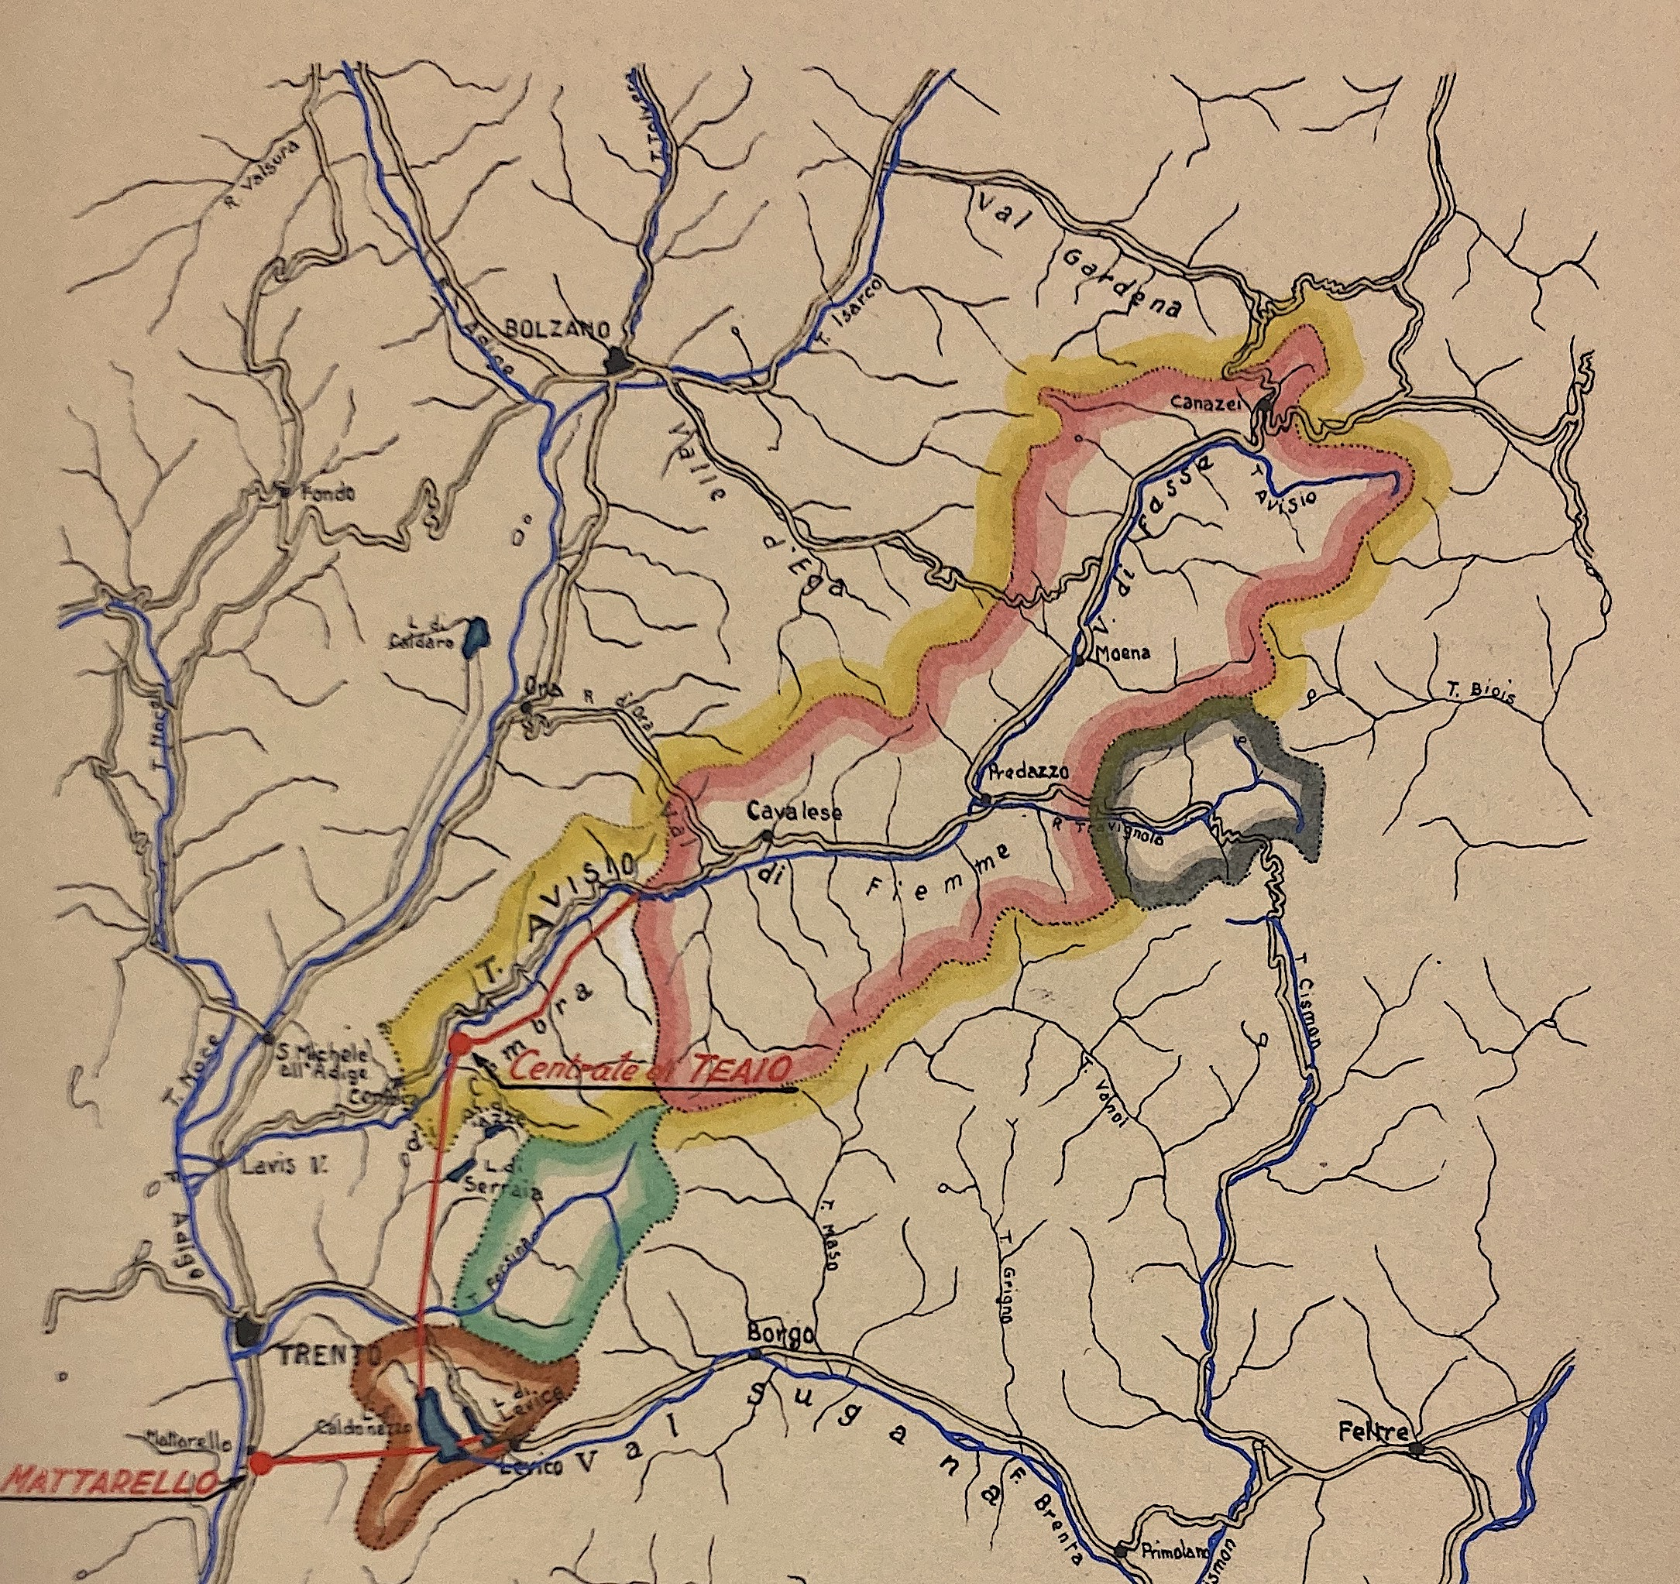
Reschen – Vernagt – Stramentizzo – Ulten
8
Although single municipalities had no direct influence on the approval of a hydro-project, regional electricity companies engaged experts to negotiate smooth resettlements with the villagers. Such companies depended on the regional sales market and their management was partially composed of regional politicians.
To avoid public controversy in the compensation agreements, and to prevent having to bargain with a village assembly, the concessionaries negotiated with the landowners individually.
Abb. 1: Juf, Averstal, 17.07.1929.
fig. 5: Hydrological map of the Val di Fiemme, 1942.

Slide 10
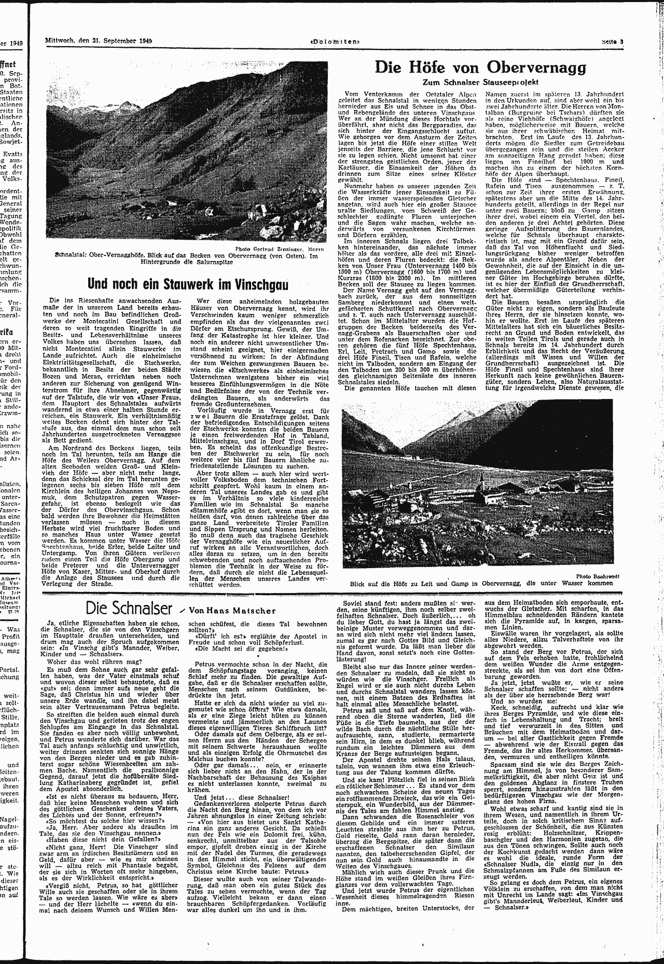
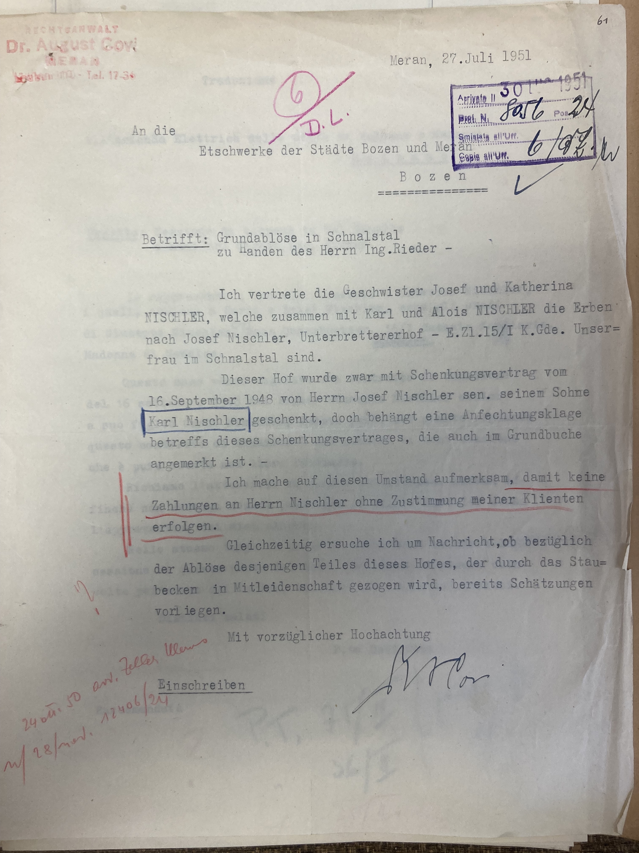
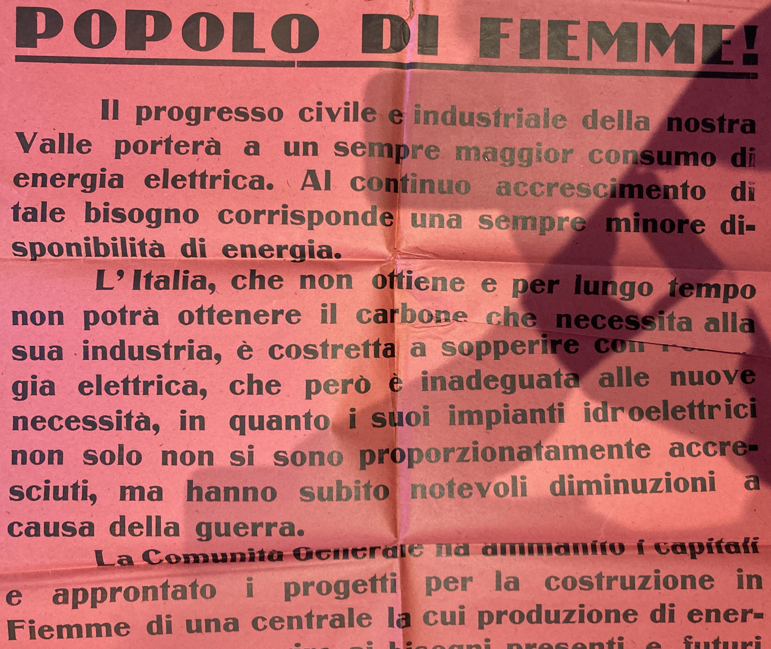
Municipal freedom of action
9
fig. 8: Protest poster from Val di Fiemme, Cavalese, 15.07.1947.
fig. 6: Newspaperarticle against the Vernagt Dam, 1949.
fig. 7: Lawyer's correspondence regarding indemnities in Vernagt, 1951.

Slide 11
Conclusion
10
The energy economy and policy of the immediate post-war years, which in Switzerland and Italy implemented projects from the early 1940s, created asymmetrical power relations between individual mountain villages and the companies engaged in the national reconstruction plans.
In federal Switzerland, as well as in centrally governed Italy, experts mediated and carried out resettlements. They issued reports that assessed the value of a settlement based on the economic productivity of its farms and land according to technocratic standards and principles.
Experts developed communication strategies that enabled energy and industrial companies to acquire concessions in Grisons and enforce compensation in Trentino-Alto Adige. Within the framework of the respective national and regional legal norms, the village communities had different freedoms of action, with which they could also engage experts as a defence against exploitative hydro-politics.

Slide 12
Index of figures
11
Cover: Marmorera resettlement action 1952, Comet Photo AG (Zürich), ETH-Zürich Image Archive: Com_M01-1004-0006.
Fig. 1: Splügen around 1930, unknown Photographer, ETH-Zürich Image Archive: PK_000885.
Fig. 2: Marmorera resettlement action 1952, Comet Photo AG (Zürich), ETH-Image Archive: Com_M01-1004-0003.
Fig. 3: Map of Trentino-Alto Adige after 1918, https://d-maps.com/carte.php?num_car=23027&lang=de, 12.04.2023.
Fig. 4: “Impianti in Esercizio, in Costruzione e in Progetto, Planimetria e Profilo”, Bolzano 1954, South Tyrol Provincial Archives, holding: "Etschwerke”.
Fig. 5: “Corografia dei Bacini Imbriferi”, Società Idroelettricà Trentina, Trento 15 June 1942, Trentino Provincial Archives, holding: “Genio Civile”.
Fig. 6: Newspaperarticle against the Vernagt Dam, “Und noch ein Stauwerk im Vinschgau”, Dolomiten, 21.09.1949, p. 3.
Fig. 7: Letter by the lawyer Dr. August Covi to the A.E.C. relating indemnities in the Schnals valley, Merano 27.07.1951, South Tyrol Provincial Archives, holding: "Etschwerke”.
Fig. 8: Protest poster from Val di Fiemme, Cavalese, 15.07.1947, Archive of the Magnifica Comunità di Fiemme, holding: CAT.XVII_N°1_Fasc. 1–5.

