Slide 1
“Val Formazza – Valle Elettrica”: The Creation of a Fascist-Hydroscape in Alpine Space after 1928. Panel / How Clean Is White Coal? Historical Perspectives on the Alpine Damscape, 1918–1950 12th ESEH Conference / Mountains and Plains Dr. Sebastian De Pretto 23.08.2023
Fig. 1: Formazza valley, 1901–1903.

Slide 2
Italy’s hydropower expansion after WWI
1
After the First World War, Italy lacked its own resources for reconstruction and thus turned to the energy of its abundant water reserves.
The 1916 Bonomi Decree centralised hydroelectric development.
Supported by private energy companies (“electrocommerciali”), Italy increased its hydropower by a factor of about four and a half between 1918 and 1932.
Under Mussolini, the Bonomi Decree was amended twice (1924 & 1933), but without furthering the rights of riverine communities.
Fascism’s hydropower schemes industrialised remote mountain valleys, flooded local villages and threatened the communities living under the dams even after the facilities went into operation. They can bee understood as “brute force technologies” (Josephson 2002).

Slide 3
Italy’s hydropower expansion after WWI
2
After the First World War, Italy lacked its own resources for reconstruction and thus turned to the energy of its abundant water reserves.
The 1916 Bonomi Decree centralised hydroelectric development.
Supported by private energy companies (“electrocommerciali”), Italy increased its hydropower by a factor of about four and a half between 1918 and 1932.
Under Mussolini, the Bonomi Decree was amended twice (1924 & 1933), but without furthering the rights of riverine communities.
Fascism’s hydropower schemes industrialised remote mountain valleys, flooded local villages and threatened the communities living under the dams even after the facilities went into operation. They can bee understood as “brute force technologies” (Josephson 2002).

Slide 4
Italy’s hydropower expansion after WWI
3
After the First World War, Italy lacked its own resources for reconstruction and thus turned to the energy of its abundant water reserves.
The 1916 Bonomi Decree centralised hydroelectric development.
Supported by private energy companies (“electrocommerciali”), Italy increased its hydropower by a factor of about four and a half between 1918 and 1932.
Under Mussolini, the Bonomi Decree was amended twice (1924 & 1933), but without furthering the rights of riverine communities.
Fascism’s hydropower schemes industrialised remote mountain valleys, flooded local villages and threatened the communities living under the dams even after the facilities went into operation. They can bee understood as “brute force technologies” (Josephson 2002).

Slide 5
Italy’s hydropower expansion after WWI
4
After the First World War, Italy lacked its own resources for reconstruction and thus turned to the energy of its abundant water reserves.
The 1916 Bonomi Decree centralised hydroelectric development.
Supported by private energy companies (“electrocommerciali”), Italy increased its hydropower by a factor of about four and a half between 1918 and 1932.
Under Mussolini, the Bonomi Decree was amended twice (1924 & 1933), but without furthering the rights of riverine communities.
Fascism’s hydropower schemes industrialised remote mountain valleys, flooded local villages and threatened the communities living under the dams even after the facilities went into operation. They can bee understood as “brute force technologies” (Josephson 2002).

Slide 6
Italy’s hydropower expansion after WWI
5
After the First World War, Italy lacked its own resources for reconstruction and thus turned to the energy of its abundant water reserves.
The 1916 Bonomi Decree centralised hydroelectric development.
Supported by private energy companies (“electrocommerciali”), Italy increased its hydropower by a factor of about four and a half between 1918 and 1932.
Under Mussolini, the Bonomi Decree was amended twice (1924 & 1933), but without furthering the rights of riverine communities.
Fascism’s hydropower schemes industrialised remote mountain valleys, flooded local villages and threatened the communities living under the dams even after the facilities went into operation. They can bee understood as “brute force technologies” (Josephson 2002).

Slide 7
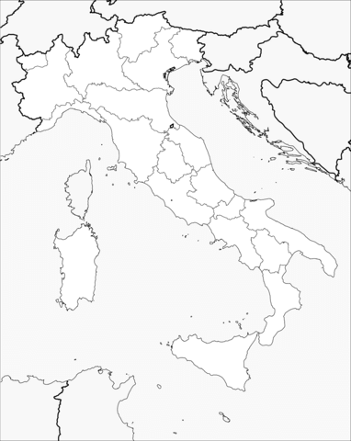
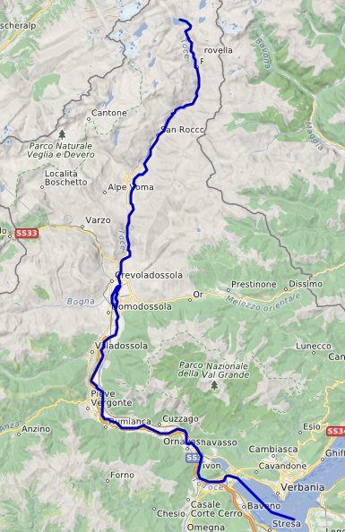
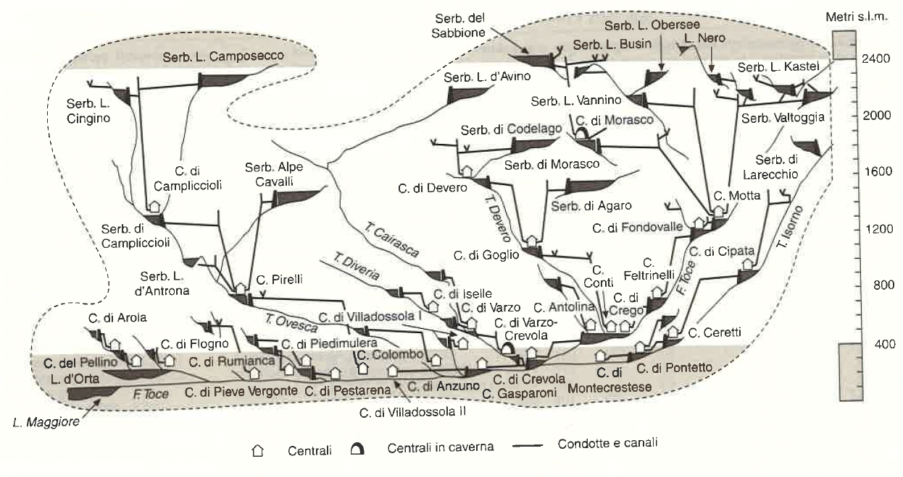
The river Toce – development of a hydroelectric engine after 1928
6
Formazza Valley
Fig. 3: Edison‘s hydropower system along the river Toce in 1958.
Fig. 2: The Toce river from Formazza down to the Lago Maggiore
Abb. 2: Yosemite-National Park, USA, Dr. Fuller and Bear Camp Roosevelt, 1926.

Slide 8
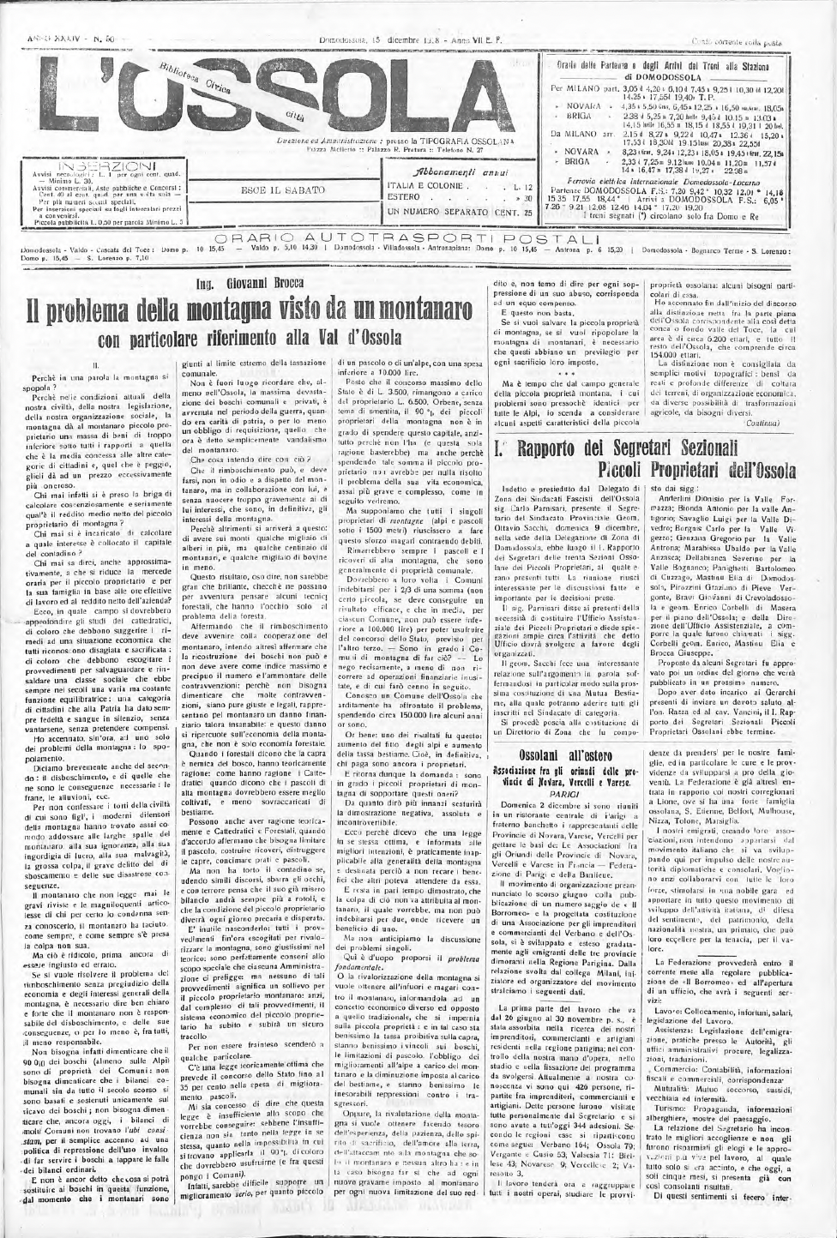
Giovanni Brocca: A critical voice from Ossola, 1928
7
Although the farmers in the mountains of Ossola possessed abundant land, it was barren and labour-intensive.
The remaining high-altitude pastures could mainly be grazed by goats, which threatened to become too expensive due to new livestock taxes.
In the 1920s, reservoirs in Ossola had already drowned several pastures. With Morasco and Agàro, further losses were imminent.
The power lines were also detrimental to the alpine economy, as they pushed aside load cableways for hay transport.
Fig. 4: Newspaper article by Giovanni Brocca, 15.12.1928.

Slide 9
Giovanni Brocca: A critical voice from Ossola, 1928
8
Although the farmers in the mountains of Ossola possessed abundant land, it was barren and labour-intensive.
The remaining high-altitude pastures could mainly be grazed by goats, which threatened to become too expensive due to new livestock taxes.
In the 1920s, reservoirs in Ossola had already drowned several pastures. With Morasco and Agàro, further losses were imminent.
The power lines were also detrimental to the alpine economy, as they pushed aside load cableways for hay transport.
Fig. 4: Newspaper article by Giovanni Brocca, 15.12.1928.

Slide 10
Giovanni Brocca: A critical voice from Ossola, 1928
9
Although the farmers in the mountains of Ossola possessed abundant land, it was barren and labour-intensive.
The remaining high-altitude pastures could mainly be grazed by goats, which threatened to become too expensive due to new livestock taxes.
In the 1920s, reservoirs in Ossola had already drowned several pastures. With Morasco and Agàro, further losses were imminent.
The power lines were also detrimental to the alpine economy, as they pushed aside load cableways for hay transport.
Fig. 4: Newspaper article by Giovanni Brocca, 15.12.1928.

Slide 11
Giovanni Brocca: A critical voice from Ossola, 1928
10
Although the farmers in the mountains of Ossola possessed abundant land, it was barren and labour-intensive.
The remaining high-altitude pastures could mainly be grazed by goats, which threatened to become too expensive due to new livestock taxes.
In the 1920s, reservoirs in Ossola had already drowned several pastures. With Morasco and Agàro, further losses were imminent.
The power lines were also detrimental to the alpine economy, as they pushed aside load cableways for hay transport.
Fig. 4: Newspaper article by Giovanni Brocca, 15.12.1928.

Slide 12
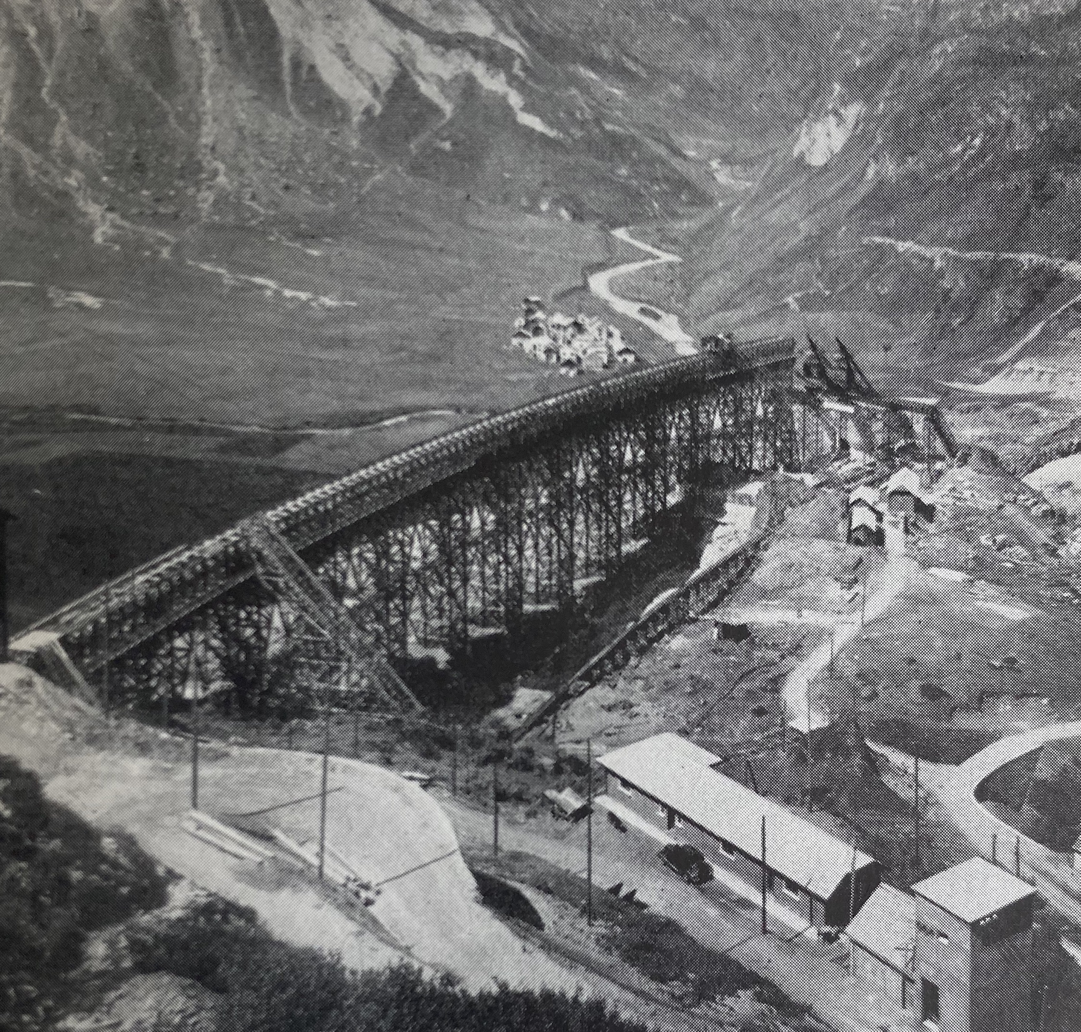
Reservoir construction under Fascism’s political ecology, 1930s
11
The Fascist regime sought to exploit natural resources to support its autarky program, using forests, rivers, and lakes as fuel for industrial production.
The regime only attributed aesthetic value to landscapes that were made useful to its high modernist agenda, ignoring the interests and sorrows of remote mountain valleys' population.
Ossola’s regional newspapers controlled by the regime highlighted the construction of the two biggest reservoirs along the Toce – Morasco and Agàro.
Little attention was given to the sacrifices made by the residents of Morasco and Agàro.
Fig. 5: Construction site Morasco reservoir, 1936–1940.

Slide 13
Reservoir construction under Fascism’s political ecology, 1930s
12
The Fascist regime sought to exploit natural resources to support its autarky program, using forests, rivers, and lakes as fuel for industrial production.
The regime only attributed aesthetic value to landscapes that were made useful to its high modernist agenda, ignoring the interests and sorrows of remote mountain valleys' population.
Ossola’s regional newspapers controlled by the regime highlighted the construction of the two biggest reservoirs along the Toce – Morasco and Agàro.
Little attention was given to the sacrifices made by the residents of Morasco and Agàro.
Fig. 5: Construction site Morasco reservoir, 1936–1940.

Slide 14
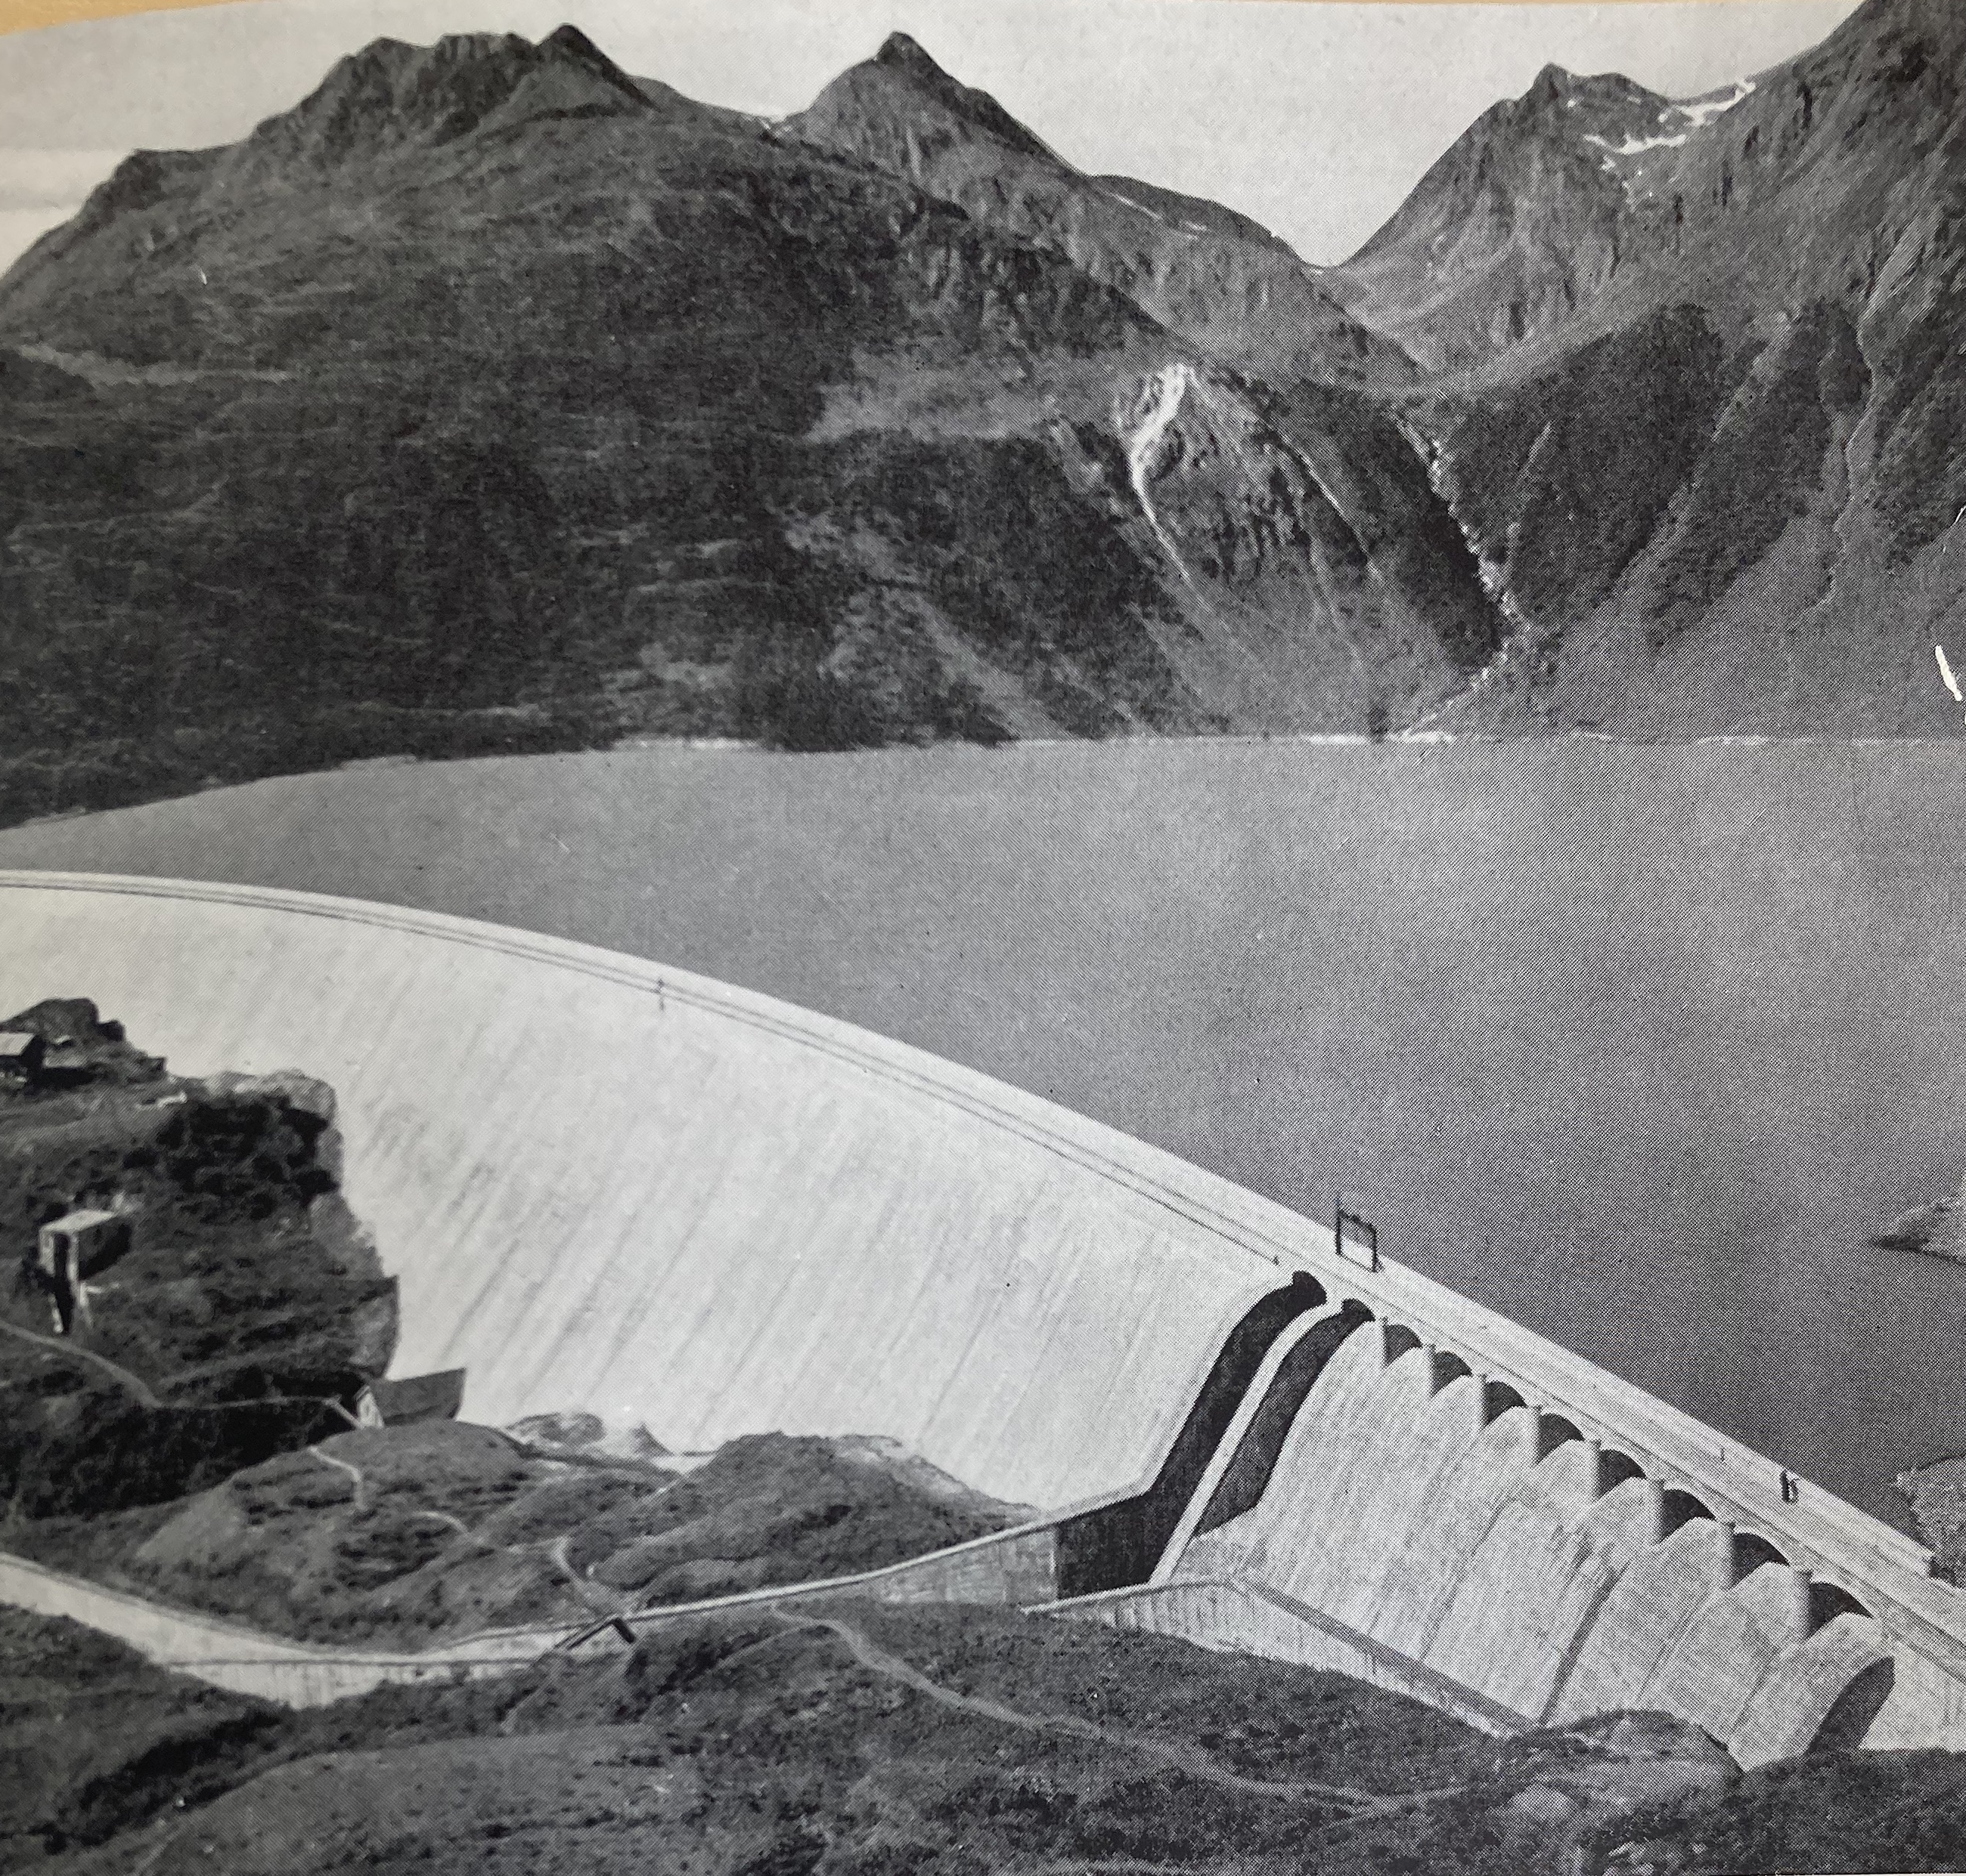
Hydropower’s consequences for the Formazza Valley after 1938
13
With the construction of the Morasco reservoir, the settlement of Morasco and its surrounding pastures were flooded in 1938.
In letters to the Ministry of Public Works in Rome, Morasco's expropriated inhabitants complained about poverty, insufficient compensation, safety concerns, and expected water shortages.
After 1945, criticism began regarding the long-term damage caused by the dams built and commissioned under Fascism – letters of complaint from Formazza (1957).
The development of hydropower in Formazza mainly damaged the valley instead of enabling any sustainable economic, agricultural, or tourist development.
Fig. 6: Morasco reservoir after its comission in 1940.

Slide 15
Hydropower’s consequences for the Formazza Valley after 1938
14
With the construction of the Morasco reservoir, the settlement of Morasco and its surrounding pastures were flooded in 1938.
In letters to the Ministry of Public Works in Rome, Morasco's expropriated inhabitants complained about poverty, insufficient compensation, safety concerns, and expected water shortages.
After 1945, criticism began regarding the long-term damage caused by the dams built and commissioned under Fascism – letters of complaint from Formazza (1957).
The development of hydropower in Formazza mainly damaged the valley instead of enabling any sustainable economic, agricultural, or tourist development.
Fig. 6: Morasco reservoir after its comission in 1940.

Slide 16
Hydropower’s consequences for the Formazza Valley after 1938
15
With the construction of the Morasco reservoir, the settlement of Morasco and its surrounding pastures were flooded in 1938.
In letters to the Ministry of Public Works in Rome, Morasco's expropriated inhabitants complained about poverty, insufficient compensation, safety concerns, and expected water shortages.
After 1945, criticism began regarding the long-term damage caused by the dams built and commissioned under Fascism – letters of complaint from Formazza (1957).
The development of hydropower in Formazza mainly damaged the valley instead of enabling any sustainable economic, agricultural, or tourist development.
Fig. 6: Morasco reservoir after its comission in 1940.

Slide 17
Conclusion
16
Under Fascism, hydropower development in the Italian Alpine provinces increased significantly.
This transformation stemmed from the regime's political ecology doctrine that disregarded the consequences for local communities reliant on the impacted areas’ water and soil resources.
The construction of reservoirs in the Formazza Valley led to forced resettlements, the loss of crucial resources, and the disruption of existing infrastructure.
Criticisms of these damages were largely suppressed due to the regime's media propaganda, while agricultural livelihoods suffered both during and after hydropower construction.
After 1945, the power connections enforced by Fascism’s infrastructures continued to exert influence on Italy’s energy sector.
Republican Italy built its energy sector on Fascist power structures as the dams and their distribution networks from the interwar years continued to supply electricity from the peripheries to the country's industrial metropolises.

Slide 18
Conclusion
17
Under Fascism, hydropower development in the Italian Alpine provinces increased significantly.
This transformation stemmed from the regime's political ecology doctrine that disregarded the consequences for local communities reliant on the impacted areas’ water and soil resources.
The construction of reservoirs in the Formazza Valley led to forced resettlements, the loss of crucial resources, and the disruption of existing infrastructure.
Criticisms of these damages were largely suppressed due to the regime's media propaganda, while agricultural livelihoods suffered both during and after hydropower construction.
After 1945, the power connections enforced by Fascism’s infrastructures continued to exert influence on Italy’s energy sector.
Republican Italy built its energy sector on Fascist power structures as the dams and their distribution networks from the interwar years continued to supply electricity from the peripheries to the country's industrial metropolises.

Slide 19
Conclusion
18
Under Fascism, hydropower development in the Italian Alpine provinces increased significantly.
This transformation stemmed from the regime's political ecology doctrine that disregarded the consequences for local communities reliant on the impacted areas’ water and soil resources.
The construction of reservoirs in the Formazza Valley led to forced resettlements, the loss of crucial resources, and the disruption of existing infrastructure.
Criticisms of these damages were largely suppressed due to the regime's media propaganda, while agricultural livelihoods suffered both during and after hydropower construction.
After 1945, the power connections enforced by Fascism’s infrastructures continued to exert influence on Italy’s energy sector.
Republican Italy built its energy sector on Fascist power structures as the dams and their distribution networks from the interwar years continued to supply electricity from the peripheries to the country's industrial metropolises.

Slide 20
Conclusion
19
Under Fascism, hydropower development in the Italian Alpine provinces increased significantly.
This transformation stemmed from the regime's political ecology doctrine that disregarded the consequences for local communities reliant on the impacted areas’ water and soil resources.
The construction of reservoirs in the Formazza Valley led to forced resettlements, the loss of crucial resources, and the disruption of existing infrastructure.
Criticisms of these damages were largely suppressed due to the regime's media propaganda, while agricultural livelihoods suffered both during and after hydropower construction.
After 1945, the power connections enforced by Fascism’s infrastructures continued to exert influence on Italy’s energy sector.
Republican Italy built its energy sector on Fascist power structures as the dams and their distribution networks from the interwar years continued to supply electricity from the peripheries to the country's industrial metropolises.

Slide 21
Conclusion
20
Under Fascism, hydropower development in the Italian Alpine provinces increased significantly.
This transformation stemmed from the regime's political ecology doctrine that disregarded the consequences for local communities reliant on the impacted areas’ water and soil resources.
The construction of reservoirs in the Formazza Valley led to forced resettlements, the loss of crucial resources, and the disruption of existing infrastructure.
Criticisms of these damages were largely suppressed due to the regime's media propaganda, while agricultural livelihoods suffered both during and after hydropower construction.
After 1945, the power connections enforced by Fascism’s infrastructures continued to exert influence on Italy’s energy sector.
Republican Italy built its energy sector on Fascist power structures as the dams and their distribution networks from the interwar years continued to supply electricity from the peripheries to the country's industrial metropolises.

Slide 22
Conclusion
21
Under Fascism, hydropower development in the Italian Alpine provinces increased significantly.
This transformation stemmed from the regime's political ecology doctrine that disregarded the consequences for local communities reliant on the impacted areas’ water and soil resources.
The construction of reservoirs in the Formazza Valley led to forced resettlements, the loss of crucial resources, and the disruption of existing infrastructure.
Criticisms of these damages were largely suppressed due to the regime's media propaganda, while agricultural livelihoods suffered both during and after hydropower construction.
After 1945, the power connections enforced by Fascism’s infrastructures continued to exert influence on Italy’s energy sector.
Republican Italy built its energy sector on Fascist power structures as the dams and their distribution networks from the interwar years continued to supply electricity from the peripheries to the country's industrial metropolises.

Slide 23
Index of figures
22
Fig. 1: Formazza valley, 1901–1903, photograph by Paul Bohny, ETH photo archives, HS_1360-0199-001.
Fig. 2: The Toce river from Formazza down to the Lago Maggiore, Wikimedia Commons, 10.08.2023.
Fig. 3: Edison‘s hydropower system along the river Toce in 1958, in: Marco Fortis, Lo sviluppo delle centrali idroelettriche e dei serbatoi alpini del Gruppo Edison dagli inizi del Novecento fino alla nazionalizzazione: i casi dei bacini del Toce e del Liro-Mera, in: Marco Fontis, Claudio Pavese, Alberto Quadrio Curzio (ed.), Il Gruppo Edison: 1883–2003. Profili economici e societari, vol. II, Società Editriche Il Mulino: Bologna 2003, pp. 647–781, here p. 664.
Fig. 4: Newspaper article by Giovanni Brocca, “Il problema della montagna visto da un montanaro con particolarmente riferimento alla Val d’Ossola”, in: L’Ossola Verbania, 15.12.1928, p. 1.
Fig. 5: Construction site Morasco reservoir, 1936–1940, in: „Barrage de Morasco“, in: Commission ANIDEL pour l‘étude des problèmes concernant les barrages (ed.), Les barrages de retenue des aménagements hydroélectriques italiens, vol. II, Milano 1952, pp. 165–175, here p. 173.
Fig. 6: Morasco reservoir after its comission in 1940, in: „Barrage de Morasco“, in: Commission ANIDEL pour l‘étude des problèmes concernant les barrages (ed.), Les barrages de retenue des aménagements hydroélectriques italiens, vol. II, Milano 1952, pp. 165–175, here p. 165.

