Slide 1
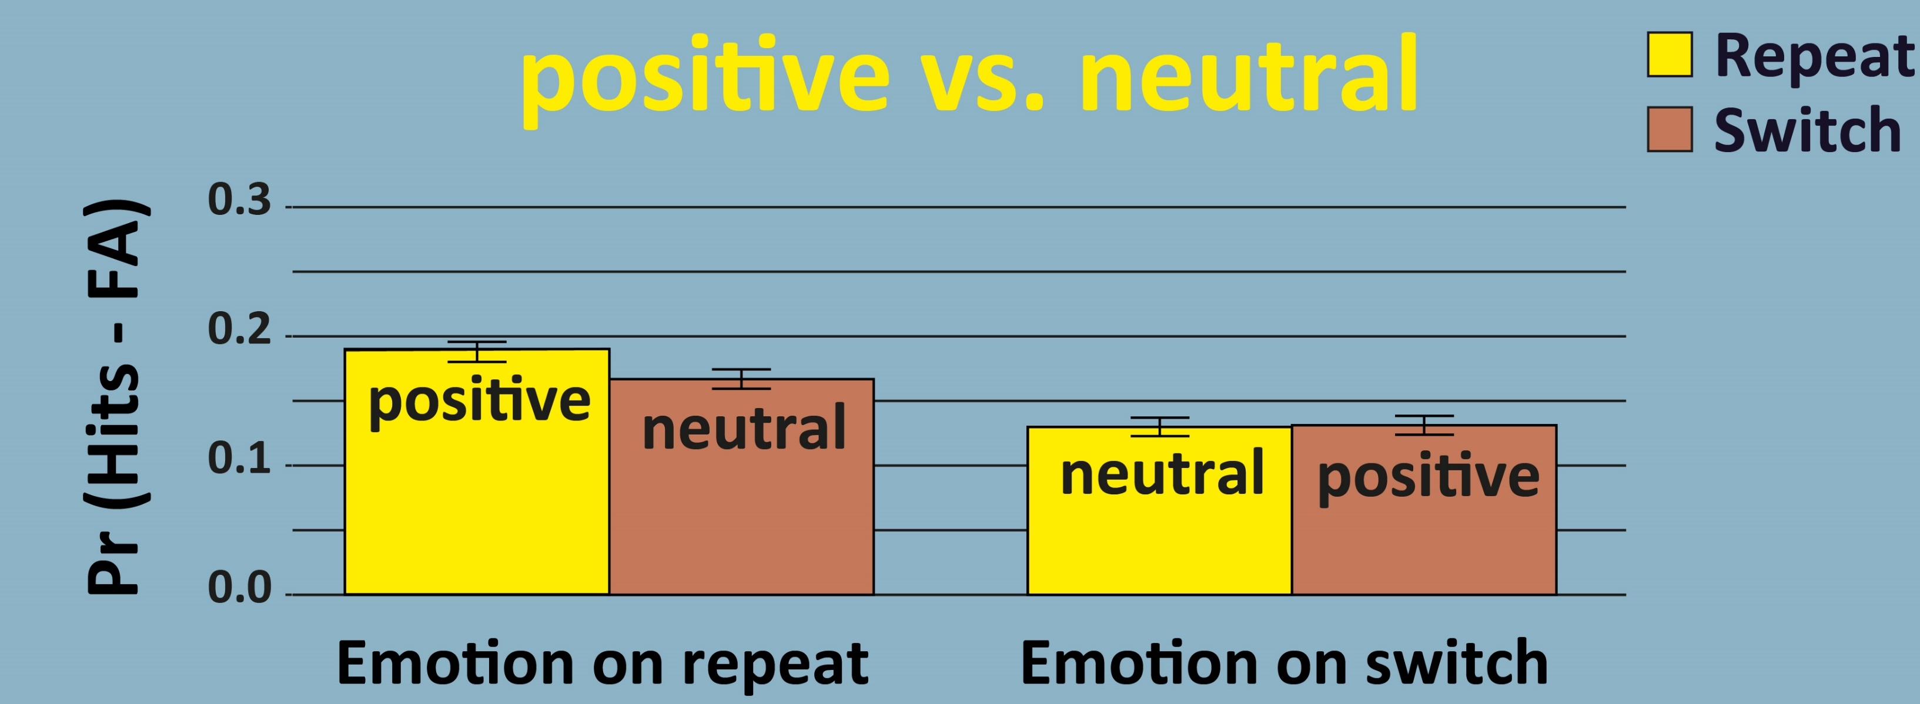
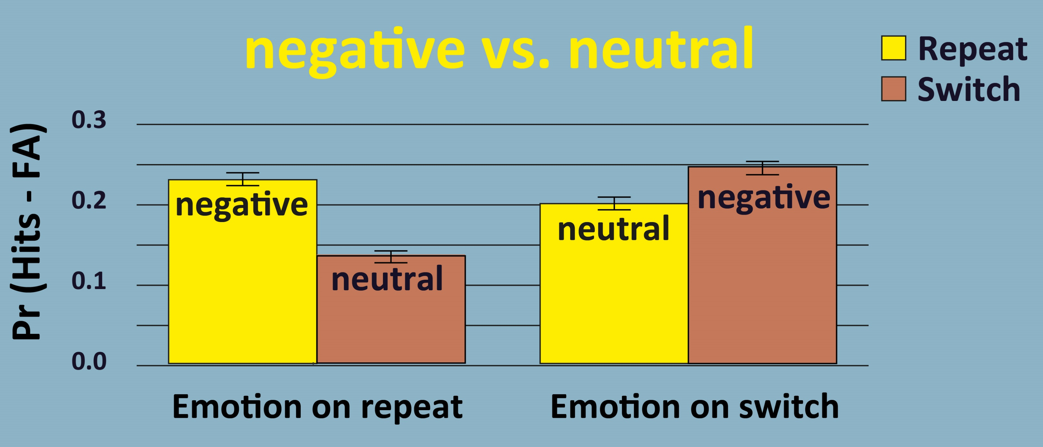
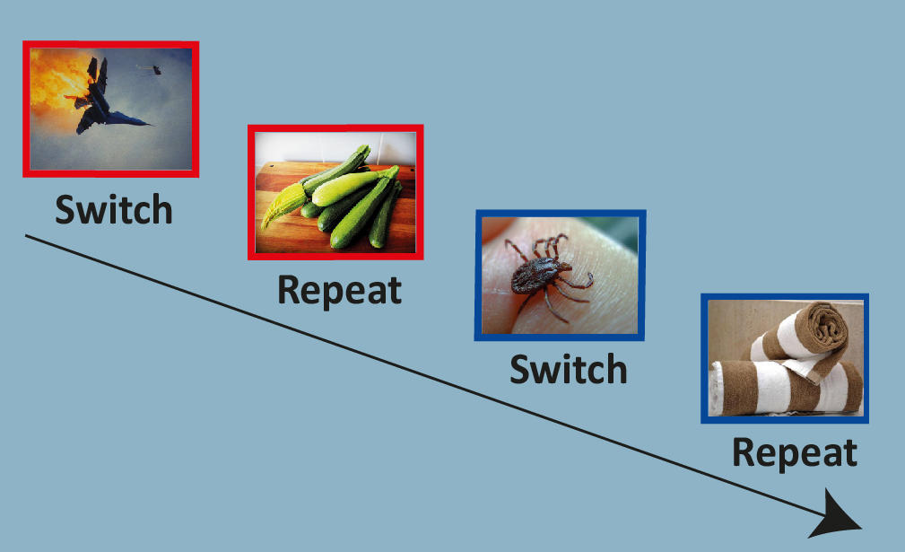
EMOTIONS WIPE OUT THE SWITCH COSTS ON SUBSEQUENT MEMORY
L
MICHELE MUHMENTHAER & BEAT MEIER University of Bern michele.muhmenthaler@unibe.ch
BACKGROUND
RESULTS
Exhausted cognitive control impairs subsequent memory
Emotional events enhance subsequent memory
Can emotions compensate for exhausted cognitive control?
METHOD
No (significant) effect for positive stimuli
Negative stimuli can compensate for the detrimental effect of task switching on memory performance
5 Experiments, N = 850
Learning phase:
Task-switching with emotional and neutral stimuli
Two categorization tasks in AABB order
Test phase
Recognition memory test
Ratio old:new = 1:1
CONCLUSION
Due to arousal, negative events can improve memory even though the cognitive resources are exhausted

