Slide 1
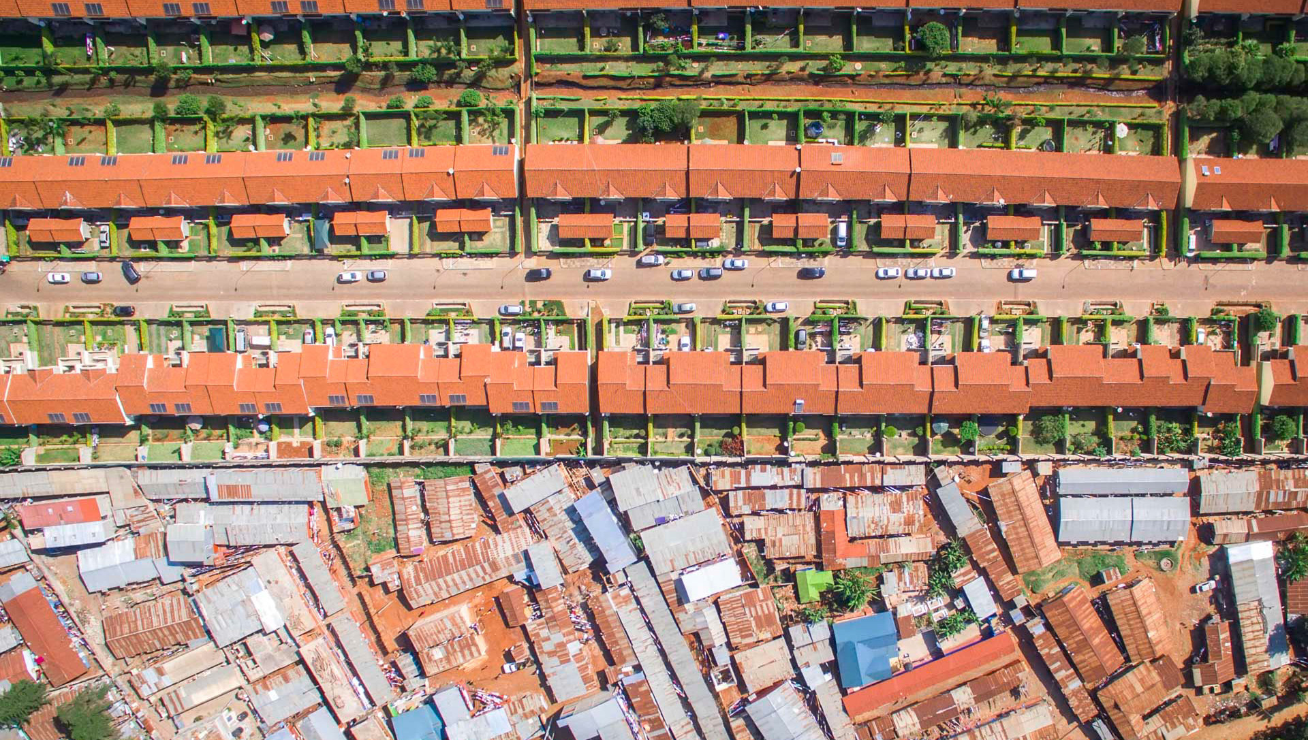
Unraveling the self-made city
The Spatial Impact of Informal Real Estate Markets in Informal Settlements
Josje Bouwmeester (Wageningen UR)

Slide 2
What is informality?
Land, labor, activities
Operating outside the legal and regulatory framework

Slide 3
What are slums?
UN HABITAT:
Group of individuals lacking one or more of the following:
Durable housing
Sufficient living space
Easy access to water
Access to sanitation
Security of tenure

Slide 4
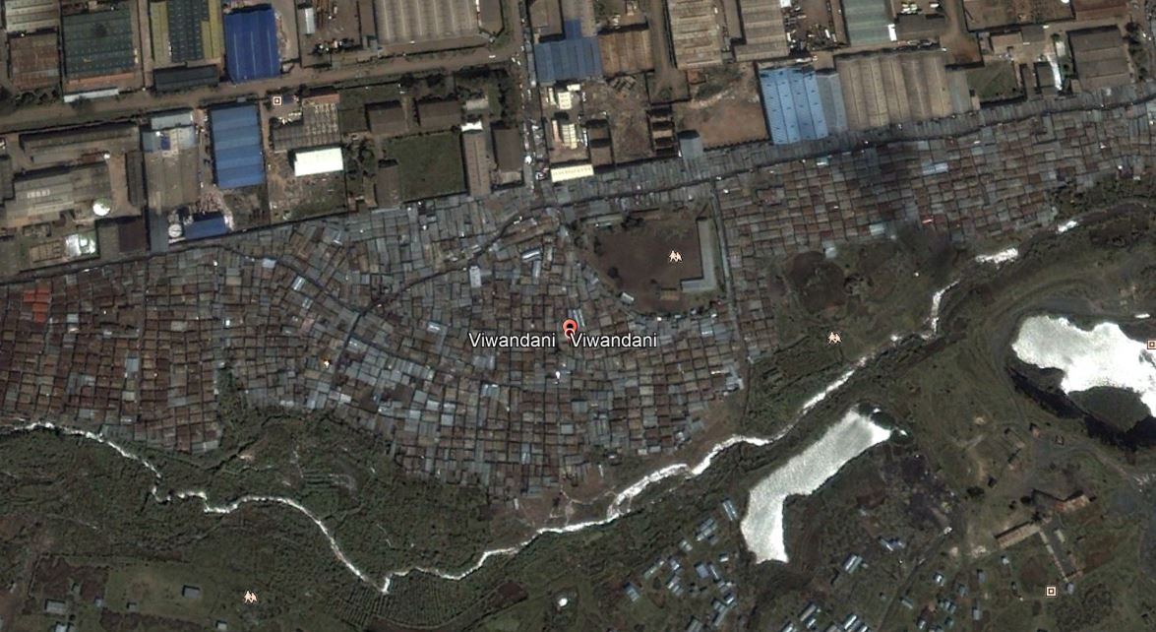
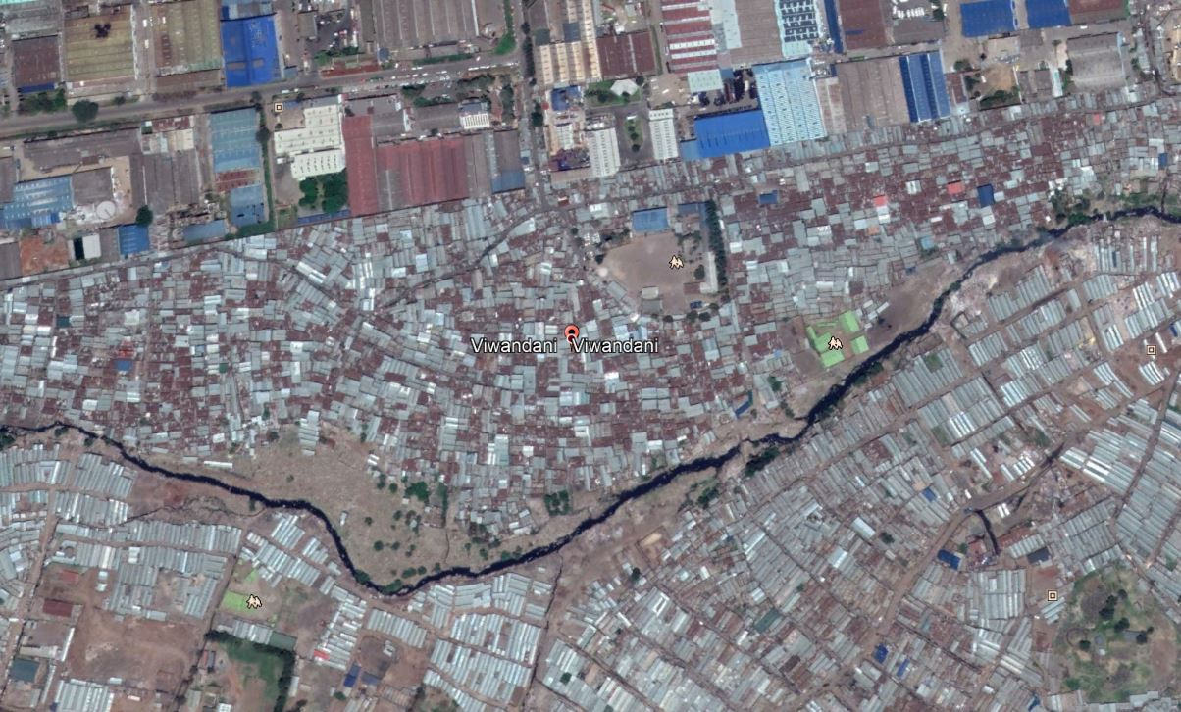
Informal real estate markets
Not chaotic and unorganized
Institutions
Notes:
Informal real estate markets Play a very important role in providing shelter to the urban poor. Because of many anthropological accounts we now know that these markets are actually not as chaotic and unorganized as previously thought, that they are insititutions based on legitimacy and that they are actually quite structured.

Slide 5
Slums are growing rapidly…
1 in 8
2020
1 in 3
2050
(UNHABITAT, 2016)
Notes:
Slums are growing rapidly: currently, 1 in 8 people live in a slum, it is expected that by 2050 this will be one in three. They are characterized by a lot of issues: access to infrastructure, services, water, waste, inadequate housing. These issues of informal settlements are well known, but at the same time, there is also a growing interest in studying the mechanisms of informal real estate markets..

Slide 6
Why study informality
70% of urban population covers 5% of the urban residential area
What can we learn?

Slide 7
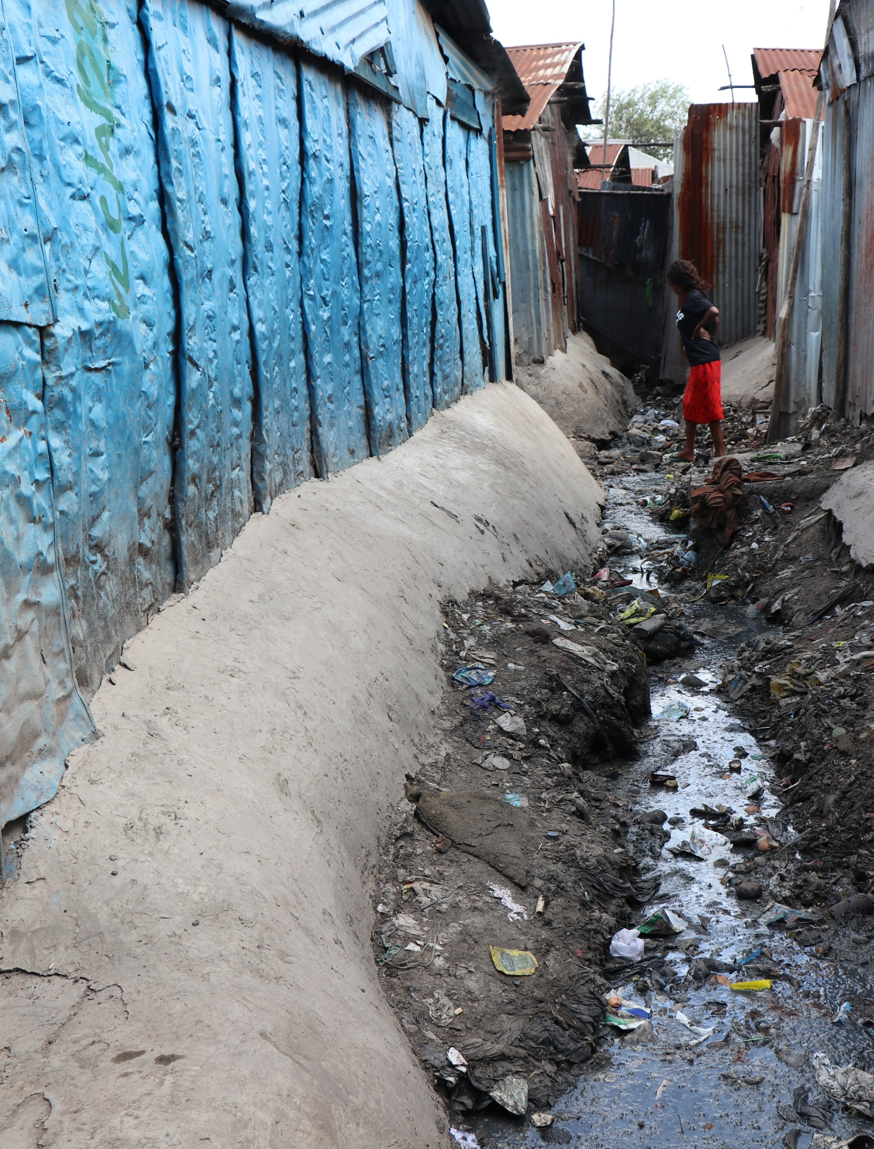
Aim
Rules-based approach
How the interaction of rules shapes urban development
Notes:
this brings me to the position of this research within the academic debate. As I just said, there have been some anthropological accounts with regards to slum real estate., Within planning there has been a shift to institutionalism to understand how rules are shaping urban development. Informal vs formal. This research aims to do that by taking a rules-based approach to slum real estate, specifically to undwrstand how the rules of slum real estate shape urban development.

Slide 8
Law and economics theory
Private law
Who can own, use and transfer rights (Cooter and Ulen, 2012)
Public law
Restrict PR > desired spatial order (Needham, Buitelaar and Hartmann, 2019)
Enforcement
Enforcement > outcomes (Needham, Buitelaar, and Hartmann, 2019).
Notes:
To answer this question, I combined two bodies of literature. First of all, I looked a property rights, or law and economics theory. How a particular city develops depends on the laws that are applicable. In general, there are two main channels through which laws can influence how land is used. In many countries of the world, state agencies can influence the way land is used through regulatory land use planning. However, the way in which rights are created, structured and trafficked, in short, the way in which the market in rights is set up, also heavily influences land use (Geuting, 2007; Geuting and Needham, 2012; Needham, Buitelaar and Hartmann, 2019). These two channels are also called public law and private law respectively
These aspects are enforced through of enforcement of rules is a key concept in the functioning of property rights regimes, or any institution out there. “Institutions are devices for achieving purposes, not just achieving agreement. We want government to do things, not just decide things” (Putnam, 1993, as cited in Needham, Buitelaar and Hartmann, 2019, p. 85). Without the proper instruments to enforce rules, they are just decisions. Only when enforced they give local authorities the power to achieve desired effects of spatial planning.

Slide 9
Informal real estate markets?
Private law
Who can own, use and transfer rights (Cooter and Ulen, 2012)
Public law
Restrict PR > desired spatial order (Needham, Buitelaar and Hartmann, 2019)
Enforcement
Enforcement > outcomes (Needham, Buitelaar, and Hartmann, 2019).
Notes:
In the case of informal property markets, there are often no legally binding agreements protecting the owner. However, this does not mean that informal activities are not regulated by informal agreements or rules.

Slide 10
Ostrom’s rules
Boundary rules
Position rules
Choice rules
Payoff rules
Information rules
Scope rules
Aggregation rules
(Ostrom, 2005)
Notes:
These sets of rules are what Ostrom (1992) refers to as institutions: “… an institution is simply the set of rules actually used (the working rules or rules-in-use) by a set of individuals to organize repetitive activities that produce outcomes affecting those individuals and potentially affecting others” (Ostrom 1992, p.19). Institutions thus define and limit the set of choices individuals have in their actions.
Rules are prescriptions concerning actions, interactions and outcomes
Rules have been classified into seven different types. Boundary rules: define who can play a role. Position rules state what roles there are. Choice rules detmerine who may or may not act and how. Payoff rules specify the rewards or sanctions for actions. Information rules specify what information participants must have. Scope rules deefine the set of outcome variables that must or must not be affected as a result of actions taken. Aggregation rules specify who has responsibility for an action at each point in the decision process.

Slide 11
Connecting rules, law & economics
Property rights theory
Ostrom’s rules
Private law
Public law
Enforcement
Position, boundary and choice rules
Scope rules
Payoff rules
Notes:
Now in my research i have connected these two theories in order to be able to analyze informal property rights market. As can be seen on the slide here, position boundary and choice rules form an elementary property rights regime. Scope rules, which delimit the outcomes of actions, can be equated to land regulations through public law. And payoff rules, which specify sanctions and rewards, are related to the concept of enforcement.

Slide 12
Methods and methodology
Exploratory mixed design
Case study research
Notes:
I used a mixed method design, using both quantitative methods to find out about rules and qualitative methods to study spatial characteristics.
And furthermore, because you cannot study institutions outside of their context, i used case study in Lunga, Nairobi.
To study the rules of the informal and formal real estate market in Nairobi, a document analysis was performed, Besides a document analysis, primary data was collected through eleven (expert) interviews from both the formal and the informal real estate market.
Furthermore, a geospatial analysis was performed in order to understand the spatial impact of informal real estate market. Three concepts and corresponding parameters of urban development were selected. Compactness was measured using the Ground Space Index (GSI) using secondary data from OpenStreetMap. Land use was expressed using the entropy index, using secondary data from OpenStreetMap and primary data collected on the ground. Lastly, the concept of zoning was expressed through plot size, which was calculated using secondary data.

Slide 13
The Informal Real Estate Market Of Nairobi
Notes:
I collected a lot of data, so I would like to just go over this really briefly, and focus my attention on the informal market. So I will now briefly tell you about some of the most important rules that I found

Slide 14
Position rules
There exist three positions:
Chief
Village elder
Structure owners
Notes:
Tell more about the chief

Slide 15
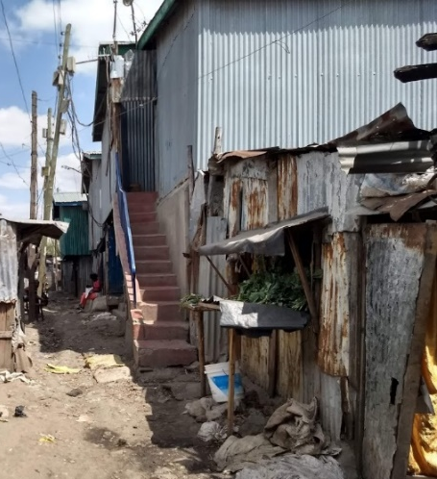
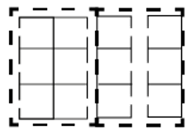
Choice rules
Meaning of land: Commodity and productive of wealth
Private and public land
“Formalized” land market
Right to use, transfer, control indefinitely & sell either one of these rights

Slide 16
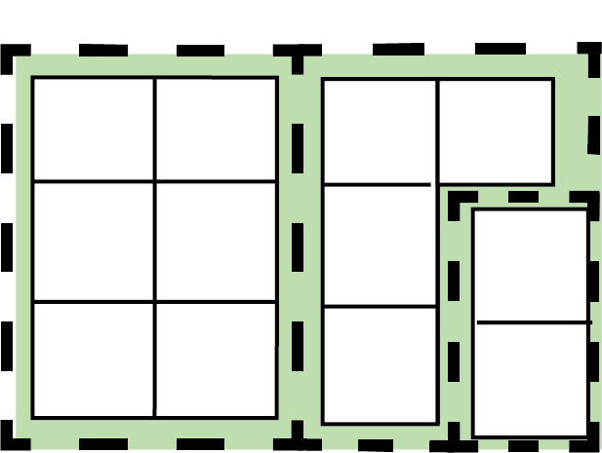
Scope rules
V.E. needs to approve any alterations made to structures
Public roads are off-limit
Similar dimensions of structure
Subdivision: separate wall
Extension to boundary

Slide 17
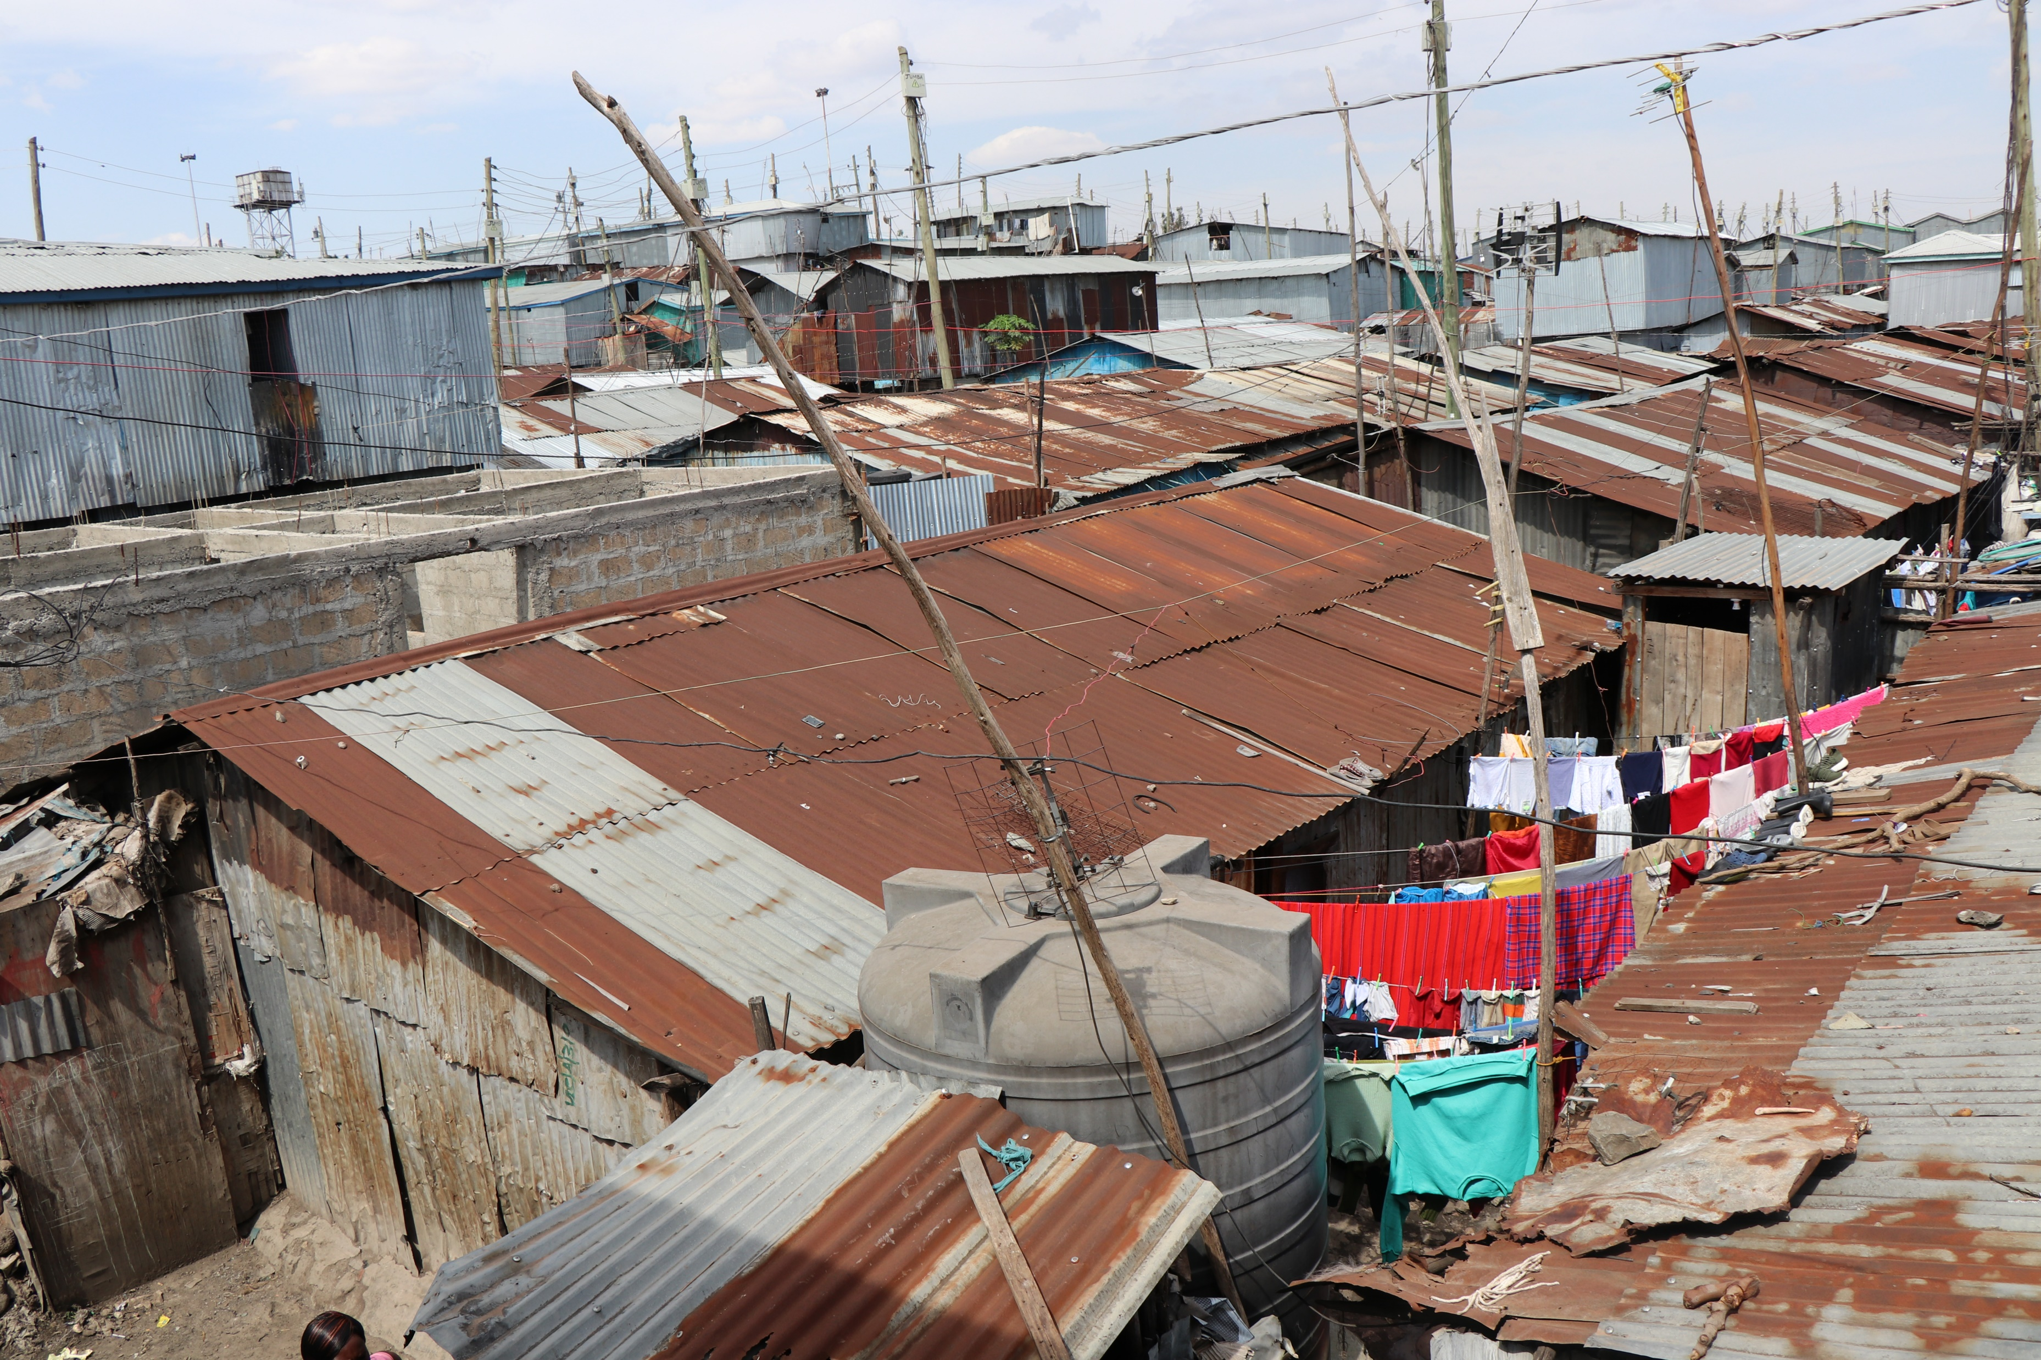
Payoff rules
Demolition of structure
Loss of ownership rights
Communal pressures

Slide 18
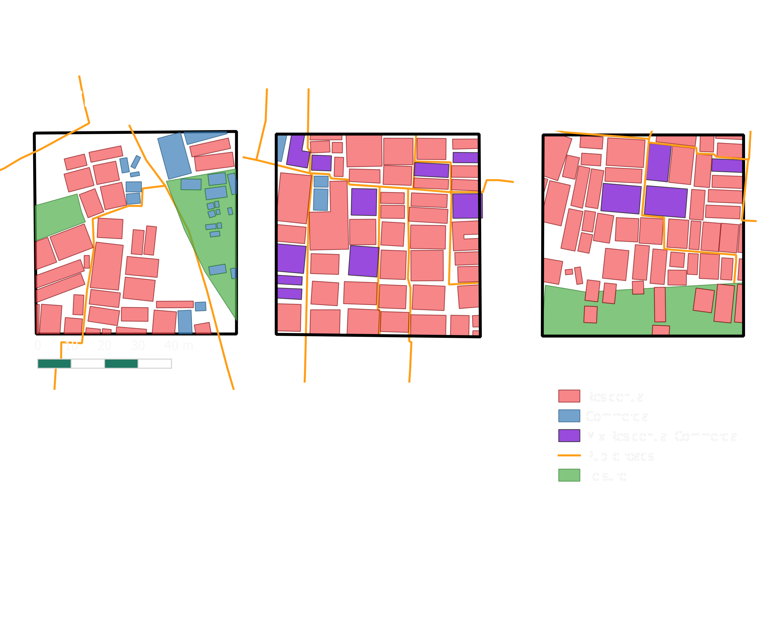
Urban development in informal settlements
High land use diversity (0.80)
High compactness (68%)
Small plot sizes (50m²)
Notes:
With regards to the second question, I found that slums have a very high land use diversity, high compactness, and reletavily small plots. Just for comparison, the smallest possible plot in the formal market is a little over 500m2
Now, what I did in this chapter was to compare how to rules identified in the previous chapter related to these spatial characteristics. I will not go through all the rules because that will be very boring for you,

Slide 19
Rules and urban development
Urban development is shaped through two main channels:
The property rights regime
Planning through real estate processes
Just like in the formal system (Geuting, Needham, etc)
Notes:
Urban development in informal settlements is thus shaped through two channels:
The property rights regime – existing mainly out of position, boundary and choice rules which determine the way the property rights market works, and thus indirectly influence urban development; and
Planning through real estate processes – existing out of scope rules which shape the outcome of urban development by placing restrictions on the bundle of rights of structure owners.

Slide 20
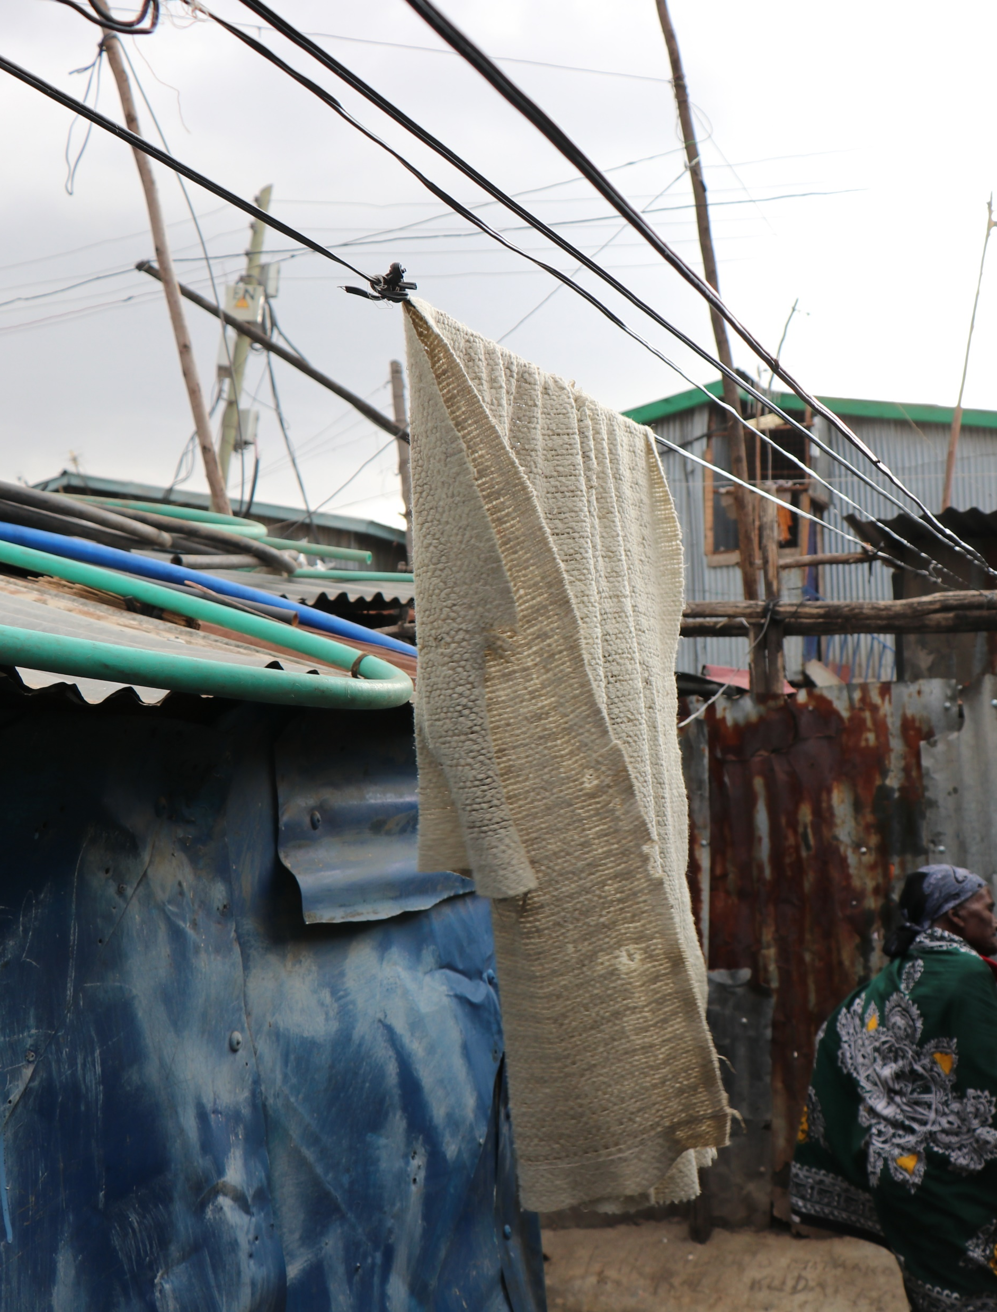
Nature of informal and formal market
Similar property rights regime
Delineation by elementary land use planning regulations
So… Can the formal and informal market coexist in peace?
Notes:
The rules of the formal real estate market are well-defined in the Constitution of Kenya, the Land Registration Act, the Land Act, the Building Code and the Physical Planning Act. Property rights in Lunga mimic those of the formal system. Just as in the formal real estate market, rights can be assigned and reassigned. However, ownership is not enforced through the legal system. Rather, ownership is enforced through informal political and communal systems.
Although in this thesis the real estate market in Lunga is referred to as informal, many of the rules that have been put into place are actually quite formal and secure in their context. People take the decision to invest in property without a clear formal title, and this decision is made based on confidence in the system. This confidence in the informal system is grounded in a believe that property rights will be enforced.
Scope rules in Lunga form an elementary planning system as there are rules in place regarding the construction, location and size of plots. However, these rules are characterized by some ambiguities that open them up to exploitation.

Slide 21
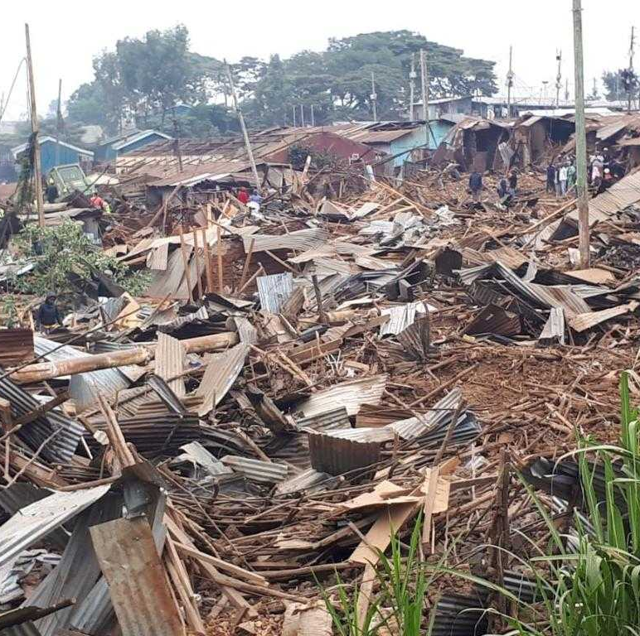
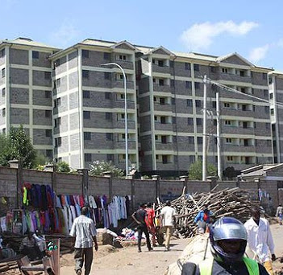
DEFINITELY NOT…
Informal land tenure not recognized in formal market
Informal land regulations adapted to context therefore not up to standards
Notes:
So in question 3 I compared the rules found in SQ1 and 2 to answer the question what would happen when rules of the formal market would be implemented in the informal market. Here I conclude that although many of the rules are very similar, the implementation of formal rules would lead to conflicts. First of all, if land regimes from the formal market would be implemented in informal settlements it would lead to evictions because land rights of informal structure owners would not be recognized.
Then, if we look at the scope rules or land regulations, we see that in the informal settlement rules are adapted to the needs of communities living there, so adapted to the little space there, low incomes, etc. So if scope rules from the formal market would be implemented here, it would also make these spaces too expensive, and probably lead to gentrification.

Slide 22
A story of legitimacy
Input vs output legitimacy
(Needham, Buitelaar and Hartmann, 2019)
Right to property vs right to the city (Lefebvre, 1974)
Notes:
Now to answer the main question I relate these conflicts to concepts of legitimacy. Needham, Buitelaar and Hartmann identify three forms of legitimacy:
Input legitimacy is derived from the agency that takes the action, and thus refers to the quality of the representation of public interests in the agent taking the action. Throughput legitimacy is derived from the process used to take an action, and thus refers to the quality of the decision-making process. Lastly, output legitimacy is derived from the results that are achieved, so when most people support the results of a certain action.
What I find is that formal real estate markets are characterized mostly by input legitimacy wheras the informal market is legitimized through the necessity of the rules in place, so output legitimacy.
This also relates to what Lefebvre’s right to property vs right to the city. In informal settlements, government claims legitimacy because they protect the rights of those formally owning the land, whereas the actors in the informal market claim legitimacy as they are excluded from the formal market.

Slide 23
References
Cooter, R. and Ulen, T. (2012) Law & Economics. 6th edn. Addison-Wesley.
Lefebvre, H. (1974). The production of space (D. Nicholson-Smith, Trans.). Oxford: Blackwell
Needham, B., Buitelaar, E. and Hartmann, T. (2019) Planning, Law and Economics. New York: Routledge.
Ostrom, E. (2005) Understanding Institutional Diversity, Public Choice. Princeton.
UN HABITAT (2016) Slum Almanac: Tracking Improvement in the Lives of Slum Dwellers. Nairobi.

