Slide 1
Barcelona – April 28th, 2024
(Hall I; 17.30-18.30)
Session SY146:
Convergent hypervirulence and multidrug resistance
in Klebsiella pneumoniae: the worst nightmare
When to suspect hypervirulent Klebsiella pneumoniae:
the role of laboratory diagnostics
Prof. Andrea Endimiani, MD, PhD
Institute for Infectious Diseases - University of Bern, Switzerland

Slide 2
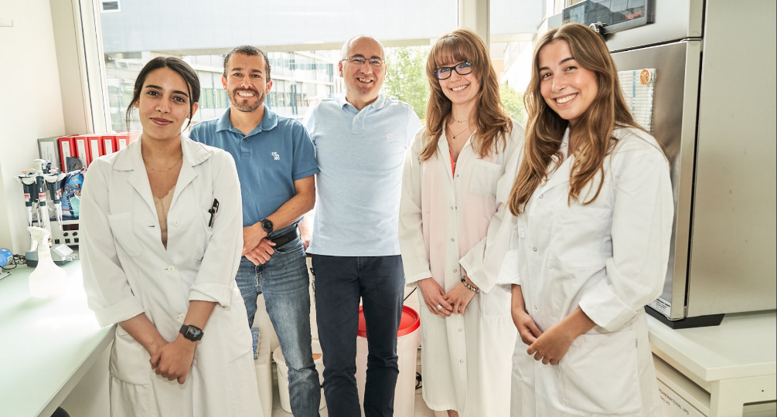
Thank you!
Edgar I. Campos-Madueno
(PhD student)
Claudia Aldeia
(Lab technician)
Yasmine Eddoubaji
(PhD student)
Cindy Kundlacz
(PostDoc)
Dania Al Ismail
(PostDoc)
SNF grant No. 192514
SNF grant No. 206400

