Slide 1
Surgical Treatment of Distal Sagittal and Parasagittal Fractures of the Proximal Phalanx in 5 Foals Santalucia V¹, O'Brien T*², Koch C*³, D Klopfenstein Bregger M*³. ¹Large Animal Department Veterinary Teaching Hospital Koret School of Veterinary Medicine the Robert H: Smith Faculty of Agriculture Food & Environment the Hebrew University of Jerusalem, Rehovot, Israel; ²Sycamore Lodge Equine Hospital, The Curragh Kildare, Ireland; ³Universitat Bern- Department of Clinical Veterinary Science, Bern, Switzerland.
ECVS Annual Scientific meeting- 4-6 July 2024- Valencia, Spain
Notes:
Good morning everyone. It's an honor to present here today.

Slide 2
No conflicts of interest to declare.
Notes:
I don’t have any conflicts of interest to declare.

Slide 3
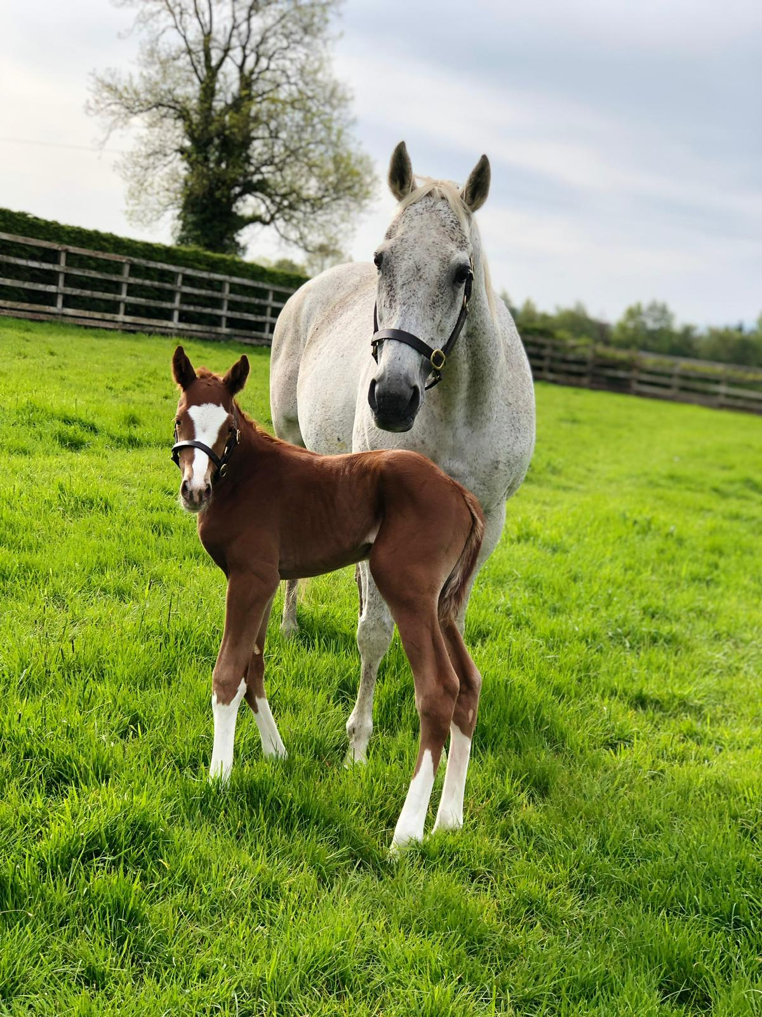
Outline
Introduction to proximal phalanx (P1) fractures
Anatomical consideration of the proximal interphalangeal joint (PIPJ)
Objectives of the study
Surgical procedure for distal sagittal/parasagittal fractures of P1
Results
Discussion
Notes:
Here is a quick outline of what I will cover today:
- Introduction to proximal phalanx fractures
- Anatomical considerations of the proximal interphalangeal joint
- Objectives of the study
- Surgical procedure for distal sagittal/parasagittal fractures of P1
- Results
- Discussion

Slide 4
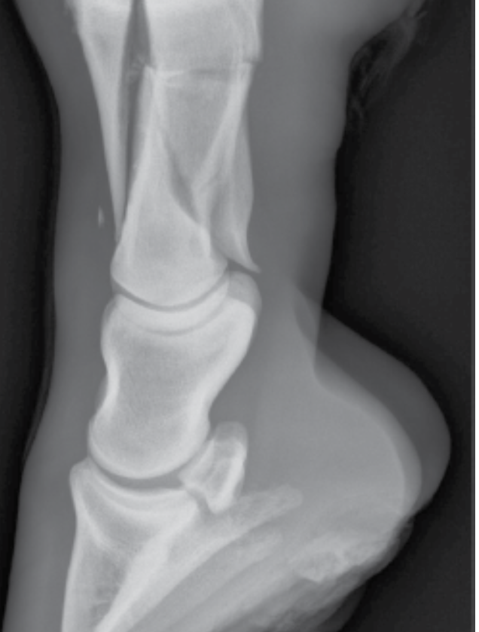
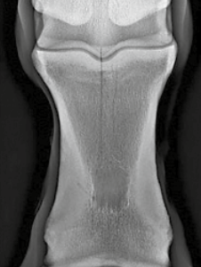
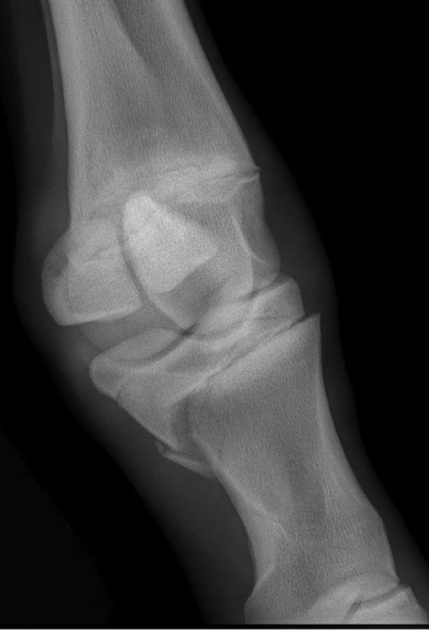
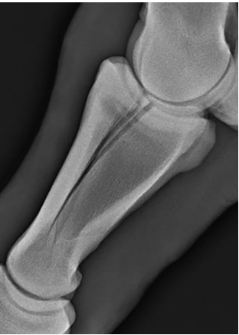
Proximal phalanx (P1) fractures
Equine Fractures Repair- Nixon 2019
Fractures in Horses- Wright 2022
Breen et al. 2023
Fractures in Horses- Wright 2022
Notes:
Everyone working with racehorses and athletic horses is familiar with proximal phalanx fractures. I’ll avoid a long and boring introduction. These fractures can present in various configurations, ranging from small fragmentations to complex comminuted fractures.

Slide 5
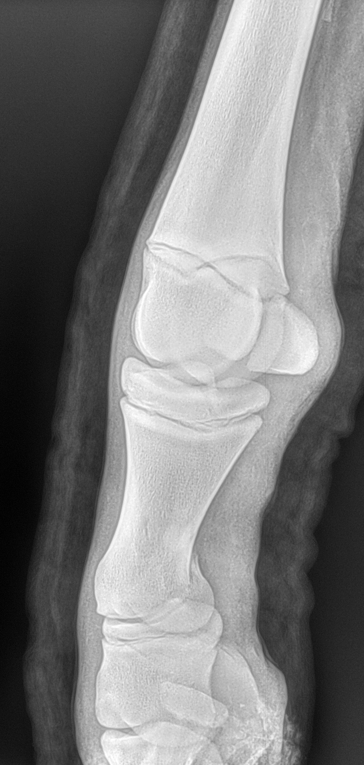
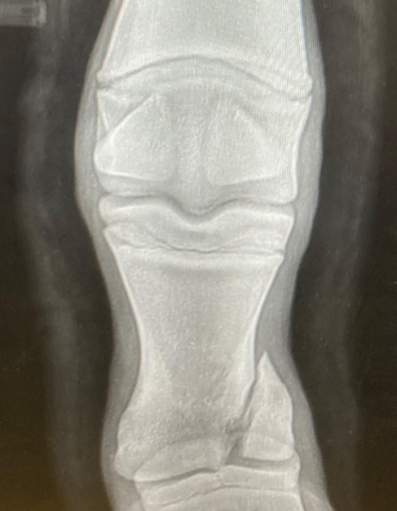
Objectives of the study
Describe distal sagittal and parasagittal fracture configuration of P1.
Describe surgical treatment with internal fixation and proximal interphalangeal joint (PIPJ) arthrodesis.
Describe short- and long-term outcomes.
Notes:
While considerable data exist regarding proximal sagittal fractures of the proximal phalanx, to our knowledge, fractures in the distal aspect of this bone have not been previously described. This study describes an uncommon fracture configuration of the proximal phalanx in foals, with the fracture starting in the sagittal or parasagittal plane at the level of the proximal interphalangeal joint and then propagating proximally and obliquely to exit the medial cortex in the lower third of the proximal phalanx. The surgical treatment with internal fixation and proximal interphalangeal joint arthrodesis is described. The short-term and, where possible, long-term outcomes are reported.

Slide 6
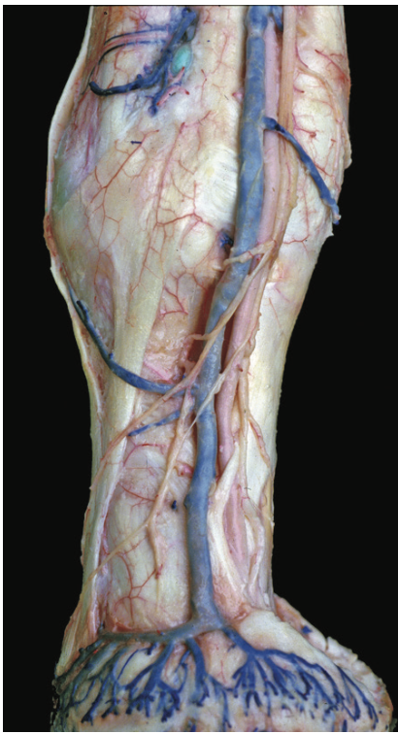
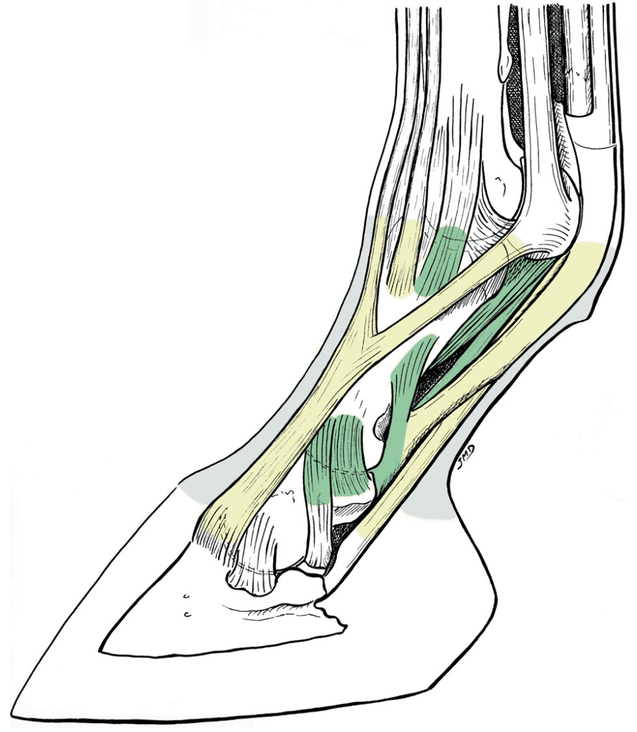
Anatomical consideration of the proximal interphalangeal joint (PIPJ)
Long digital extensor tendon
Abaxial plantar ligament of the PIPJ
Insertion branch of the SDFT in the middle scutrum
Collateral ligament of the PIPJ
Suspensory ligament of the navicular bone
The Equine Distal limb- J.M. Denoix 2000
Essentials in Clinical Anatomy of the Equine Locomotor System- J.M. Denoix 2019
Notes:
A quick anatomical consideration: the proximal interphalangeal joint is surrounded by dense fibrous connective tissue. This joint is stabilized by tendons and ligaments. Dorsally, the long digital extensor tendon attaches to the fibrous joint capsule. Abaxially to the dorsal extensor tendon lie the suspensory ligaments of the navicular bone, the collateral ligaments, and the abaxial plantar ligaments of the PIP joint. On the plantar aspect, the middle scutum is located, where the straight distal sesamoid ligament, the plantar ligament of the pastern joint, scutum compedal ligaments, and fibrous joint capsule converge. Also, the branches of the superficial digital flexor tendon attach abaxially to the middle scutum. Together, these structures maintain the stability of the PIP joint.

Slide 7
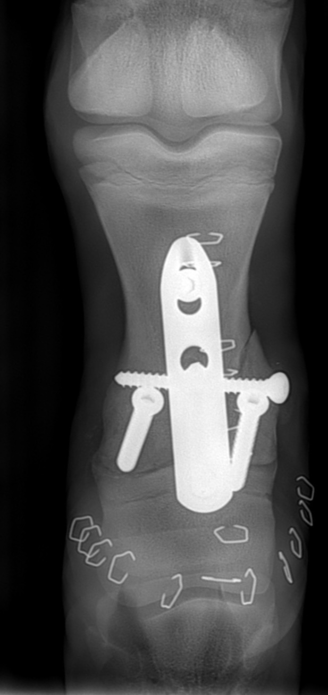
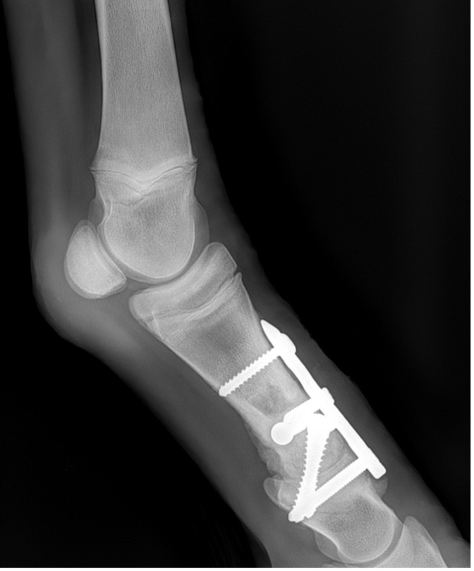
Methods
Foals underwent surgical treatment of distal P1 between 2018 and 2023.
Foals treated with internal fixation and PIPJ arthrodesis were included.
Surgical procedure:
Exposure of the PIPJ:
Inverted-T skin incision and underlying fascia.
Inverted-V incision on long digital extensor tendon.
Transection of collateral ligaments of PIPJ.
Internal fixation of distal P1:
4.5mm cortex screw in lag fashion.
In some cases, internal fixation was performed before exposing the PIPJ.
Cartilage removal and osteostixis:
Open approach.
Notes:
The medical records of horses that underwent surgical treatment for distal fractures of the proximal phalanx between 2018 and 2023 were reviewed. The surgical procedures were performed under general anesthesia, with the foals placed in lateral recumbency and the affected limb lowermost. An inverted-T incision in the skin and underlying fascia was made in the dorsal aspect of the pastern, followed by an inverted-V incision of the long digital extensor tendon. The tendon was dissected and freed around the plate, ensuring that the coffin joint was not penetrated. The collateral ligaments were transected and the joint was exposed. The fractures were reduced using a single 4.5 mm cortex screw placed in the frontal plane across the distal condyle of P1 in a lag fashion, with radiographs confirming the correct placement of the implant. In some cases, internal fixation was performed before exposing the proximal interphalangeal joint. The articular cartilage was debrided and osteostixis of the proximal and middle phalanx was performed.

Slide 8
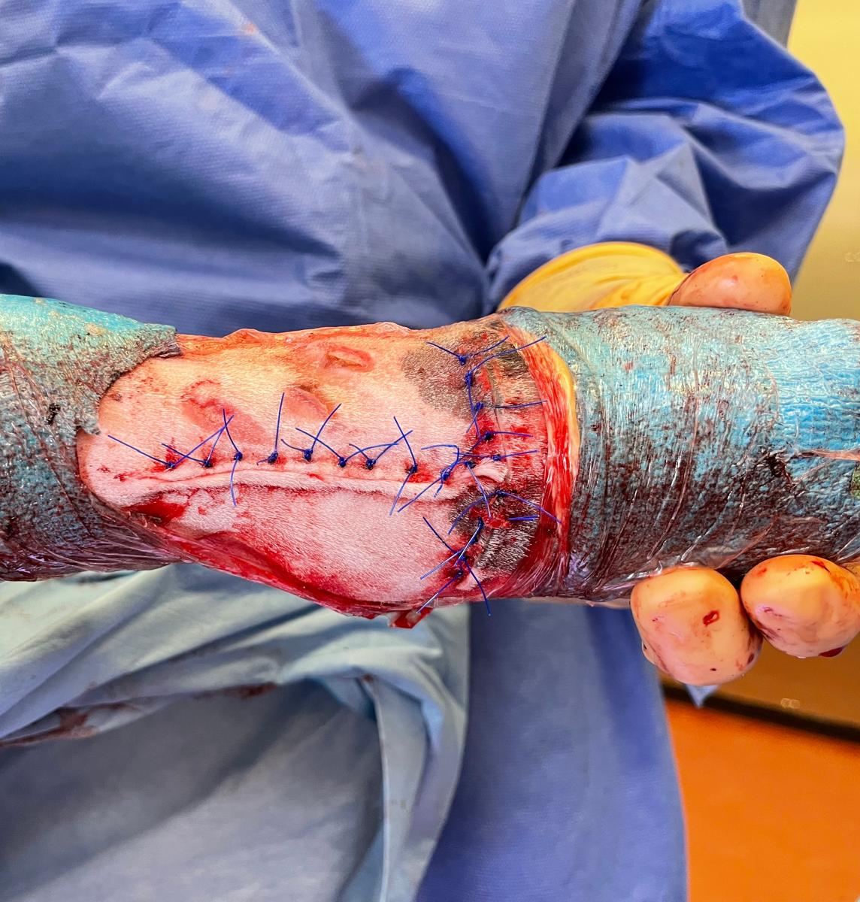
Methods
Implant Placement:
Narrow 3 or 4 hole LCP (4 cases) and 4.5mm LCP-PIPJ (1 case).
5.5mm transcortical screws in lag fashion- in some cases just 1 screw to avoid line of fracture.
Closure:
Long digital extensor tendon routinely.
Skin incision with tension-relieving sutures and/or skin staples.
Notes:
A single axially narrow 3 or 4-hole 3.5 mm locking compression plate was used in four cases, and a three‐hole 4.5 mm locking compression plate designed for proximal interphalangeal arthrodesis was used in one case.
Additionally, two 5.5 mm transarticular cortex screws were placed abaxial to the plate in a lag fashion. The glide holes were drilled retrogradely. In some cases, only a single 5.5 mm transarticular screw was used to avoid penetrating the fracture line on the medial aspect.
The extensor tendon was closed routenly. The skin was closed with a vertical mattress pattern and staples in some cases.

Slide 9
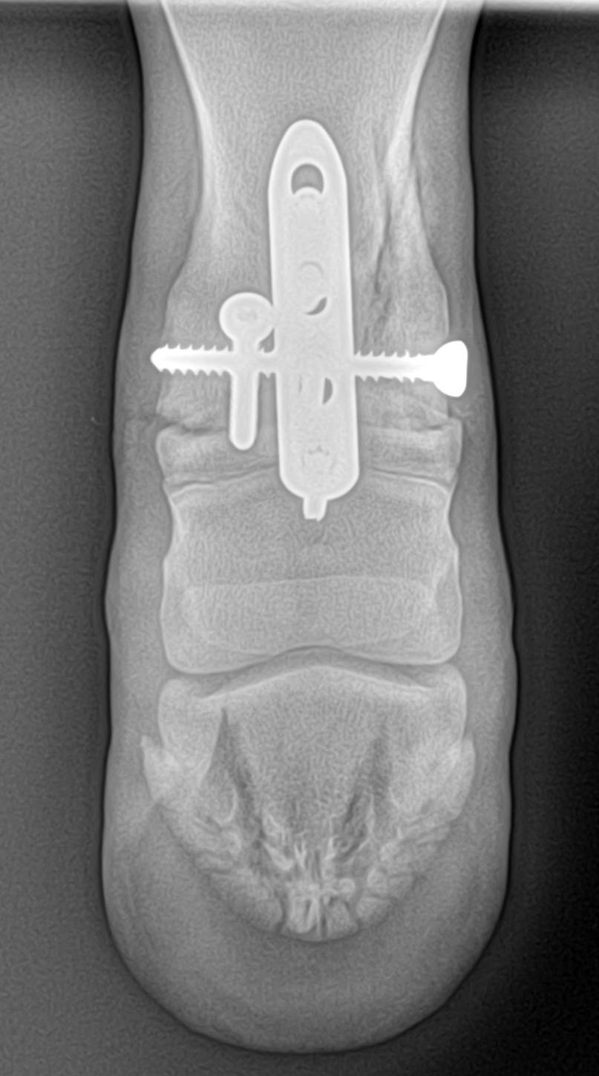
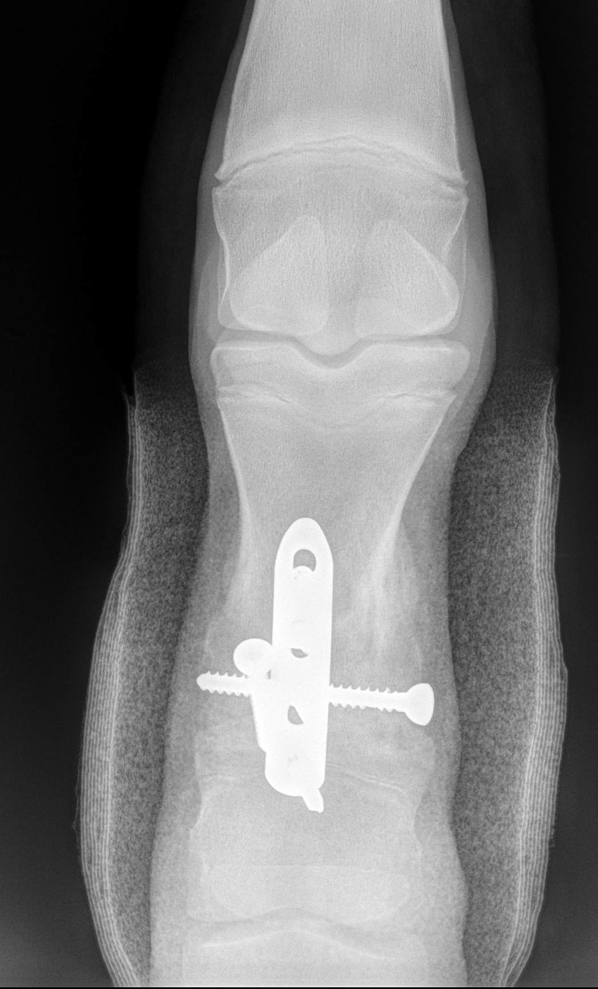
Methods
Post-op:
2-week cast followed by a half-limb bandage.
Stall rest for 3 months followed by controlled exercise.
Corrective shoes with plantar extension.
Notes:
A half-limb cast was applied post-operatively for 10 to14 days to facilitate soft tissue healing. Stall rest followed by paddock confinement was advised for 3 months.

Slide 10
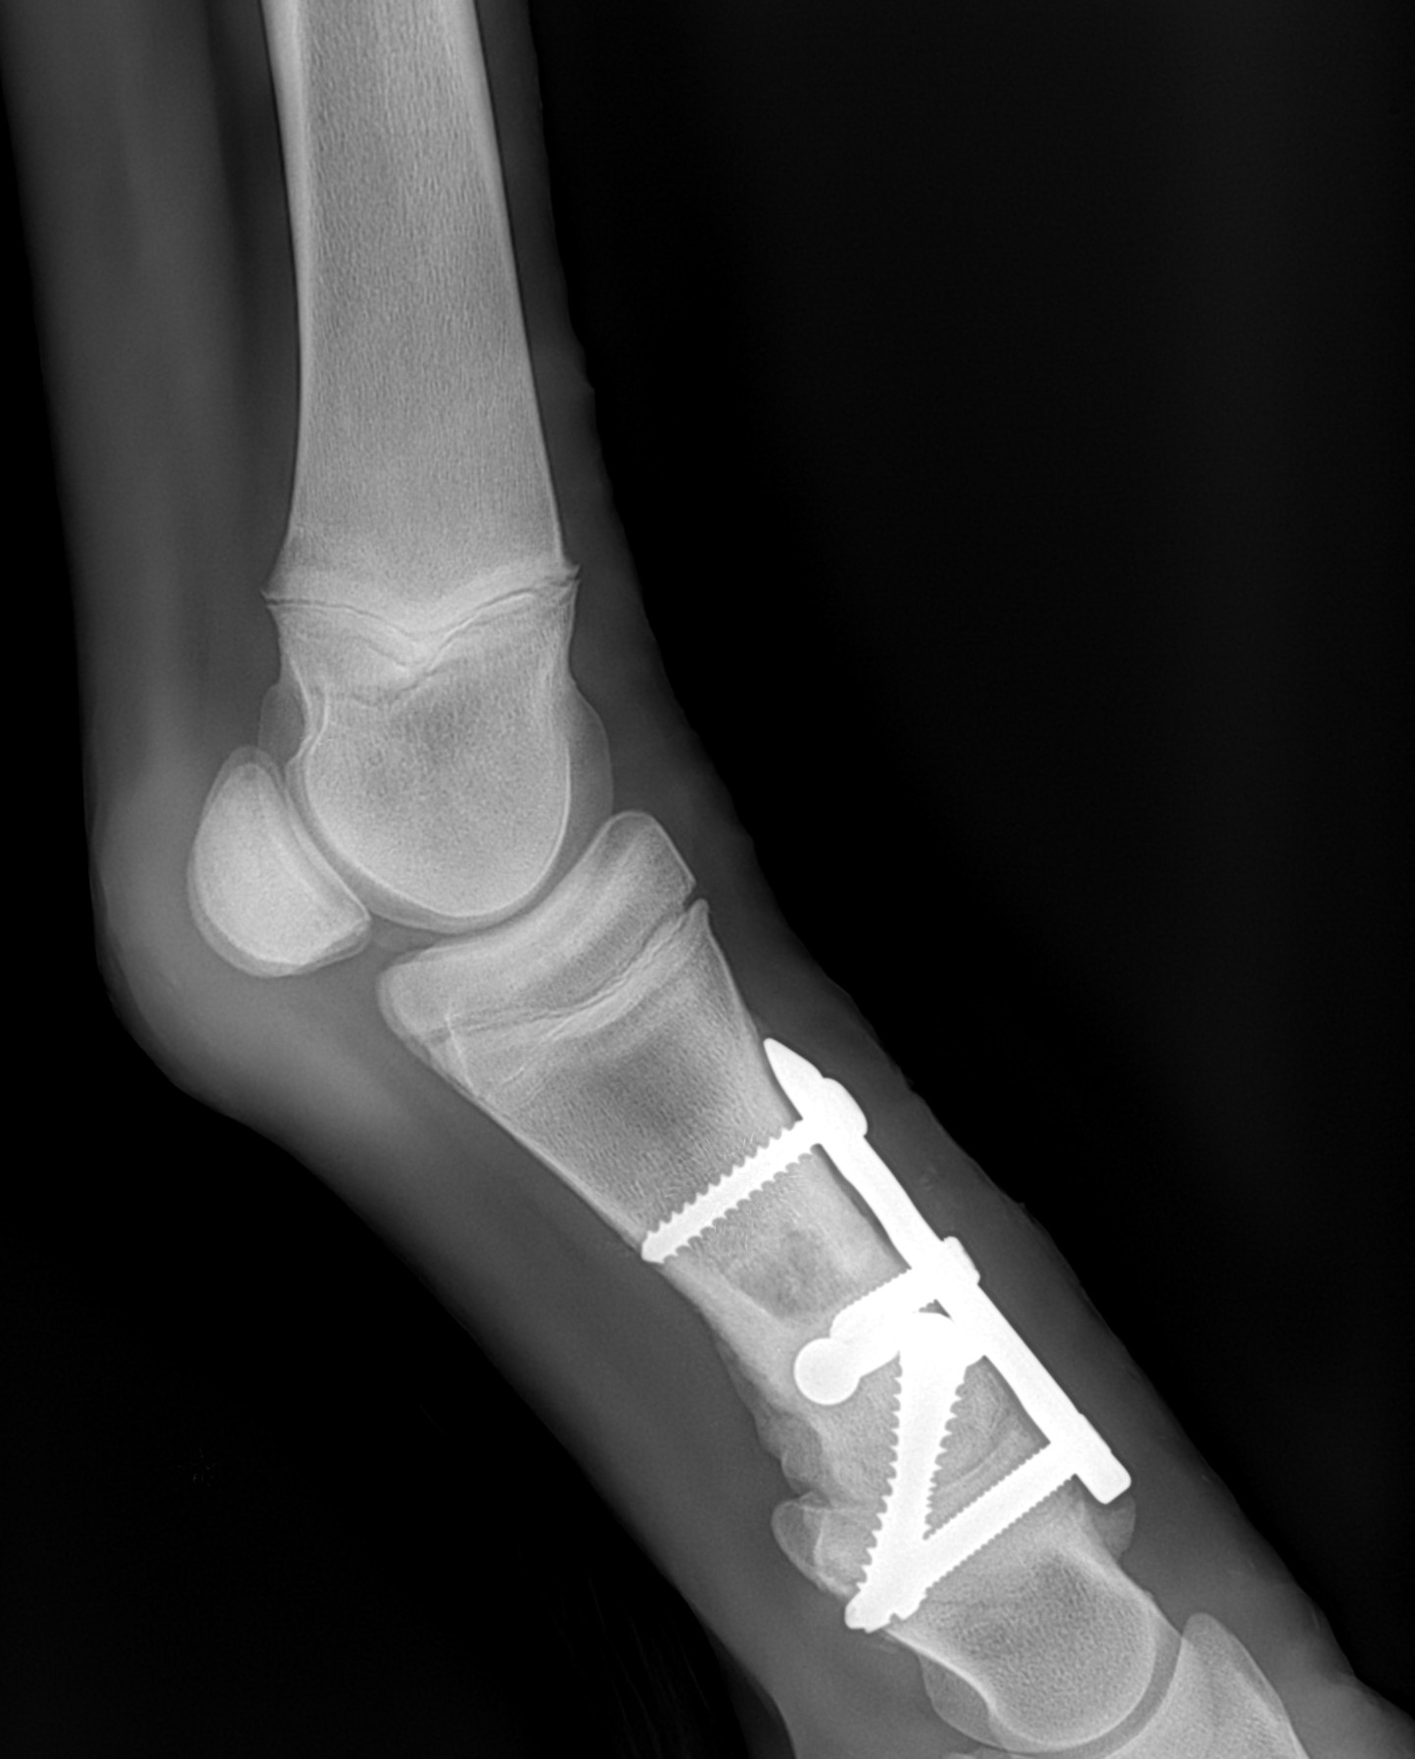
Results
5 foals: 4 TB, 1 WB.
Age: 4-8 months.
All fractures occurred in the hindlimb: 3 in the right hind limb and 2 in the left hind limb.
In all cases, the fracture line exited through the medial cortex.
5/5 foals were sound after surgery.
3/5 foals entered in races and 2/5 foals remained sound (underwent surgery in 2022-23).
Notes:
Regarding the results of our study, 5 foals met the criteria for inclusion, 4 thoroughbreds and 1 warmblood, aged between 4-8 weeks. All the fractures were in the hindlimb (3 right hind and 2 left hind). The fracture line exited the medial cortex in the lower third of the proximal phalanx in all cases. Soundness was restored in all foals. Three of the five foals entered race training. The foals treated in 2022 and 2023 are reported to be sound, though it is too early to determine their athletic performance.

Slide 11
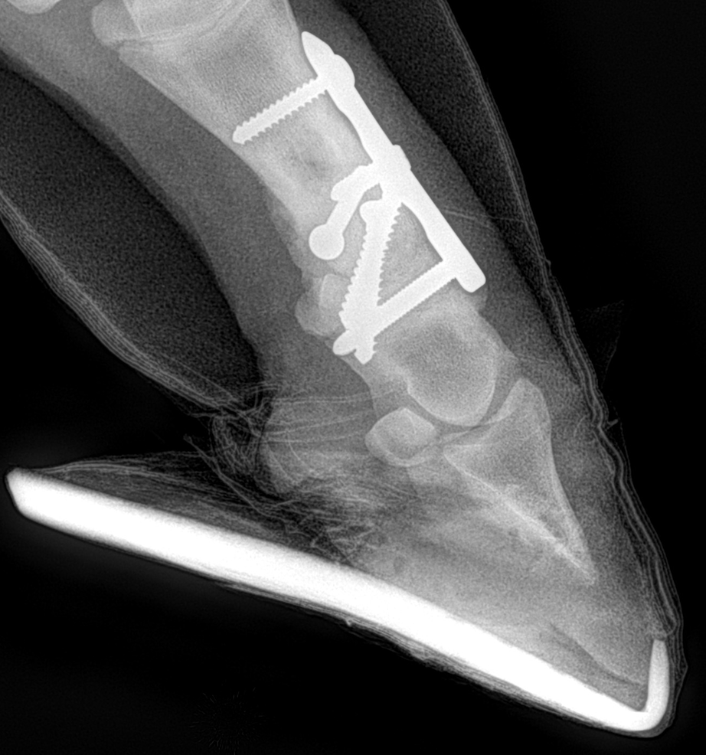
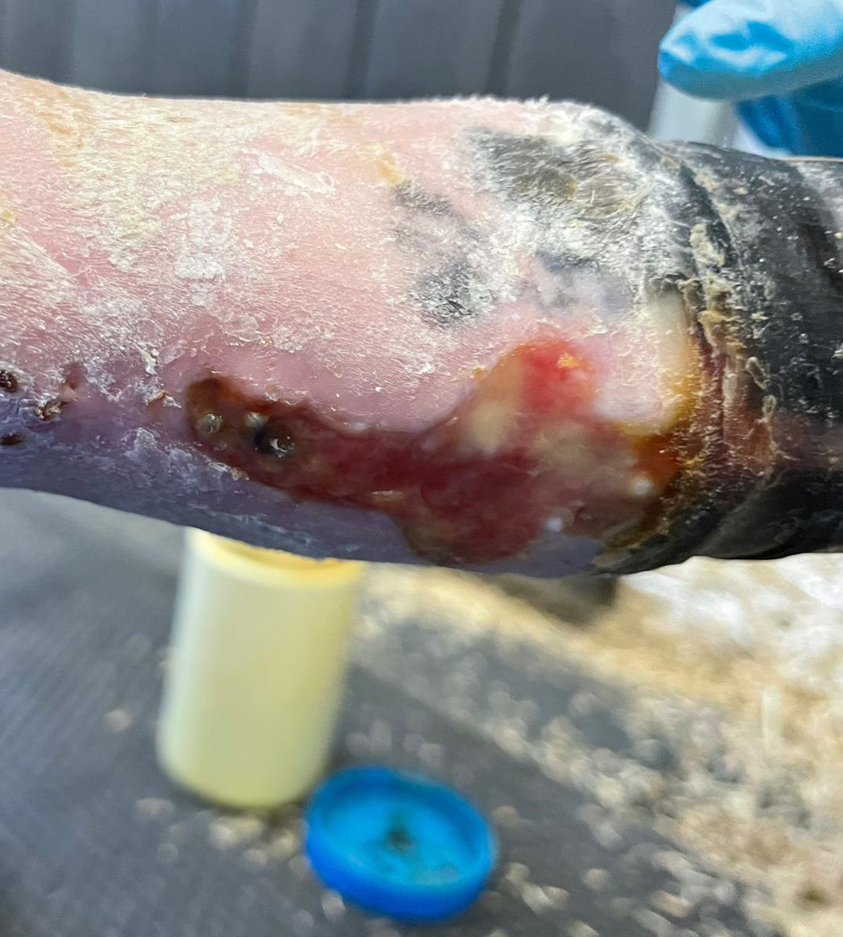
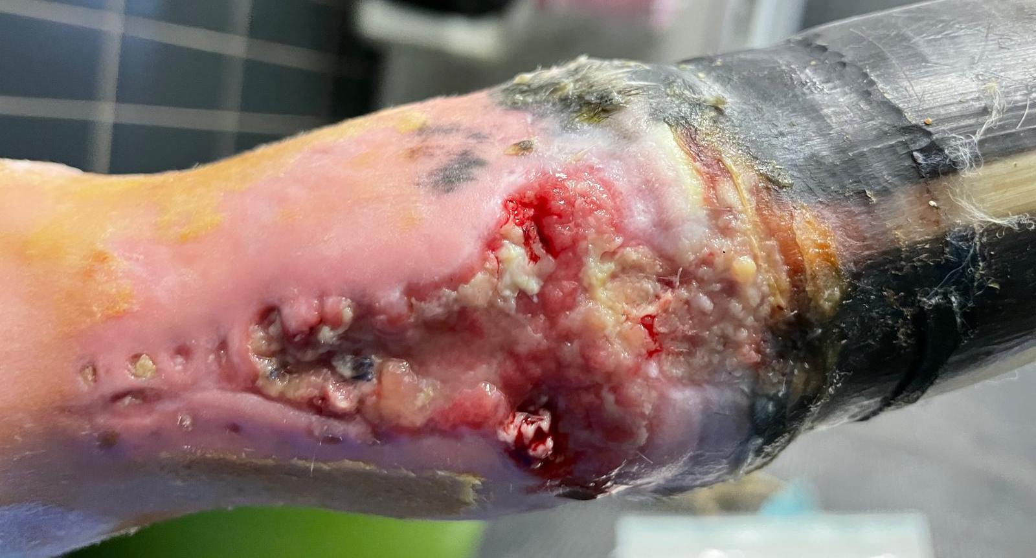
Results
All foals developed flexural tendon laxity.
2/5 foals experienced wound dehiscence.
Notes:
Due to the cast immobilization, all the foals developed flexor tendon laxity and required the application of shoes with a plantar extension. Two foals developed wound dehiscence, which was resolved with appropriate wound management. The wounds did not involve the implant. These pictures illustrate the wound in both its early and late stages of healing.

Slide 12
Results
Notes:
This is one foal treated for a distal fracture of the proximal phalanx on the left hind limb that developed a dehiscence of the surgical site. She still had a plantar extension; however, she appeared sound at walk.

Slide 13
Discussion
Notes:
Pastern arthrodesis has demonstrated significant success in treating osteoarthritis of this joint or fractures of the second phalanx. Various surgical techniques have been reported in the literature, including the use of three transarticular screws in parallel or convergent configurations, and plates such as the dynamic compression plate or locking compression plate with abaxial transarticular screws placed in lag fashion. In a retrospective study by Herthel et al., which included 82 horses, it was found that 83% of those treated with three 5.5 mm transarticular screws in lag fashion, 82% treated with a dynamic compression plate, and 79% treated with a locking compression plate successfully returned to function. Knox and Watkins reported a successful outcome in 95% of hindlimbs treated with a dynamic compression plate and abaxial transarticular lag screws. In a more recent study by the same authors, 85% of hindlimbs treated with pastern arthrodesis using a locking compression plate had a successful outcome.

Slide 14
Discussion
Internal Fixation and PIPJ Arthrodesis in horses with P1 fracture:
Restored sagittal alignment and stabilization.
Enhanced cartilage removal and promoted faster joint fusion- reducing new bone formation.
Reduced cast immobilization time.
Suitable treatment for athletic horses.
Notes:
In our cases, pastern arthrodesis using transarticular screws was inadequate due to sagittal instability of the pastern joint with the fracture displaced. Additionally, in the same case, we chose not to place a transarticular screw in the medial aspect of the first phalanx because it was positioned directly over the fracture line. Using an axial plate and two abaxial transcortical screws in the pastern arthrodesis allowed us to restore sagittal alignment and stabilize the joint effectively. An open approach, rather than a minimally invasive technique, facilitates the removal of more cartilage, promoting faster joint fusion with reduced periarticular new bone formation. Previous studies have indicated that using a single axial plate for pastern arthrodesis, in conjunction with two transarticular screws, reduces the duration of cast immobilization. In our study, foals kept in a cast for only two weeks developed flexor laxity, suggesting that prolonged casting could exacerbate complications. Flexor laxity was successfully managed using plantar heel extensions, with no additional complications noted. Our findings support that horses with fractures involving the distal aspect of the proximal phalanx treated with internal fixation and pastern arthrodesis using an axial plate and two transarticular screws experience immediate patient comfort and can pursue a racing career. Why didn't we use internal fixation alone and instead combine it with pastern arthrodesis? Internal fixation alone may fail to fully restore joint congruity, increasing the risk of pastern joint osteoarthritis and potentially requiring later arthrodesis, which could prematurely end an athletic career. Of the horses in our study, 3 out of 5 racehorses have successfully started a racing career, while the 2 horses that underwent surgery recently are sound but not yet competing. While we can prove that horses with fractures of the distal aspect of the proximal phalanx treated with pastern arthrodesis can pursue a racing career, we cannot determine if this technique is suitable for jumping horses for a long athletic career. However, previous studies have shown that jumping horses undergoing pastern arthrodesis competed successfully. This X-ray illustrates complete bone fusion with minimal new bone proliferation in one case treated for a fracture at the distal aspect of the proximal phalanx.

Slide 15
Future Directions
Further research, larger sample sizes and longer follow-up periods will help confirm these results and refine our techniques.
Notes:
Of course, further research, larger sample sizes, and longer follow-up periods will help confirm these results and refine our techniques.

Slide 16
Conclusion
This is the first study to describe a new fracture configuration in the distal aspect of the first phalanx.
In conclusion, internal fixation combined with pastern arthrodesis appears to be a suitable treatment for distal sagittal and parasagittal fractures of the proximal phalanx in foals.
Notes:
In conclusion, this is the first study to describe a new fracture configuration in the distal aspect of the first phalanx. Internal fixation combined with pastern arthrodesis appears to be a suitable treatment for distal sagittal and parasagittal fractures of the proximal phalanx in foals.

Slide 17
Acknowledgments
Tom O’Brien.
Christopher Kock.
Micaël Klopfenstein Bregger.
Notes:
I would like to express my gratitude to my co-authors for their invaluable contributions to this study and for giving me the opportunity to present these findings.

Slide 18
Questions?
The Curragh Racecourse- Ireland
Notes:
Thank you for your attention. I am now open to any questions you may have about our study.

