Slide 1
Swiss Political Science Association
Annual Congress 2013
January, 31, and February, 1, 2013
Big changes of political power in
democracies: 1920-2011 Klaus Armingeon and Sarah Engler
University of Berne

Slide 2
Crisis as window of opportunity?
‘In the prosperous years preceding the crisis, a policy approach and support coalition developed. Then came crisis, challenging both policy and coalition. Crisis opened the system of relationships, making politics and policy more fluid. Finally a resolution was reached, closing the system for a time, until the next crisis’ (Gourevitch 1986: 21-22).

Slide 3
First hypothesis: changing the politics
Research question:
Crises → higher P(change of power)?
Definition of change of power
Major shift in government composition
1960-2011: shift between left, center and right parties (>33% of cabinet seats)
1919-1936: shift between social democratic, liberal, Christian democratic, conservative and agrarian parties (>33% of parliamentary seats of the governing parties)

Slide 4
Two restrictions
Elections
Only change of power due to elections (main argument: crisis changes electoral behavior and party programs)
Rule of 5 years:
If comeback of old composition within 5 years → no change (e.g. Portugal 2002: election of a right-wing government; 2005: comeback of Socialist party (no change)

Slide 5
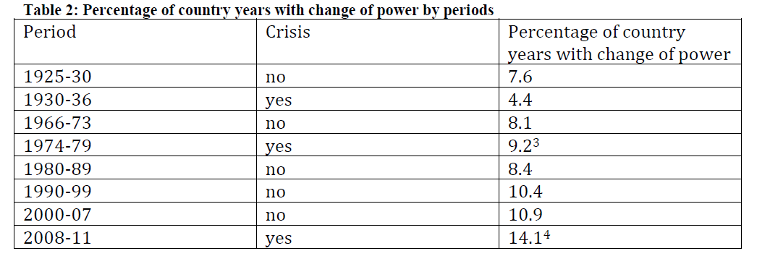
Results 1925-2011: Time trend
Notes:
8.8 (66-73) 8.3 (74-79) 11.4 (2000-2007) 13.0 (crisis today)

Slide 6
Results Logistic Regression 1966-2011
Model 1/2
Crisis dummy: no significant effect
Trend variable (year): positive effect
Model 2/3
Country specific economic situation (change of unemployment, inflation, real growth of GDP): no effect
Trend variable: positive effect

Slide 7
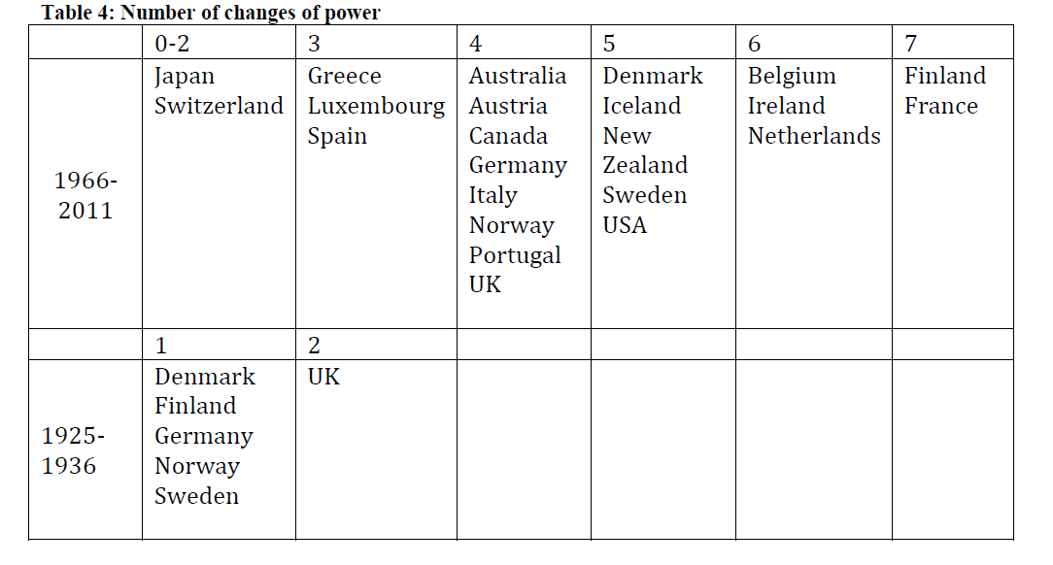
Institutional explanation? No clear clusters…

Slide 8
How to explain trend effect?
One explanation: volatility (Pedersen-Index)
Model 5/6:
Volatility: positive significant effect
Trend variable: loses significance
Concerns about volatility:
Volatility is necessary for change of power
Non-stationary (Dickey Fuller test: no)

Slide 9
Discussion
Big changes of political power in democracies: 1920-2011

