Slide 1
Do Labor Market Reforms Pay Off?
Klaus Armingeon (Bern) & Lucio Baccaro (Geneva)
June 2013

Slide 2
Problematique
Politicians:
May 29, 2013: EU Commission will ease ist hard line on austerity on the condition that countries embark on labor market reform – rigid rules: inefficiency, segmentation, dualization
Economists:
Labor market rigidities are responsible for high unemployment. Liberalization works – but this is not unconditional
VOC and others:
Rigidities may not be bad – provided there are institutional complementarities

Slide 3
Summary
Focus: Reforms – not levels
Question:
Will liberalizing reforms of labor markets reduce unemployment and increase employment?
If no: Under what conditions will liberalization work?
Answers: (1) No (2) Favorable conditions
Difference-in-Differences
fRDB plus own data collection
14 EU countries, 1972-2012

Slide 4
Identifying reforms
fRDB: liberal experts assemble a database on reforms with comparable information
Criteria: Complete (majority of workforce) and / or structural (modification of overall design of system)
171 country-years with liberalizing reforms. From these we take the top 15% (26 cases=5% of all 546 country-years). Control group: Country years without reforms/USA
Example: Hartz Reforms

Slide 5
Analysis
The basic idea of a difference- in-differences analysis is to de-compose the change in outcome variables before and after treatment in (1) a parameter which indicates the outcome value before treatment , (2) a parameter that indicates changes in all outcome values after treatment, (3) a parameter that indicates the average outcome value in treatment countries which is not due to the treatment and (4) a parameter that indicates the impact of the treatment (see Wooldridge 2003: 454-460)
∆u, which is due to reform = (u after treatment in treatment group – u in control group after treatment)-(u before treatment in treatment group-u before treatment in control group)
Quasi-Experimental design (no random assignment to treatment)
Improvements: trend; exclusion rules, entering into force, lags

Slide 6
Figure 1: Hypothetical Trajectories of the Unemployment Rate in Treatment and Control Groups

Slide 7
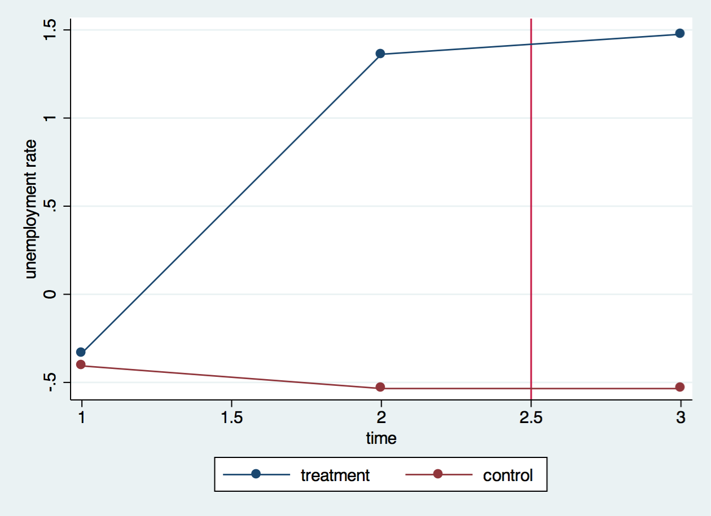
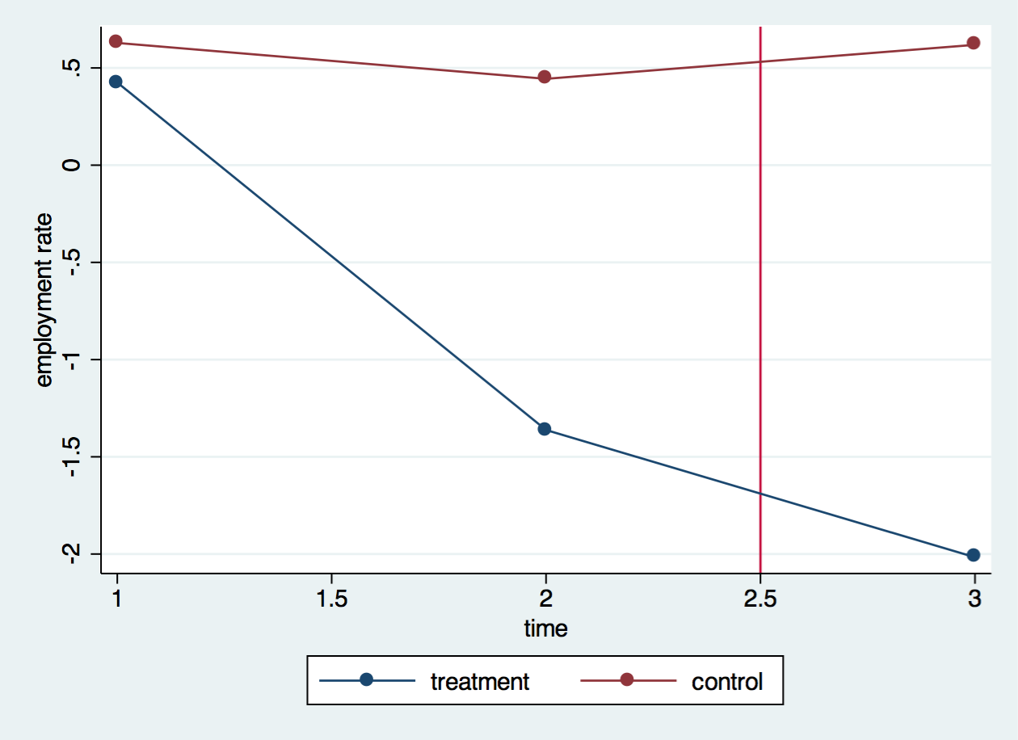
Trajectories: Unemployment (left) and employment (right)

Slide 8
Regression analysis
DV: residual of a regression of the original outcome variable on time and country dummies )average 5 years after reform)
b₁ treatment
b₂ time (1 if post-treatment)
b₃ treatment * time
b₄ lagged DV
b₅ trend
b₆ treatment group * trend
b₇ treatment group * time
b₈ trend * period dummy
b₉ controls, such as growth

Slide 9
Robustness tests
Raw data rather than residuals
Different periods before, after
Different operational definitions of reforms
Different data bases (Scruggs, EPL)
Only non-employment benefits
Standard TSCS
Ceiling effects (EPL as a control)

Slide 10
When does it work?
Consistency
Context
Growth
Policy
Product market regulation
Social policy (two measures)
Tax policy
Politics
Liberal Government
Single Party/Minimum winning coalition
Vetopoints

Slide 11
When does it work?
A simple measure of success is the difference between the differences of the respective dependent variable in the treatment and the control group.
A second measure controls for the trend and compares the differences between the slopes in the treatment groups with the differences between the slopes in the control group.
We defined a reform as successful if both measures were positive.

Slide 12
When does it work?
Truth table
Context:
Economic growth is crucial for success. In all cases in which reforms failed, economic growth was weak. In 80 percent of all cases of successful reforms, economic growth was strong.
Policy
No success without supporting development of the welfare state. In order to improve employment outcomes, liberalization of the labor market has to be accompanied by public policies that do not countervail the logic of liberalization. In 85 % of all failed reforms, liberalized labor market rules tended to be offset by increasing social policy spending (standardized by GDP). In contrast in 80-89% of all cases of successful labor market reforms, social policy development did not countervail – but that means that politicians do not expand WFS more than growth rate.
Politics
Political institutions are of some relevance for the success of liberalizing reforms. Social democratic and centrist parties engage more frequently in major liberalizing reforms than conservative-liberal parties, but this is irrelevant for success. In 57% of all failed reforms, government were not much constrained by many institutional veto player, while this share was 90% in the case of successful reform

Slide 13
Conclusion
A common trajectory: Liberalization
In about 50% of cases reforms are successful, in about 50% they fail.
Growth is crucial (and perhaps once you have growth you don’t need reforms)

