Slide 1
Contact, Mobility and Authenticity: Language Ideologies in Koineisation
Wellington Thesis Group, 14th April 2014
Laura Tresch
Prof. David Britain
University of Bern

Slide 2
Introduction
How are new dialects represented in metalinguistic discourse?

Slide 3
Introduction
How do notions of unity, authenticity, mobility, economic efficiency, etc. in dialect contact situations affect the legitimacy and status of certain varieties (and vice versa)?

Slide 4
Introduction
Two relatively new varieties will be analysed, as we regard the early stage of a variety as particularly interesting when it comes to negotiating its status and constructing ideological perceptions in discourse.

Slide 5
Dialect Project
More legitimised
Local standard variety
Overt prestige
New Zealand English
Less legitimised
Non-standard variety
Covert prestige
Estuary English
Southeast England

Slide 6
Key Concepts: Language Ideologies
‘Language ideologies’ have recently been defined as:
beliefs, feelings, and conceptions about language structure and use which often index the political economic interests of individual speakers, ethnic and other interest groups, and nation states. These conceptions, whether explicitly articulated or embodied in communicative practice, represent incomplete or ‘partially successful’, attempts to rationalize language usage; such rationalizations are typically multiple, context-bound, and necessarily constructed from the sociocultural experience of the speaker (Kroskrity 2010:192).

Slide 7
Key Concepts: Language Ideologies
“Language ideologies are never just about language. Language ideologies are […] about construction and legitimation of power, the production of social relation of sameness and difference, and the creation of cultural stereotypes about types of speakers and social groups” (Spitulnik 1998: 164).

Slide 8
Multisitedness
Paul Kroskrity (2010) draws on Susan Philips, stating that there are two types of ideological sites:
sites of ideological production (ex. newspapers, broadcasting, educational system)
sites of metapragmatic commentary (ex. newspapers, letters to the editor)
“[I]t is only the latter which both requires and demonstrates the discursive consciousness of speakers” (Kroskrity 2010: 199).

Slide 9
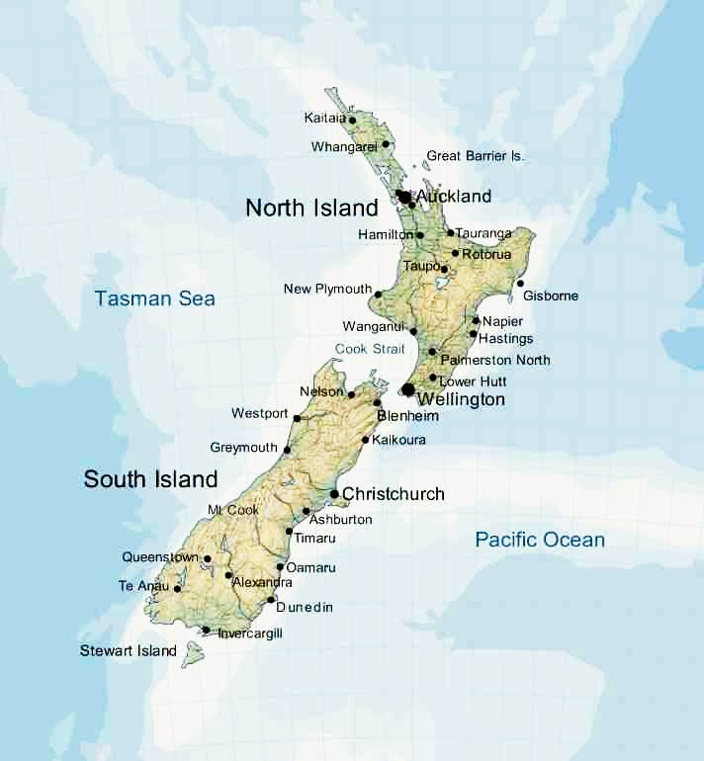
Case Study: New Zealand English
Language Ideologies: the Formation and Legitimisation
of New Zealand
English

Slide 10
Case Study: New Zealand English
Introduction:
For long only British standard norms (RP) were deemed suitable for media broadcasting and educational purposes → Exonormative linguistic orientation.
Today NZE is more acceptable and legitimate in areas where before only RP was → The country became endonormative.

Slide 11
Case Study: New Zealand English
Main aims:
Investigate the metalinguistic discourses during the period of transition from a British norm to a New Zealand norm in the media context (and other relevant areas).
Identify and examine the (language) ideologies that have shaped and underlain these discourses and their related practices in these media (e.g. broadcasting norms).
Consider sociolinguistic and pragmatic effects.

Slide 12
Case Study: New Zealand English
Why New Zealand English?
Nothing explicitly on language ideologies and on the discourses of the legitimisation of this variety.
Relatively new variety of English.
Relevant socio-historical and sociolinguistic context: ‘linguistic colonialism’ (Bell 1992) and ‘cultural cringe’ (Bayard 2000).
Comparability ‘Estuary English’ and wider project.

Slide 13
Case Study: New Zealand English
Methodology:
Focus on debates about the appropriateness of New Zealand English vis à vis external (British) models of language in public discourses (media, educational system etc.)

Slide 14
Case Study: New Zealand English
Salient periods:
1970s-1990s (1973)
1990s-Today

Slide 15
1970s-1990s
Change in attitudes and standards (1973 Britain enters the European Union).
Related to changes in socio-historical context: general attitudes towards Britain and development of a stronger sense of national identity (see Belich 2001 and Palenski 2012).

Slide 16
1970s-1990s
“A number of factors are involved in the shift that's apparent in the way some New Zealanders at least now are viewing their own form of English speech. Perhaps the chief point in New Zealand's new, or heightened, sense of independent nationhood” (Deverson and Gordon 1985:81).

Slide 17
Case Study: New Zealand English
SOURCES:
Debates in the main newspapers
Other relevant sites (Internet, Sound Archives…).
Policies and Norms
→Broadcasting Policies
→ Educational Policies and Curriculum

Slide 18
Case Study: New Zealand English
1) Newspapers
(articles about language and specifically New Zealand English, letters to the editor...):
- The New Zealand Listener
- The Dominion
- The Herald
- The Christchurch Press
- The Educational Gazette
- The Metro Magazine
- The North and South Magazine

Slide 19
Case Study: New Zealand English
2) Interviews (on the topic of New Zealand English and attitudes towards this variety, policies, standards, entry criteria, accent correction, debates):
Four members of the staff at the Christchurch Broadcasting School (including the admission manager)
Employee at the Ministry of Education (Sonia Glogowski, Head Advise, Sector Capability and Rachel Wikaira)
Presentation Standards Manager at RNZ (Hewitt Humphrey)
Editorial Policy Manager at RNZ (Gael Woods)
New Zealand English experts (Hay, Deverson, Gordon)
Journalist (Lindsay Perigo)
Speech coach (David England)
Former newsreaders (Hewitt Humphrey, Geoff Robinson, Judy Bailey)
Auckland Journalism School professors (Mollgaard, Hoar, Sissons)
David Killick (Freelance journalist and photographer, Home editor, The Press)
David Dunley (Director of the Tandem Voice Booth)

Slide 20
Case Study: New Zealand English
3) Policies and Norms:
RNZ/TVNZ Pronunciation Guides, Editorial Policies, Style Books, Accent Correction, Presentation Standards etc. (also public comments on these). → Radio New Zealand’s reference library
4) TV and Radio Archives:
Programmes on the topic, preferably with public participation and comments (New Zealand Film Archive, Sound Archives, Archives New Zealand).
5) Online material: Youtube comments (accent imitation and parody videos), blogs, online articles and related comments section.

Slide 21
Case Study 2: New Zealand English
Were there also people who supported this variety? What were the arguments in favour of it?
Why does the academic literature focus mainly on negative perceptions and comments?

Slide 22
Some Debates:
Three main newspapers debates:
Listener, 2009. Triggered by Jane Clifton's article "Mincing words”.
2) Listener, 2005 triggered by comments on TV documentary “New Zild”.
3) The Press, 1997. Triggered by Bernard Gunn's article “New Zild speech is turning our English into a foreign language”.

Slide 23
Some Debates:
Three substantial online debates:
4) Lindsay Perigo’s article «Kiwi accent killing the news» with 550 comments
( http://www.stuff.co.nz/stuff-nation/8185142/Kiwi-accent-killing-the-news).
5) YouTube video, parody NZE with 1700 comments
(https://www.youtube.com/watch?v=u7t2f-L6Z04).
6) YouTube « Beached Whale » video with 11’000 comments
(https://www.youtube.com/watch?v=ZdVHZwI8pcA).

Slide 24
Some Examples
« New Zild is now a mere pidgin. » (The Press, 1997)
«The time is past for putting ourselves down. New Zealand has come of age as a nation and there is no reason whatsoever to deny our linguistic identity. » (The Press 1997)

Slide 25
Some examples
« There is a huge difference, see the Australians (or Aussies as you put it) do SPEAK English, but for the kiwis, they DON´T. Would be really breaking news to hear a kiwi speak! I believe you were referring to the fruit, OR??? » (Youtube)
«We're proud of our New Zealand accent in a way we never used to be. » (Jim Mora)

Slide 26
Questions
Where else could manifestations of meta-linguistic discourse and language ideologies be found?
Any debates today?

Slide 27
Bibliography
Bayard, D. 2000. The cultural cringe revisited: changes through time in Kiwi attitudes towards accents. In A. Bell and K. Kuiper (Eds.) New Zealand English. Amsterdam: John Benjamins Publishing Company, 297-324.
Belich, J. 2001. Paradise Reforged: a History of the New Zealanders; from the 1880s to the Year 2000. New Zealand: Penguin Books.
Bell, A. 1991. The politics of English in New Zealand. In G. McGregor and M. Williams, Dirty Silence: Aspects of Language and Literature in New Zealand. Essays arising from the University of Waitako Winter Lecture Series of 1990. Auckland: Oxford University Press, 65-75
Bell, A. 1992. Hit and Miss: Referee Design in the Dialects of New Zealand Television Advertisements. Language & Communication 12: 314, 327-40.
Deverson, T. and E. Gordon 1985. New Zealand English in the twentieth Century. In T. Deverson and E. Gordon (Eds.) New Zealand English: an Introduction to New Zealand Speech and Usage. Hong Kong: Heinemann, 52-8

Slide 28
Bibliography
Duranti, A. 2001 (Ed.). Linguistic anthropology: history, ideas, and issues. In A. Duranti, Liguistic Anthropology: a Reader. Oxford: Blackwell Publishers, 1-38.
Kroskrity, P.V. 2010. Language ideologies - Evolving perspectives. In J. Jaspers, Östman, J-O, Verschueren, J. (Eds.) Society and Language Use. Amsterdam/Philadelphia: John Benjamins Publishing Company.
Palenski, R. 2012. The Making of New Zealanders. Auckland: Auckland University Press.
Spitulnik, D. 1998. Mediating unity and diversity: the production of language ideologies in Zambian broadcasting. In B.B. Schieffelin, K.A Woolard and P.V. Kroskrity (Eds.) Language Ideologies: Practice and Theory. New York and Oxford: Oxford University Press, 163-189.

