Slide 1
Choosing the Path of Austerity: How Policy Coalitions Shape Welfare-policy Choices in Periods of Fiscal Consolidation
Klaus Armingeon, U of Bern and Collegio Carlo Alberto, Torino (Fall term 2014)
Kai Guthmann & David Weisstanner, U of Bern
July 1, 2014, XXVI Villa Mondragone International Economic Seminar

Slide 2
Problem
In the period of ‚permanent austerity‘ governments have the choice to design their austerity policy with regard to
- size
- tax or spending based
- balanced (all policy sectors and all groups similarly hit) or unbalanced policy (some policy sectors and some groups are particularly hit)
Empirically the choice is limited:
- Hardly any austerity policy without some spending cuts
- Spending cuts concern also the largest budget item: welfare state. Since social expenditure is correlated with net income inequality: the more government rely on spending cuts, the more inequality.

Slide 3
Question & Theories
Question
How do different governments design austerity policies with respect to the welfare state?
Is there any effect of
Partisan composition?
Type of government?
Theories:
Left parties more reluctant to retrench welfare state/particularly able to retrench welfare state
One-party governments particularly able to pursue austerity policies. Centralized decision-making, no compromises
Broad coalitions particularly able to pursue austerity policies which cut back welfare state expenditure considerably. Time-consistency, electoral risks, investment for the future & symmetry of contributions

Slide 4
Our argument
A functionalist element:
Once you are forced to do austerity policies, the room of maneuver is very limited:
You have to rely on spending cuts
You cannot spare the welfare state, which has to make the largest contribution
Parties make no difference
A politico-institutional element:
The electoral risks and the risks of policy reversal are particularly high for one-party governments and minimal winning coalitions: Keep the policy package as small as possible.
If major potential opposition parties are included, substantial retrenchment is feasible: no electoral campaigns based on social cruelties & ‘fair’ distribution of burdens & time-consistency.

Slide 5
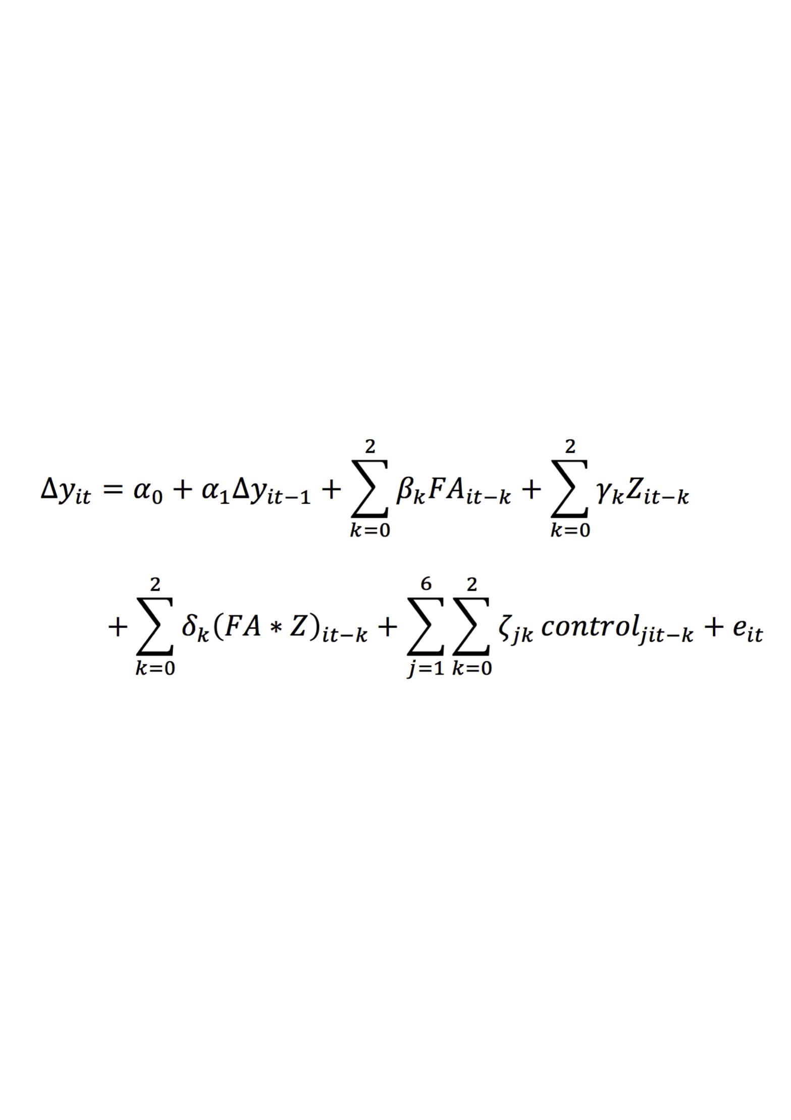
Data and methods
17 mature OECD democracies, 1982-2009
Austerity policies and not deficit development during phases of austerity policies. Devries et al. 2011 IMF. Dummies for small and large fiscal adjustments.
TSCS: A general autoregressive distributed lag model with t, t-1, t-2, calculation of long-run multipliers
Calculation of long-run multiplier: the total effect of x(t) on y(t)
distributed over future periods
Notes:
where ∆yit represents the change in total public social expenditures in country i from time t-1 to t, α0 is the constant, and α1 is the coefficient of the LDV. Z stands for either the partisanship dummy or the dummy indicating the breadth of the policy coalition (that is, we estimate two separate series of models). βk, γgammak, and δdeltak are three coefficients each (i.e. at t, t-1, and t-2) for the relevant FA dummy (FA, FA large, FA small), the relevant partisanship dummy (results reported for left governments only) or coalition dummy, respectively, and the relevant FA*partisanship or FA*coalition interaction term. Moreover, ζzetajk are coefficients for our six control variables at a maximum of three time points each. Finally, eepsilon it is an idiosyncratic error.

Slide 6
Results: No partisan effect, but coalition effect

Slide 7
Conclusion
Findings are robust: Yes, various tests. No endogeneity
There is no austerity policy without welfare state retrenchment
There is no partisan effect: Left parties do not cut less/more than non-left parties.
One-party/minimal winning coalitions tend to design welfare retrenchment as part of austerity policies in a minimalist way: electoral risks, risks of policy reversal
Broad coalitions can achieve large cuts – since they do not face the risk of being accused by large opposition groups, since they can invest in the future –although the time costs of arriving at decisions may be higher.

