Slide 1
Austerity: a comparative analysis
Klaus Armingeon
Institute of Political Science
Universität Bern
plus: Lucio Baccaro (Geneva), Marco Battaglia (Bern), Besir Ceka (Bern/EUI/UNC), Skyler Cranmer (UNC), Kai Guthmann (Bern), and David Weisstanner (Bern)
Questioning Austerity: Realities and Alternatives, York University, July 10, 2014

Slide 2
Questions, Message, Methods
Does Politics Make a Difference in the Age of Austerity? How large is the room of maneuvre for old and new political actors?
A narrow room of maneuvre: Actors are forced to respond to requirements of markets.
Politics makes a difference – but these are mainly the political decisions taken some time ago (liberalizing capital markets, creating the Euro)
In addition to left and right, the form of government makes a difference.
Methods: Comparative Analysis, EU & OECD; 2007-present; 1980-2009/a report about various papers

Slide 3
Structure
The age of austerity:
  Little political choice when responding to functional requirements
The politics of embarking on austerity
  Large coalitions do it less frequently, but more determined
The politics of protecting the welfare state during periods of austerity
  Why the left is not important, but the form of government
Ordinary citizens in extraordinary times : How austerity undermines democracy
  Why citizens blame the wrong actors and lose their trust in democracy

Slide 4
  The Age of Austerity: Little political choice when responding to functional requirements
Functional requirements:
Basic developments:
  Demography
  Globalization
    Eurozone
  Growth to limits: big government and the welfare state

Slide 5
Demography: A growing share of the population that needs support:

Slide 6
Pensions: A strong correlation between % elderly and total pension spending

Slide 7
While needs are increasing, growth decelerates

Slide 8
Big government is growing to a (unkwon) limit – there must be a limit, but we don’t know where it is.

Slide 9
Which is mainly driven by welfare state expenditure

Slide 10
  The Age of Austerity: Little political choice when responding to functional requirements
Functional requirement: Globalization (liberalization of capital markets)

Slide 11
And this goes together with international trade

Slide 12
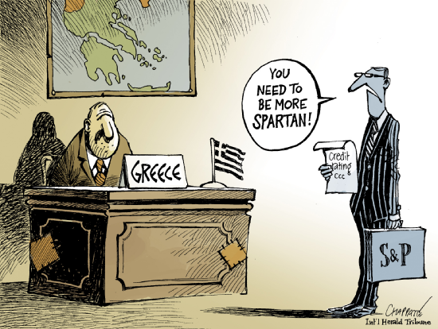
  The Age of Austerity: Little political choice when responding to functional requirements
Functional requirement: The Euro-Zone
If countries in a currency union do not converge with regard to competitiveness they have to adjust
  If devaluation is no longer feasible, there is nothing left but internal devaluation

Slide 13
  The Age of Austerity: Little political choice when responding to functional requirements
Functional requirement:
  We have no empirical evidence that actors had a choice in Greece, Portugal, Cyprus….
  A statistical analysis: The austerity plans since 2007 are a function of the interest rates on sovereign bonds
  Another statistical analysis: The interest rates on sovereign bonds are a function of ratings by S & P, Moody’s and Fitch.
  - Economic fundaments
  - PLUS some ideology (they don’t like big government)

Slide 14
  The Age of Austerity: Little political choice when responding to functional requirements
Besides from TINA: A new dominant and institutionally embedded discourse: Liberalize! Sound public finances –even if you have to cross a valley of tears (EU; WTO; OECD).
The politics of the decision making in the European council: The likelihood to side with the German government is a function of the interest rates on your sovereign bonds * level of debt.
Big choices:
  Liberalization of capital markets (Quiet politics)
  Euro and decisions in the Eurozone (e.g. Stability and growth pact: Debt > 60% needs to be reduced by 1/20 (i.e. 5%) of the difference between 60% and real level of debts. I.e. 100% debt means an annual rate of debt reduction of 2% of GDP)
    Greece 177% means 6% of GDP annually; Italy 135% means 4% of GDP annually. Economic growth rates Greece (nominal) since 2000: 4.4; Italy 3%

Slide 15
  The Age of Austerity: Little political choice when responding to functional requirements
No counter-discourse due to frail left?
Hardly! The left is as strong as before! But it has joined the new discourse (and it has some reasonable arguments for that)
The old left (trade unions) is withering away

Slide 16
A strong left

Slide 17
Withering away? The old left

Slide 18
The politics of embarking on austerity
Large coalitions do it less frequently, but more determined
Data: IMF data set on austerity policies, 1978-2009, 17 OECD democracies
What type of governments embark on austerity policies?
The standard argument: right one-party governments
Our argument: may be true for the likelihood of austerity policies, but not necessarily for the magnitude.
Governing for the long term (Jacobs 2011): Broad coalitions can achieve large austerity programs, since electoral risks are minimized and actors have less reason to be afraid of free riding/externalizing costs to groups outside the coalition.

Slide 19
Non-right parties in broad coalitions significantly opt less for austerity

Slide 20
But once the functional pressures grow stronger, broad coalitions are more determined to cut spending

Slide 21
The politics of protecting the welfare state during periods of austerity
Why the left is not important, but the form of government
The argument:
A functionalist element:
Once you are forced to do austerity policies, the room of maneuver is very limited:
  You have to rely on spending cuts
  You cannot spare the welfare state, which has to make the largest contribution
Parties make no difference
A politico-institutional element:
The electoral risks and the risks of policy reversal are particularly high for one-party governments and minimal winning coalitions: Keep the policy package as small as possible.
If major potential opposition parties are included, substantial retrenchment is feasible: no electoral campaigns based on social cruelties & ‘fair’ distribution of burdens & time-consistency.

Slide 22
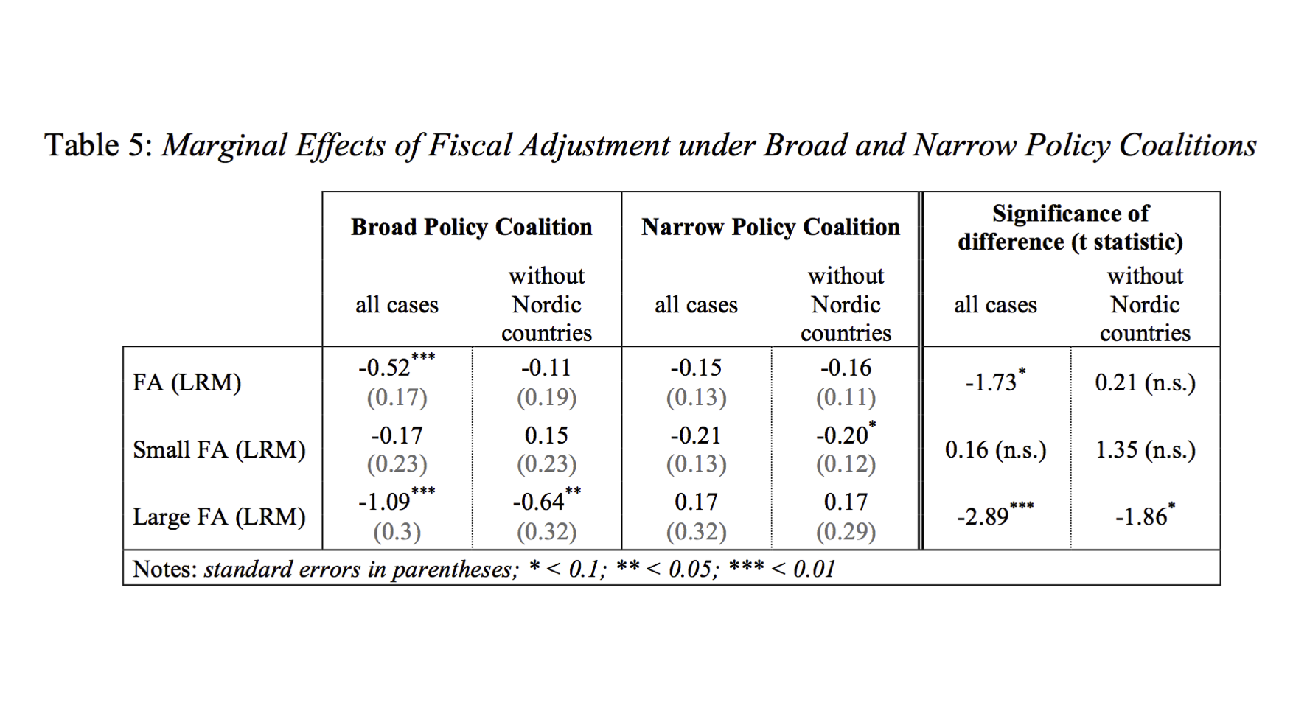
The politics of protecting the welfare state during periods of austerity
Why the left is not important, but the form of government
Results: No partisan effect, but coalition effect
Broad policy coalitions make big fiscal adjustments and this implies also big welfare state cuts

Slide 23
Ordinary citizens in extraordinary times: Support for national and supranational institutions
If national democracy is suspended by the Troika; if national governments have less and less to say and if national parliaments cannot do much against the functional and political pressures for austerity: What happens to political support by citizens?
Three papers (Armingeon/Ceka in EUP 2014; Armingeon/Guthmann in EJPR 2014; Armingeon/Guthmann/Weisstanner pallned for PVS 2015)

Slide 24
Ordinary citizens in extraordinary times: Support for national and supranational institutions
A systematic effect of Troika policies: Loss of trust in EU, loss of support for national democracy
More important: the nation state and the national economy is the point of reference for citizens: they blame their national government if the economy is not doing well due to EU policies etc. And they tend to see the EU the more positive the more positive they see their national government.
In a globalized world, citizens perceive the world through national lenses.
A divide? Trusting and supporting Northern Europe and skeptical citizens in the South

Slide 25
Conclusion: What I have learnt
(1) We live in the world of decisions taken long time ago.
(2) The room of maneuver for political actors is very limited.
(3) Under these conditions left and right have only limited effects on policies.
(4) Austerity hits those most, who are most depend on the welfare state.
(5) Centralized one-party governments are good for quick and consistent decisions; but if you need long-term solutions which are time-consistent and which are socially balanced, the larger the government coalition, the better.
(6) Support for democracy is much more dependent on economic performance than suggested by the logic of diffuse support (the older a democracy, the less is support depended on performance). The ice is thin and austerity melts this ice.

