Slide 1
TD-CONFERENCE 2010
Partnership Actions for Mitigating Syndromes (PAMS): Experience with a transdisciplinary tool in the NCCR North-South programme
Eva Heim
University of Bern

Slide 2
Content
Introduction: The NCCR North-South
PAMS – a TD tool
Case study: Risk management in Bolivia
Conclusions - Do researchers need a funding scheme for implementation?

Slide 3
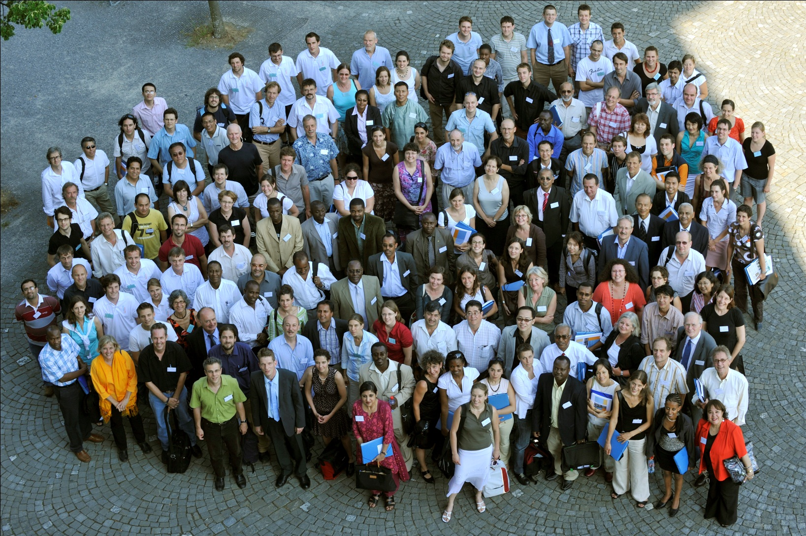
The NCCR North-South
Introduction: The NCCR North-South

Slide 4

The NCCR North-South
Introduction: The NCCR North-South
One of twenty NCCRs established by the Swiss National Science Foundation (SNSF) to promote scientific advancement in vital research areas
Co-funded by the Swiss Agency for Development and Cooperation
Network of over 350 researchers active in more than 40 countries worldwide

Slide 5
TD in the NCCR North-South
Introduction: The NCCR North-South
Special emphasis on the needs of developing and transition countries
Dedicated to finding sustainable, practicable solutions to specific challenges of global change
Research partnerships between institutions in Switzerland and the partner countries
Interdisciplinary research in three areas:
  Governance and livelihoods
  Health and sanitation
  Natural resource management
Collaboration between academic and non-academic partners

Slide 6
PAMS – a TD tool
Partnership Actions for Mitigating Syndromes (PAMS) are projects of limited financial scope and duration.
PAMS are implemented by local actors (NGOs, Ministries, CSOs) in close collaboration with NCCR North-South researchers.
PAMS implement and test approaches, methods and tools developed in research, in order to identify promising strategies and potentials for sustainable development.
The projects can cover a variety of activities such as training courses, policy dialogue, cultural programmes, or small-scale improvements in infrastructure and technology.

Slide 7
PAMS – a TD tool
PAMS – a TD tool
Research
Policy & Practice
  NCCR North-South
Research community
…
Researcher
Executing agency
  Local people
Civil society
Government
Dev. agencies
…
Notes:
In the ideal case, researchers closely collaborate with a partner, the EA (NGO, Ministry, CSO)
Researchers and the EA jointly develop a method or tool to bring research into practice, thereby sharing their knowledge and experiences.
The jointly implemented activities involve other stakeholders, such as... These stakeholders benefit from the activities and themselves provide their experiences and knowledge. In this way, the pathway or method can be adapted.
PAMS also have an effect on reserach, in the sense that researchers learn from the interaction and can integrate the non-academic knowledge into their work.

Slide 8
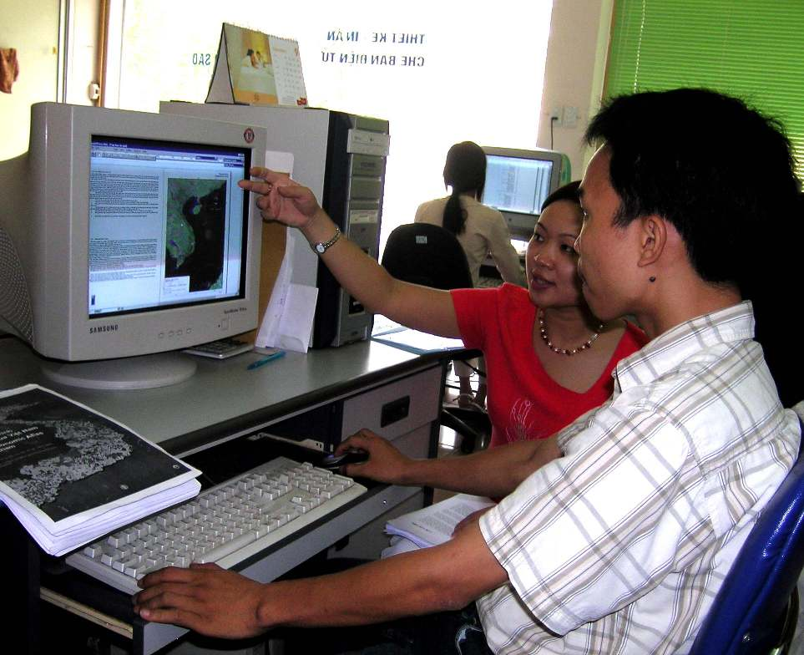

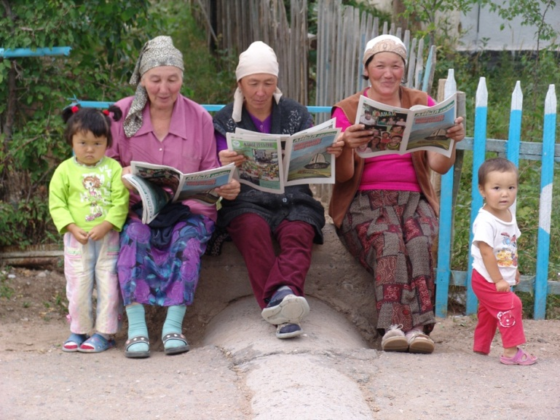
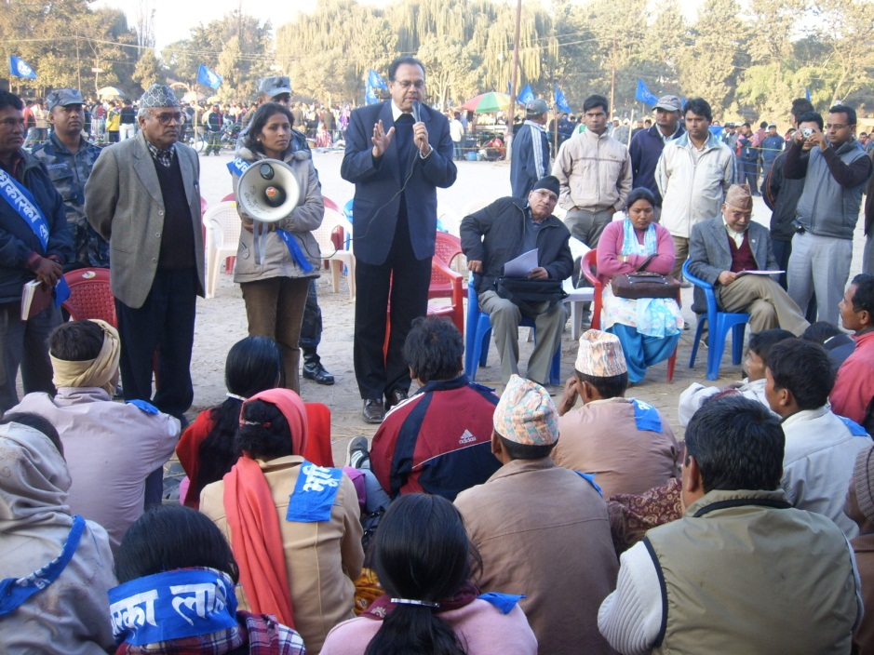
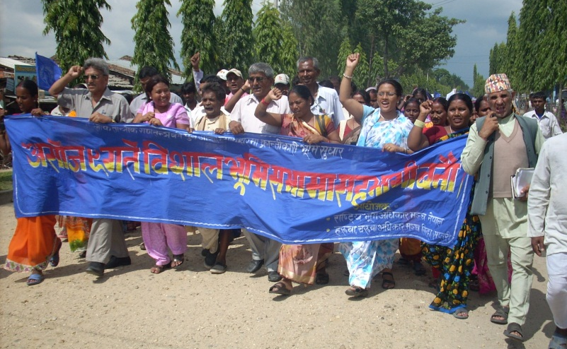
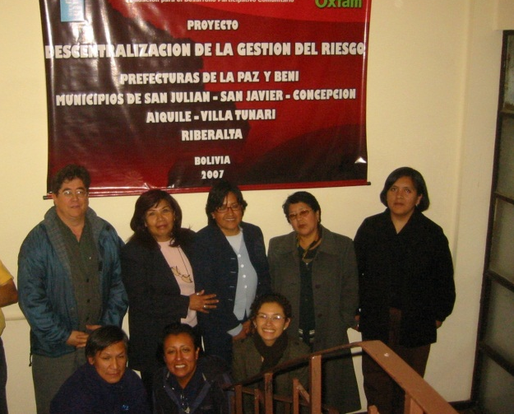
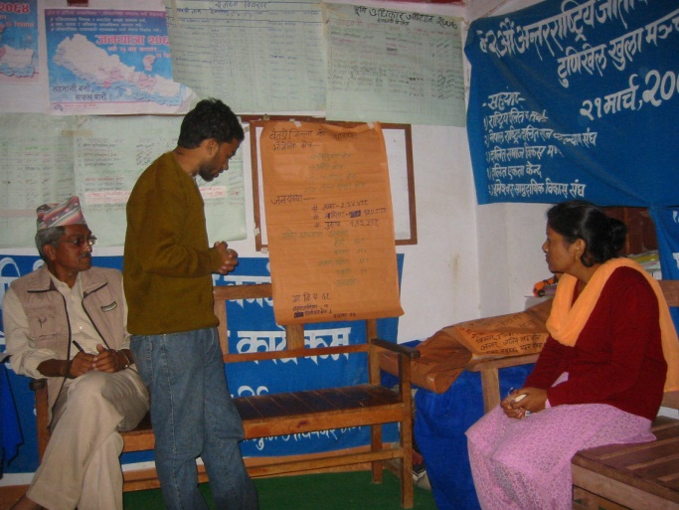
PAMS – a TD tool

Slide 9
Evaluation of Phase 1
Lack of transdisciplinarity: The principles of transdisciplinarity were not satisfyingly applied. In most PAMS, knowledge was transferred mainly unilaterally from the scientific community to society, without society having any effect on science.
Missing research-society nexus: Only about half of the PAMS addressed a mutual exchange between researchers and society. The other projects were either small development actions (implementation without research) or participatory research projects (research without implementation).
Notes:
The evaluation showed that the implementation of td projects bears several risks, and better criteria for selection of projects were needed in order to promote td projects.

Slide 10
New PAMS principles for Phase 2
PAMS – a TD tool
PAMS projects are required to be linked to NCCR North-South research.
Non-academic partners must be involved from the beginning, and should share responsibility for project implementation.
Co-funding is highly recommended, because it shows that other partners are interested in the pathways tested in PAMS.
The proposal must show how social learning between academic and non-academic partners will be triggered.

Slide 11
Evaluation of Phase 2
PAMS – a TD tool
PAMS are now better linked to NCCR North-South research.
In most PAMS (68%), researchers closely cooperated with the Executing Agency or were part of it.
In 5% of PAMS, researchers provided scientific backstopping to the Executing Agency.
In 27% of the PAMS, researchers were implementers, without another Executing Agency.
Most often, Executing Agencies are NGOs, Ministries or National Institutes (76%).
Sixty percent of PAMS had co-financing.

Slide 12
Involvement of researchers in PAMS
PAMS – a TD tool

Slide 13
Non-academic partners
PAMS – a TD tool

Slide 14
Evaluation of Phase 2
PAMS – a TD tool
Researchers and their partners applied a variety of strategies to foster social learning in PAMS:
  Disseminating research results beyond a scientific audience
  Networking with policymakers, development practitioners and local communities
  Dedicated sharing and mutual learning events
  Advising decision-makers
  Teaching
  Lobbying and advocacy
Notes:
Disseminating research results beyond the scientific audience. Research results are consciously translated to audiences outside the scientific realm and communicated in media read by policy-makers, development practitioners and local communities.
Networking with policy-makers, development practitioners and local communities. Networking means that researchers proactively explain the policy relevance of research insights to possible partners.
Dedicated sharing and mutual learning events. Multi-stakeholder workshops whose aim is exchanging different types of knowledge and supporting learning among the participants.
Advising decision-makers. By contrast with networking, which depends on a proactive researcher, advice is given in response to demand. Researchers who are able to maintain close and trusting contacts with policy-makers offer regular counsel on policy matters from the perspective of research.
Teaching. Capacity development is a specific way of transferring research results into policy and implementation. Researchers are sometimes assigned to teach in their fields of competence.
Lobbying/advocacy. Lobbying and advocacy are used when policy and implementation actors show indifference or even hostility towards research. It implies a close link with civil society organisations and the media in order to raise the public pressure on decision-makers.

Slide 15
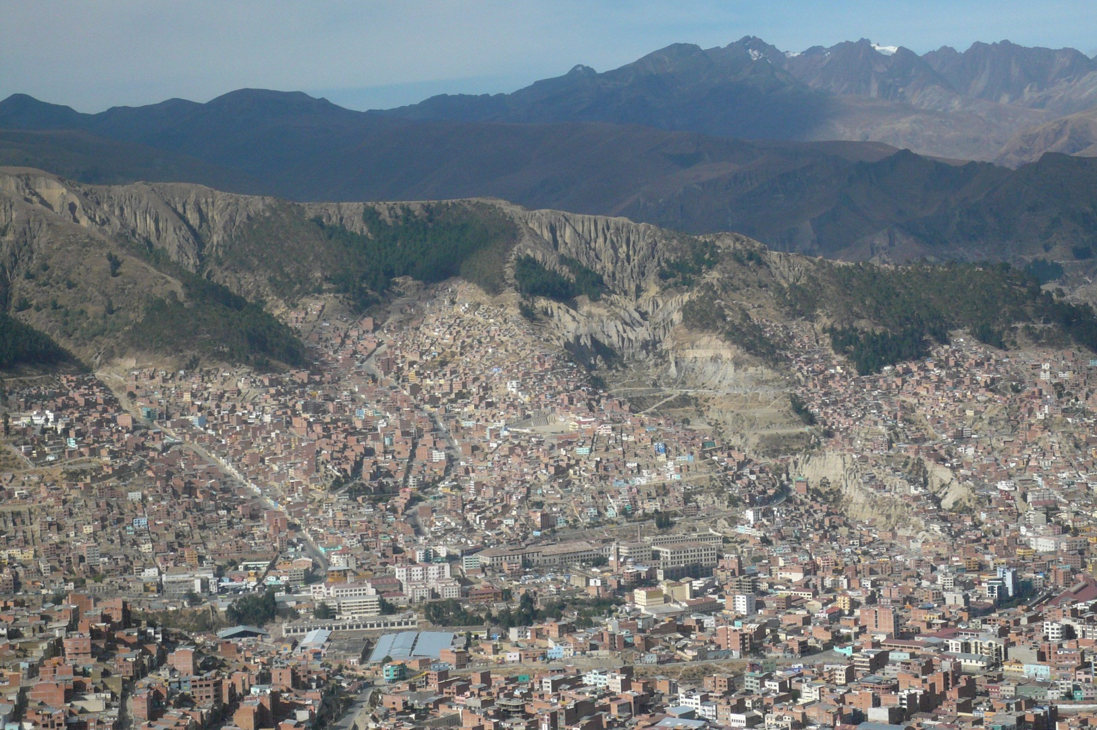
Case study: Risk management in Bolivia

Slide 16
Context
Bolivia is exposed to various natural disaster risks, such as floods, earthquakes and droughts.
Risk management mechanisms are insufficient, local governments focus on emergency actions instead of risk prevention.
Researchers cooperated with powerful local NGOs in order to put research insights into practice.

Slide 17
Activities
Workshops were organised with local governments and community members for awareness-raising.
Vulnerability maps were compiled in collaboration with local people, showing the most important threats, risks and exposed elements within their community.
A methodology for gathering and elaborating scientific data on risk-relevant issues was developed.
This information was brought into a format that is understandable and accessible to development actors and state officials.
The information was then compiled in an Atlas, which is the first document to show threats and vulnerabilities in Bolivia.

Slide 18
Outcomes
OXFAM International is financing the continuation of the project in other Departments in Bolivia.
Ministries, development agencies and intergovernmental organisations request the use of information from the Atlas.
Risk management is now enshrined as a transversal theme in Municipal Development Plans.
Research was ongoing during the PAMS, so researchers themselves learned from the experiences and included them in their work.

Slide 19
Researchers’ strategies
The researchers had joined hand with a powerful NGO in order to bring their research into policy and practice.
They built strategic alliances with departmental and local governments.
They cooperated with national research institutes, offering them capacity building in exchange for data.
Dissemination of information through several books, radio interviews and newspaper articles was important for awareness-raising.
Notes:
They did not ask the National Institutes for data, knowing that they would not receive them. Instead, they offered them capacity building in how to bring the data in a format that is understandable for policy makers. They showed them how to produce maps. That is how they came into contact with all relevant institutes, such as the institute for statistics, the national service for meteorology and hidrology, or the seismographic observatory.

Slide 20
Conclusions:
Do researchers need a funding scheme?
PAMS are often just «one piece of the mosaic» for larger development activities.
PAMS provide researchers the opportunity to get in contact with non-academic actors and to test approaches which can then be continued by their partners.
Researchers can adapt their research and benefit from the non-academic knowledge.
PAMS have proven to be a successful tool to foster TD research in the NCCR North-South.

