Slide 1
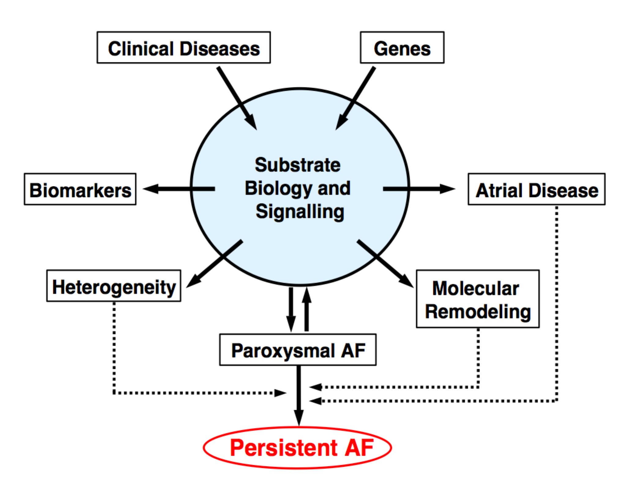
Figure 1

Slide 2
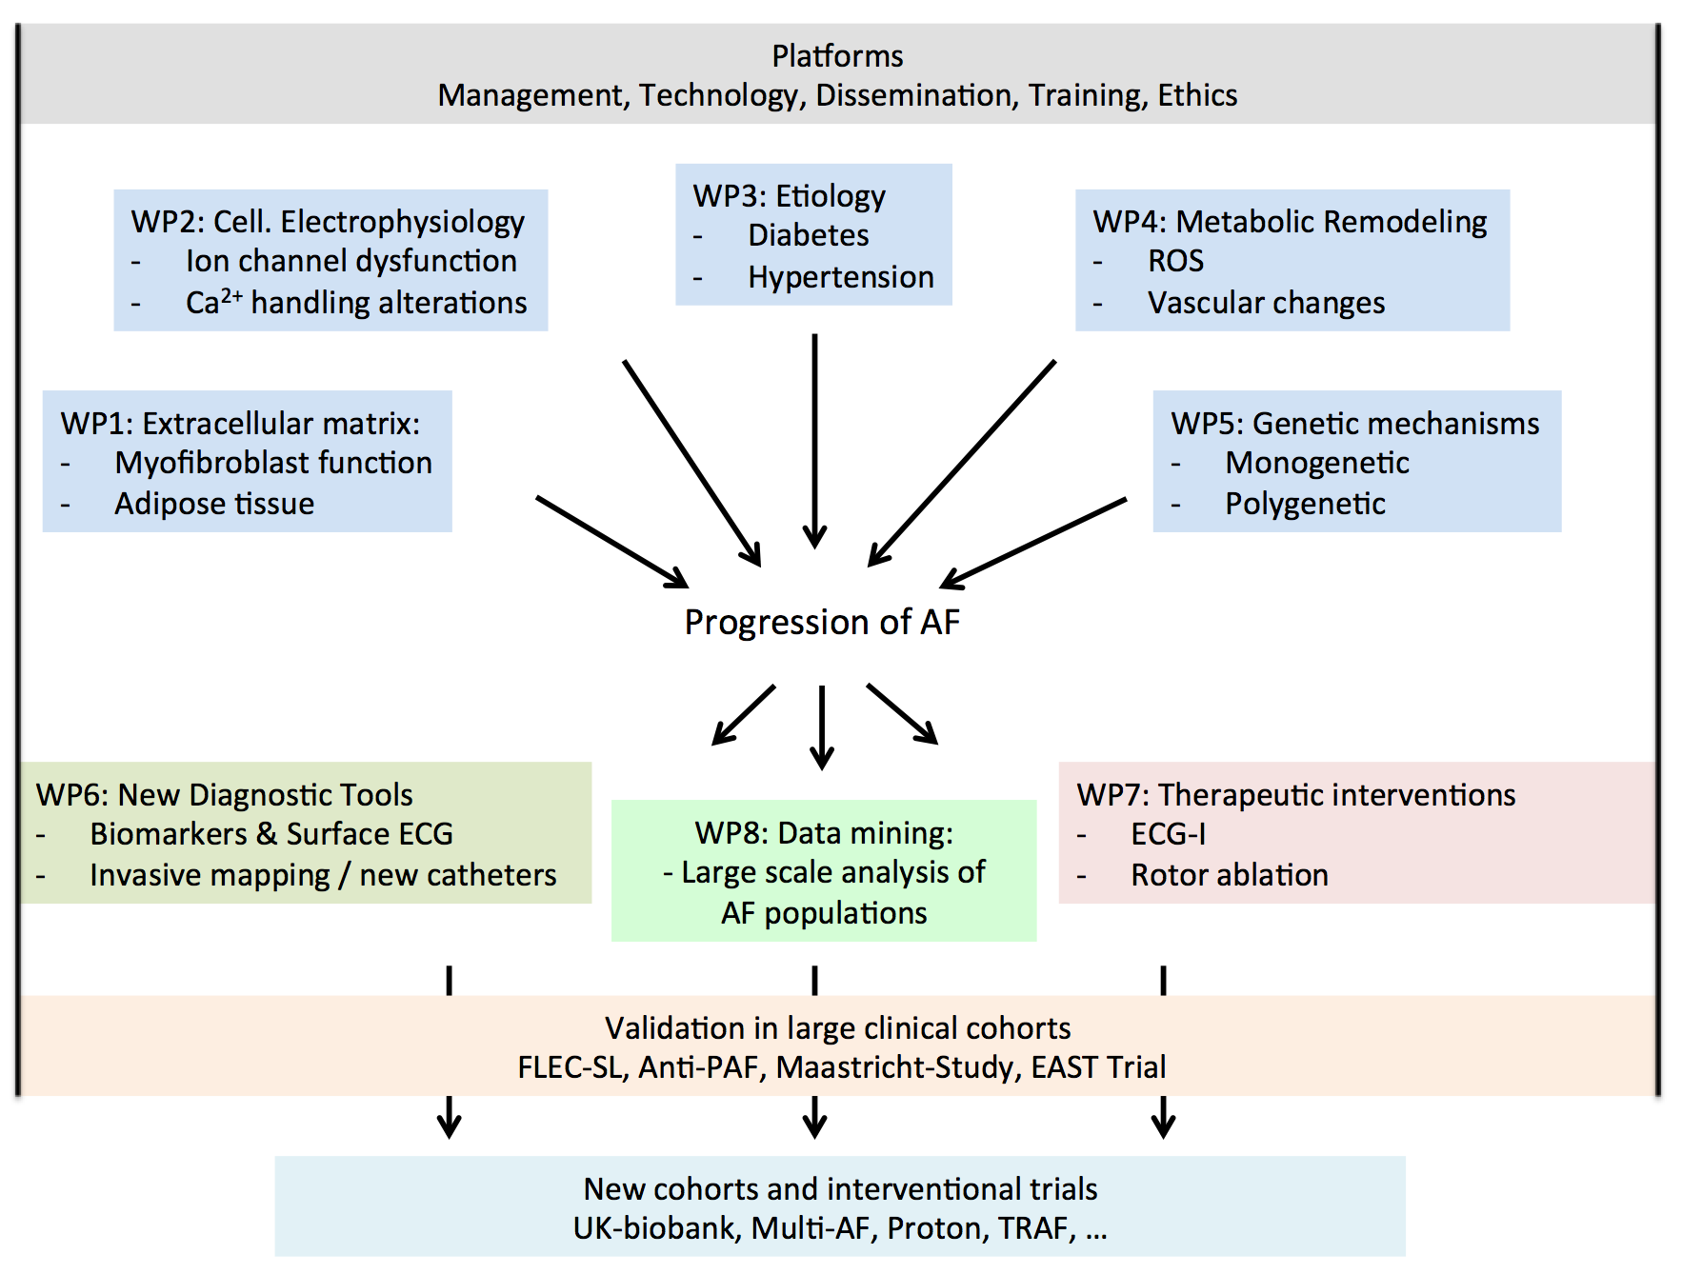
Figure 2

Slide 3
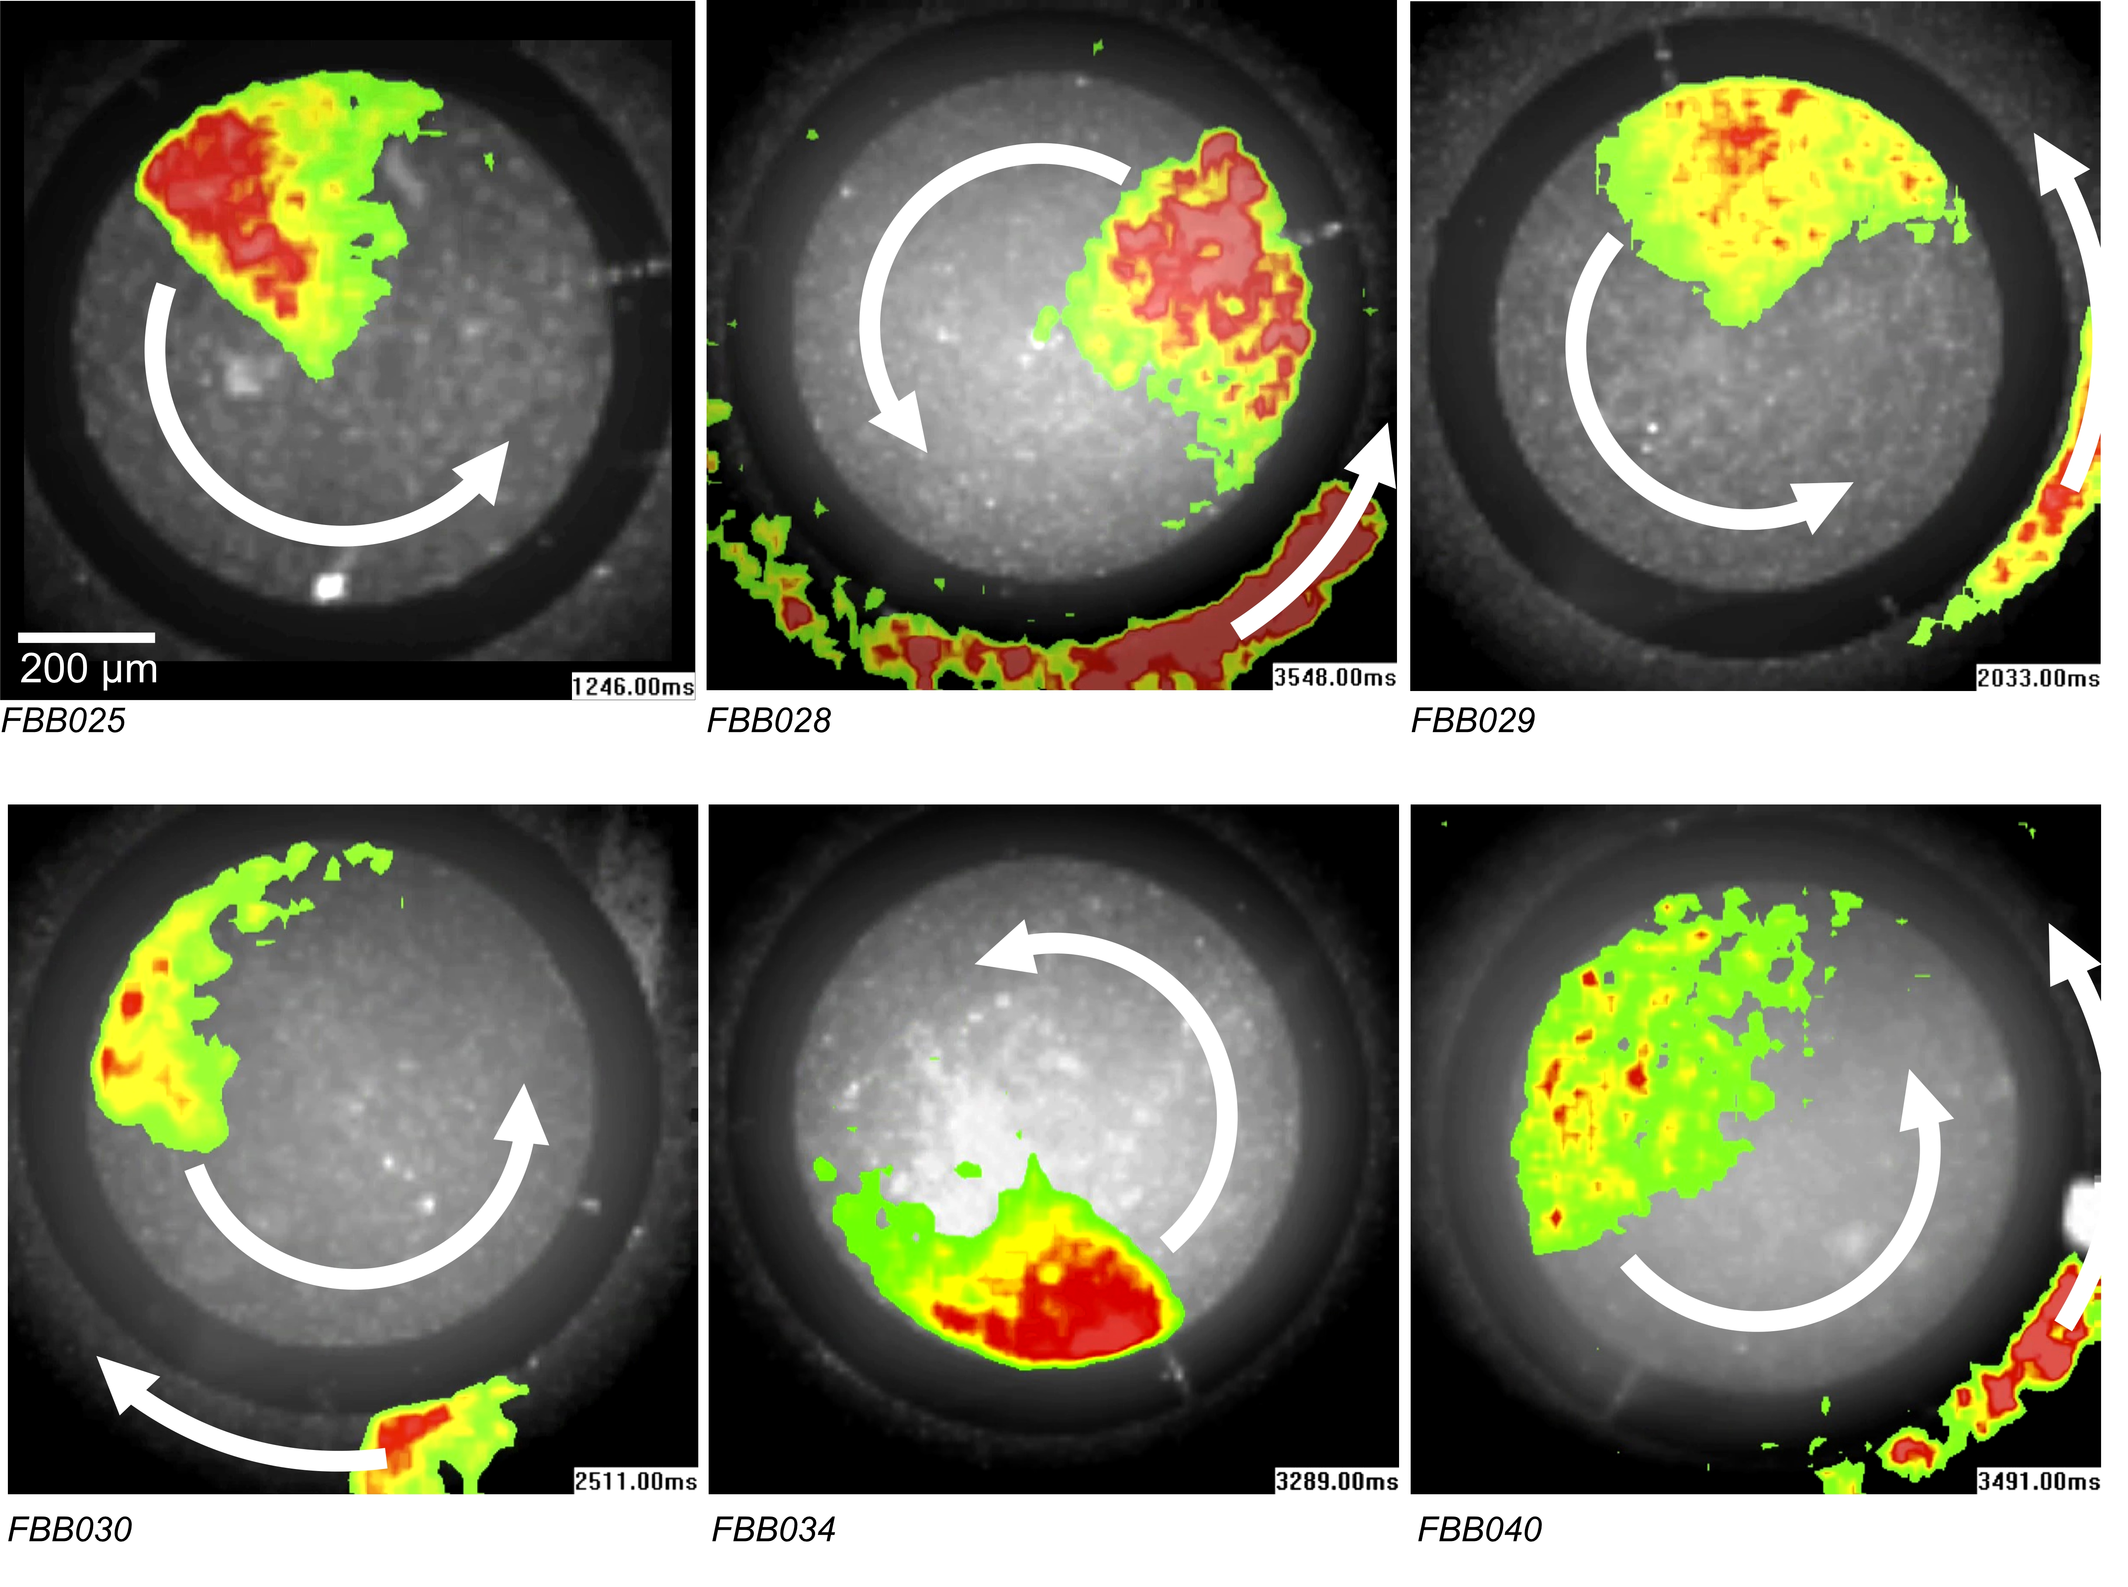
Figure 3

Slide 4
Figure 4

Slide 5
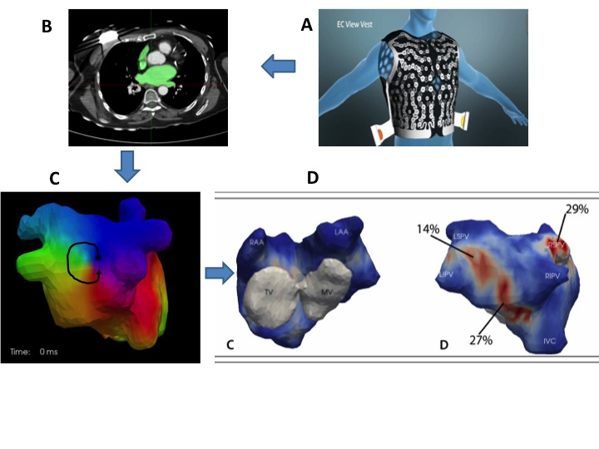
Figure 5

Slide 6
Figure 6

