Slide 1


Long-term outcomes of bariatric procedures:
sleeve gastrectomy, Roux-en-Y gastric bypass,
and biliopancreatic diversion
with duodenal switch
D Kröll, Y Borbély, J Altmeier, D Candinas, PC Nett
University Obesity Centre Berne
Department of Visceral Surgery and Medicine, Inselspital, Berne
University Hospital and University of Berne

Slide 2
INTRODUCTION
Sleeve gastrectomy (SG) as a single-stage bariatric procedure is becoming increasingly popular
Preliminary results have suggested that the weight loss and resolution of comorbidities with SG could be comparable to those with Roux-en-Y gastric bypass (RYGB) or biliopancreatic diversion with duodenal switch (BPD-DS)

Slide 3
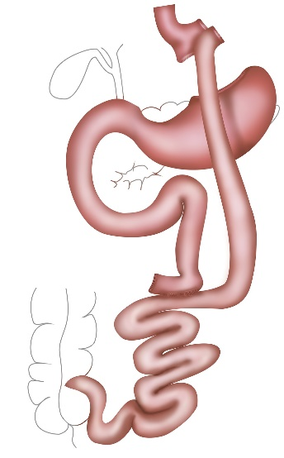
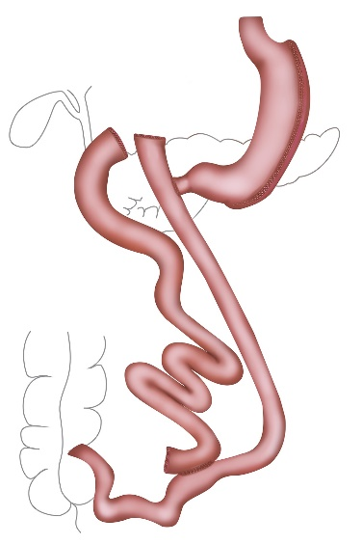
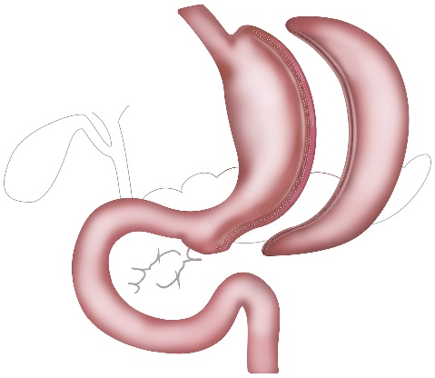
AIM OF THE STUDY
1° Long-term % of excess of weight loss (%EWL) in SG,
RYGB and BPD-DS
2° Long-term resolution of comorbidities
Type 2 diabetes mellitus
Hypertension
Dyslipidemia
OSAS
GERD

Slide 4
METHODS
Retrospective case-matched analysis (matched for age, sex, preoperative BMI)
each arm n=30
Evaluation of %EWL and resolution of comorbidities at 1, 3, and 5 years

Slide 5
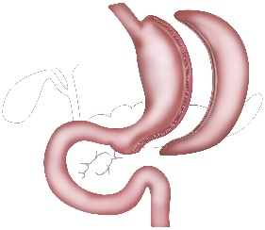


PATIENTS
n=30/30/30
P
Gender (m/f)
9/21
7/23
7/23
n.s.
Age (years)
41
(21-63)
36
(23-52)
39
(27-51)
n.s.
BMI (kg/m²)
48
(43-56)
44
(38-49)
47
(41-52)
n.s.

Slide 6
RESULTS
%EWL – 1 year P = n. s.
64%
61%
72%

Slide 7
RESULTS
%EWL – 3 years P = n. s.
70%
66%
75%

Slide 8
RESULTS
%EWL – 5 years P = n. s.
65%
62%
69%

Slide 9
RESULTS
Resolution of comorbidities – 1 year
Diabetes
39% – 7/18
68% – 13/19
68% – 15/22
Hypertension
71% – 15/21
65% – 13/20
61% – 11/18
Dyslipidemia
58% – 11/19
56% – 9/16
60% – 12/20
OSAS
59% – 13/22
58% – 11/19
63% – 10/16
GERD
(21%) – 17/14
71% – 15/21
23% – 4/17

Slide 10
RESULTS
Resolution of comorbidities – 1 year
Diabetes
39% – 7/18
68% – 13/19
68% – 15/22
Hypertension
71% – 15/21
65% – 13/20
61% – 11/18
Dyslipidemia
58% – 11/19
56% – 9/16
60% – 12/20
OSAS
59% – 13/22
58% – 11/19
63% – 10/16
GERD
(21%) – 17/14
71% – 15/21
23% – 4/17

Slide 11
RESULTS
Resolution of comorbidities – 1 year
Diabetes
39% – 7/18
68% – 13/19
68% – 15/22
Hypertension
71% – 15/21
65% – 13/20
61% – 11/18
Dyslipidemia
58% – 11/19
56% – 9/16
60% – 12/20
OSAS
59% – 13/22
58% – 11/19
63% – 10/16
GERD
(21%) – 17/14
71% – 15/21
23% – 4/17

Slide 12
RESULTS
Resolution of comorbidities – 3 years
Diabetes
56% – 10/18
63% – 12/19
68% – 15/22
Hypertension
57% – 12/21
55% – 11/20
50% – 9/18
Dyslipidemia
53% – 10/19
56% – 9/16
50% – 10/20
OSAS
50% – 11/22
53% – 10/19
57% – 9/16
GERD
14% – 2/14
76% – 16/21
12% – 2/17

Slide 13
RESULTS
Resolution of comorbidities – 3 years
Diabetes
56% – 10/18
63% – 12/19
68% – 15/22
Hypertension
57% – 12/21
55% – 11/20
50% – 9/18
Dyslipidemia
53% – 10/19
56% – 9/16
50% – 10/20
OSAS
50% – 11/22
53% – 10/19
57% – 9/16
GERD
14% – 2/14
76% – 16/21
12% – 2/17

Slide 14
RESULTS
Resolution of comorbidities – 3 years
Diabetes
56% – 10/18
63% – 12/19
68% – 15/22
Hypertension
57% – 12/21
55% – 11/20
50% – 9/18
Dyslipidemia
53% – 10/19
56% – 9/16
50% – 10/20
OSAS
50% – 11/22
53% – 10/19
57% – 9/16
GERD
14% – 2/14
76% – 16/21
12% – 2/17

Slide 15
RESULTS
Resolution of comorbidities – 5 years
Diabetes
50% – 9/18
52% – 10/19
59% – 13/22
Hypertension
48% – 10/21
40% – 8/20
50% – 9/18
Dyslipidemia
42% – 8/19
50% – 8/16
45% – 9/20
OSAS
50% – 11/22
47% – 9/19
50% – 8/16
GERD
14% – 2/14
71% – 15/21
18% – 3/17

Slide 16
RESULTS
Resolution of comorbidities – 5 years
Diabetes
50% – 9/18
52% – 10/19
59% – 13/22
Hypertension
48% – 10/21
40% – 8/20
50% – 9/18
Dyslipidemia
42% – 8/19
50% – 8/16
45% – 9/20
OSAS
50% – 11/22
47% – 9/19
50% – 8/16
GERD
14% – 2/14
71% – 15/21
18% – 3/17

Slide 17
RESULTS
Resolution of comorbidities – 5 years
Diabetes
50% – 9/18
52% – 10/19
59% – 13/22
Hypertension
48% – 10/21
40% – 8/20
50% – 9/18
Dyslipidemia
42% – 8/19
50% – 8/16
45% – 9/20
OSAS
50% – 11/22
47% – 9/19
50% – 8/16
GERD
14% – 2/14
71% – 15/21
18% – 3/17

Slide 18
SUMMARY
Long-term results (5 years)
✓
✓
✓
%EWL
✓
✓
✓
Resolutions of comorbidities
✓
Symptomatic Reflux/GERD

Slide 19
CONCLUSION
SG, RYGB and BPD-DS are comparable in the long-term (5-years) in terms of weight reduction and remission of comorbiditiesis in the treatment of morbid obese patients.
However, symptomatic reflux and GERD disease are more often in patients undergoing SG and BPD-DS compared to RYGB

Slide 20


Slide 21


