Slide 1


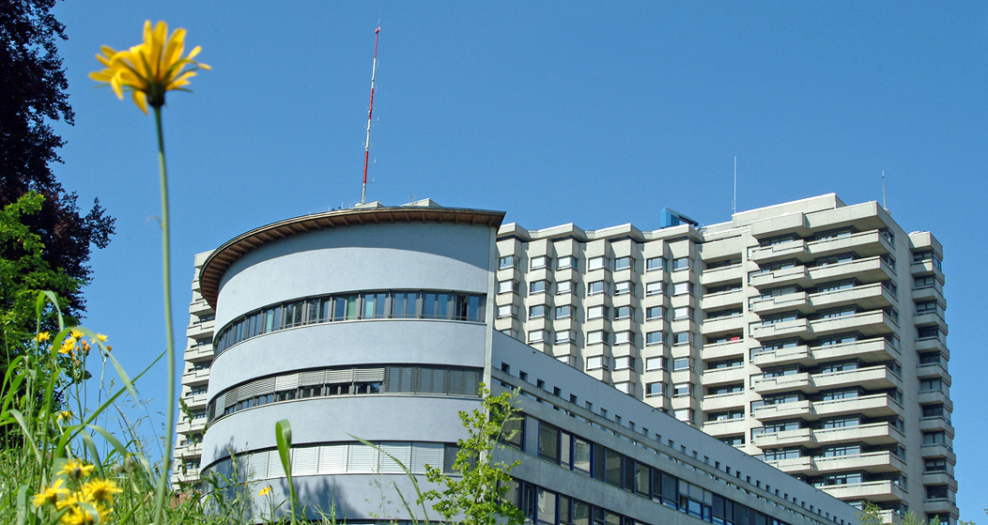




Metabolic Surgery
An update from surgical perspective
D. Kröll
University Obesity Centre Bern
Department of Visceral Surgery and Medicine, Inselspital Bern
Notes:
Good afternoon ladies and gents. Thank you very much for the invitation and the opportunity to present an update on metabolic surgery that is focusing on the surgical perspective in bariatric surgery and Diabetes patients.

Slide 2
Bariatric / Metabolic Surgery
«Bariatric» operations cause remission of
type 2 diabetes (T2DM) in most cases
This occurs in part trough weight-independent
anti-diabetes mechanisms
These observations impel consideration of
«metabolic surgery», used expressly to treat T2DM, including in lower-BMI patients

Slide 3
Evidence for Weight-Independent
Anti-DM Effects of RYGB
Fast kinetics of diabetes resolution
Glucose homeostasis improves more with RYGB than with equal weight loss from other means
Inconsistent correlation between amount of weight lost and DM remission rates after RYGB
Some intestinal bypass operations improve diabetes with little or no weight loss
Hints from hyperinsulinemia

Slide 4
Weight-Independent Anti-Diabetes
Candidate Mechanism of RYGB
GLP-1 (& PYY & OXM)
Ghrelin
Amylin
Duodenal factor
Intestinal LCFACoA & CCK
Intestinal Gluconeogenesis
  Bile acids
  Ceramides
  in Gut Microbiome
  Inflamm & oxidative stress
  Branched Chain AA in blood
Reprogram intest glu metab
  Intestinal SGLT-1

Slide 5
Where does bariatric-metabolic surgery fit in diabetes care ?
Do the benefits of surgery apply
to people outside of NH criteria – for example,
with T2DM and BMI <35?

Slide 6
NIH Consensus Development Panel
Criteria for Bariatric Surgery (1991)
BMI > 40
or
BMI > 35 with diabetes

Slide 7
The concept of «Diabetes Surgery» or «Metabolic Surgery» has become relatively well accepted in academic circels

Slide 8
Diabetes Surgery Summit 2007
Metabolic Surgery can be considered to treat Type II diabetes in patients with BMI > 30 kg/m2
Rubino et al. Ann. Surg 2010, Ann Rev Med 2010

Slide 9
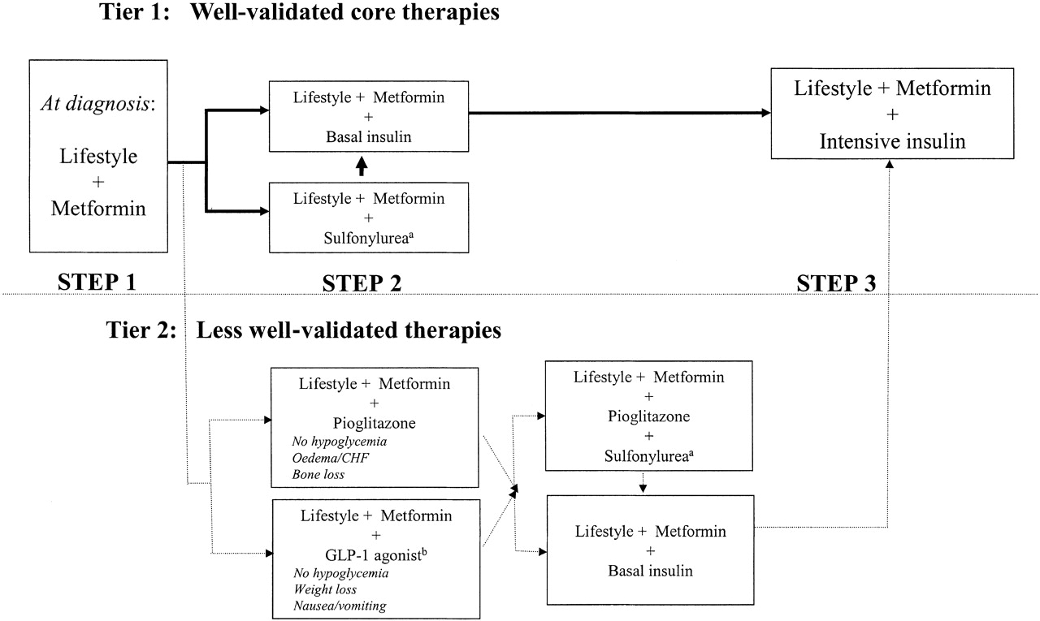

ADA and EASD Consensus Algorithm for T2DM Treatment
Bariatric Surgery not mentioned for anyone
David M. Nathan et al. Dia Care 2009;32:193-203
©2009 by American Diabetes Association
Notes:
Algorithm for the metabolic management of type 2 diabetes; Reinforce lifestyle interventions at every visit and check A1C every 3 months until A1C is <7% and then at least every 6 months. The interventions should be changed if A1C is ≥7%. aSulfonylureas other than glybenclamide (glyburide) or chlorpropamide. bInsufficient clinical use to be confident regarding safety. See text box, entitled titration of metformin. See Fig. 1 for initiation and adjustment of insulin. CHF, congestive heart failure.

Slide 10
Main Problem
Previous paucity of Level-1 evidence from RCTs comparing surgical vs. medical/behaviroal DM Diabetes care

Slide 11

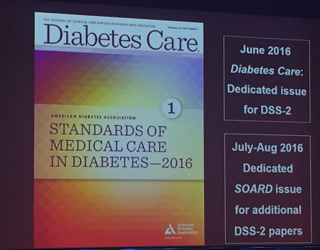

International Guidelines for Diabetes Surgery
June 2016 Diabetes care journal
Notes:
Despite Herculean challenges, RCTs of surgery vs. medicines/lifestyle are being done
Some have been criticized for not having a sufficiently rigorous medical/lifestyle intervention.
Diabetes Surgery Summit 2(DSS-2) systematic review & meta-analysis of only RCTs.

Slide 12
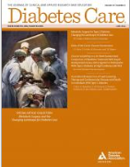
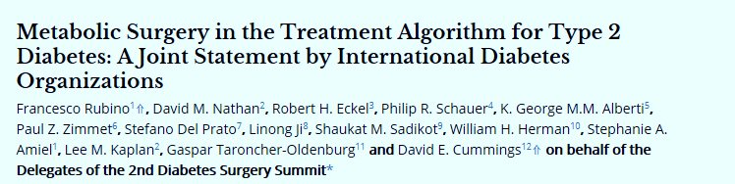



Slide 13
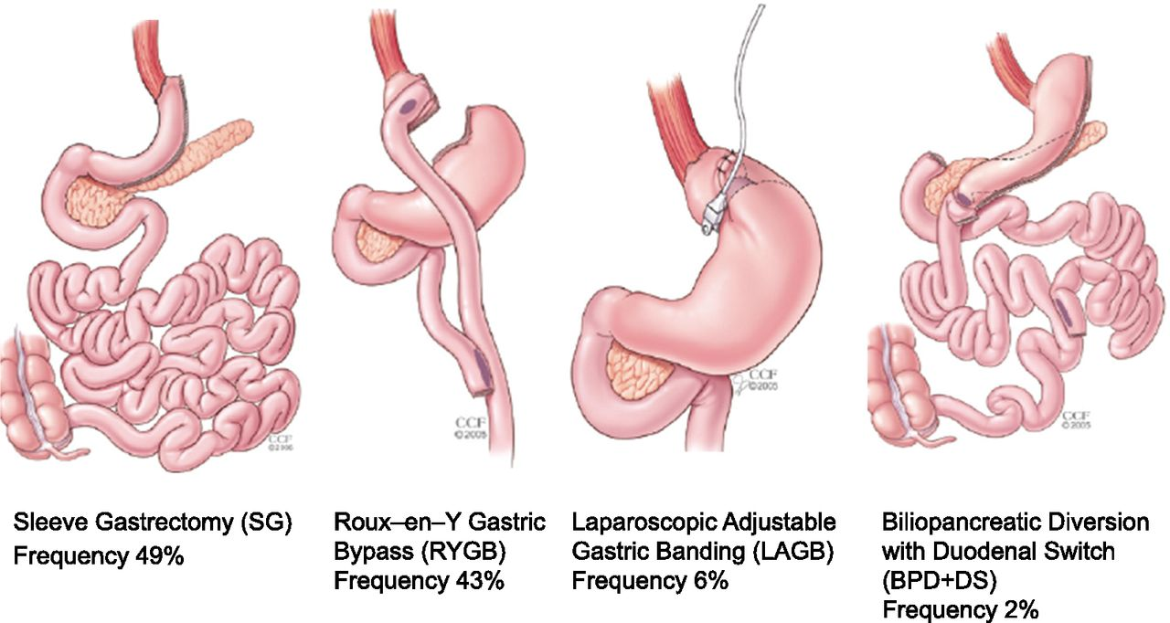
Metabolic surgery 2016
Worldwide frequency of use
©2016 by American Diabetes Association
Notes:
Common metabolic procedures and their frequency of use.

Slide 14
Safety
Efficacy

Slide 15
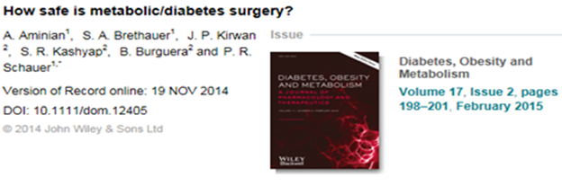
US national data of postoperative composite complications rate (%) of 8 procedures in patient with type 2 diabetes
N = 66 678 diabetic patients

Slide 16
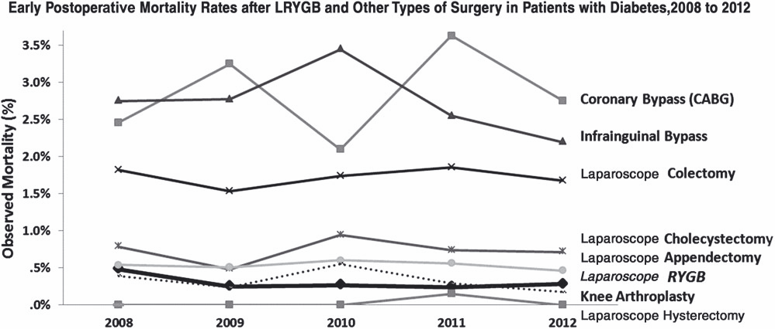
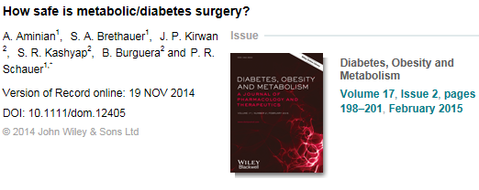
Mortality Rates (%) of 8 Procedures in Diabetics 2008-2012
Mortality rate of LRYGB= 3 in 1000

Slide 17
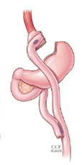
Most common complications after Roux-en-Y-Gastric bypass
Early (< 30 days) | Late
Leak with peritonitis | Stomal stenosis/stricture
Pulmonary embolism/DVT | Gastric ulcer
Bleeding | Dumping syndrom
Bowel obstruction | Bowel obstruction
Wound infection | Incisional hernia
Nausea/Vomiting/Dehydration | Cholecystitis
Pulmonary Complications | Vitamin and Mineral deficiency
Cardiac complications | Weight gain
 | Hypoglycemia
Moustarah et al. Current Surgical Therapy Ed., Comeron 2010, Elvesier

Slide 18
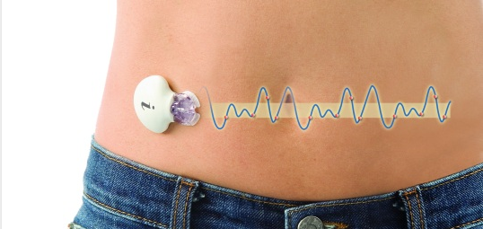
iPro2

Slide 19
Efficacy

Slide 20
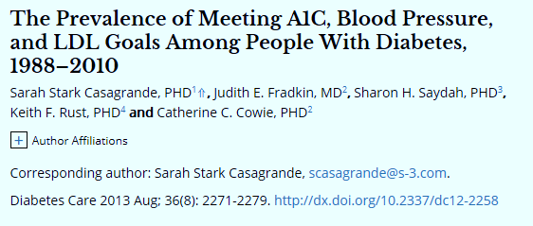
NHANES data 2007-2010 n=4.926
A1c < 7 % | 52.5%
BP< 130/80 | 51.5%
LDL < 100 mg/dl | 56.2%
ALL 3 | 18.8%

Slide 21
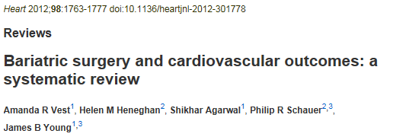
73 studies 3 RCT’s
Excess weight loss (EWL) | 54%
 | Baseline | % Resolution/Improvement
Hypertension | 44.4% | 62.5%
Diabetes mellitus | 24.0% | 73.2%
Hyperlipidemia | 43.6% | 65.2%

Slide 22
What about the effect of surgery on long-term morbidity and mortality
MACROVASCULAR CHANGES
Clinical
Features
MICROSVASCULAR CHANGES
Years
-10
-5
0
5
10
15
20
25
30
Adapted from Type 2 Diabetes BASICS, Minneapolis, MN International Diabetes Center, 2000

Slide 23
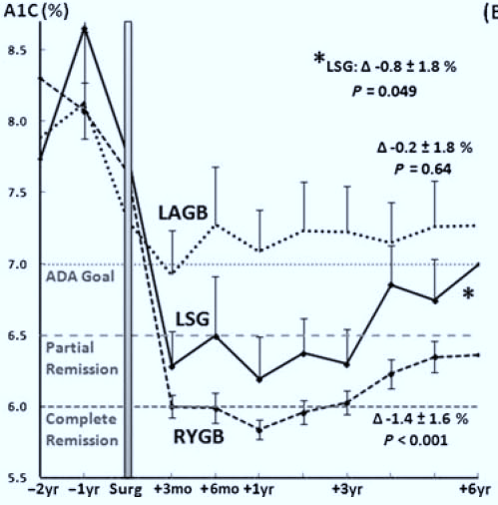
Long term A1c changes
N=32
N=23
N=162
Brethauer, Stacy et al., Annals of Surgery. 258(4):628-637, October 2013. Can Diabetes Be Surgically Cured? Long-Term Metabolic Effects of Bariatric Surgery in Obese Patients with Type 2 Diabetes Mellitus.

Slide 24
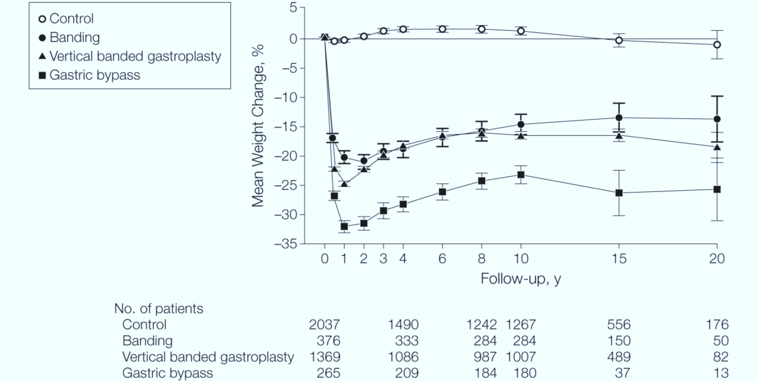
Bariatric Surgery SOS
JAMA. 2012;307(1):56-65. doi:10.1001/jama.2011.1914

Slide 25
Bariatric Surgery SOS
JAMA. 2012;307(1):56-65. doi:10.1001/jama.2011.1914
Surgery associated with
Reduced all cause mortality
Reduced CV events (fatal and nonfatal)
Reduced Cancer mortality
Reduced microvascular complications

Slide 26
RCT’s comparing Bariatric surgery with medical treatment
for T2TM

Slide 27
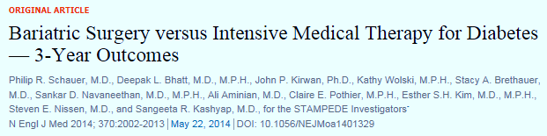

Evidence from a Superlative RCT: STAMPEDE

Slide 28
Treatment arms
Intensive Medical therapy
ADA guidelines
Lifestyle Intervention
Drug RX Goal HbA1c ≤6%
Oral agents
GLP-1 agonists
Insulin
Scheduled visits with
Nutrition
Psychology
Endocrinology
Follow-up visits
3 months through year 2
6 months thereafter

Slide 29
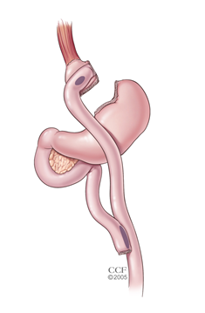
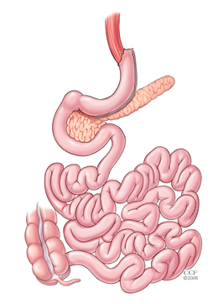
Treatment arms
Intensive Medical therapy | Gastric bypass | Sleeve gastrectomy
ADA guidelines
Lifestyle Intervention
Drug RX Goal HbA1c ≤6%
Oral agents
GLP-1 agonists
Insulin
Scheduled visits with
Nutrition
Psychology
Endocrinology
Follow-up visits
3 months through year 2
6 months thereafter

Slide 30
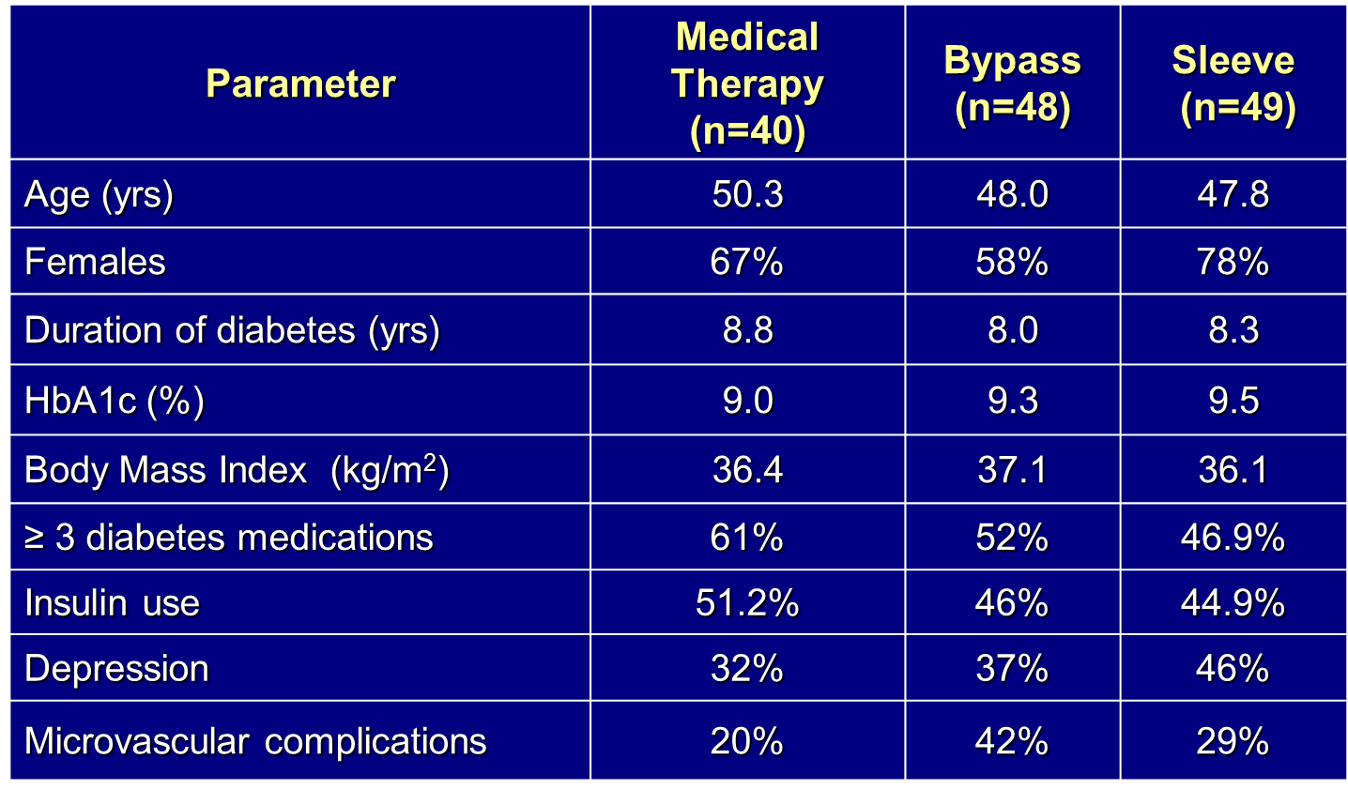
Baseline characteristics

Slide 31
Primary and Secondary Endpoints at 5 years
Parameter | Medical Therapy (n=38) | Bypass (n=49) | Sleeve (n=47) | P Value1 | P Value2
HBA1c ≤ 6% | 5% | 29% | 23% | 0.005 | 0.02
HbA1c ≤ 6% (without DM meds) | 0% | 22% | 15% | 0.002 | 0.02
HbA1c ≤ 7% | 21% | 51% | 49% | 0.004 | 0.008
Median change in FPG (mg/dL) | -14 | -72 | -49 | <0.001 | 0.01
Relapse of glycemic control | 80% | 40% | 50% | 0.16 | 0.34
% change in HDL | +7% | +32% | +30% | 0.003 | 0.008
Median % change in TG | -8% | -40% | -29% | 0.01 | 0.02
1 Gastric Bypass vs Medical Therapy / 2 Sleeve vs Medical Therapy

Slide 32
Change in HbA1c over 5 years
Follow up in months

Slide 33
Change in Diabetes medication

Slide 34
Change in Body mass index over 5 years
Follow up in months
BMI
P<0.02

Slide 35
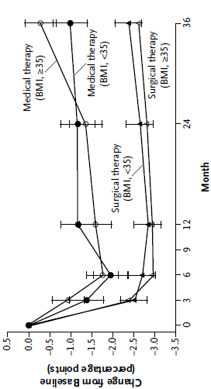
Change in HbA1c for BMI < 35 vs. > 35
Medical Therapy
Surgical Therapy

Slide 36
Renal and Ophthalmic Outcomes
Parameter | Medical Therapy (n=37) | Bypass (n=47) | Sleeve (n=45)
Baseline Albumin/Creatinine ratio | 6 | 9 | 12
% change | 7.1 | -16.7 | -59.5*
Baseline Albuminuria | 3 (9%) | 13 (28%) | 8 (18%)
Resolved | 2 (6%) | 8 (17%) | 5 (11%)
Developed | 7 (21%) | 4 (8%) | 2 (4%)
Baseline Retinopathy | 3 (12%) | 9 (21%) | 6 (17%)
Retinopathy at 5 Years | 2 (8%) | 6 (17%) | 4 (14%)
* p<0.00l compared to baseline and medical therapy

Slide 37
Adverse Events Over 5 Years
Parameter | Medical Therapy (n=43) | Bypass (n=50) | Sleeve (n=49)
Fatal myocardial infarction | 1 (2%) | 0 | 0
Stroke | 0 | 0 | 1 (2%)
Nephropathy | 6 (14%) | 11 (22%) | 9 (18%)
Bowel obstruction | 1 (2%) | 1 (2%) | 1 (2%)
Stricture | 0 | 1 (2%) | 1 (2%)
Gastric Fistula | 0 | 0 | 1 (2%)
Ulcer | 1 (2) | 4 (8%) | 1 (2%)
Severe hypoglycemia | 0 | 2 (4) | 0
Anemia (mild) | 7 (16%) | 14 (28%) | 24 (49%)
Weight gain >5% | 8 (19%) | 0* | 0*
Re-operation | NA | 3 (6%) | 4 (8%)
* p<0.05 compared to medical therapy group

Slide 38
CROSSROADS Trial (an RCT)
Calorie Reduction or Surgery:
Seeking Remission for
Obesity and Diabetes

Slide 39
CROSSROADS Trial
RCT of T2DM Rx in BMI 30-40
Standard RYGB & Medical Care OR
Intensive Medical-Lifestyle Rx
- Aerobic exercise
- Diet (low-calorie, low-fat)
- State-of-the-art DM Rx per ADA/EASD

Slide 40
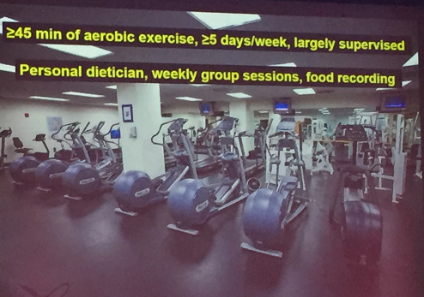

Slide 41
CROSSROADS
One-Year Results

Slide 42
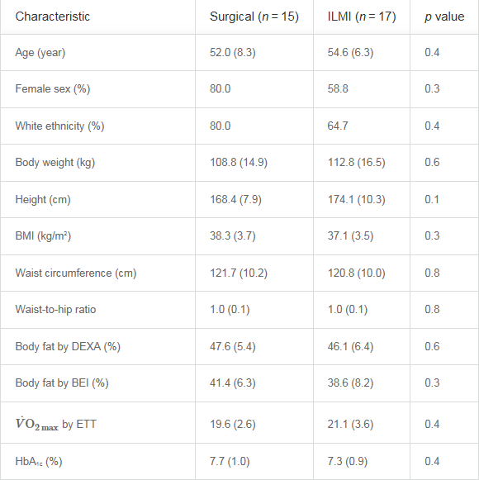
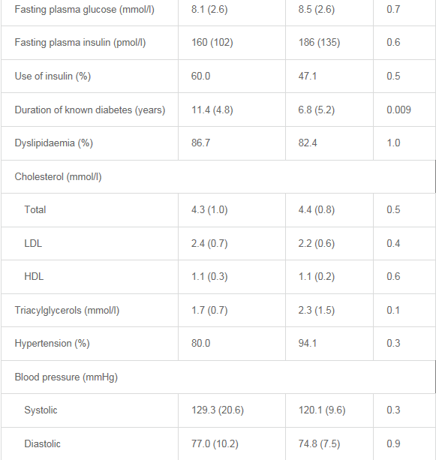
Baseline Charateristics
Demographics
Anthropometrics
Bodycomposition
Fitness
Glycemia
Lipids
Blood pressure

Slide 43
Primary Endpoint: Diabetes Remission at One Year (HbA1c <6.5 off all Diabets Medications)
Percent
in Remission
Cummings et al., Diabetologia (2016)

Slide 44
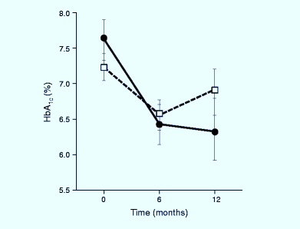
Changes in Glycemia
Significantly greater
fall in A1c with surgery
Med-Lifestyle
Surgical

Slide 45
Average of Metabolic Meds Taken at 1 Year

Slide 46
Adverse Events
No major events in either group
Substantially more hypoglycemia reported in the
medical group
One inpatient admission for alcohol abuse in a
surgical patient

Slide 47
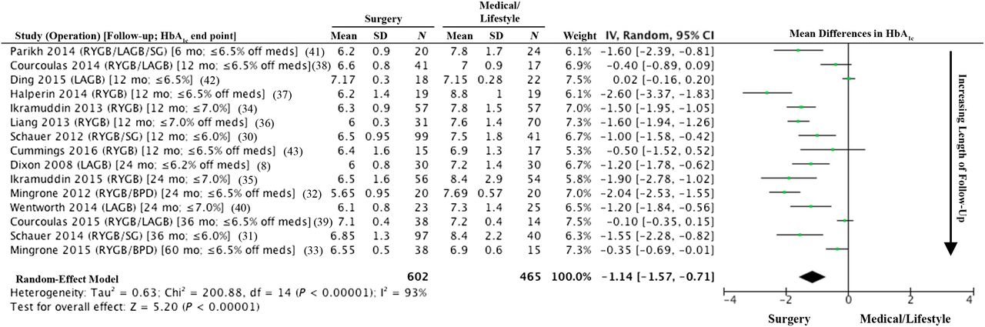
RCT’s surgery vs. medical/lifestyle Rx for T2DM (N= 794)
Philip R. Schauer et al. Dia Care 2016;39:902-911
©2016 by Amrican Diabetes Association
Notes:
Forest plot of mean differences (MDs) of %HbA_{1c} serum levels after bariatric/metabolic surgery compared with medical/lifestyle treatments in published RCTs. Data are arranged in order of ascending time to follow-up. Study duration and HbA_{1c} end point thresholds are shown in brackets in column 1, where “off meds” indicates a threshold achieved off all diabetes medications; otherwise, end points represent HbA_{1c} thresholds achieved with or without such medications. Negative MDs denote lower HbA_{1c} levels following surgery than medical/lifestyle treatment. MDs for each study are shown as the MD with its 95% CI.

Slide 48
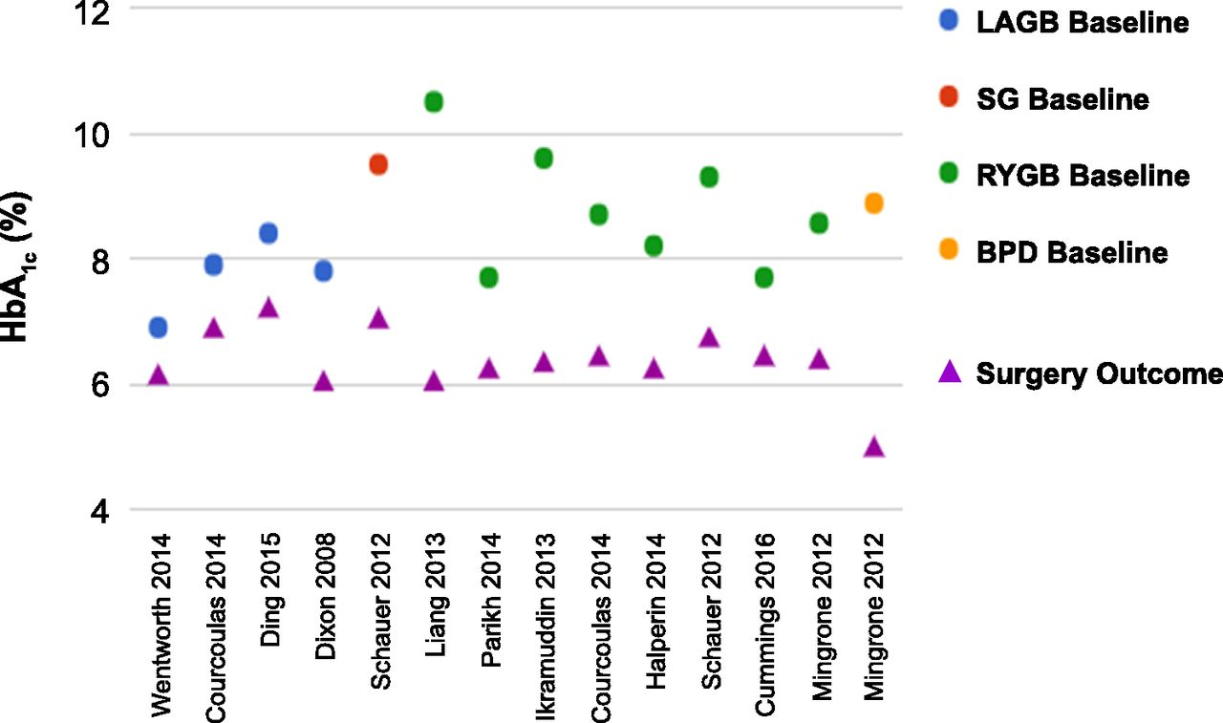
Change in HbA1c after LAGB, RYGB, SG, and BPD in 11 RCTs
Philip R. Schauer et al. Dia Care 2016;39:902-911
©2016 by American Diabetes Association
Notes:
Change in HbA_{1c} after LAGB, RYGB, SG, and BPD in 11 RCTs.

Slide 49
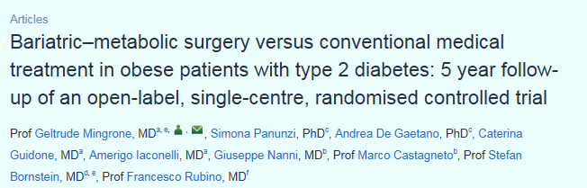

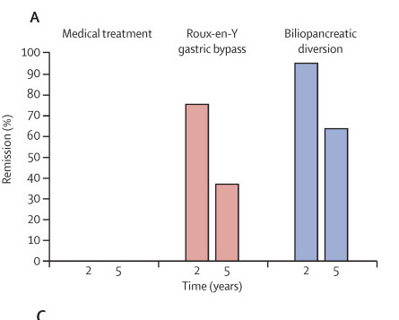
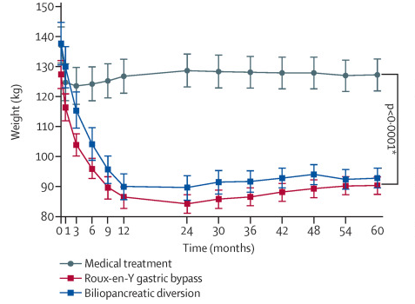

Slide 50
Summary of Study Outcomes:
RCT’s Surg v. Med Rx for T2DM
11 studies, 794 randomized patients
Surgery superior to med Rx (p<0.05) (Except Ding 2015)
Wt. loss, HbA1c, T2DM remission, TG, HDL, remission of metabolic syndrome, QOL, medication reduction
Most showed No difference in BP or LDL (but reduced meds)
Surgery Complications
- No perioperative (<30 days) CV events or deaths
- Most common: Anemia (15%), Reoperation (8%), GI (5%)
- Hypoglycemia – not different then control group
Notes:
Bariatric/metabolic surgery is more effective than medical-lifestyle interventions for weight-loss, glycemic control, DM remission, & improvements in other CVD risk factors, with acceptable complications, for at least 1 to 5 years, including in patients with a BMI <35.

Slide 51
CONCLUSION I
Bariatric Surgery is Safe and Effective
International Guidelines for T2DM NOW include
evidence based recommendations for surgery to treat T2DM and it co-morbidities
Notes:
We no have many relevant RCTs and large, long-term prospective studies with hard outcomes to inform policy!

Slide 52
What about long-term diabetes surgery results for BMI <35?

Slide 53
Distribution of T2DM According BMI
Thin
Normal
Overweight
Obese I
Obese II
Obese III
Population (100’s)
BMI
Bays et al. Int. Journal of Clinical Pract 2007

Slide 54
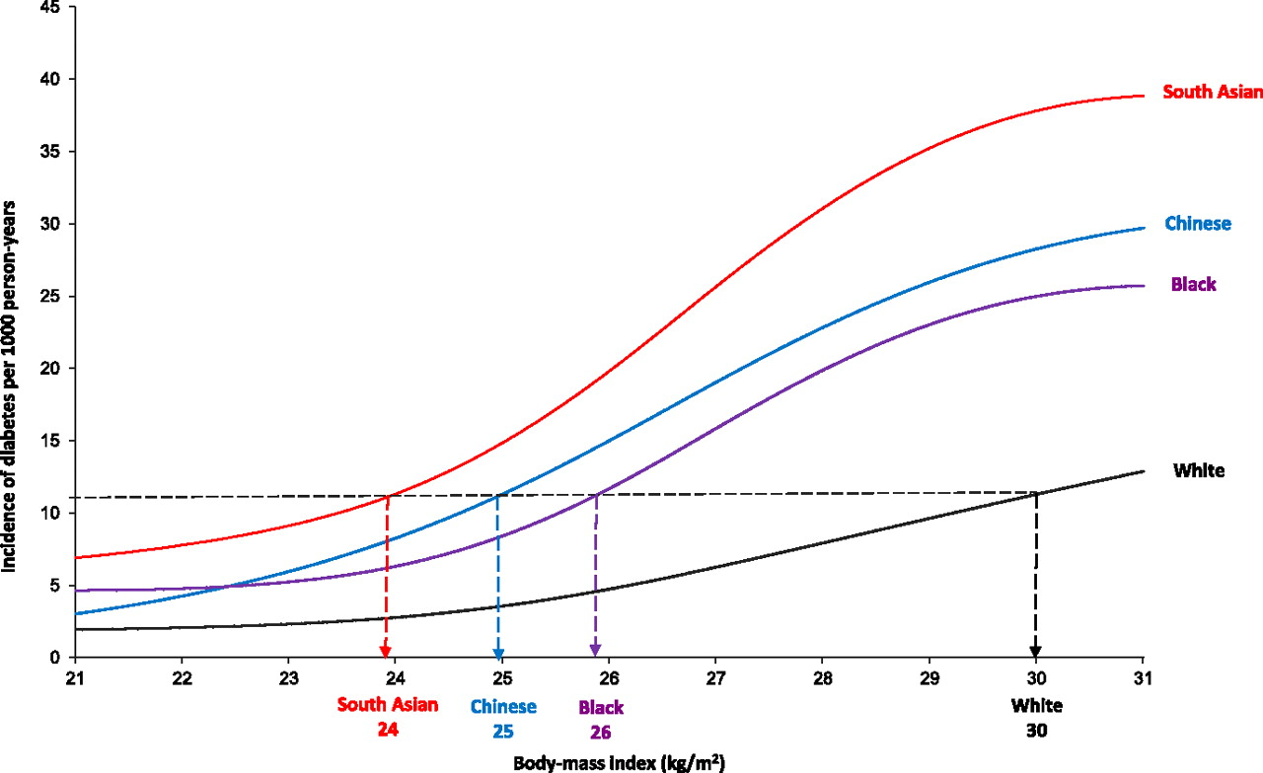
Association between the incidence rate of diabetes and BMI by ethnic group.
Maria Chiu et al. Dia Care 2011;34:1741-1748
Notes:
Association between the incidence rate of diabetes and BMI by ethnic group. The multivariate Poisson regression model included age, sex, BMI, BMI-ethnicity interaction, age-BMI interaction, income adequacy, survey year, and urban versus rural dwelling. Four knots were used to generate the restricted cubic splines. All estimates were weighted by the survey sample weight to allow for estimates to be generalizable to the overall Ontario population. Data were derived from the Ontario components of Statistics Canada’s NPHS and CCHS, 1996–2005.

Slide 55
COSMID Trial
RCT in 80 Asian Indians with T2DM & BMI 25-35
RYGB & standard post-op care OR
Medical-lifestyle intervention
- Monthly face-to-face counseling
- Exercise advice and paid gym membership
- Diet (reduced-calorie, low-fat)
- Orlistat and/or liraglutide in most patients
- State-of-the-art DM Rx per ADA/EASD

Slide 56
Primary Endpoint: Diabetes Remission at 2 Years (HBA1c < 6.5 Off All Diabetes Medications)
Percent
In Remission

Slide 57
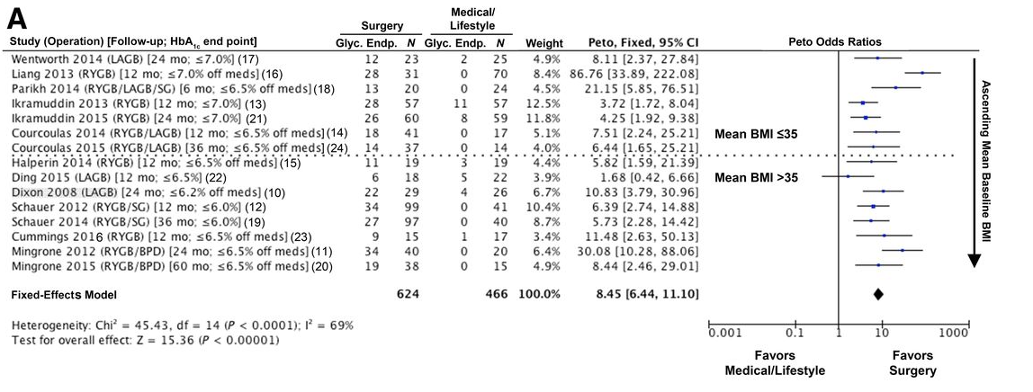

Slide 58
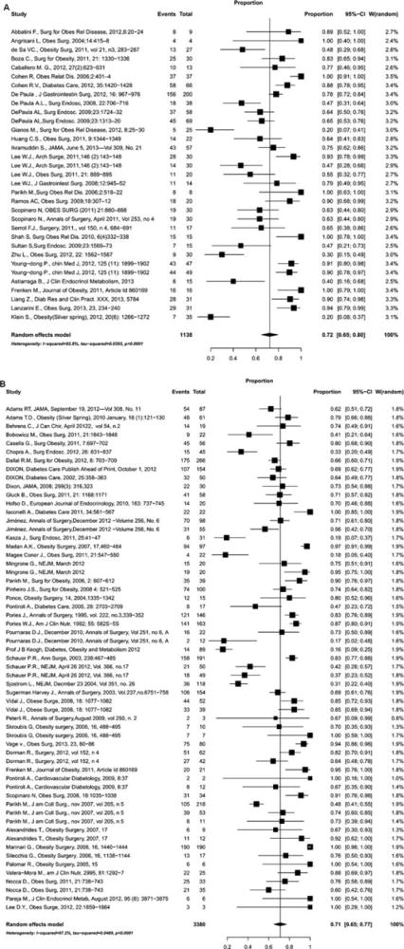
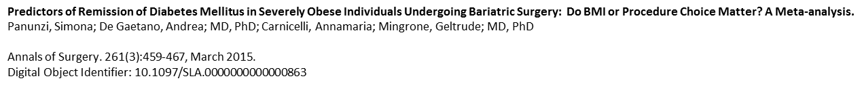
T2DM Remission Rates in Metaanalysis of All Studies of Metabolic Surgery in BMI < 35
Studies of BMI < 35
DM Remission: 72%
94 studies
94.579 surgical patients
Studies of BMI > 35
DM Remission: 71%

Slide 59
47 Societies that Endorse/Ratify
DSS-2 Guidelines
ADA
International Diabetes Federation
Chinese Diabetes Society
Diabetes India
EASO
AACE
Endocrine Society
The Obesity Society
American Gastroent Assoc
American College of Surgeons
National diabetes societies of most major
European and many South American nations

Slide 60
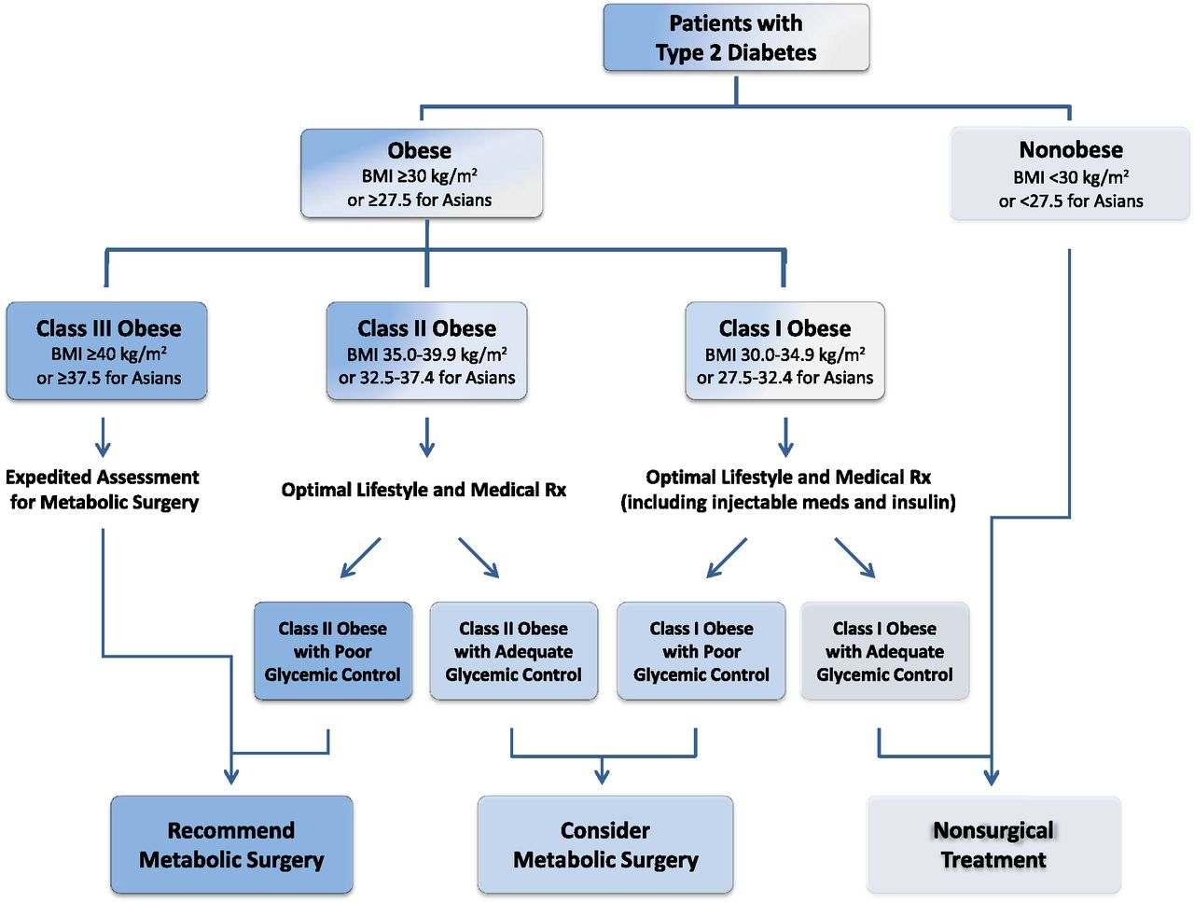
Conclusion II: Algorithm for the treatment of T2D, as recommended by DSS-II voting delegates.
Metabolic surgery may be considered
to treat T2DM in patients with a BMI
≥30 kg/m2, or down to 27.5 for Asians
Francesco Rubino et al. Dia Care 2016;39:861-877
©2016 by American Diabetes Association
Notes:
Algorithm for the treatment of T2D, as recommended by DSS-II voting delegates. The indications above are intended for patients who are appropriate candidates for elective surgery. meds, medications.

Slide 61

Thank you

Slide 62
Müller-Stich et al, Ann Surg 2015
High-quality systematic review and pooled meta-analysis of Level-1 & Level-2 evidence from studies comparing surgical vs. medical-lifestyle interventions for T2DM with baseline BMI <35
7 RCTs, 6 prospective observational comparisons
818 patients with diabetes
Follow-up 1-3 years, no deaths

Slide 63
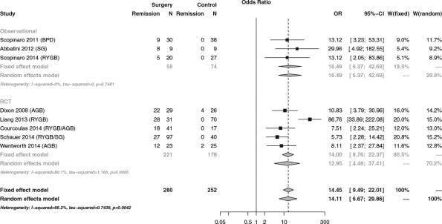
Meta-analysis of T2DM Remission in BMI < 35
Muller-Stich et al. Surgical Versus Medical Treatment of Type 2 Diabetes Mellitus in Nonseverely Obese Patients: A Systematic Review and Meta-analysis, Annals of Surgery. 261(3):421-429, March 2015

Slide 64
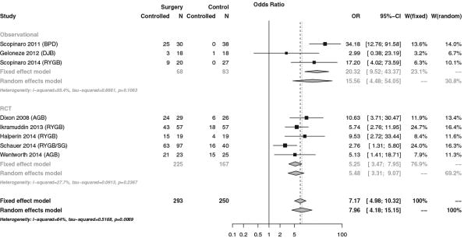
Meta-analysis of Glycemic Control in BMI < 35
Muller-Stich et al. Surgical Versus Medical Treatment of Type 2 Diabetes Mellitus in Nonseverely Obese Patients: A Systematic Review and Meta-analysis, Annals of Surgery. 261(3):421-429, March 2015.

