Slide 1
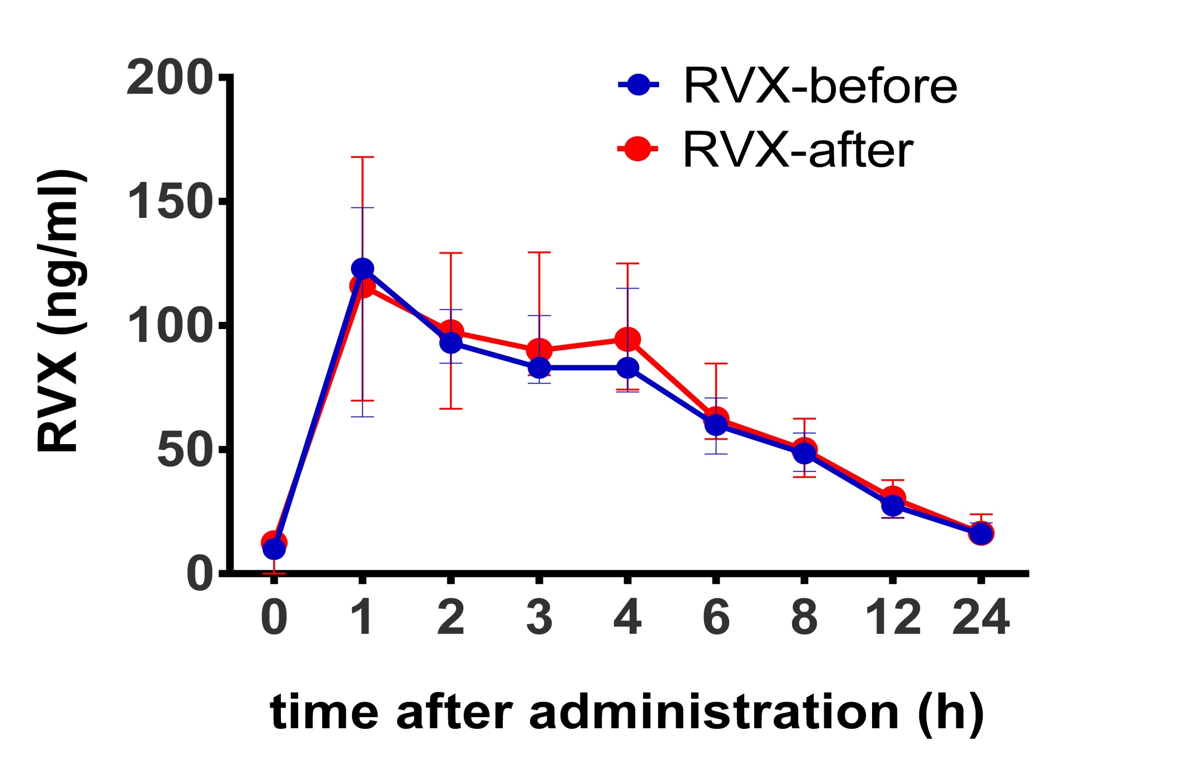
Effect of rivaroxaban on thrombin generation in vivo
Debora BERTAGGIA CALDERARA¹, Dino KRÖLL², Christiane GERSCHHEIMER¹, Nicole NICOLAS¹, Guido STIRNIMANN², Lorenzo ALBERIO¹
¹Department of Hematology, CHUV Lausanne University Hospital, Lausanne, Switzerland
²Department of Visceral Surgery and Medicine, Bern University Hospital, Bern, Switzerland
INTRODUCTION and OBJECTIVE
CONCLUSIONS
Rivaroxaban (RVX), a new oral direct inhibitor of factor Xa, is used for treatment and secondary prevention of venous thromboembolic events (VTE).
An unsolved question deals with the anticoagulant efficacy of a given RVX concentration and the related potential hemorrhagic risk in case of a pharmacological or surgical intervention.
This problem is particularly challenging in obese patients, because obesity itself is an increased risk factor for the development of VTE (1) and pharmacokinetics and pharmacodynamics of RVX in these patients are not well known (2).
The aim of this study was to assess the in vivo anticoagulant effect of various RVX concentration in obese patients undergoing bariatric surgery.
RVX pharmacokinetic is not affected by surgery (Figure 1).
2) RVX strongly inhibited thrombin generation (TG) ex vivo, in a dose dependent manner (Figure 2, Table A). Our finding agrees with previous reports (3, 4).
3) TG is inhibited in vivo by RVX concentrations higher than 80 ng/ml (Table A). This is no longer the case when RVX falls below 60 ng/ml. At 30 ng/ml RVX is still able to inhibit TG ex vivo but not in vivo (Time 12-24h, Table A vs B).
4) These data show for the first time that ex vivo TG inhibition does not reflect the real in vivo anticoagulant effect of RVX in obese patients.
RESULTS
Time (h) | 0-1 | 2-4 | 6-8 | 12-24
RVX ng/ml | ≤15-120 | 90-80 | 60-50 | 30-15
A
Lag time | 100 /+75 | +81 / +67 | +59 / +51 | +34 / +18
Time to peak | 100 / +92 | +97 / +83 | +58 / +50 | +30 / +15
Peak | 100 / -49 | -60 / -49 | -40 / -31 | - 18 / -5
Velocity index | 100 / -75 | -82 / -73 | -67 / -55 | -34 / -14
Ex vivo effect | yes | yes | yes | yes
trend
B
TAT ng/ml | - 63 | - 21 | - 6 | + 11
F1+2 pmol/L | - 13 | - 12 | + 2 | + 13
In vivo effect | yes | yes | no | no
trend |  |  | =
Figure 1: RVX plasma concentration vs. time profile in patients before and after bariatric surgery, following RVX administration.
A)
B)
Figure 2: representative thrombogram of one patient (P1) before (A) and after surgery (B).
The thrombogram shows the dose dependent influence of RVX on ex vivo thrombin generation in platelet poor plasma over time after activation by tissue factor.
Table: A) percentage inhibition compared to baseline (without RVX)
B) percentage change in the indicated time frames
METHODS
References
We investigated 12 obese patients receiving a single dose of 10 mg RVX before and at day 3 after bariatric surgery. Whole blood was taken at baseline and at different time points over 24 hours after RVX ingestion.
Plasma concentration of RVX (ng/ml) was quantified with an automated anti-Xa chromogenic assays (5).
The in vivo anticoagulant effect was assessed by measuring thrombin-antithrombin complexes (TAT) and prothrombin fragments 1+2 (F1+2) with commercial ELISAs.
The ex vivo anticoagulant effect on tissue factor induced thrombin generation (TG) was measured in patients’ platelets poor plasma (PPP) using the calibrated automated thrombogram method (CAT) (6).
1) Circulation. 2008; 117: 93-102
2) ClinicalTrials.gov NCT02438098
3) J Thromb Haemost 2007; 5: 25554-6
4) J Clin Pharmacol 2007; 47: 1398-1407
5) Thromb Res. 2012; 129: 492-498
6) Thromb Haemost. 1993; 70: 617-624
Corresponding authors:
Lorenzo.Alberio@chuv.ch Dino.Kroell@insel.ch

